Slide 1
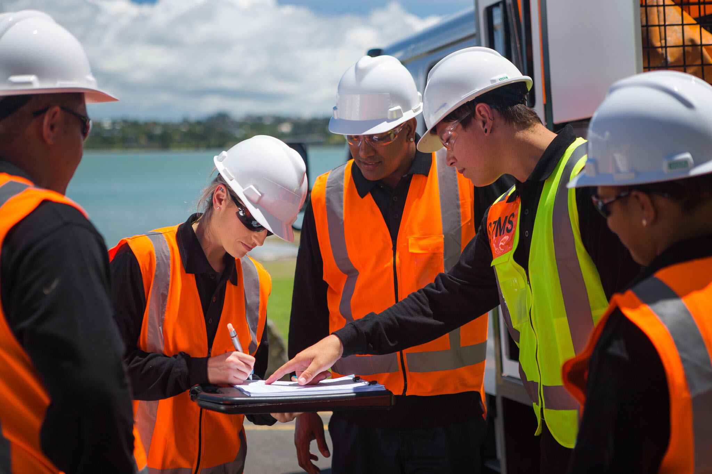
New Zealand Certificate in Temporary Traffic Management (STMS)
Photo of STMS working on the road
Connexis Logo Big

Slide 2
New Zealand Certificate in Temporary Traffic Management (STMS)
Notes:
Todays topic is around developing and implementing an NZQA New Zealand Certificate in Temporary Traffic Management for STMS’
There are currently unit standards in TTM but these have not really been used and the relationship with the ITO and NZTA has not really flourished in the past.
With the NZTA competency framework coming in now is the perfect time to align the two.

Slide 3
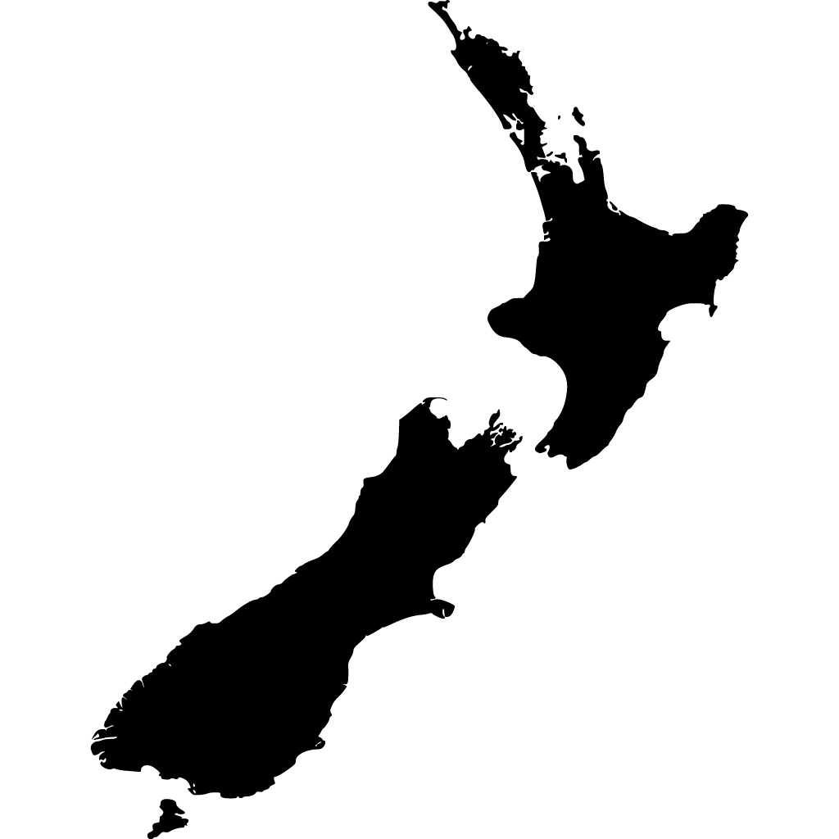
Purpose:
To develop a qualification that is a nationally recognised, competency based and provides a career pathway for the Temporary Traffic Management Industry in New Zealand; endorsed by the industry, NZTA and NZQA.

Slide 4
Employers PCBUs in relation to training and supervision as stated in the Health and Safety at Work Act 2015
‘The provision (provide) of any information, training, instruction, or supervision that is necessary to protect all persons from risks to their health and safety arising from work carried out as part of the conduct of the business or undertaking.’
Notes:
Worksafe requires us to provide the right information, training, instruction and supervision that is necessary to protect all persons from risk to their health and safety for any of the work they carry out.
So legally, if we are putting people out on the road, we need to make sure they are competent to do their job in complaint and safe manner.
A rather large, complex responsibility for an STMS closing down the CMJ.

Slide 5
Duty of care as employer
Any PCBU with pursuant to TTM or CoPTTM
Ensure duty of care for the Health and Safety of workers for the PCBU
Are not exposed to health and safety risks arising from the work they do
This includes being put in situations they are not adequality trained for whether or not they have the “warrant”
Notes:
CoPTTM reiterates the requirements set out by Worksafe NZ – we cannot be putting our staff in situations they are not adequality trained for.
However, we find there is no clear view for the training required and there are a number of missing key skills and competencies not covered in standard TTM training.

Slide 6
What is an ITO?

Slide 7
ITO Responsibilities
Sets national standards for the industry
2. Access government funding for development
and maintenance of Industry standards
Arrange the delivery of on and off job training
Arrange the assessment of trainees
Moderate the quality of assessment
Provide information and advice to trainees and
employers

Slide 8
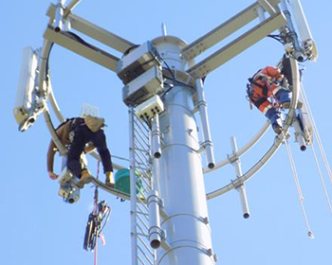
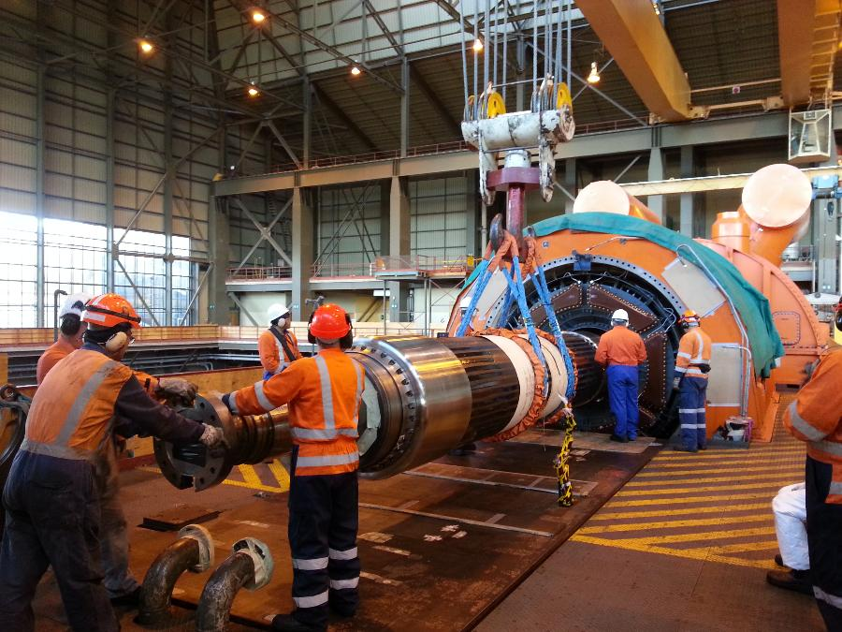
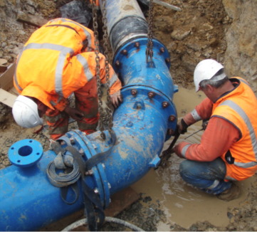
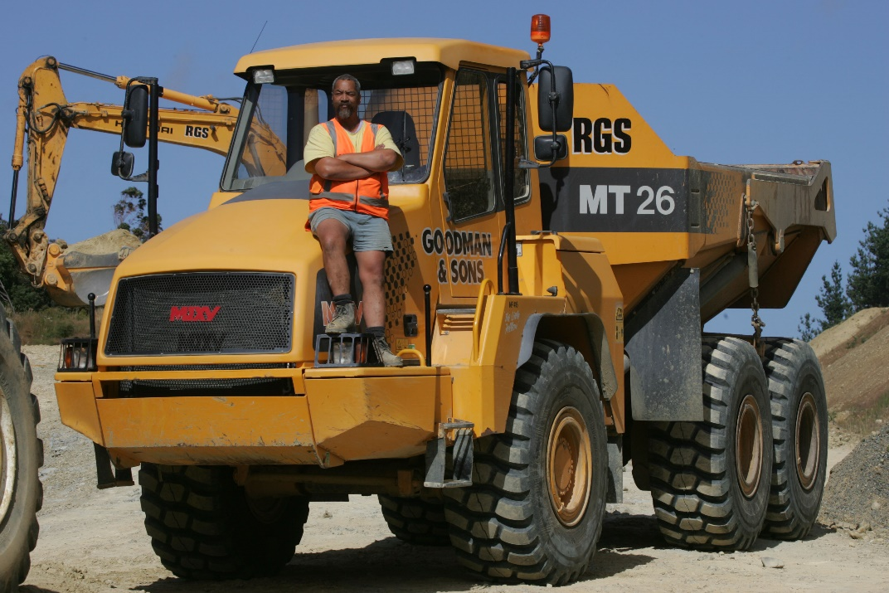
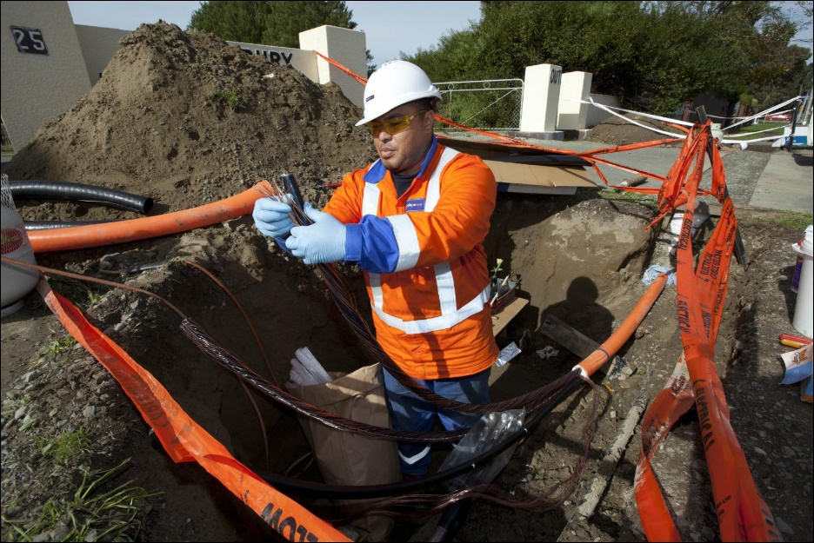
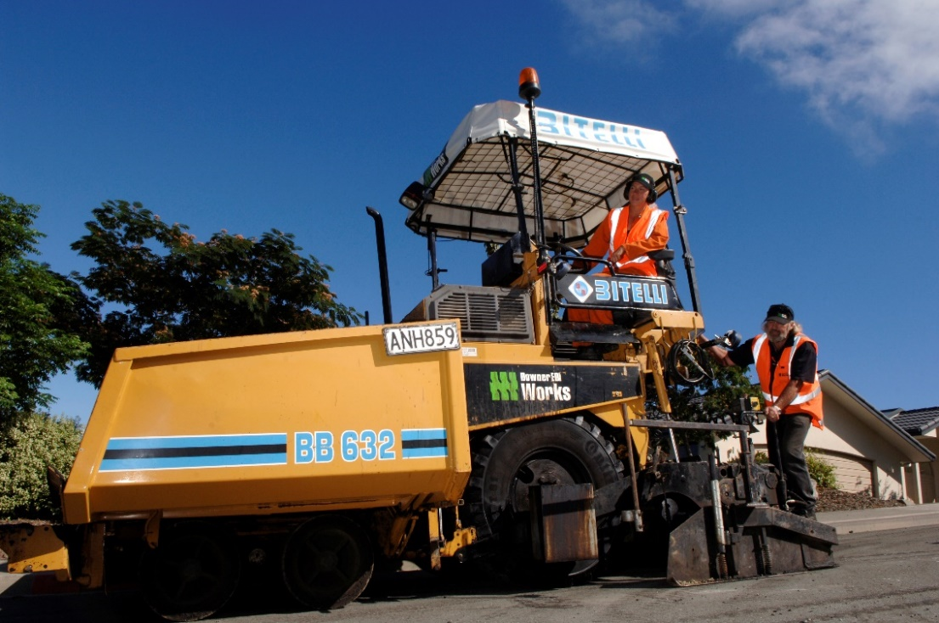
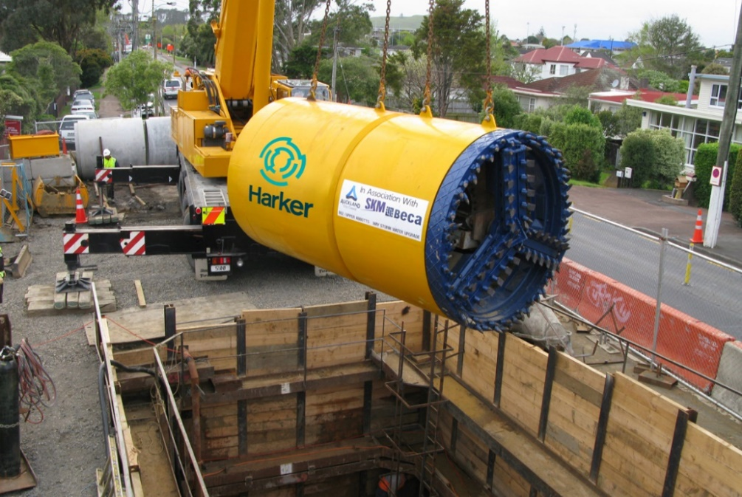
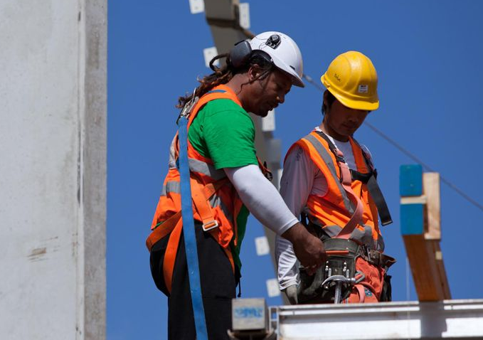
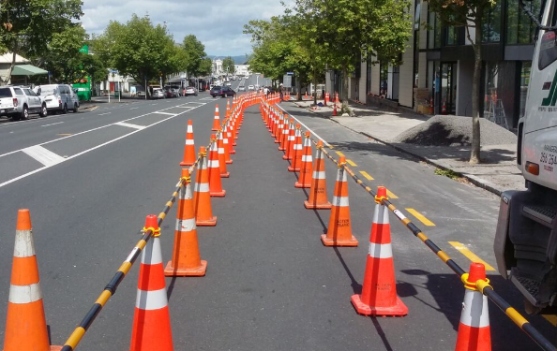
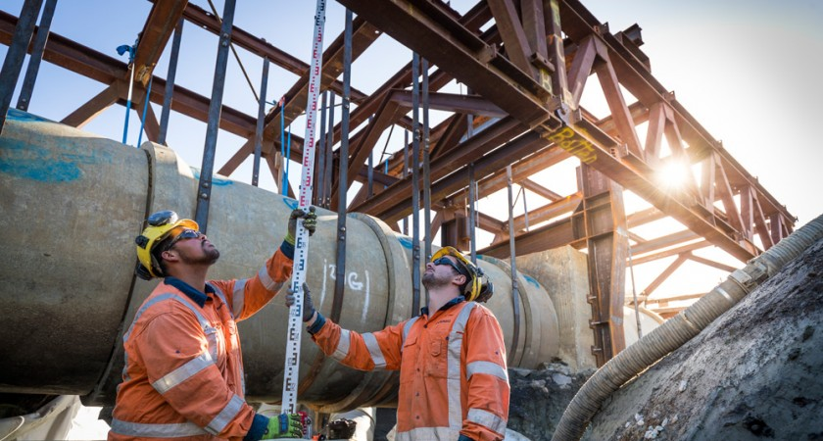
Infrastructure
Industry Training Organisation
Water Industry
Electricity
Telecommunications
Civil Industry
Notes:
Connexis is the Training Organisation for the Infrastructure Industry providing qualification pathways for those working in the Industry.
The Industry includes the following Sectors:
Water Industry includes the 3 waters of;
Drinking water
Wastewater
Storm water; Edgecombe floodin
Electricity includes;
Generation
Distribution and lines
Retail
Telecommunications includes;
Ultrafast Broadband installation and maintenance
Telco networks
Civil Industry includes;
Earthworks
Construction
Pavement Surfacing
Roadmarking
Roadside furniture
Open space management
Maintenance

Slide 9
The New Zealand Government crown entity tasked with providing leadership in assessment and qualifications.
Mandated by Government to manage the NZ Qualifications Framework (NZQF)
Benchmark for level of skill
Provides a pathway
Skills, knowledge and application demonstrated to complete a specific qualification
Ensures usefulness, relevance and value needs of industry
Developed collaboratively with stakeholders

Slide 10
Job Role
TMP
STMS
LCP in Traffic Control
Job Role
Civil Technician
Civil Engineer
Site Engineer
Project / Contract Manager
Skilled Operator
Machine Operator
New to Industry
Labourer / School Leaver
Level | Certificate | Diploma | Degree
10 |  |  | Doctoral Degree
9 |  |  | Master's Degree
8 | Postgraduate Certificate | Postgraduate Diploma | Bachelor Honours Degree
7 | Graduate Certificate | Graduate Diploma Diploma | Bachelor's Degree
6 | Certificate | Diploma
5 | NZ Certificate | Diploma
4 | NZ Certificate
3 | NZ Certificate
2 | NZ Certificate
1 | NZ Certificate
Notes:
The TTM proposed NZ Certificate
Unit Standards @ Level 3 for Traffic Controllers as a Limited Credit Programme (LCP)
NZ Certificate in TTM (STMS) Level 4
In line with the NZTA Competency model for Traffic Management

Slide 11
Qualification Development
NZC in Traffic Management
Connexis
Industry
Technical Expert
NZTA
Notes:
Agree on a need for an Industry qualification
Agree on what job the qualification is for
Agree on the skills required
Check alignment with Regulatory Body
Consult with Industry before final content is confirmed
Develop resources and assessments
Train Industry Assessors, both NZTA and Connexis
Release product to Industry

Slide 12
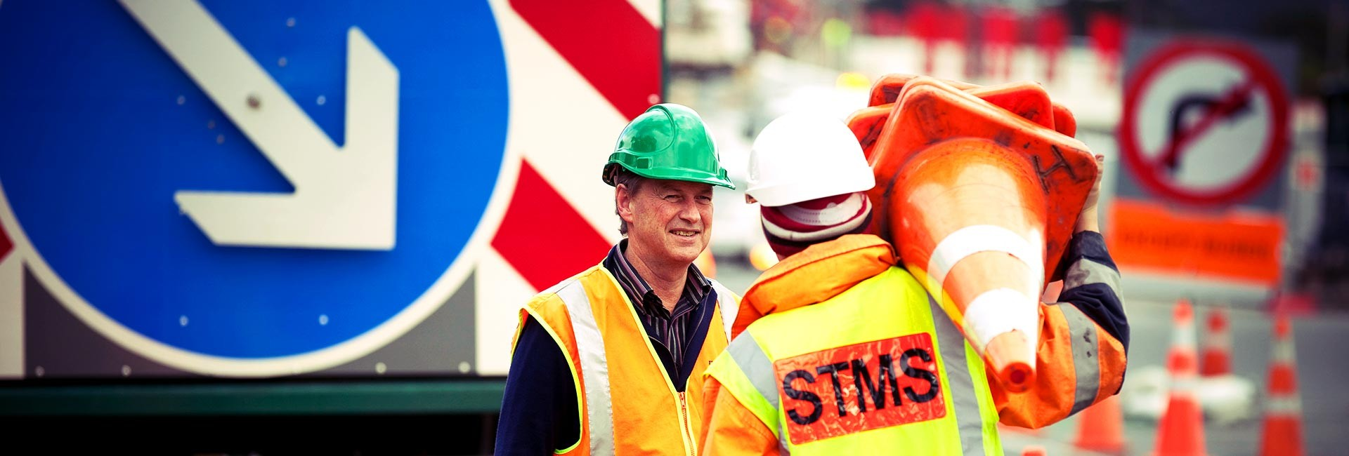
NZC in Temporary Traffic Management (STMS) Level 4
Risk Assessment
Communication
Implement TMP’s, monitor and maintain
Notes:
Assess risk and apply contingencies to ensure the safety of road users and workers at Temporary Traffic Management (TTM) worksites
Communicate with stakeholders to deliver an end to end TTM service
Implement Traffic Management Plan (TMPs) and monitor and maintain a temporary traffic worksite to meet legislation, industry codes of practice and guidelines

Slide 13
NEW ZEALAND CERTIFICATE IN TEMPORARY TRAFFIC MANAGEMENT
(STMS) (Level 4) (Credits 80)
Assess risk and apply contingencies to ensure the safety of road users and workers at Temporary Traffic Management (TTM) worksites. (Credits 20)
Communicate with stakeholders to deliver an end to end TTM service. (Credits 20)
Implement Traffic Management Plans (TMPs) and monitor and maintain a temporary traffic worksite to meet legislation, industry codes of practice and guidelines. (Credits 40)

Slide 14
Notes:
In 2015, Civil Contractors NZ and Connexis launched Civil Trades in Parliament with the first 14 people certified.
In the same line as a Registered / Certified Builder, Registered Drainlayer, Electrician and Plumber. The TTM Industry has the potential to become Certified alongside your civil counterparts.

Slide 15
How Connexis works in with NZTA
Connexis creates NZ Certificate, unit standards, register units, award NZ Certificate
NZTA provide content / workbooks for units
Able to change content of workbooks with CoPTTM updates
NZTA award Practising warrant to work on road, once Connexis has awarded NZ Certificate (for NP unit standards not needed)
NZTA approve course material, trainers, verifiers, assessors
Practical competency based assessments at all road levels

Slide 16
Practical Competency Assessments
Developed by the Industry / NZTA Competency Working Party
Unit standards developed by Connexis - Workbooks developed by NZTA – in line with Competency Model
Achievement of competency model units gains NZQA units and credits towards NZ Certificate
Like an apprenticeship

Slide 17
Implementation
Sign off and approval from NZTA and NZQA
Connexis develop units in conjunction with NZTA competency model
Industry feedback
Connexis communicate and engage with companies, trainers etc
Timeline – in parallel with competency development
Launch
Notes:
Moving forward we would like to develop our proposal with NZTA and the industry
Engage with the ITO to develop training, assessment materials and accurate criteria
We would then communicate and engage current trainers and launch the PTE

Slide 18
Questions

