Slide 1
Competency and Customer Satisfaction in
Events

Slide 2


TTM Cont
Trainer
Event Mgr
The Event Specialist!
Auditor
Cycling

Slide 3
Contents
Examples of some of the events I am involved with & challenges
Types of people that I am required to work with
About the Events section in the CoPTTM
Training – examples of participants
How they fit with the new Training and Competency Model
Current challenges for clubs

Slide 4
Types of Events
Static Operation Events
Sports events: Cycling Races, Triathlons, Duathlons, Marathons etc On road, Fun Walks and Cycle events off road but crossing roads
Concerts, Races, Markets, A & P Show etc (incl inside Road closures)
Parades inside Road Closures
Funerals
Elite Cycling Champs within City Course
Mobile Operation Events
Cycling Races –Part Static
Hikoi
Parades
Horse parades thru CBD,
Tractor Protest parade – 8 km long – State Highway
Funeral convoys
While some are straight forward some require a lot of thought and in excess of 20+ TM Diagrams.

Slide 5
The Team! A range of people, skill levels etc
STMS and TC from cycling club/friends- people who understand events
TC Hired (road workers) – they are learning.
Retired volunteer group – completed TC events course – more a fact finding exercise
Maori wardens – try and use when can, but have lots of limitations. Like setting up – not sports people.
Volunteers supplied by organisers.
I am accountable and have to manage them all.

Slide 6
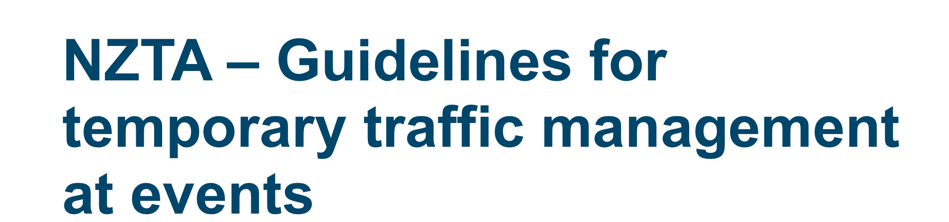
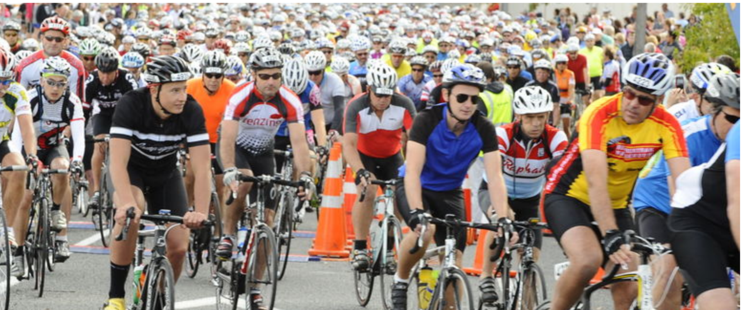

Slide 7
It’s great we have a section on events in Section I.3
Sample TMD to use/help in preparation of TMPs
Examples of TMP and TMD in the training material
TC Events specific course available (much shorter)
STMS Events specific course (similar to Road works but with a Cycling angle)

Slide 8
Some points
Event Training Course Material is Cycling based. Many other events out there, so need to adopt training material so it’s relevant – e.g. Triathlons, Runners. Maori wardens – principles are generally the same - i.e. stopping traffic.
So trainers need a good understanding of what the Sport/event entails and what key points you need to cover
Still not common knowledge of this information out there.
  A group of cyclists had to sit through a roadworks course that went over their heads. Club was not aware of a separate course.
A trainer decided that the TC event course wasn’t good enough and would only run a modified roadworks course.

Slide 9
Training Hat
Trainer
Broadly trainees are from the following groups
Cyclist and Tri Clubs members - many actively assist in setting up sites.
Running/Walking groups – NB run on the other side of the road.
Red Badge Security – Cruise ship pedestrian management, parking, road closure occasional stop/go.
Maori Wardens – generally off road or behind road closures. Occasionally on road but not equipped to do well.
Other TC’s – Markets etc – very small TM duties.

Slide 10
So where do TC & STMS Events volunteers/staff fit in the
Proposed Training and Competency Model?
Also a comparison of commercial/ road works TC & STMSs

Slide 11
Profile of TC
The qualified person on level LV and level 1 roads who:
Assists with deployment of the operation
Maintains the site within existing TTM phase while the STMS is away from worksite.
Note: The TC will only be able to assist an STMS installing, modifying or removing TTM at a worksite
Take corrective actions (to make site safe)
Dealing with common worksite situations
Manage MTC activities
Maintain pedestrian/cyclist facilities
Follow and read TMP (including contingency)
TC practical
Must MAINTAIN at least 1 closure from each activity type listed below. One of the closures must include footpath or cyclist control.
1. Shoulder closure, berm or footpath control
2. Lane merge, lane shift, cycle lane, priority control and TSL
3. MTC

Slide 12
Profile of TTM Worker
TTM Knowledge
• No go zones (including safety zones)
• Manual handling/lifting of TTM equipment
• Using a Stop/Go paddle
• Using radio communications
• Set out TTM equipment
• The role of a ‘spotter’
• Interaction with people (good/bad practises and dealing with conflict)
About TMP (TMP for each site, includes text and diagram. Worksite set out as per TMP)
TTM Worker practical
• Handling equipment
• Comms/radio (RT)
• Working on a TTM equipment vehicle
Using a Stop/Go paddle

Slide 13
Events TC
Based on what they do :
Unlikely to complete any of the practical
Would only ever do 1 practical
Would manage to achieve all practical exercises

Slide 14
Commercial TC
Based on what they do :
Unlikely to complete any of the practical
Would only ever do 1 practical
Would manage to achieve all practical exercises
Unison also similar %

Slide 15
Profile of STMS
STMS practical
Level LV and L1 specific on the job skills to be verified:
Deliver a site safety briefing/induction
Static operations (including stop/go)
Mobile operations and closures
Inspections / special activities
Semi static operations and closures

Slide 16
Event STMS
Based on what they do :
Unlikely to complete any of the practical
Would only ever do 2 practical
Would manage to achieve all practical exercises
Ex Maori Wardens

Slide 17
Commercial STMS
6%
Based on what they do :
Unlikely to complete any of the practical
Would only ever do 2 practical
Would manage to achieve all practical exercises

Slide 18
Challenges with the Competency Model
Events TC and STMSs will struggle to fit into new model
Clubs rely on TCs to set up. (hard to get volunteers to do to TM)
Maybe call it a separate “TC Events” qualification
Struggle to see the merit or need for the NZQA qualification
Remember there are a lot of small “Road Work” type TC and STMS who will also struggle to fit in.
Unison locally will not start work until STMS checked TC site now!

Slide 19
Challenges & Feedback from Cycling Clubs
Consistency across country
Some RCAs very helpful but others appear anti cyclists
Required to belong to Site Wise
Applications go through Regional Sports Trust
Excessive equipment for operations – we are not a road work site!
Daunting for average committee member
Struggle to find people to undertake TTM
Club of 18 members suspended races because they were unable to meet requirements.
Cost

Slide 20
My Final Challenge
UCI endorsed events (3) – requiring rolling road blocks
Police only ones who can run true rolling blocks
They have generally been pulling back in all events for some time
Limited ability for others to run a rolling block
Limited to mobile closure – stop traffic up to 10 minutes.
I understand that some work is being done with Stuart and his team and I see potential in this group of “Pilot” motorbike riders known as C.E.R.N.Z who can help achieve this.

Slide 21
Questions?

