Slide 1
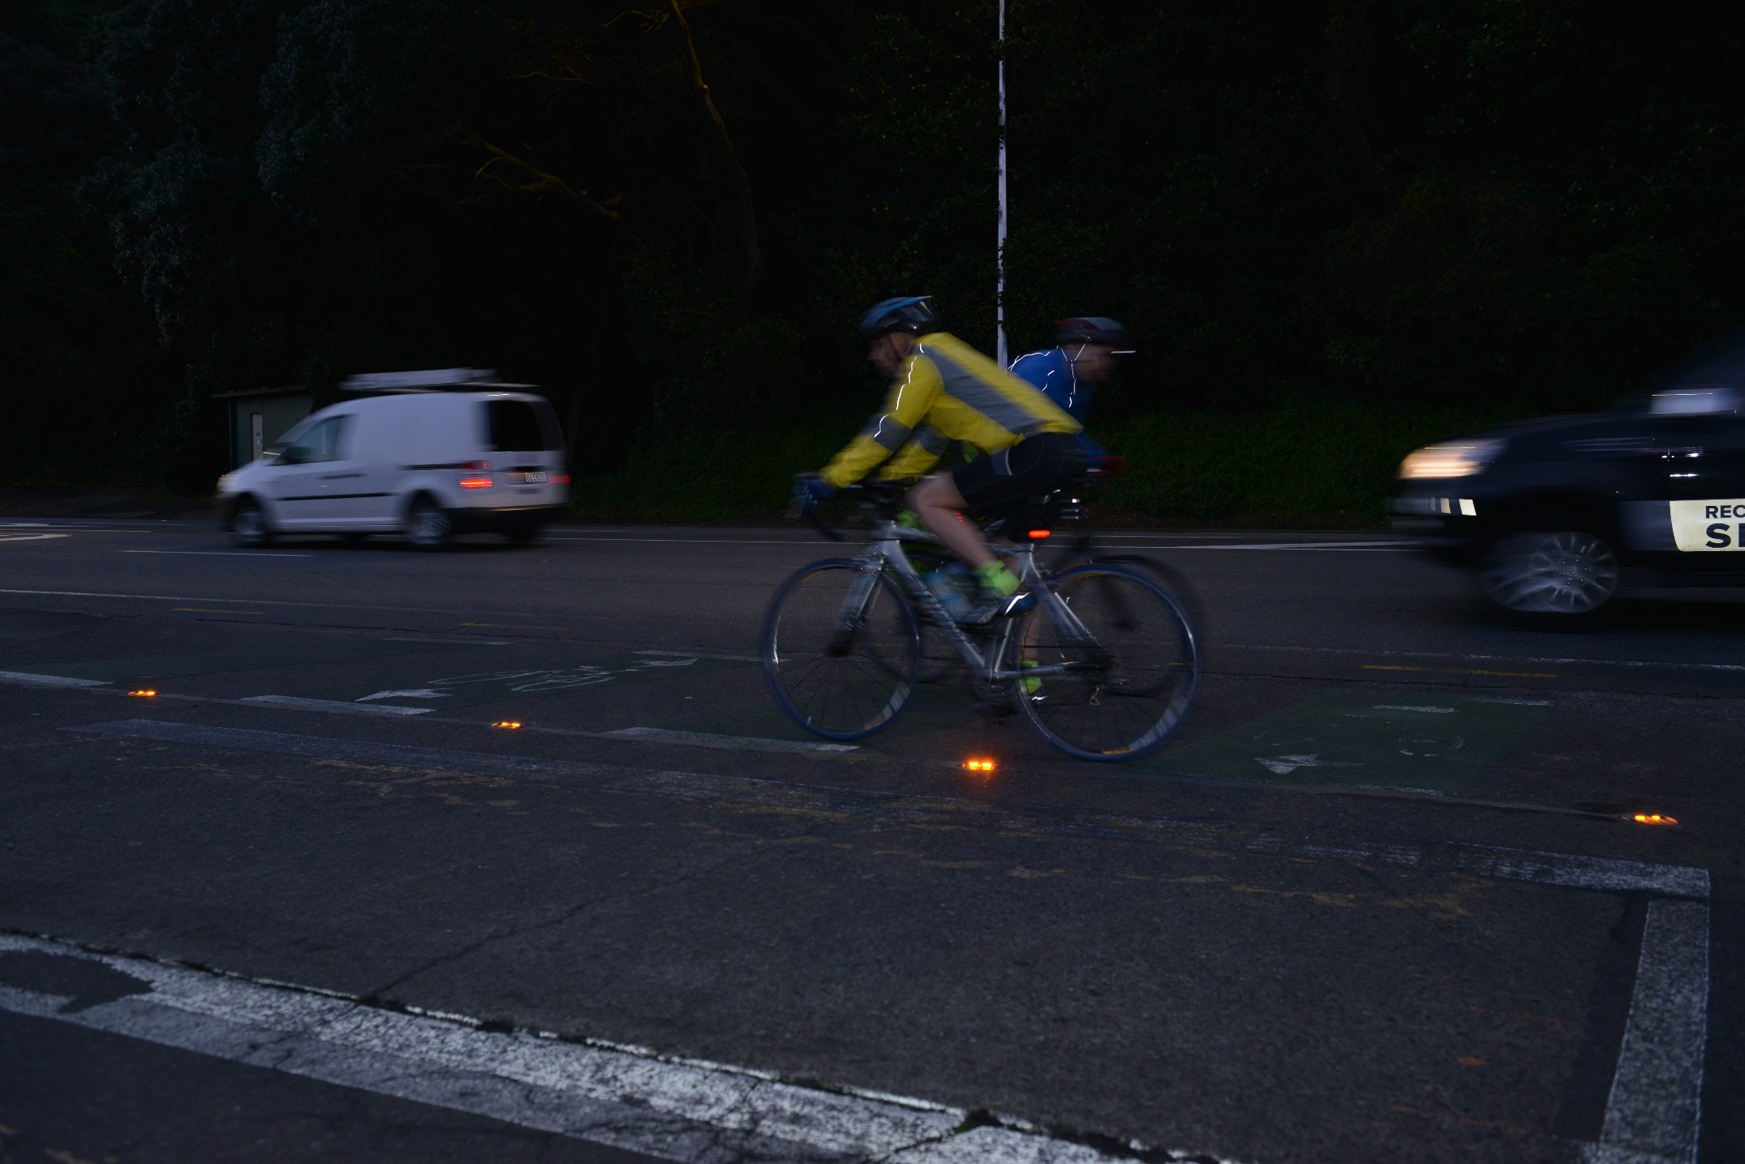

Innovation & Traffic
Keeping our People Safe

Slide 2
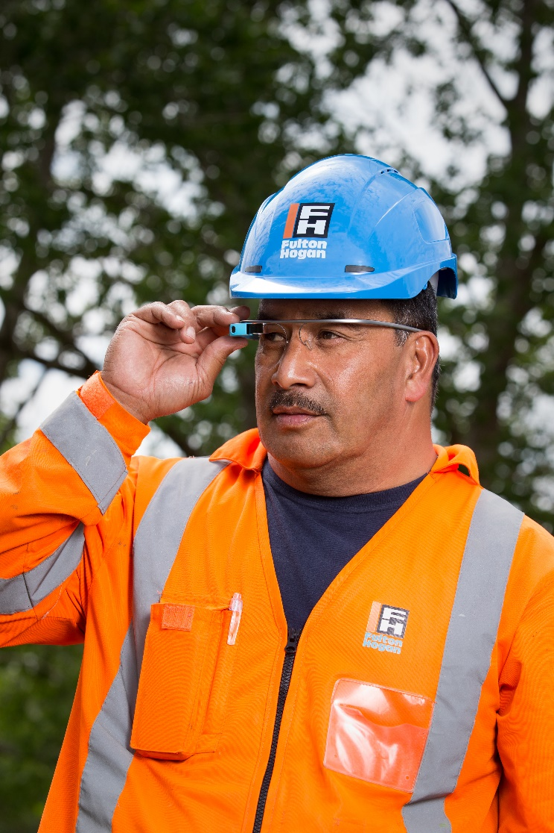
Today’s Session
Fulton Hogan: why we innovate
Bikescout – a cycle safety solution
Road studs – innovative lighting solutions for our roads
Closure breach solutions
  Hoon alert
  X-net
  Worker guard alert system
Halo lights
Future of traffic management

Slide 3
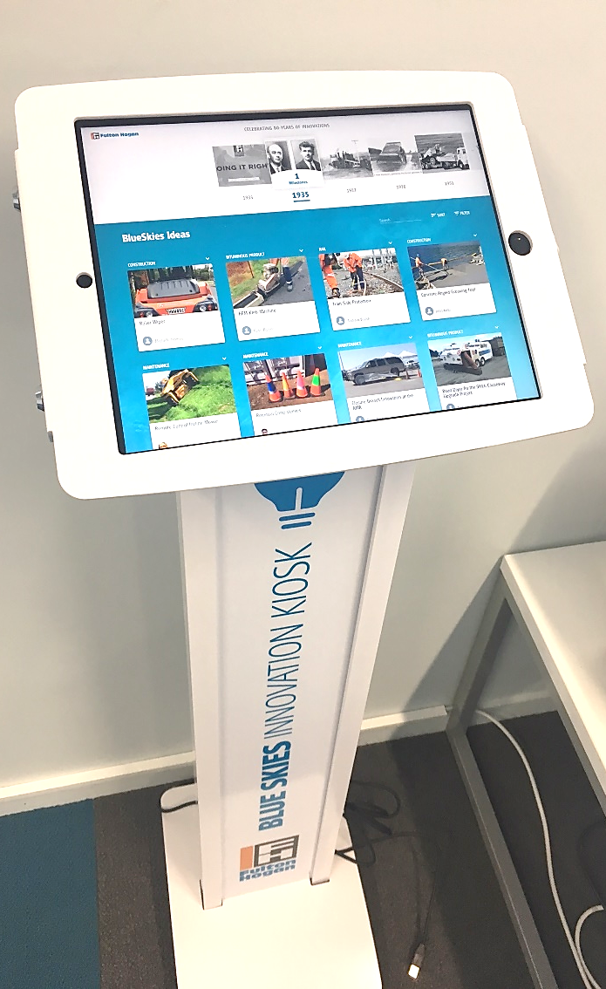
Why We Innovate
Safety
Our people are our main priority and their safety while working on our roads comes first.
Communication
We have a diverse business with 7,500 people, great ideas need to be shared.
To Compete Internationally
Create closer ties with the global community to harness technology developed overseas.
Customer Focus
We innovate to respond to our customers drive for innovation and new technology, and improved value for money outcomes.

Slide 4
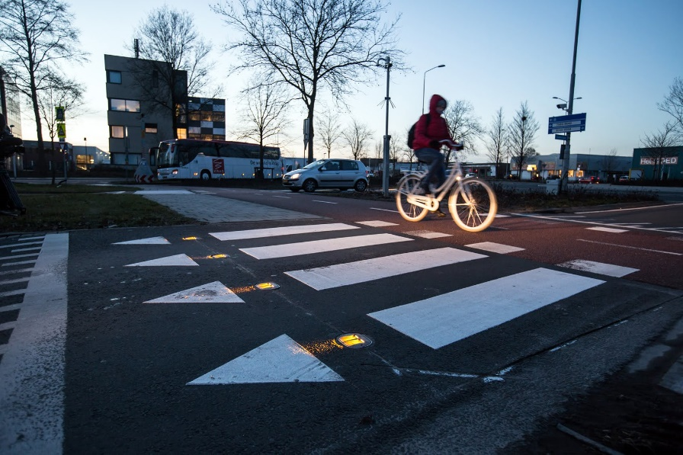
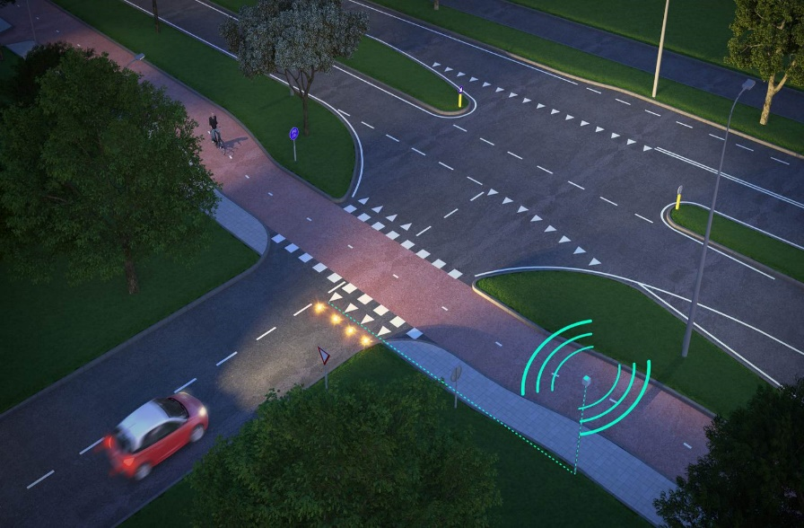
Bikescout
A new solution for cycle safety
Cycle safety a growing concern with more cyclists on our roads
New cycleways being built
Integrating into existing infrastructure:
  Cycleways often a tight fit
  How to cross existing access ways
  Problems with attack from the blind side where vehicles do not see cyclists
Bikescout now installed in Wellington
Operational since July 2017
  Speed and distance calculation
  Very accurate two-way polygon radar technology
  Advance warning to motorist
  Accessible data

Slide 5
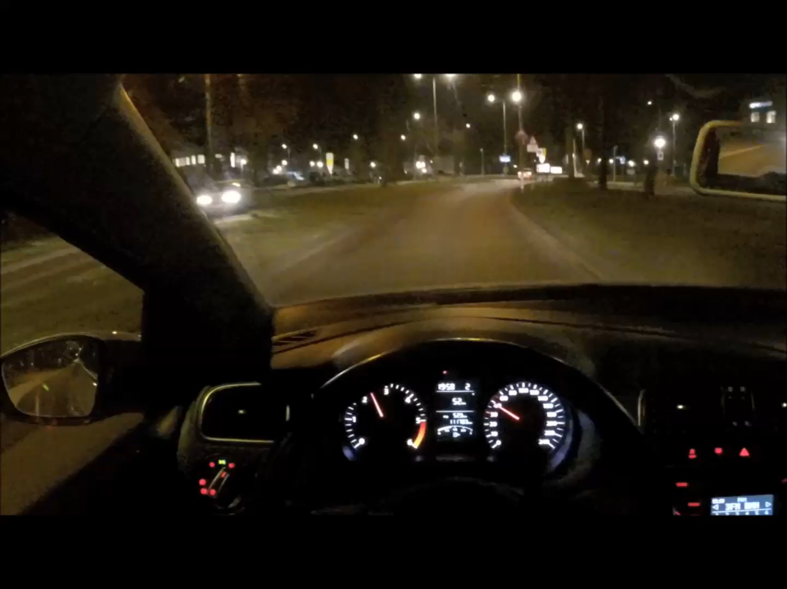

Slide 6
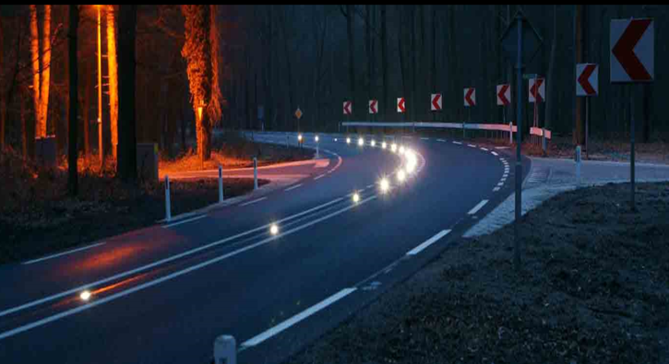
Road Studs – Reflective, Solar, Powered
Rely on road marking for delineation
Centre and edge line is often the only delineation visible to road users
Traditional road marking is often hard to see
  Flushed Roads
  Poor surface drainage
  Loss of visibility during rain
  Missing markers, wear and tear
New Technology
  Increased reflectivity – 10x more reflective than standard RRPM’s
  Solar and powered available
  Energy efficient
  Colour control options
  Great for rural areas and darker urban areas
  Lifespan 7-10 years

Slide 7
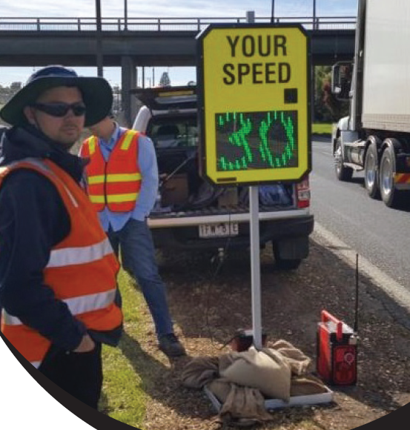
Closure Breach Solutions
Hoon Alert
Innovative system that displays vehicle speed
Sounds loud siren when vehicles are too fast
Siren warns any workers on site
‘Unusual pitched sound’ that is aimed at changing driver behaviour, stands out from normal construction noise
Can be remotely and manually activated
Currently in use in Australia

Slide 8
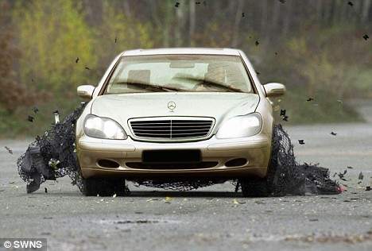
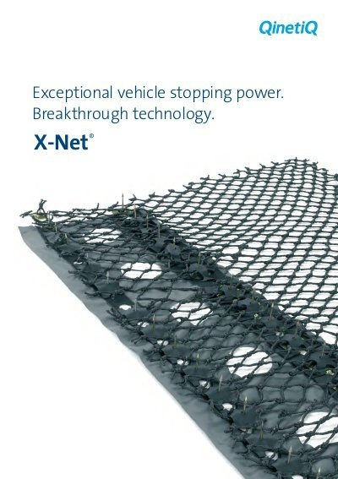
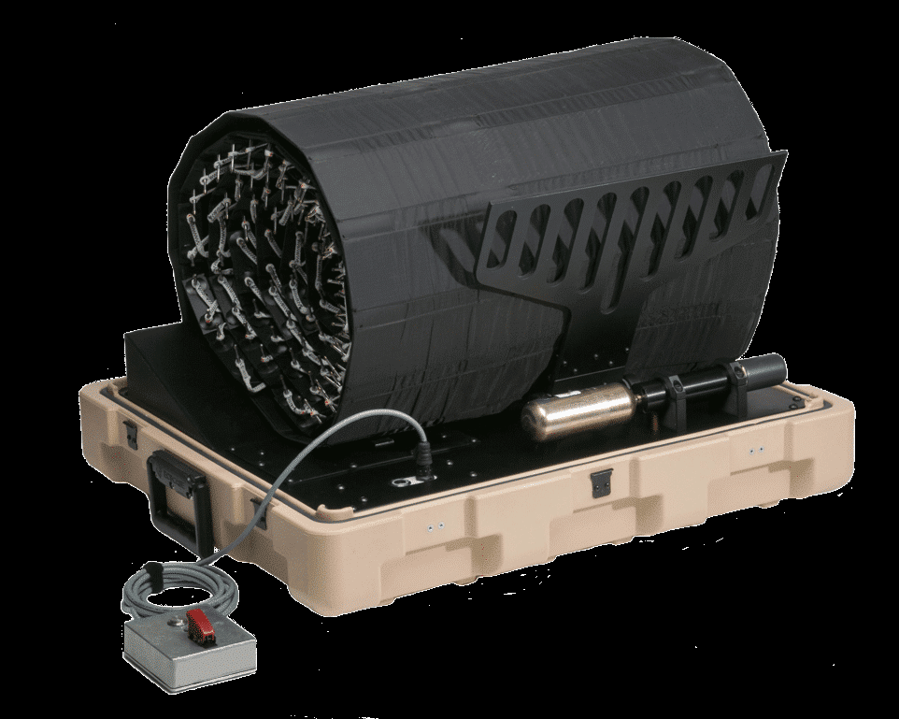
Closure Breach Solutions
X-Net
Barbed spikes penetrates the tyres which then causes the net to entangle front wheels of the vehicle, resulting in a safe and controlled stoppage
Military grade, high-strength net
Great for off and on ramp closures
Easy to set-up, no ground anchoring required
System deploys in under 3 seconds
Trialled on AMA

Slide 9
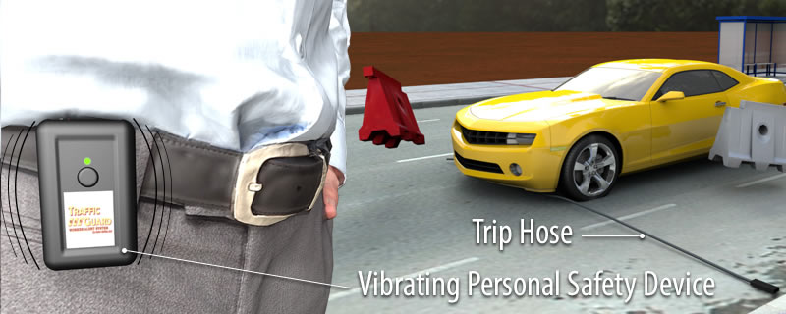
Closure Breach Solutions
Worker Guard Alert System
Lightweight, easy to transport 4m long trip hose and sensor
Uses wireless technology to set-off personal alarm when vehicle drives over hose, warning workers of vehicles that have breached the closure
Includes rechargeable alarm and flashing light
In use in Auckland, West Coast and Nelson/Marlborough

Slide 10
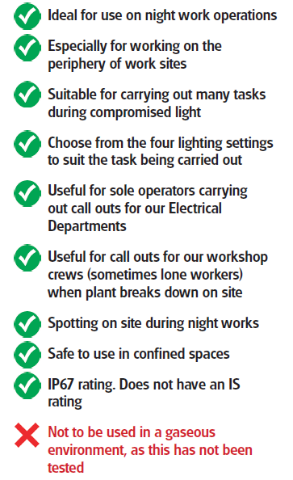
Halo Lights

Slide 11
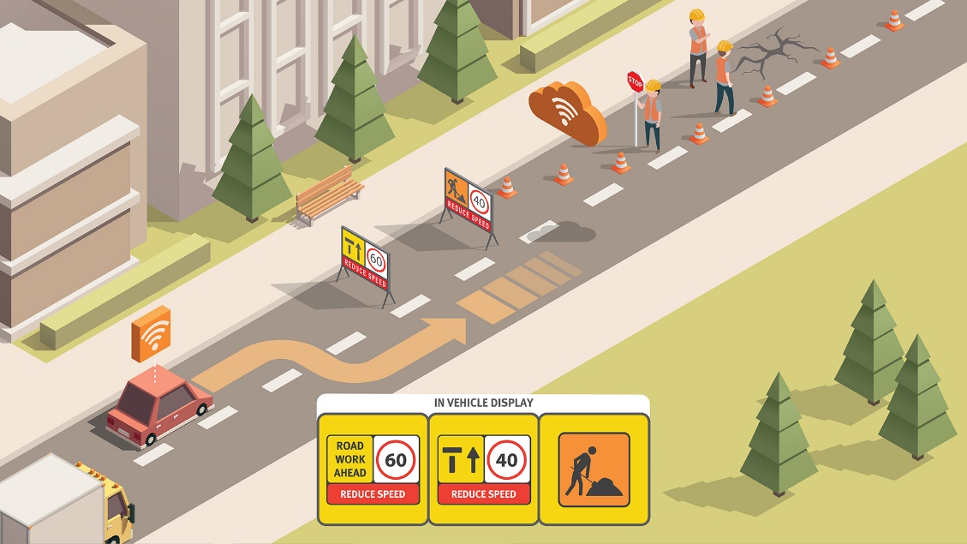
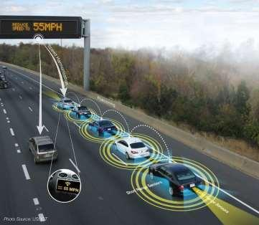
Future of Traffic Management
Some final thoughts…
What is the future of traffic management?
Already seeing automation in some areas, likely to increase over the next 5-10 years, what does this mean for our sites and our people?
What part does drones, robotics and technology play?
How will our traffic management interact with automated vehicles? Some development required in this space

Slide 12
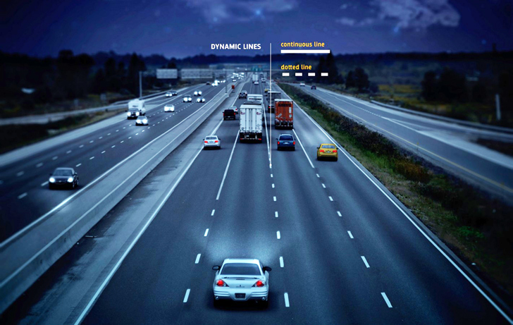
Thank You

