Slide 1
Buffer zones and cones: Trialling intuitive layouts for safer speeds
Jared Thomas, Damien Houlahan, Tiffany Lester, Anna Davison, Bill Frith

Slide 2
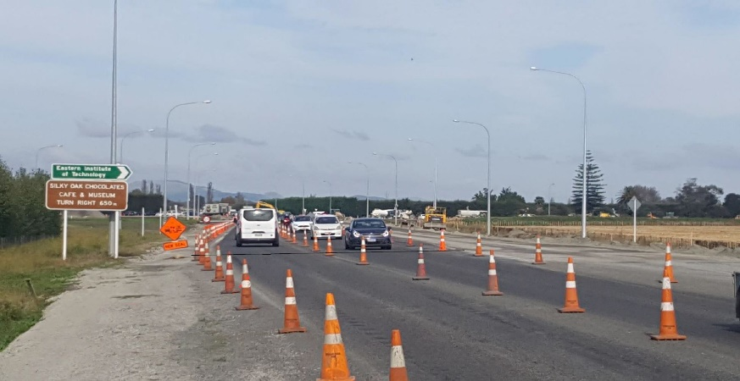
Background
Industry called for better information around speed threshold treatments
Positive traffic management setups/tools
Wanted to test:
Phase 1: Basic threshold setups
Phase 2: Additive setups – To test compounding effects

Slide 3
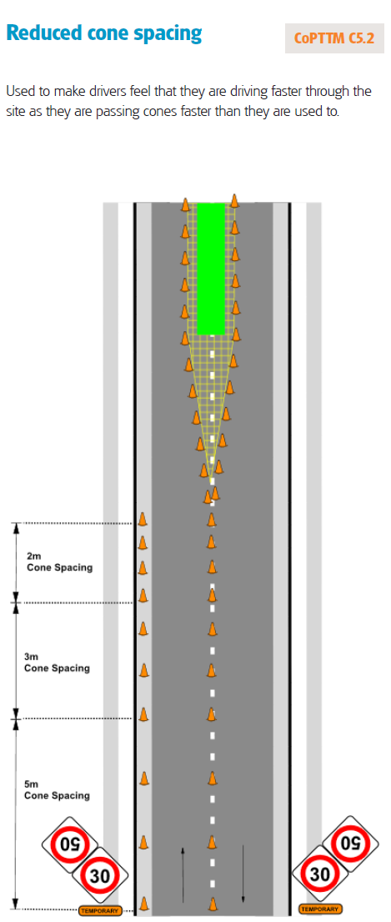
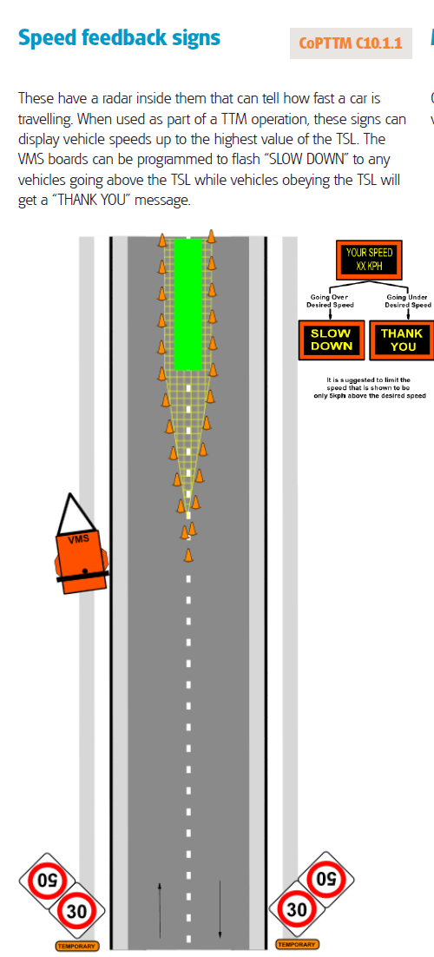
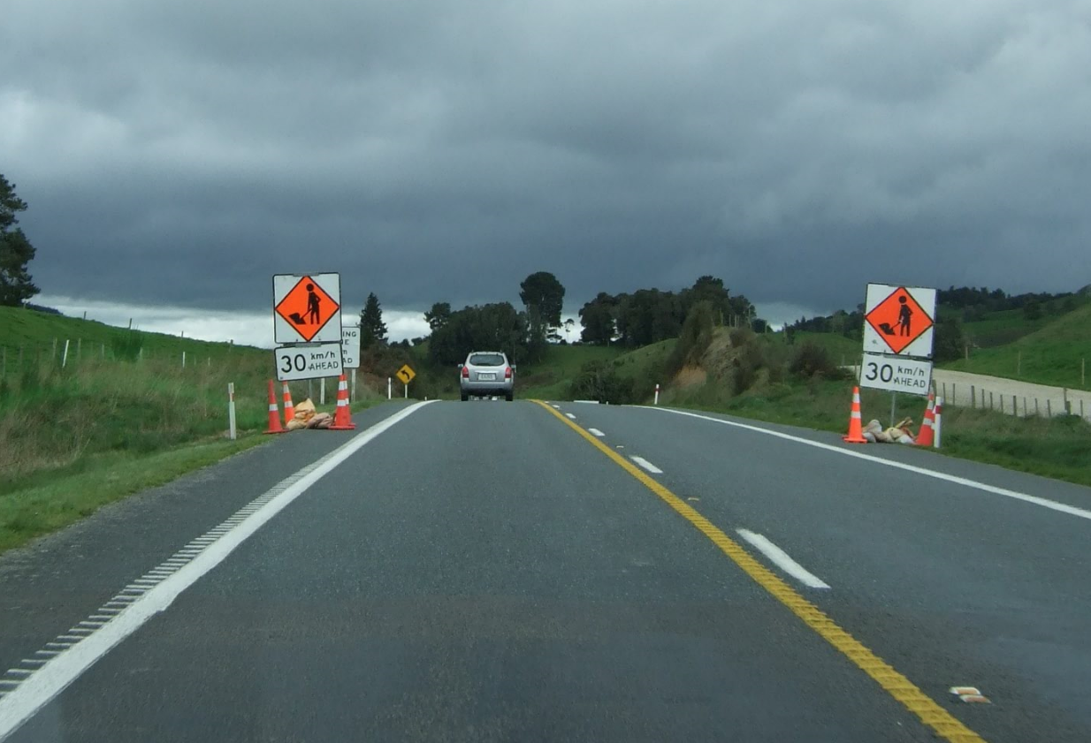
Additional signage options
Perceptual countermeasures
ITS Solutions

Slide 4
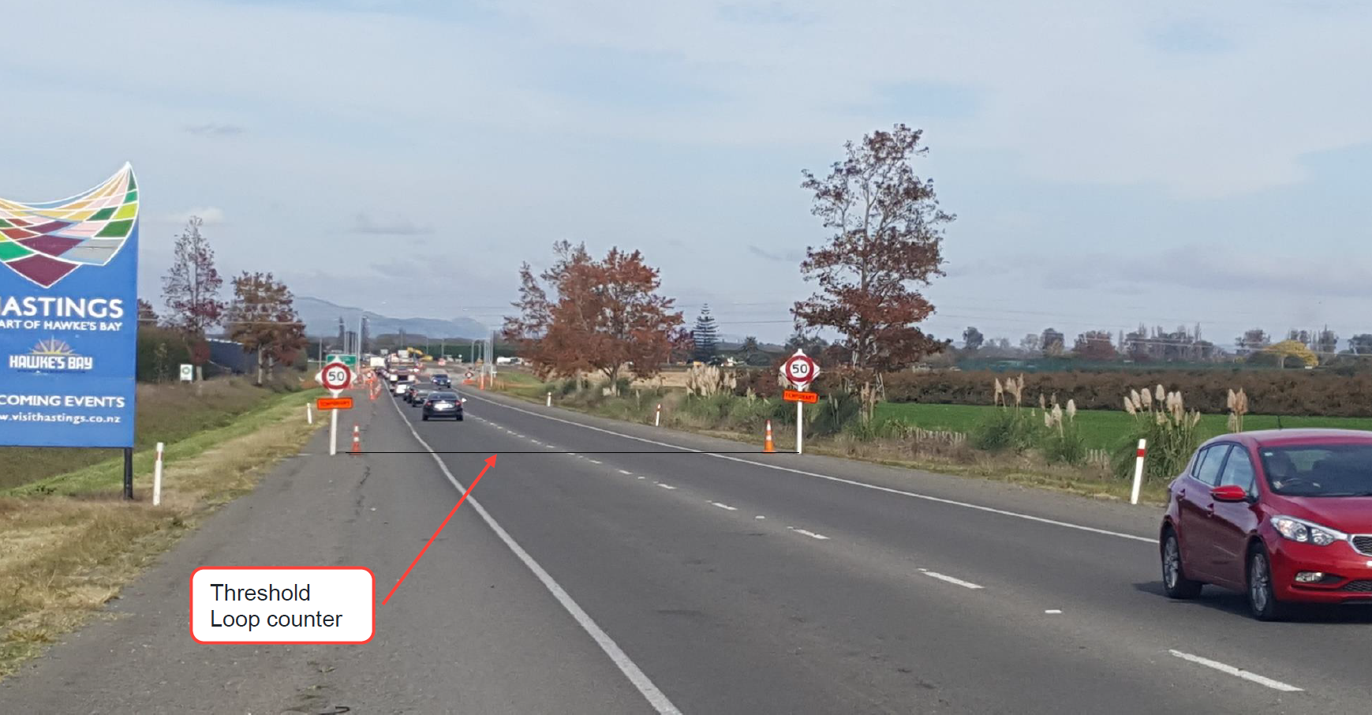
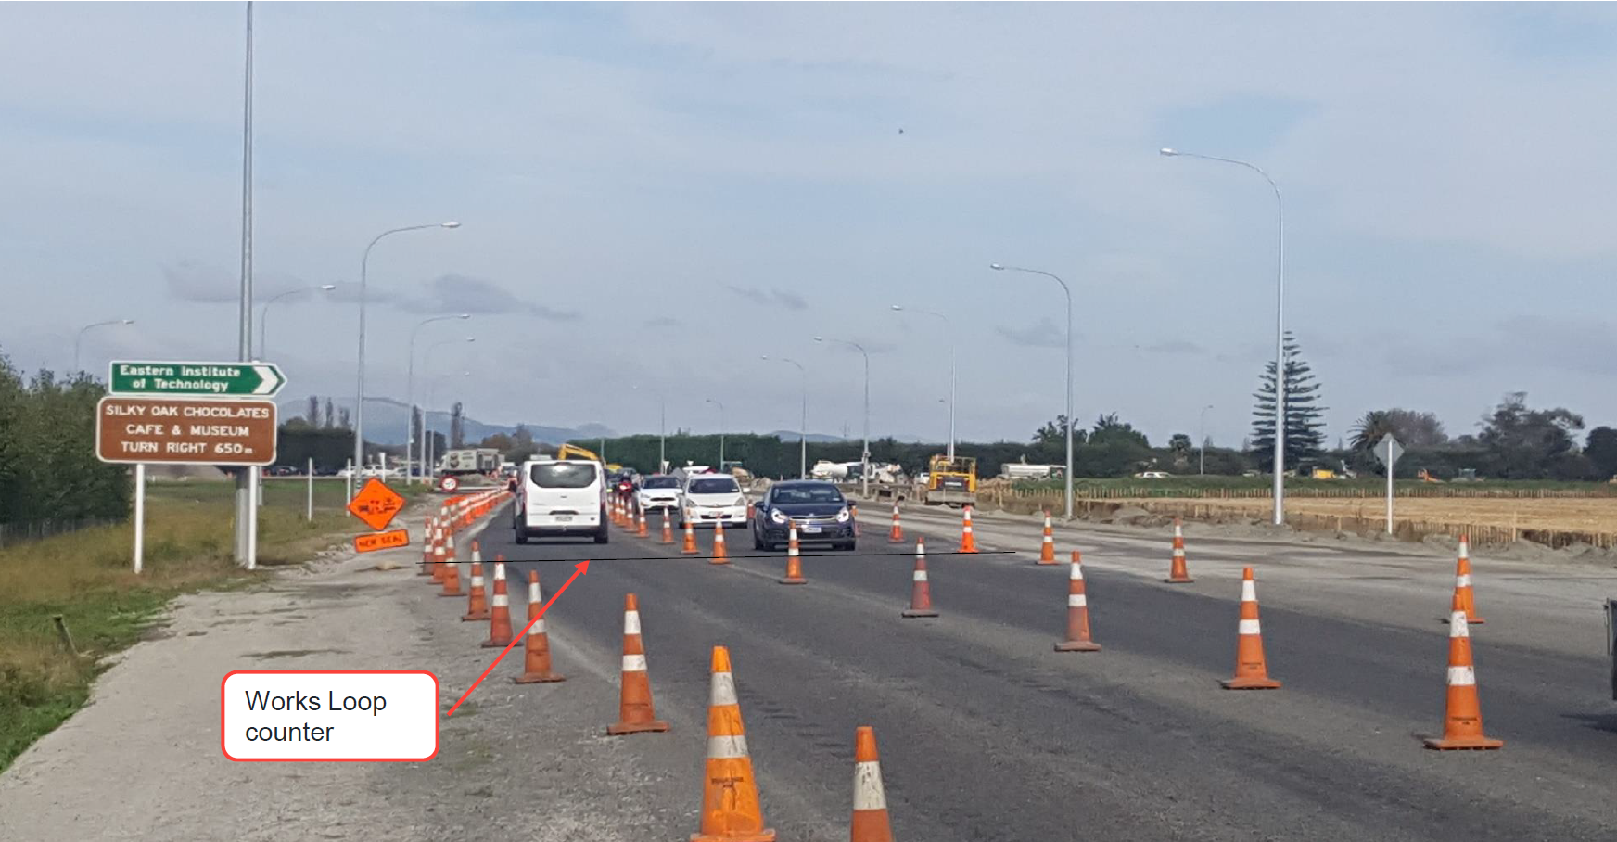
50
Site and experiment
Expressway environment, roundabout being installed
Long-term roadworks site (100 km/h to 50km/h)
2 speed measures (threshold and active work zone)
50
≈200 metres
Notes:
Higgins
SH50/50A

Slide 5
Phase 1: Threshold treatments
Start of site
50
50
50
150 m advance of site
50
km/h AHEAD
50
km/h AHEAD
300 m advance of site
50
km/h AHEAD
70
Notes:
In reality, before getting to the works-proper there was a chicane-like shift across of the traffic lane
The 300m advance warning gives about 12s warning vs about 6s warning

Slide 6
Cleaning the data
Cars only were analysed
For trucks the counter data was not so clean, (so we excluded it from the full analyses)
In a sample we did clean, the speed distribution from trucks consistently slower than the speed distribution from cars (about a 7km/h gap)
Cars with “Free” speed cars only were analysed (4 second headways)
6 days of off-peak data (N = 596 – after cleaning)
Notes:
To check this was ok, we cleaned and inspected truck speeds from one trial at the threshold

Slide 7
Site 1: Speed entering site
 | km/h speed at 50 km/h threshold
 | Median | 85th %ile
150 m advanced warning | 85 | 94
300 m advanced warning | 83 | 93
70 km/h buffer | 83 | 92
Notes:
Speeds are well above the 50 km/h limit entering the site
No effective difference between the approach setups

Slide 8
Site 1: Check speed through site
 | km/h speed at 50 km/h threshold |  | km/h speed just prior to active site
 | Median | 85th %ile | Median | 85th %ile
150 m advanced warning | 85 | 94 | 53 | 63
300 m advanced warning | 83 | 93 | 48 | 60
70 km/h buffer | 83 | 92 | 47 | 59
Notes:
Slower speeds through the site but still a wide range

Slide 9
Site 2: Speed entering site
 | km/h speed at 50 km/h threshold
 | Median | 85th %ile
150 m advanced warning | 73 | 84
300 m advanced warning | 81 | 92
70 km/h buffer | 74 | 86
Notes:
Speeds still well above the 50 km/h limit entering the site
The 300 m advanced warning on its own seems less effective here – though not at the other site

Slide 10
Site 2: Check speed through site
 | km/h speed at 50 km/h threshold |  | km/h speed just prior to active site
 | Median | 85th %ile | Median | 85th %ile
150 m advanced warning | 73 | 84 | 37 | 45
300 m advanced warning | 81 | 92 | 46 | 54
70 km/h buffer | 74 | 86 | 40 | 48
Notes:
Slower speeds through the site but still a wide range - so we are unsure how drivers are choosing their speed
The lane shift might be having the biggest effect but if it was the only effect then would the three speed distributions be the same?

Slide 11
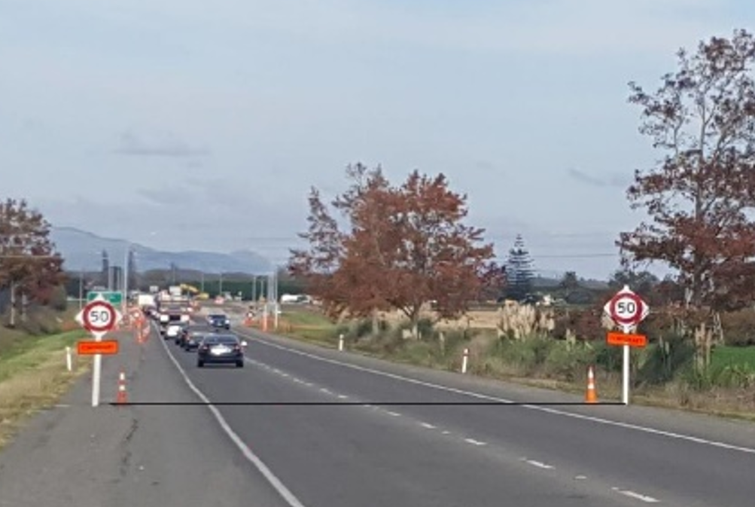
Insights across the sites
Signage signalling advanced warning or graduated speed buffer zones had mixed findings.
Potential for minor speed benefits (~ 5 km/h) (but across our sites these were inconsistent)
Major speed drops – Between the threshold and the live work site (~ 30 km/h drop)
Can attribute this to people responding to the work site
Supported by a physical chicane cone layout
There is room for improvement in safer site speeds
Notes:
1.
2.
3.

Slide 12
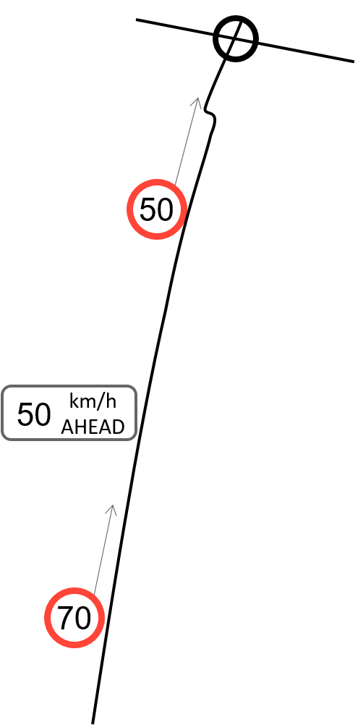
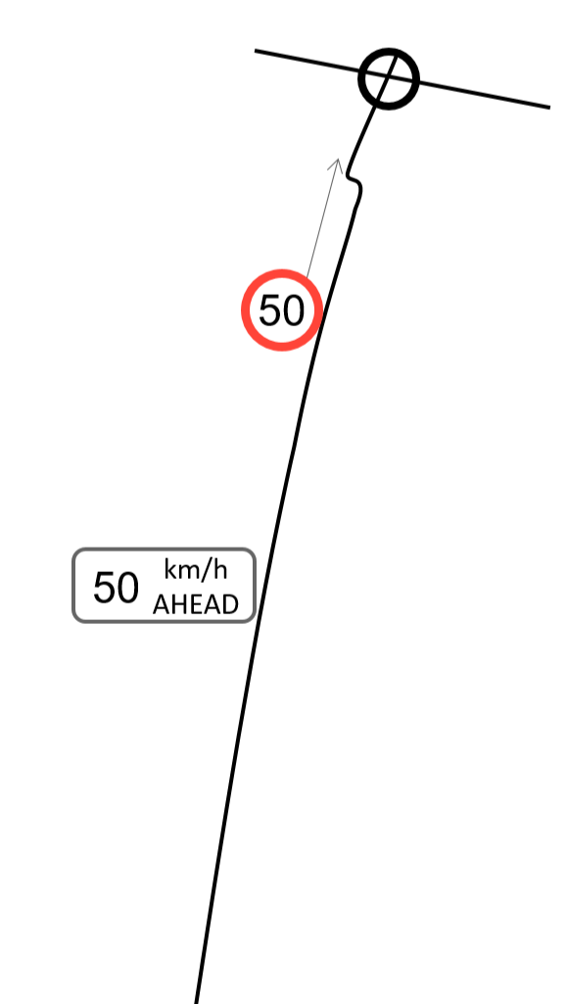
Potential insights (But…not confirmed)
1) Buffer zones vs Multiple Messages
Buffer zones did not work as intended
But…are there benefits from multiple, evenly spaced signs prior to the site?
2) Sign Proximity (150m vs 300m)
Have we optimised the distance between signage and our live works?
Considering sight distance to the live site at the location of the sign
Notes:
Welcome your thinking on this – neat opportunity to check in…
Analogy to the Advanced Warning VMS – Keep close to the mobile site…

Slide 13
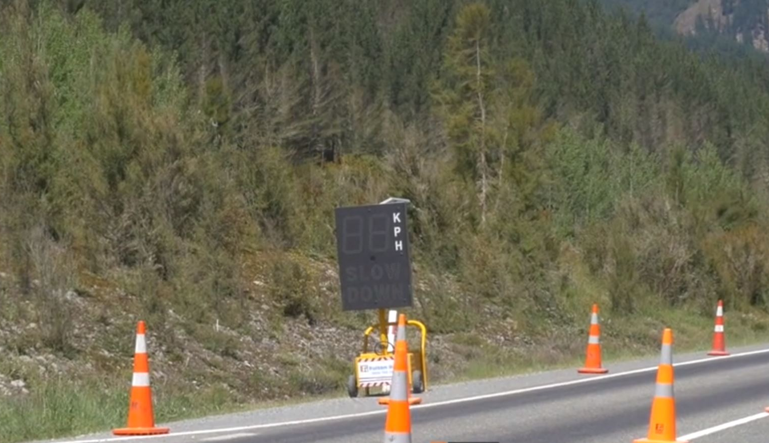
Where to from here?
Still looking for sites
Especially investigating the Buffer Zone Alone (i.e. replacing the advanced warning)
Will look at an additive approach, looking at:
Signage/Buffer Option (pick best of Phase 1)
Perceptual countermeasures (Cone placements)
ITS Solution (Speed feedback)

