Slide 1
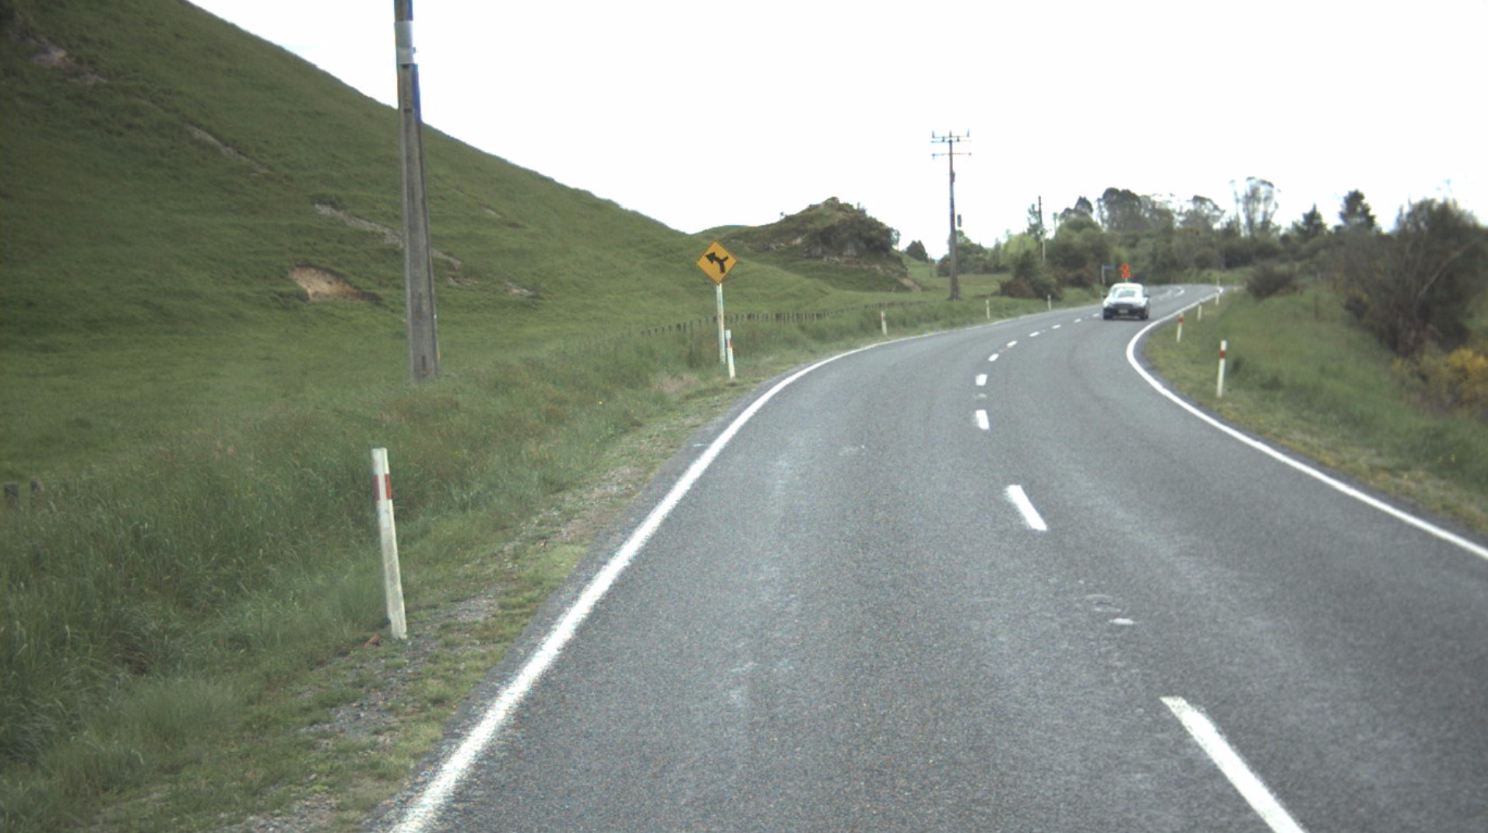
Network Outcomes Contract TTM Crash Investigation
Bill van der Vliet
Chip Sealing Manager Waikato/Bay of Plenty
Downer
Robert Swears
Technical Principal: Road Safety Engineering
WSP Opus

Slide 2
NOC: TTM Crash Investigation: 2017/18
Presentation Overview:
Reflection on the past
Background
The investigation
The crash
Incident response
Resealing traffic management theory
Site TTM

Slide 3
NOC: TTM Crash Investigation: 2017/18
Presentation Overview:
Site TTM
TMP for site
Comparing GTMP with CoPTTM
Documentation and communication
Lessons learned
Actions required
Conclusions

Slide 4
Reflection on the past
TTMC, Rotorua, 2013

Slide 5
Reflection on the past
TTMC, Rotorua, 2013

Slide 6
TTMC, Rotorua, 2013
Reflection on the past

Slide 7
TTMC, Rotorua, 2013
Reflection on the past

Slide 8
TTMC, Rotorua, 2013
My opinion hasn’t changed in the intervening period

Slide 9
NOC: TTM Crash Investigation
Background:
On a state highway network there had been several crashes at road worksites over a short period.
We were asked to investigate a non injury crash at a reseal site as an example to identify whether there were underlying issues.

Slide 10
NOC: TTM Crash Investigation
The investigation:
Consider factors associated with the crash.
Focus on sealing activity and associated TTM.
Identify lessons that can be learned and applied for all activities on the network.
Reduce potential for crashes where TTM is a factor.

Slide 11
NOC: TTM Crash Investigation
Important considerations:
Many of the issues we identified are not peculiar to resealing, the particular highway, or the network.
Crash investigated was used as a case study from which to identify potentially systemic issues.
Investigation was not intended to scrutinise the individuals or companies involved in the incident.
Many of the matters identified through the investigation can be applied to a range of activities.

Slide 12
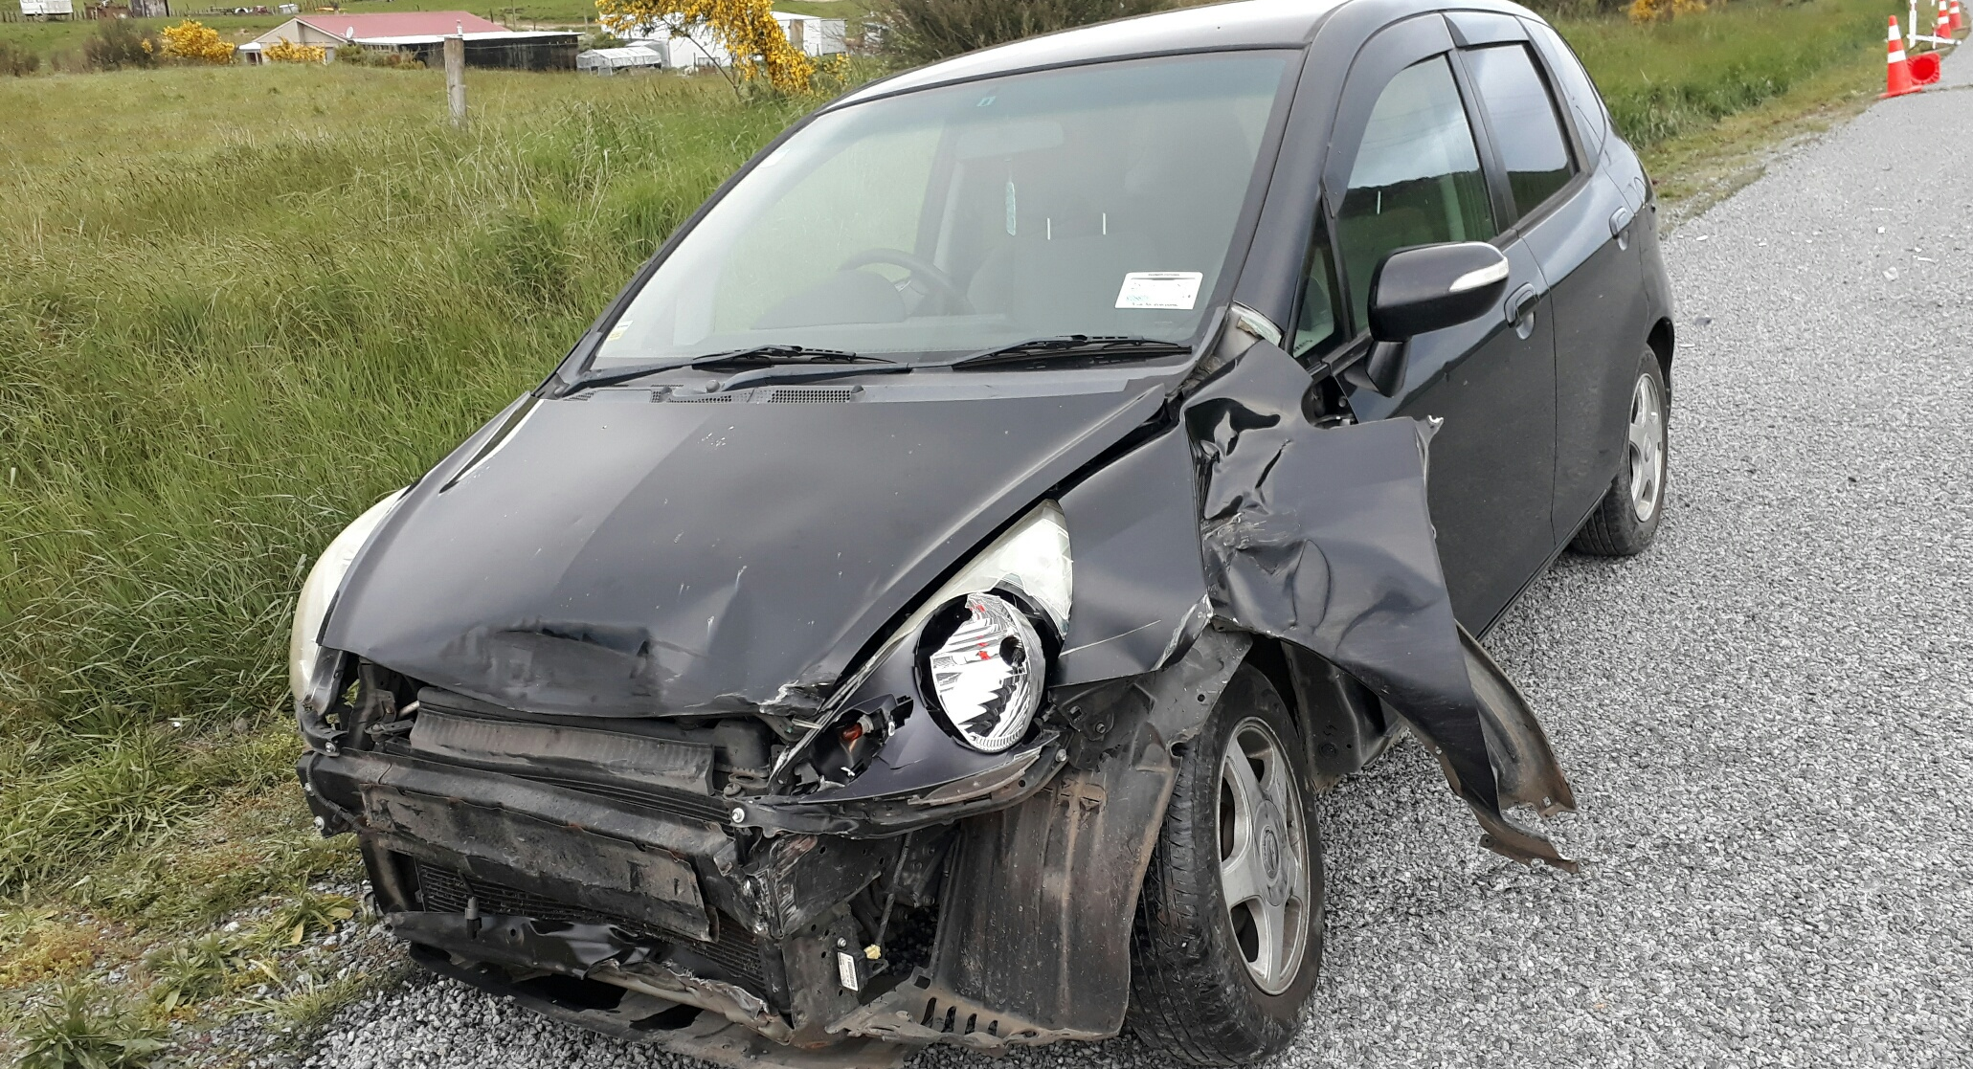
NOC: TTM Crash Investigation
The crash (from TCR):
Occurred on a Sunday in November 2017 at 17:08 hours.
Vehicle travelling north on highway entered the Site.
"Honda vehicle travelling north at about [80 km/h] entered road works (all signs and cones down!!). Lost control on loose stones on the new seal. Went sideways and side swiped ute [towing] trailer".
“Temporary speed zone not correctly signed. No signs or cones all were lying down”.
“Had signs been visible would have reduced speed”.

Slide 13
NOC: TTM Crash Investigation
The crash (from TCR):
“I [driver of northbound vehicle] was driving north i came round [… the] corner and i was on loose stones“.
Driver noted there "[…] was no signs or anything warning me. I was doing 80 and the vehicle spun out“.
Conditions at time of crash: fine, dry surface, bright sun, loose material on surface, no road markings.

Slide 14
NOC: TTM Crash Investigation
NOC incident response:
Crash occurred at 17:08.
Contractor contacted by TOC at 18:15.
TOC advised (19:08) by contractor there were staff on site.
Signs re-erected and stabilised with available sandbags.
TOC were advised (19:46) matter was resolved.
But systems were not in place to ensure contractor’s staff attending the incident returned home safely?

Slide 15
NOC: TTM Crash Investigation
Team meeting on Monday following crash:
When leaving a site that will be unattended, staff need to ensure sign bases are adequately stabilised.
Sandbags should be of adequate weight.
If not enough sandbags on-site, arrange for more sandbags to be supplied and placed ASAP.
There needs to be clarity when a TTM site is handed from one STMS to another STMS.
Notes:
If not have enough sandbags on-site, arrange for more sandbags.
Change to following
If not and you don’t have enough additional sandbags on on-site, arrange for more sandbags to be placed ASAP.

Slide 16
NOC: TTM Crash Investigation
Resealing traffic management theory
TTM teams; typically have three teams for a 24-hour period for each sealing crew.
Sealing crew.
Sweeping crew; up to two per sealing crew.
Road marking team; includes: A-type road marking crew, B-type road marking crew, and RRPM crew.
Notes:
Added in
One sealing crew

Slide 17
NOC: TTM Crash Investigation
TTM timeline:
Day 1 (Fri): TTM company STMSs responsible for site.
Day 2 (Sat): Last TTM company STMS left site early in morning after overnight management of site.
Day 2 (Sat): Sealing contractor broom operator went to site, did not sweep, re-erected signs and cones.
Marking contractor not advised site had not been swept.
Day 2 (Sat): Marking contractor went to site to road mark but site not swept. Signs were upright at that time.

Slide 18
NOC: TTM Crash Investigation
TTM timeline [continued]:
There were missed opportunities to address TTM issues before crash.

Slide 19
NOC: TTM Crash Investigation
STMS responsible at time of crash:
TTM contractor STMS who left site at 0523 on Day 2 was last recorded person responsible for site.
Not realistic for this person to have responsibility at time of crash (approximately 36 hours later).
Unclear who was STMS at time of crash.

Slide 20
Reflection on the past
TTMC, Rotorua, 2013

Slide 21
Reflection on the past
TTMC, Rotorua, 2013

Slide 22
TTMC, Rotorua, 2013
Reflection on the past

Slide 23
TTMC, Rotorua, 2013
Reflection on the past

Slide 24
TTMC, Rotorua, 2013
My opinion hasn’t changed in the intervening period

Slide 25
NOC: TTM Crash Investigation
Traffic Management Plan for site:
NOC Generic TMP (GTMP) used.
But, GTMP was not appropriate for site:
GTMP allowed maximum TSL of 800 m:
Site was longer than 800 m.
GTMP did not allow work on weekends:
Work was being done on weekend.
TMC was not advised of sealing on Day 1:
Therefore, GTMP could not apply.
Effectively, no TMP for the activity.

Slide 26
NOC: TTM Crash Investigation
Comparing GTMP with CoPTTM:
GTMP too broad to cover resealing activity (and various other activities on network).
Did not describe installation, maintenance, and removal of TTM equipment.
Required STMS to consult full CoPTTM document; this was unreasonable.
Required STMS to refer to a NOC procedural document not relevant to sealing operation.

Slide 27
NOC: TTM Crash Investigation
Comparing GTMP with CoPTTM [continued]:
Did not describe Positive Traffic Management (PTM) and circumstances under which it must be applied.
Did not adequately describe how to deal with contingencies/emergencies.
Likely that on-site records used by STMSs did not comply with GTMP.

Slide 28
NOC: TTM Crash Investigation
Comparing GTMP with CoPTTM [continued]:
Site safety measures not addressed.
Included some cumbersome requirements (e.g. advise approving TMC of TMP changes).
Did not comply with numerous aspects of CoPTTM and likely to be cumbersome for STMSs to use (75 page document).

Slide 29
NOC: TTM Crash Investigation
Documentation was cumbersome:
Paperwork can be challenging for some STMSs.
For crash site, TTM contractor documentation included:
Daily Work/Time Sheet.
Site Hazard ID Form.
On-Site Record.
Checking Process for Generic TMPs.
Daily Checklist.
Booking Sheet.
Solution: optimise documentation required on site.

Slide 30
NOC: TTM Crash Investigation
Communication between companies:
For crash site incident communication could have been better.
No handover of site from TTM contractor STMS on morning of Day 2 (Sat).
No communication from sealing contractor to roadmarking contractor that site not swept.
No communication from sealing contractor or roadmarking contractor that TTM should have been under TTM contractor STMS.
Notes:
No Communication from Roadmarkers to TMNZ STMS to hand site back to STMS

Slide 31
NOC: TTM Crash Investigation
Opportunities before crash to address TTM:
When TTM contractor left the site.
When sealing contractor visited the site for sweeping.
When roadmarking contractor visited the site (although all signs were up at that time).
When off duty police officer drove through the site.

Slide 32
NOC: TTM Crash Investigation
Lessons learned:
17 lessons identified.
GTMP lesson incorporates 25 sub lessons.
Each lesson has accompanying action(s).

Slide 33
NOC: TTM Crash Investigation
Actions we identified include:
Ensure staff have arrived at and returned from any incident scene.
Simplify site documentation.
Amend GTMP.
Improve communication between network partners (including Police).
Significantly increase TTM auditing; use the training opportunity associated with auditing.

Slide 34
NOC: TTM Crash Investigation
Top 5 actions:
Install and maintain CoPTTM compliant TTM.
All staff, if unable to carry out assigned task, must report up. Establish Traffic Operations Manager (TOM) role.
Define Positive Traffic Management (PTM) measures and when to be used.
Produce system to ensure staff safely return from incident scene.
Provide clear guidance regarding determining and managing delays.

Slide 35
NOC: TTM Crash Investigation
Conclusions of investigation:
GTMP needed amendment.
Many of the actions are relatively simple.
If we (the industry as a whole) do not improve TTM on the network, then we can’t expect the situation to improve.
Notes:
Who’s

Slide 36
NOC: TTM Crash Investigation
Questions for our industry:
Are all TMPs CoPTTM compliant and fit for purpose?
Are we sure our incident response staff return safely from incidents?
How does an STMS hand an unattended site to another STMS?
Do all of our staff know what to do if there are issues with TTM at a site?
Can we do better?
Notes:
Who’s

Slide 37
NOC: TTM Crash Investigation
My view:
On an international scale, CoPTTM is pretty good.
We as an industry are inconsistent and we often don’t comply with CoPTTM.
I don’t want to be subpoenaed to a coroner’s hearing to talk about TTM and CoPTTM compliance.
The way forward:
If we (the industry as a whole) don’t improve TTM on the network, then we can’t expect the situation to improve.
Notes:
Who’s

Slide 38
NOC: TTM Crash Investigation
Acknowledgement:
The benefits that can be realised through initiating the actions identified from the investigation would not be possible without the cooperation we received from everyone with whom we spoke when conducting the investigation.
Thanks are due to the various individuals who provided open and honest responses to the questions that we raised.
Bill van der Vliet
Chip Sealing Manager Waikato/Bay of Plenty
Robert Swears
Technical Principal: Road Safety Engineering

Slide 39
NOC: TTM Crash Investigation
Thank you
Any questions?

