Slide 1
Industry-led safety insights for Temporary Traffic Management Sites
Jared Thomas, Andrea Williamson, Maggie Trotter
Notes:
Title slide for use with Water work stream

Slide 2
Our industry-led approach
Transport Agency and Safety at Road Works Advisory Group
Novel approach - Industry-led insights around issues and solutions from the field
Highly valuable, but rarely used approach
Four interactive workshop sessions: Hamilton, Auckland, Christchurch, Wellington
Disclaimer – Availability heuristic – more likely to pick up common or widely discussed solutions
Notes:
Evaluation of TTM safety – Innovative to capture knowledge from the experienced staff and those with fresh eyes who are on the ground.
Therapy sessions – People felt heard/validated – highly valued the discussion
Locations were used to capture a range of road environments – urban, rural, motorway
People who attended

Slide 3
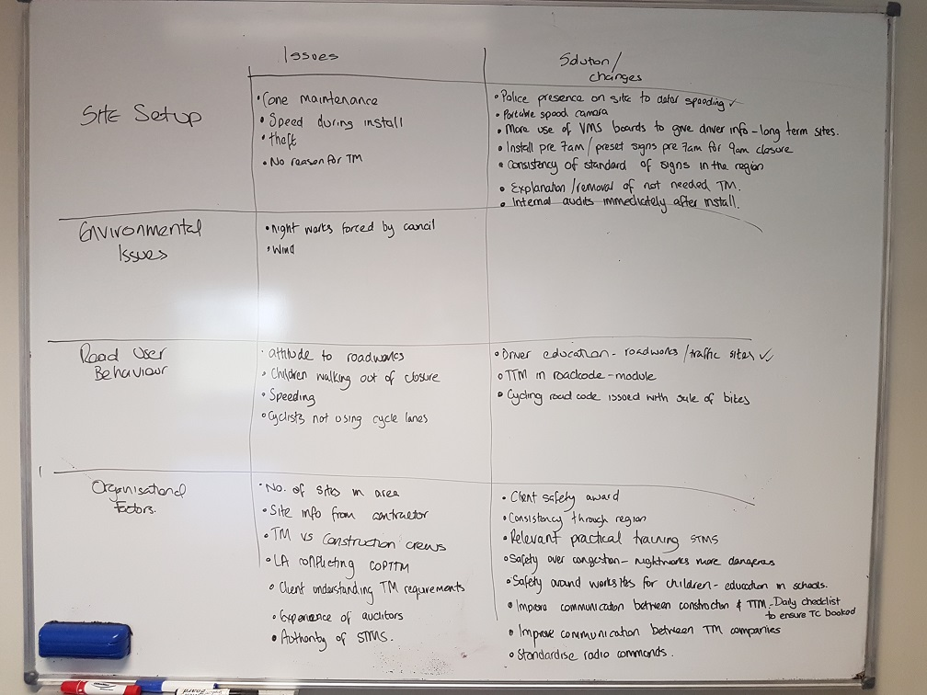
Overview of Highlights
Consistent Highlight Solutions
Knowledge-sharing
Constructive auditing
Balancing site consistency vs flexibility
Public education
Training
Other innovative solutions
Body cameras
Mobile application
CoPTTM Search Functionality
Multi-modal sites
Cyclist/Pedestrian approved products
Speed threshold treatments
Notes:
Text slide

Slide 4
Knowledge Sharing
“Clear communication between agencies…there should be a channel of discussion where agencies can help each other, rather than competing.”
Issue: Inter-agency communications, including at the on-site level, was seen to be valuable, but not done with any frequency or purpose.
Solutions
Proactive communication channels: Having governance group members actively ask what STMS’s want raised (and feedback around any actions)
Regular staff meetings: Share common recent site experiences, discuss audit reports, focus on positive lessons
Inter-agency sharing: Showcasing and acknowledging positive knowledge sharing – working from the common goal around safety
“I have never encountered that, that is bloody good.”
Notes:
Solutions offered:
1. There was a recommendation that governance group members actively ask what STMS’s want raised at the governance group. This would raise visibility of the existing communication channel. Also, ensuring feedback loops, so that the story is shared when there is a change as a consequence of voicing an opinion (this demonstrates the value of sharing). There was a belief that this would be especially effective if enough of the same messages were pushed up with common issues from different sources within industry.
“I have never encountered that, that is bloody good.”
2. Regular staff meetings to discuss audit reports, common experiences and issues will allow staff to learn from one another, with experienced staff able to share key lessons and answer questions of less experienced staff. This enhances knowledge sharing and provides a forum for any identified issues to flow up to management. Such meetings should be designed to discuss positive rather than negative experiences.
3. Enable opportunities of inter-agency sharing of lessons and solutions on the ground. There was also a discussion of showcasing and acknowledging the positive stories around knowledge sharing. Recognition of the positive behaviours in this way positively encourages a sharing mentality based around the shared goal of safety.

Slide 5
Constructive auditing
Issues
Within the external audit there was seen to be a lack of clarity around the interpretation of a safe site, and a lack of consistency between different auditors
“Once upon a time it was very, very inconsistent. …. Recently I’ve heard from within the same RCA that they don’t look to shut down sites, that they look at improving them.”
Solutions offered
Internal audits: To continue to promote and use internal auditors (including as mentors)
Auditor Support: To improve compliance, including the suggestions of shared site walk-throughs
Consistent auditor training, including road experience
Auditors as knowledge-sharers
Notes:
Solutions offered
Support from the auditor to improve compliance, including suggestions for improvements and positive feedback from the auditor to reinforce what was done well (perhaps allowing a stronger mechanism to capture the positive).
Shared site walk-throughs between an external Auditor and STMS to enable better communication. This would enable them to understand each other’s perspective better, and set it up to be a constructive process working together to improve site safety together. This is especially important the first time an auditor is working with an STMS.
Improved auditor training so that all auditors are enforcing rules consistently and STMS are not being cited for one behaviour in one jurisdiction while it is encouraged in another. Focus should be holistic—on the overall safety of site—rather than on specific details.
All auditors to have road experience so they understand the competing pressures STMS are exposed to. This would add to the practicality of site improvement suggestions and also add credibility to enable auditors to better influence positive STMS site changes.
Internal auditors provide unbiased feedback and try to mentor and improve behaviour rather than penalising. These auditors are seen as important to improving consistent compliance.
Auditors to capture smart, proactive site solutions to common problems, where these can be shared wider and recognised. Also, capturing special cases where the site setup was compliant, but not ideal (i.e. identifying setups which would be valuable to review for possible solutions with a wider group of experts).
Good stories:
Positive behaviour changes seen via the internal process

Slide 6
Balancing site flexibility with consistency
Issues
Site-specific elements where the existing Traffic Management Plan is not fit-for-purpose
“A lot of the time the TMPs are becoming very rigid…If you go out to do a mill-out, and the road has failed, and the site becomes 50m or 100m longer than expected then the work cannot be done within the TMP safety zone, then you are left scrambling just to change it.”
Solutions offered
Specific circumstances: Where an STMS can authorise changes (e.g. extension to advanced warning)
Ammendments: STMS be able to record these as amendments on the TMP drawing on-site.
Guidance related to events that include the aforementioned flexibility, and a process for determining when this is appropriate.
Notes:
For safety and efficiency (in terms of cost and delay to motorists), there are certain circumstances where it would make sense to be able to have conditions where an STMS can authorise changes.
There is a recommendation that the STMS be able to record these as amendments on the TMP drawing on-site. Note that this process is already in place in some locations and amongst some organisations (which highlights the need for improved consistency).
Specific guidance related to events that include the aforementioned flexibility, and a process for determining when this is appropriate. Also, discussions with client around expectations of responsibility.
AVWMS – Tail pilot – Requested to pull back.

Slide 7
Public education
Issues
A lack of understanding around correct behaviour by the public.
Solutions offered
Why, what, how? Understanding why I should behave this way, under what circumstances, and how they should make it through the site safely
Translation: Adding the “so what” (e.g. what kind of delay there would be if there was a crash on site)
Basic comprehension: Sign meanings, such as lane drops
Teaching the next generation: Schools/Road code.
Notes:
Solutions offered
In terms of education content, there was discussion around the “Why” component, and that drivers do not understand the reasons behind the expected behaviour (such as speed). There was also mention of the “so what”, in terms of taking one step further and translating it into something that is meaningful to the driver (such as the kind of delay if there was a crash on site, or from more frequent delays from increased maintenance required due to seal damage from excess speed).
Advertisement/Education campaign around road works, including sign meanings, especially: flag man, lane drops, and work men signs.
Ensuring advertising and materials are in different languages to enable better engagement with wider communities.
Development of materials in multiple formats that could be picked up by the public or agencies to use, including educational videos and pamphlets.
Having a NZ Road Code module dedicated to work site behaviour and signage comprehension (and updating this as the Road Code is updated) was mentioned as an excellent opportunity to improve understanding and promote good behaviour in new drivers.
Ensuring safety around work sites was a strong component of the existing road safety education in schools to teach the next generation. As some of the misunderstanding of the correct behaviour through sites comes from younger pedestrians and cyclists. Building respect for site risks even before youth are driving was viewed as important.

Slide 8
Training
Issues
Overly reliant on mentoring and on the job learning – can cause inconsistency and pressure on experienced STMS.
Solutions offered
Real-world assessments: More time on site at every level
Support: Supervision and mentoring (e.g. more supervised hours for newly qualified, on-call)
Capability building: Pathway to promote going beyond the minimum (e.g. Apprenticeship)
New and refresher training: Consistency in approach is key. Allowing for different learning styles (e.g. multi-media options), people skills competency
“It is a self-taught industry. You go out and do your basic TC [Traffic Controller] ticket. You learn from an STMS. Then they pass on what they learn, and it is all just Chinese Whispers all the way.”
Notes:
Text slide

Slide 9
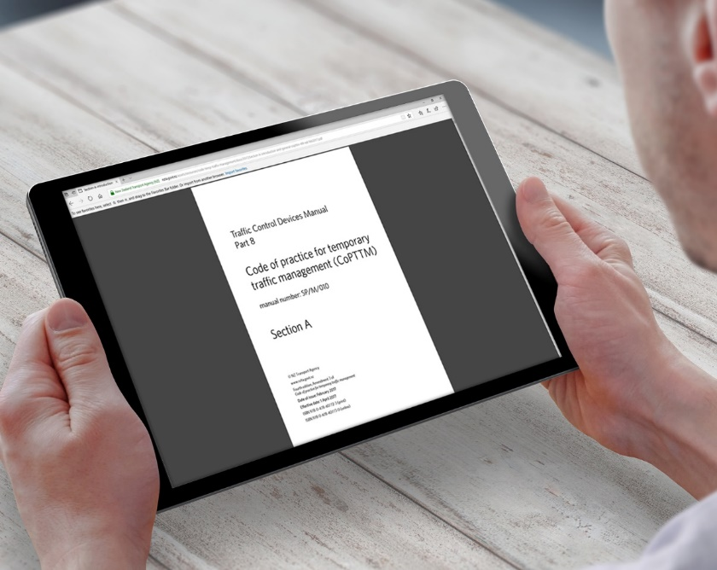
Other key recommendations
Body cameras – As a staff wellbeing intervention
Mobile application – Ability to check relevant data (e.g. site-specific safety history)
CoPTTM Search Functionality - To improve usability
Multi-modal sites – Looking at different user needs, to improve communications/efficiency/ safety
Fit-for-purpose - Cyclist and pedestrian materials for safe routes
Speed threshold treatments – Trials at high speed zone sites (e.g. use of graduated speed zones)
Notes:
Reduce public abuse – which seemed consistent through each group. Usability testing specific equipment needs to review effectiveness in different conditions.
Relevant crash history/speed data around the location – as well as the site setup.
Improved search algorithms – common searches understood etc.
Definite pain-point - Identify some options that work well vs don’t in advance – Capture some lessons around this in an interactive workshop with key stakeholders
Reality vs Approved products – there is a gap here. There was a fatality recently – Wheelchair
Trialling now

Slide 10
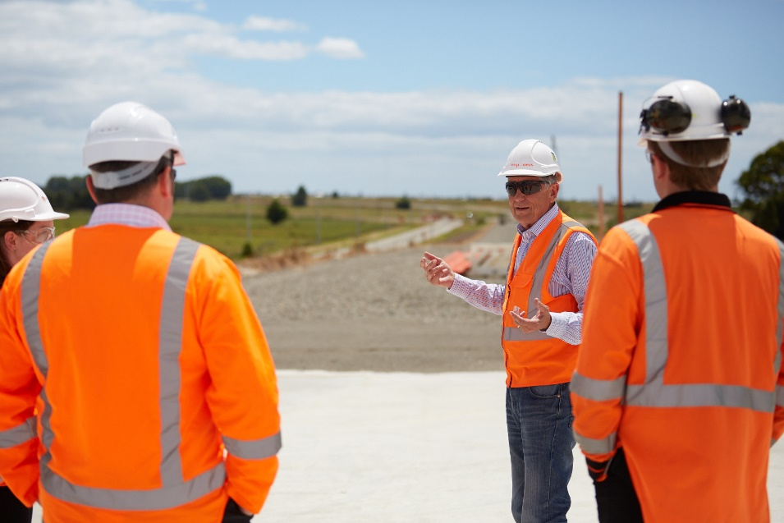
Where to from here?
Presented to the Zero Harm Leadership Group
Training initiatives
Speed threshold trials
“Stories from the ground” – Holding annual workshops to capture and share
Leadership around knowledge sharing
Notes:
Worked best in an open environment – No managers in the room

Slide 11
Acknowledgements

