Slide 1
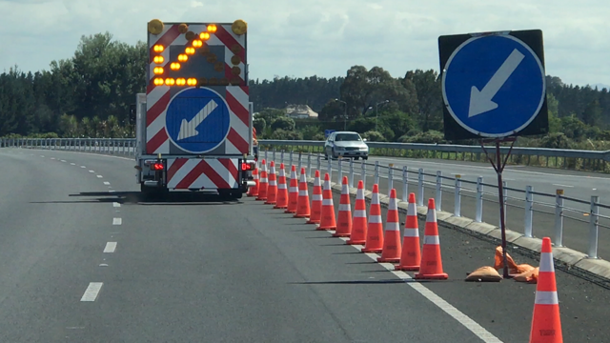
Proposed Minimum Disruption methods for Installation of L2/3 Closures
Presented by Leanne McAdams
Notes:
Good morning
As introduced I’m both a L2/3 Trainer and an Assessor. I’m keen to work with the industry to clarify ‘best practise ‘ methodologies and improve the sequencing of mobile installation and removal procedures for L2/3 worksites.
My topic considers how we currently install our L2/3 closures, current CoPTTM procedures and how this could be modified to provide a more succinct and efficient set up.
click

Slide 2
Current Situation
C11.2.1 Order of Worksite Establishment
On single direction carriageways signs must be deployed on the left side of the road first, and then on the right hand side of the road, if required.
The first sign erected must be the advance warning sign.
Remaining signs are placed in order from the advance warning sign until the works end sign is reached. The vehicle then makes a loop on a single direction carriageway ...
Tapers and delineation devices must only be placed once all signs have been installed.
Notes:
The current order of Worksite Establishment in CoPTTM for a single direction carriageway requires that:
signs are installed first on the LHS in order from the first advance warning sign to the works end sign, a loop is is made and then the signs are installed in order on the RHS. Only after all of the signs are installed are the delineation devices able to be installed
click

Slide 3
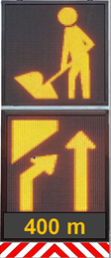
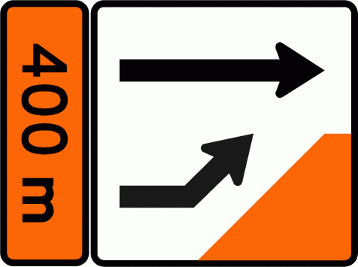
Current Situation Right Lane Closure
Industry Practice has accepted installing closure prior to the Works End sign to reduce to 2 loops
Notes:
I’m going to quickly take you through how we currently show the methodology in our training
Firstly, the Right lane closure – note that although currently in CoPTTM the delineation is to be placed after the signs we do instruct to install the friction cones on the LHS along with the signage.
Click
The signs are installed on the left, a loop conducted, the AWVMS changes display, the signs are installed on the RHS…
We also promote the closure being installed on the 2nd loop which is accepted industry best practise. To enable this cones are installed beyond the closure to the End of Works sign. The WE sign is installed and the work truck backs back to closure removing the cones.

Slide 4
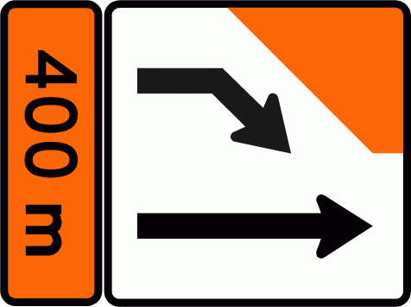
Current Situation Left Lane Closure
3 loops as signs are required on LHS first
Notes:
Click
Currently when installing a left lane closure the signs must be installed on the LHS first. A loop is conducted to install the signs on the RHS (along with the RHS friction cones)
Note how at this point the gated left lane drop static signs are in conflict with the AWVMS
Click
and then a third loop is conducted to install the left lane closure. At this point there is no conflict between the AWVMS and the static signs. The taper is installed along with the closure
3 loops are required as the signs must be installed on the LHS first
Click

Slide 5
CoPTTM Right Lane Closure
Typically used for Practical Assessments
Notes:
Typically for a Practical Assessment a Right lane closure is used. Only 2 loops are conducted as opposed to 3 loops which means there is less time in spent in the process, this is in accordance of with the CoPTTM Principle of ‘Minimum Disruption’.
click

Slide 6
Industry Questions
Are the current requirements:
Minimum disruption?
Logical?
Efficient?
Can we do better?
Notes:
Is the current requirement to install signs on the LHS first promoting the most effective set up?
Does it support minimum disruption?
Is it logical? Efficient?
Are there procedures we could consider adopting that are more succinct?
click

Slide 7
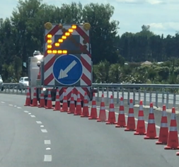
Consider Principles of CoPTTM
A3 Principles
Activities on any road must be planned so as to cause as little disruption, delay or inconvenience to road users as possible without compromising safety.
C11.1 General
The installation of traffic management signs and devices must be undertaken so that it:
is efficient, logical and quickly isolates the working space from road users.
Notes:
Let’s consider the Principles of CoPTTM. A key principle of CoPTTM is that activities on the road must be planned so as to cause as little disruption, delay or inconvenience to road users as possible without compromising safety
click
Also consider the General Installation requirements…
Currently the usual Practise for the right lane closure allows for a ‘less disruption’ than the left lane closure, the sequencing of the right lane closure is more ‘efficient and logical’ than the left lane closure.
Due to the requirement to install signs on the LHS first an extra loop is required for the left lane closure
click

Slide 8
Background - Why the LHS signs first?
Land Transport Rule, Traffic Control Devices
4.4(9)
A road controlling authority must install a traffic sign on the left-hand side of the road from the point of view of a person approaching the sign, except if a different position:
would be safer and more effective in the circumstances;
or
(b) is specified in any enactment.
Notes:
So let’s look at why CoPTTM states the signs are to be installed on the LHS first.
The reason for this is for compliance with the Land Transport Rule - Traffic Control Devices
This states that the ‘RCA must install traffic signs on the LHS of the road’.
Before we read further into this let’s look at CoPTTM installation practices……
click

Slide 9
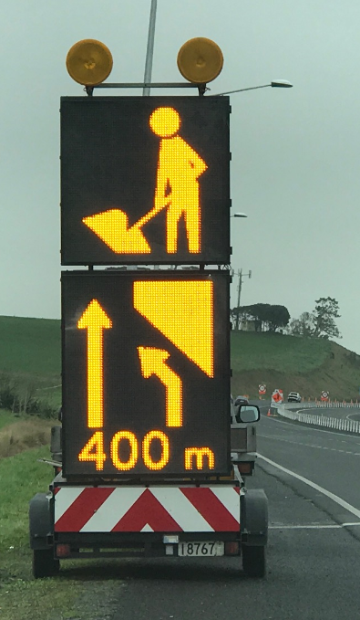
How does this apply to CoPTTM?
During installation activity the activity is a Mobile Operation rather than a Static
CoPTTM already allows that the AWVMS can be placed on the LHS or the RHS of the road
D1.9.2.2 Operational principles
The AWVMS may … be used:
on the left hand roadside shoulder clear of the edgeline, or
in the central median where it can be established 2m clear of any live lane …
Notes:
During the installation of signs for TTM we are actually operating under a mobile operation.
Therefore the RU is at this point under the control and guidance of the mobile operation signage rather than the static site signs . So it would reasonable to say that this clause is not referring to the signs during the installation process. But rather to signs that have been installed and are in use.
click
Furthermore, CoPTTM already allows that the AWVMS which we use for the Advance Warning for the mobile operation may be placed on the LHS or the RHS while conducting the mobile activity
click

Slide 10
Background - Why the LHS signs first?
Land Transport Rule, Traffic Control Devices
4.4(9)
A road controlling authority must install a traffic sign on the left-hand side of the road from the point of view of a person approaching the sign, except if a different position:
would be safer and more effective in the circumstances;
or
(b) is specified in any enactment.
Notes:
Back to the Land Transport Rule..
Traffic control devices goes on from stating ‘the RCA must install a traffic sign on the left-hand side’ …. to providing an exception that signs… could be installed in a different location if ‘it was safer or more effective in the circumstances’
click

Slide 11
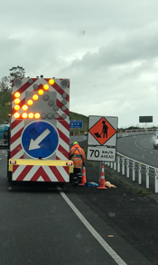
How does this apply to CoPTTM?
Where the closure is a Left lane drop it can be justified that:
it would be safer and more effective in the circumstances to install the signs on the RHS first
Benefits include:
safer as our trucks and crews are on the road for less time
more effective as there is less conflict with the lane drop signs
Notes:
How does this apply to CoPTTM?
Where the closure is a Left lane drop it can be justified that:
it would be safer and more effective in the circumstances to install the signs on the RHS first
Benefits include:
safer & ‘less disruption’ as our trucks and crews would only need to conduct 2 loops meaning that they are on the road for less time
Also the process of the set up is more effective as there is less conflict with the static lane drop signs & the AWVMS
Its recognised also that we have better control of traffic when we merge the faster right lane traffic into a slower traffic lane. This also supports installation on the RHS
click

Slide 12
Proposed Left lane Closure Installation of signs on RHS first
Notes:
click
The AWVMS is positioned to show a right lane closure, the signs are installed on the RHS from the AW to the WE sign. Note how although there is a conflict between the static sign and the AWVMS that it is limited by the signs not being gated at this point.
The AWVMS blanks its display and the vehicles do the loop
click

Slide 13
Proposed Left lane Closure Installation of signs on RHS first
2 loops required
Notes:
click
The AWVMS now displays a left lane closure, the signs are installed on the LHS from the AW to the WE sign. The closure is installed and the cones are extended to allow placement of the WE sign. The work vehicle reverses within the closure picking up the additional delineation until it is back into the working space
click

Slide 14
Where is this at?
Its proposed that the next edition of CoPTTM
Will allow for installation or removal of signs on either the LHS or RHS first
Notes:
So Where is this at?
It is currently approved that the next release of CoPTTM will allow for installation or removal of signs on either the LHS or RHS first. The decision of which side to be placed first to reflect the most efficient sequencing for the installation of that closure
click

Slide 15
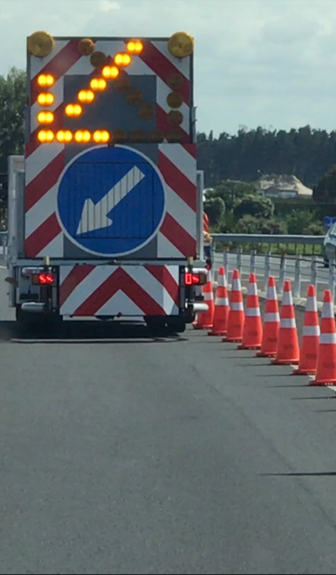
Where is this at?
CoPTTM Consult has been submitted with request to allow:
installation or removal of delineation (friction cones) on the same loop as the signs
Works End Signs to be installed following installation of the closure
Notes:
How about the order of installation?
A COPTTM Consult has been submitted with request to allow:
installation or removal of delineation (friction cones) on the same loop as the signs
Works End Signs to be permitted to be installed following installation of the closure
These items are currently recognised as ‘best practise’ however do not comply with the wording in CoPTTM
click

Slide 16
Current Situation
C11.2.2 Removing the worksite
The removal of TTM measures must be in the reverse order of establishment, ie reverse order for removal as per (c), (b), (a).
For level 2 and level 3 roads where an AWVMS is used to replace the advance warning sign, all signs on one side of the road may be removed in a single pass.
Notes:
How about removing the worksite. Could we also improve the efficiencies of this process?
The current wording in CoPTTM requires that
The delineation devices are removed first
Then the D&P signs followed by the EW
Finally the AW sign
We had in the past for Practical Assessment some candidates proposing to conduct up to six loops through a simple lane closure site to enable them to correctly follow the CoPTTM procedure.
Feb 2017 we had as the result of a CoPTTM consult the addition of the wording into CoPTTM: ‘ where an AWVMS is used to replace the AW sign the signs may be removed in a single pass’
This recognised that the site was under the control of the AWVMS as AW rather than the static AW warning signs
It has also been accepted industry practise that the friction cones are picked up on the same loop as the signs on that side. This reduced the number of loops to 3 loops.
click

Slide 17
Current Practise - Removal
3 loops required
Notes:
Current Practice
Removal of Closure two industry accepted methods
Reverse removal within the closure from the end of the closure or forward removal of the closure from the start of the closure
Remove RHS signs in order from AW to EW
Remove LHS signs in order from AW to EW
click

Slide 18
Industry Questions
Can we reduce time for removal of the worksite?
Notes:
Is the current requirement to remove the closure first promoting the most effective removal?
Is there procedure we which will promote a lesser disruption?
click

Slide 19
Possible ‘Minimum Disruption’ - Removal
2 loops required
Notes:
Where we use a forward removal method for removing the closure if we could remove the closure on the same loop as the signs we would reduce the removal to 2 loops.
This is significant if there is a considerable distance for turn around areas to complete the loops
click

Slide 20
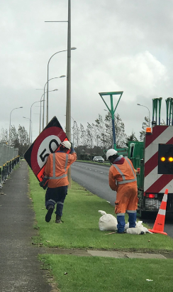
Where is this at?
A CoPTTM Consult has been submitted to allow:
Removal of signs (incl. AW) on the same pass as the closure
Notes:
A CoPTTM Consult has been submitted with request to allow:
Removal of signs (incl. AW) on the same pass as the closure
click

Slide 21
Proposal
Determine methodologies for ‘Best Practise’
Ensure reflected in CoPTTM
Information sharing in Section I
Notes:
In Summary I propose
Time is spent examining the current industry practises and determining which are ‘best practise’
Ensure that the wording in CoPTTM does reflect ‘best Practice’
I’d also like to see information on Section I (of the NZTA CoPTTM website) providing information and guidance to new STMS on ‘best practise setups and removals’

