Slide 1
CHALLENGING TTM FOR
Dave Tilton
Andrew Young
Major Projects

Slide 2
2008
2018
2028
The Last Decade
The Next Decade

Slide 3
This last decade…
Hobsonville deviation (sh18)
2009
Mangere Harbour Crossing (MHX)
NEWMARKET GATEWAY ALLIANCE (NGA)
2010
Victoria Park Tunnel (VPT)
2011
2012
Lincoln road interchange (lri)
Papakura interchange (pap)
2013
Waterview tunnel project (wca)
Causeway upgrade (cup)
Te Atatu interchange (tat)
2014
Kirkbride upgrade (mhx-k)
St lukes interchange upgrade (sli)
2015
Southern corridor improvements (sci)
Sh1 Ellerslie widening
2016
Lincoln to westgate (l2W)
East west link neilson st improvements
2017
Northern corridor improvements (nci)
2018

Slide 4
What have we learnt…
Geometric Design and Traffic Alignment
Disruption Management
Barrier systems
The ‘traffic manager’ and ‘the project’ stms roles
Notes:
This is what WE’VE learnt (others may have learnt more or less)
This is scratching the surface

Slide 5
Geometric Design and Traffic Alignments

Slide 6
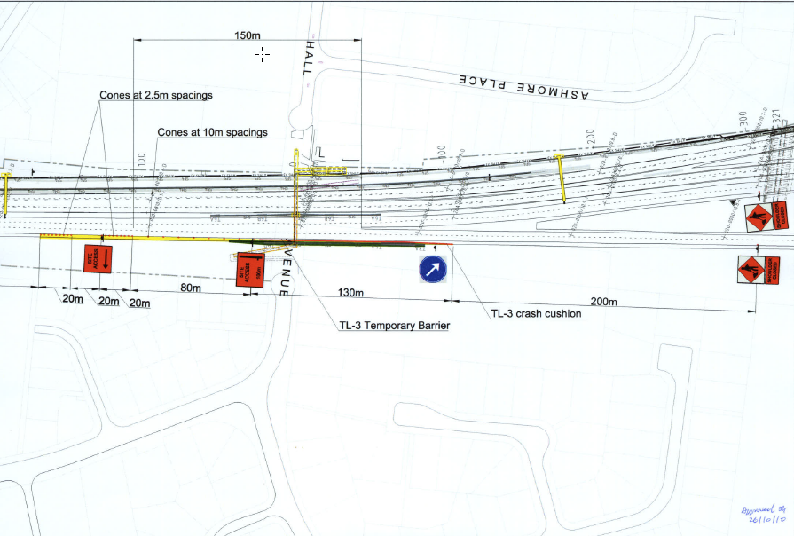
Geometric Design & Traffic Alignment

Slide 7
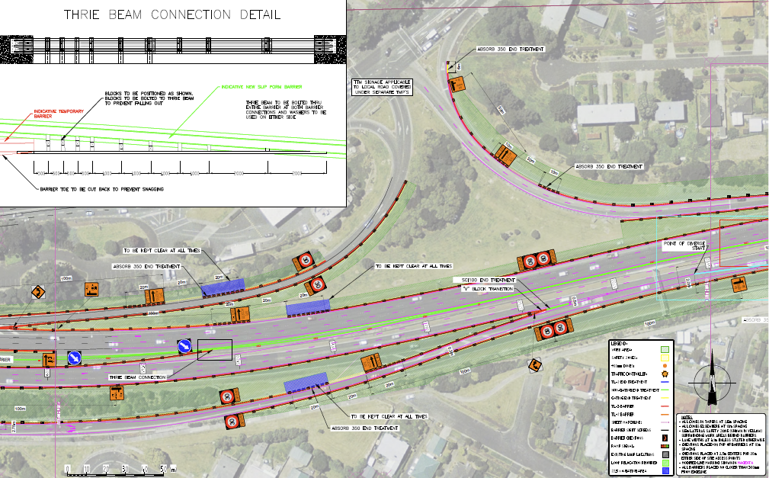
Geometric Design & Traffic Alignment

Slide 8
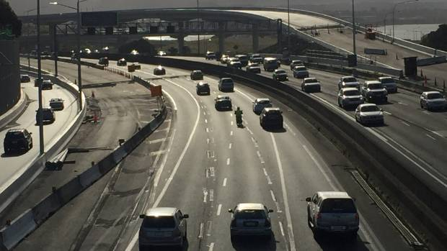

Slide 9
Geometric Design & Traffic Alignment
STAGE 3
STAGE 4
STAGE 5

Slide 10
Disruption Management

Slide 11
Disruption Management

Slide 12
Disruption Management
2008
2018
$180* mil
$500 mil
3 years
4 years
5.0 mil / month
10.4 mil / month
*Inflation adjusted

Slide 13
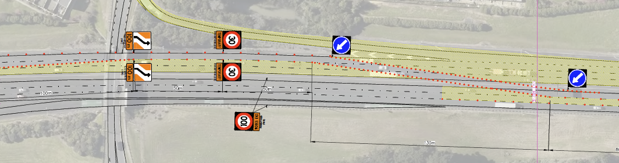
Disruption Management

Slide 14
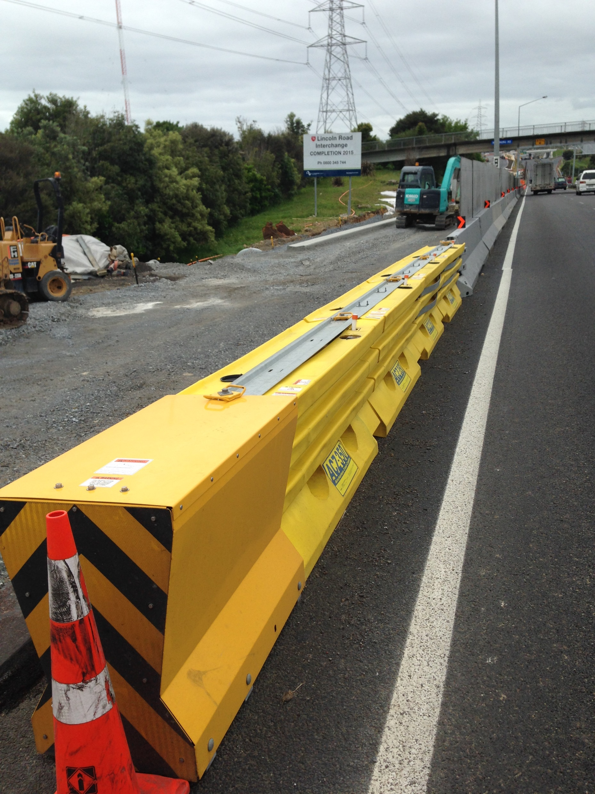
Disruption Management

Slide 15
Road Safety Barrier Systems

Slide 16
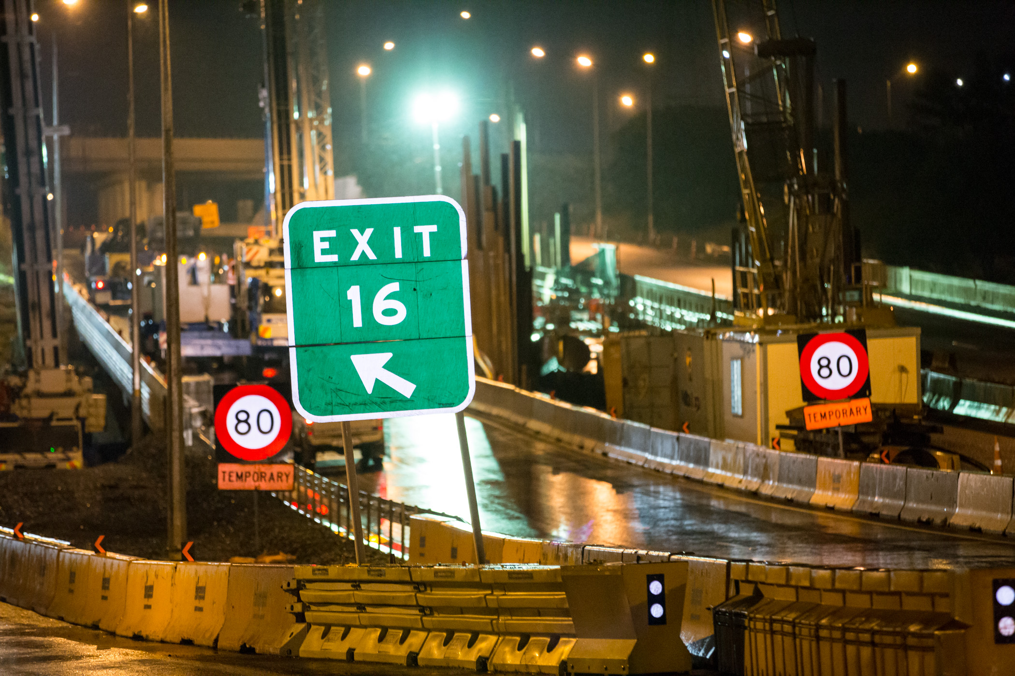
Road Safety Barriers

Slide 17
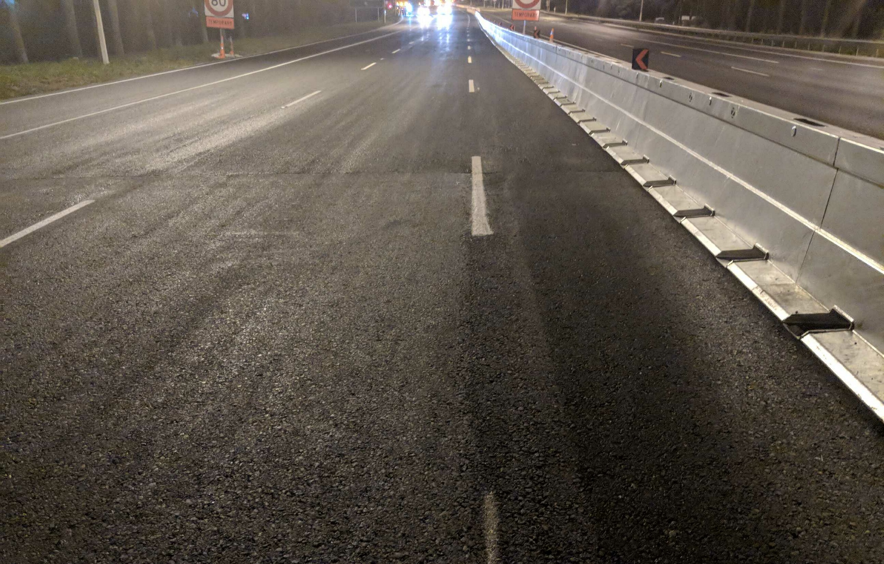
Road Safety Barriers

Slide 18
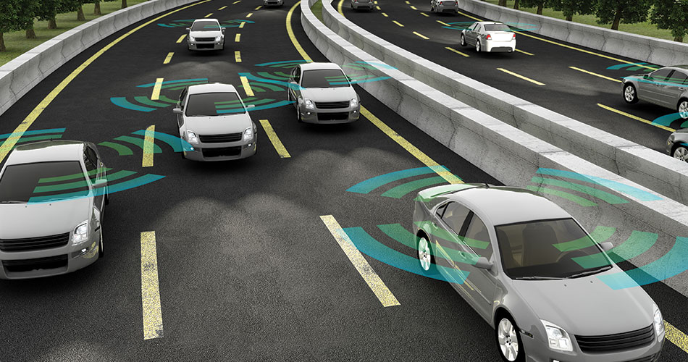
Road Safety Barriers

Slide 19
The Traffic Manager and Project STMS

Slide 20
Engineer
Barrier Specialist
Not a TMP Designer
Barrier Installation
Significantly experienced
The ‘lead’ STMS

Slide 21
Questions?

