Slide 1

Work Zone ITS
SMART
Work Zones
Sandon Button
Western Regional Sales Manager
Ver-Mac, Inc.
Notes:
Sandon Button
Western Regional Sales Manager for Ver-Mac.
Ver-Mac is a manufacture of Portable Electronic Traffic Control Equipment.
I have been with to company for 10 years. I was originally brought in as a Technical Support Specialist and then moved on to Managing the Western United States, Australia and New Zealand Sales Territories.
I have been involved in the Smart Work Zone side of the business working in the field doing the deployment on up to presenting it to road authorities throughout my territory.
And now to standing up here speaking with all of you!!
(What is a Smart Work Zone)

Slide 2
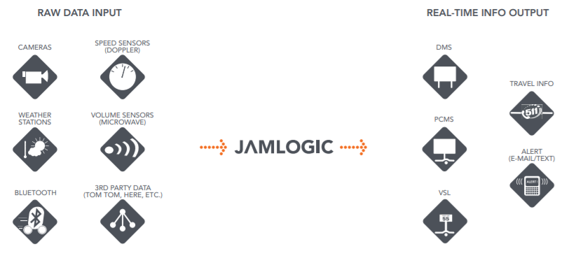
Collect Analyze Output
What are Smart Work Zones?
Notes:
What are Smart Work Zones?
Collection of raw data – Via wireless modems from a variety of field sensing devices and/or third party data
Analysis the data – for the appropriate applications.
Automated Real-time Outputs – Providing real-time information to the motoring public, project managers, road authority TMC and public websites.

Slide 3
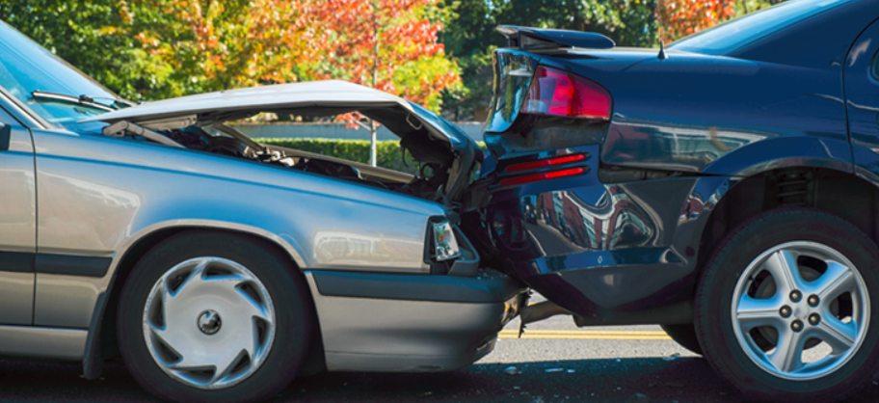
Overview
Safety
&
Mobility
Justifications
Common Applications
Easy Application Specification
Notes:
Why do you want to do it? Safety and Mobility (corkscrew)
Make Intelligent Work Zones easy to use and Specify. When Appropriate
What Questions do you have when looking at SWZ’s? and How do you make them easy to use.
Common Applications – What types of systems are there?
Justification – When is it appropriate?
What is the cost benefit?
Hard Costs
Preventing Crashes / Property Damage
Soft Cost – that are harder to put a number too
Saving Lives
Saving motorists time
Easy Application Spec’s – How to put in the tender
Standard Templates – How to execute (more tools in the toolbox)

Slide 4
Justifications – when to use a swz
Notes:
Justifications –
How do you know if you should put one into project tender or add one to an existing project?

Slide 5
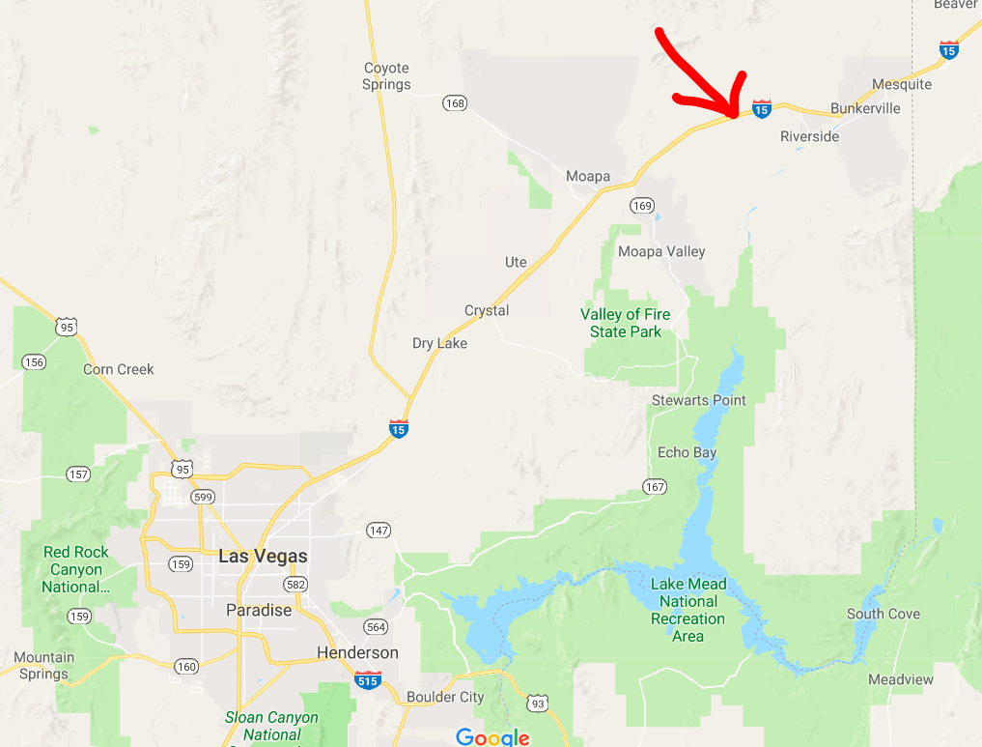
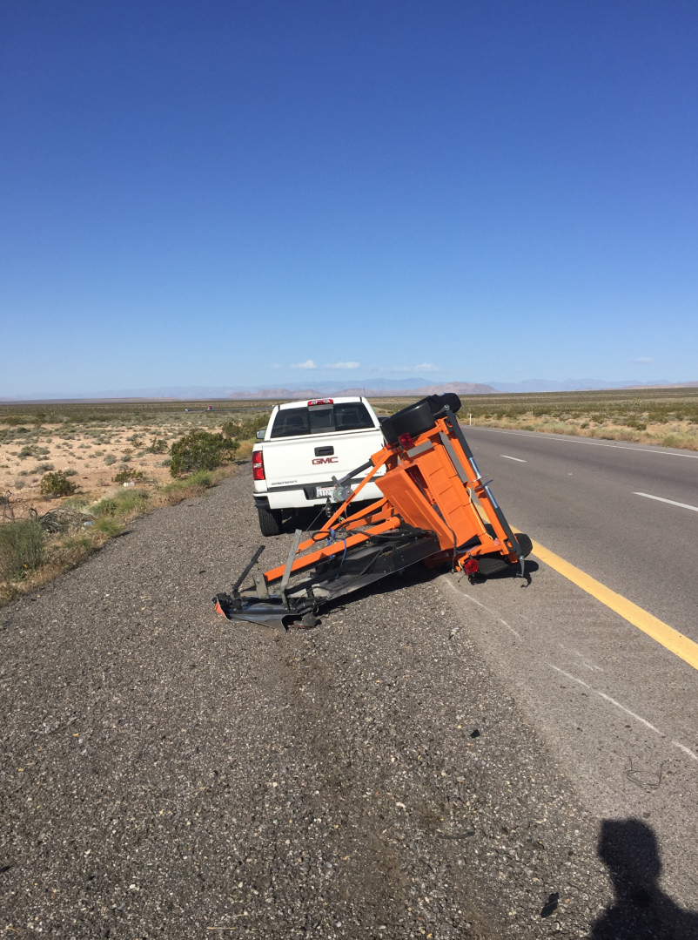
Where was the high wind warning!?
Notes:
I know I could have used an Automated High Wind system this time last year about 70 miles north of Las Vegas!!!
Wind had gusts of up to 70 MPH that day.
(Virginia)

Slide 6
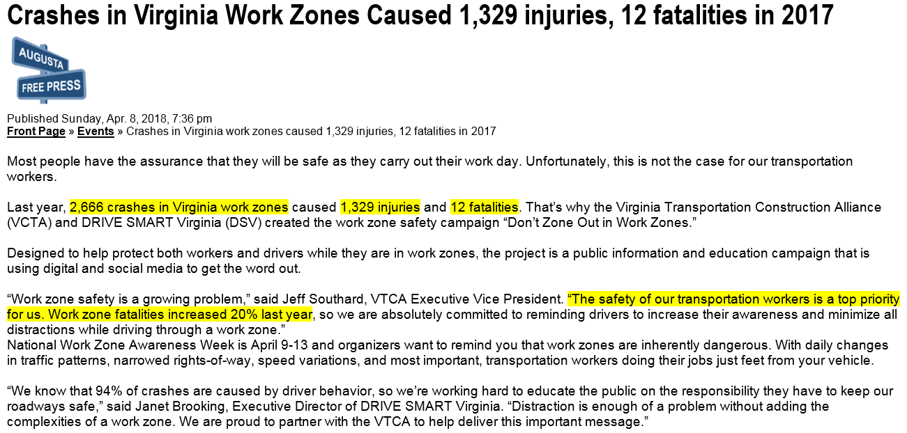
Justification #1 – improve safety with technology
Notes:
Virginia Letter
Here is a very recent article about the state of Virginia published on April 8th of 2018
Its written that last year alone there where 2666 crashes in work zones resulting in 1329 injuries and 12 fatalities.
This was a 20% increase from 2016.
Needless to say – Virginia would absolutely benefit from have technology in work zones.

Slide 7
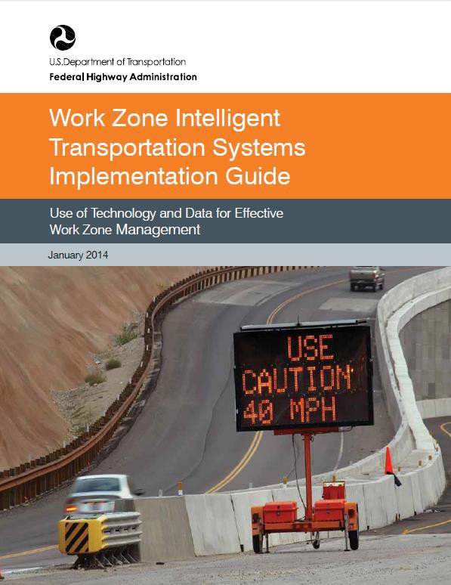
Easy to apply warrants (FHWA)
WHEN?
WHERE?
WHY?
Notes:
But you shouldn’t wait until something bad happens to make a change. To be proactive you can use this.
January of 2014 the Federal Highways Administration (FHWA) released a document called the:
“Work Zone Intelligent Transportation Systems Implementation Guide”
The goal was to help local state road agencies understand when it is appropriate and how to apply the use of Work Zone ITS or SWZ’s.
****Maybe if Virginia started this last year they could have prevented the 22% increase in work zone related incidents.

Slide 8
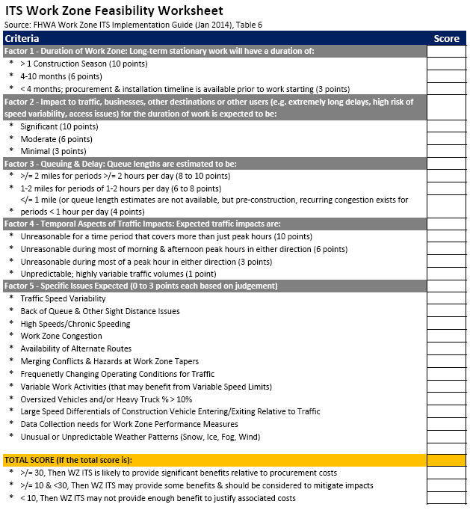
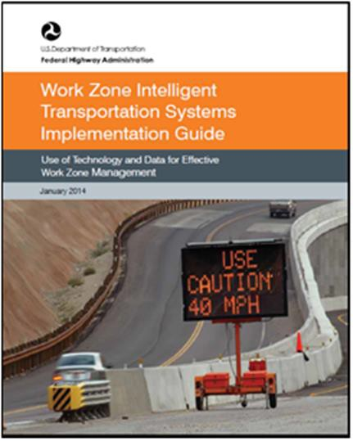
SWZ – system warrants/criteria
Change Orders allow for quick and easy Queue Warning systems to be installed. Some DOT’s are tendering service contracts and renting by the day or week when needed.
Notes:
Within the guide, is the “ITS Work Zone Feasibility Worksheet”
This sheets intention was to help determine if a SWZ is recommended.
This sheet works on a 5 factor points system:
Factor 1 – Duration
– How long is the project
Factor 2 – Impact to Traffic, Businesses, and other destinations during the work
Extreme Delays
Speed variability
Access Issues
Factor 3 – Queuing & Delay
How long are the estimated or existing queue’s? Time and Distance
Factor 4 – Temporal Aspects of traffic impacts
When will the work have the greatest impact? All hours of the day or just peak traffic hours?
Factor 5 – Project Specific Issues ***Highlight 3-4 specifics****
There are a variety these from visibility to the amount of truck traffic.
Based on your total there will be 1 of 3 results
30+ It is recommended
10+ Should consider
< 10 - Not enough benefit to justify costs
****Now to put this into perspective. In Factor 1, if the duration is longer than 10 months it will earn 10 points for that single question. And that’s only the first factor!

Slide 9
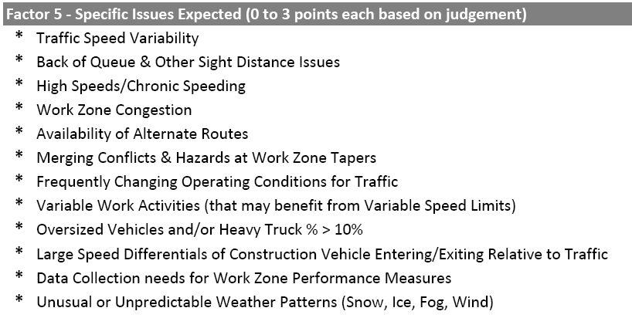
Project Specific Issues

Slide 10
SWZ – common applications easy scalability & flexibility
Notes:
Common Applications

Slide 11
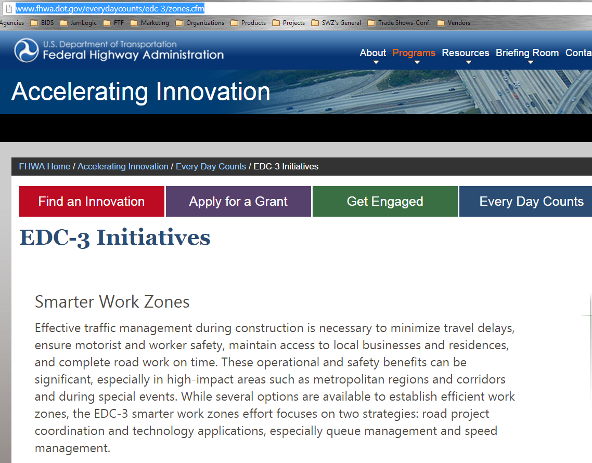
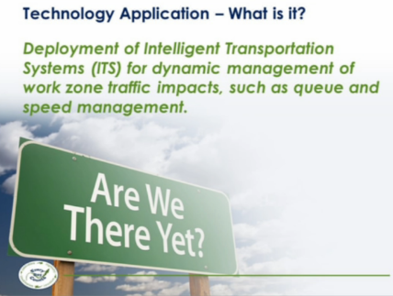

SWZ encouraged by fhwa
EDC-3 SWZ Focus Areas:
Road Project Coordination
Technology Applications
SWZ Areas of Focus:
Queue Management Systems
Speed Management Systems
Dynamic Lane Merge Systems
Notes:
Federal Government stepped in second time and created the Every Day Counts (EDC) educational complain for the traffic industry – Main Focus was Safety and Mobility
The name says it all… What we do in the traffic control industry, from protecting the customers (Traveling Public) to our own, working on the side of the road, EVERY DAY COUNTS.
Every year they have a different focus and in 2014 for EDC3 it was SWZ’s with a focus on:
Queue Warning Systems
Speed Management
Dynamic Lane Merges

Slide 12
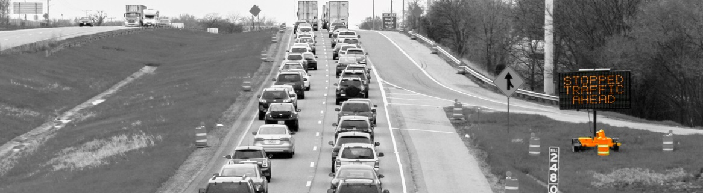
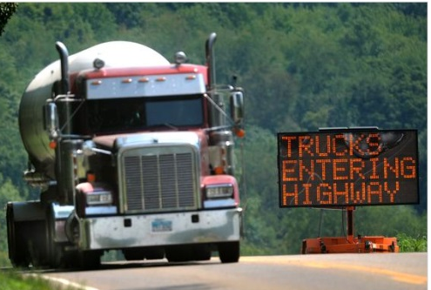
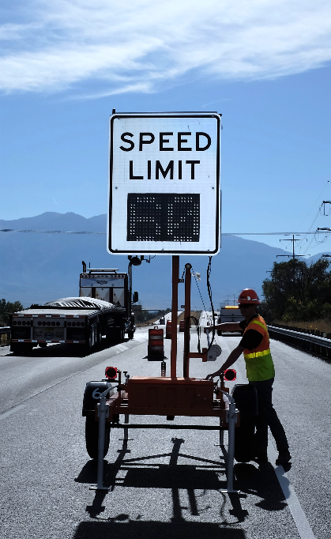
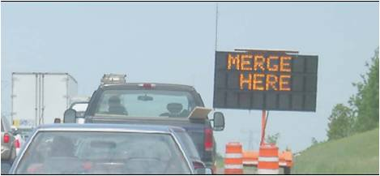
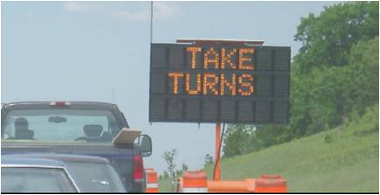
Common applications
Queue Warnings
Truck Entry Systems
Zipper
(Late) Merge
Portable Variable
Speed Limits
Notes:
Common applications
The four most common are:
Queue Warnings
Zipper (late) Merge
Portable Variable Speed Limits
Truck Entry Systems
Some others are:
Travel Time (Noticeably Absent)
RWIS Road Weather Information Systems – Rain, Wind, Ice, Visibility

Slide 13
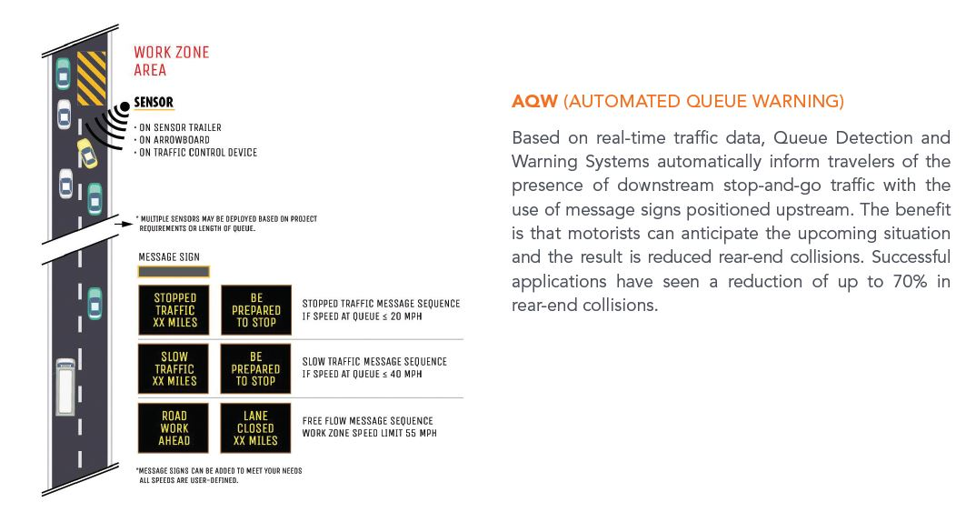
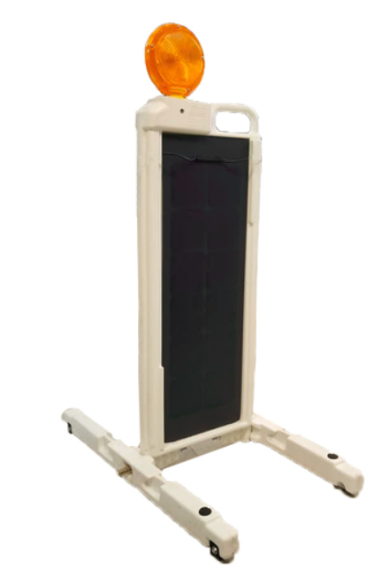
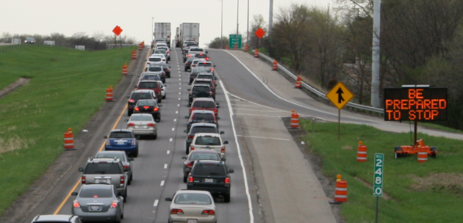
QUEUE WARNING SYSTEMS
Notes:
Queue Warning System’s are designed to be portable and easy to deploy and you can see an example of one in the center of this slide.
They automatically inform traffic of slowed or stopped traffic conditions downstream in real time.
This allows the travelling public the ability to plan for and slow down before approaching the upcoming traffic condition.
Traffic smoothing ( gradual slowdown / abrupt stops)

Slide 14
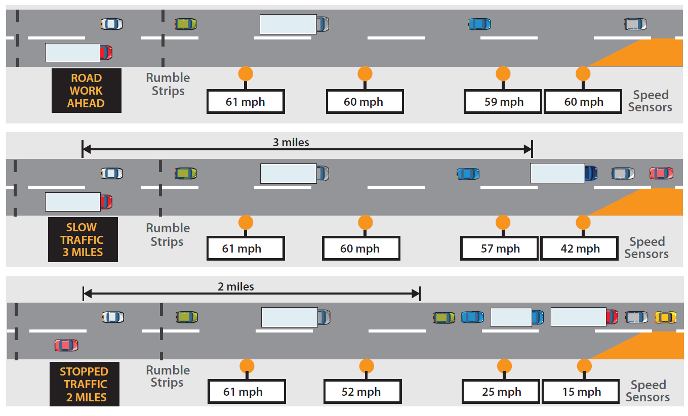
Automated Queue warning - operation
Source: ARTBA Work Zone Safety Consortium (Sept 2015)
Notes:
Typical deployment and functionality
First section – Normal Traffic Speeds
Second – Traffic slowing down below 45 MPH (72 KPH) on the first sensor near the taper triggering the Slow Traffic message
Third – Speeds have dropped below 25 MPH (40 KPH) at both sensors 1 and 2 triggering a Stopped Traffic message
When you are looking at this slide remember the sensor example I show two slides ago. One person in a truck can easily set up this system in 15-20 mins.

Slide 15
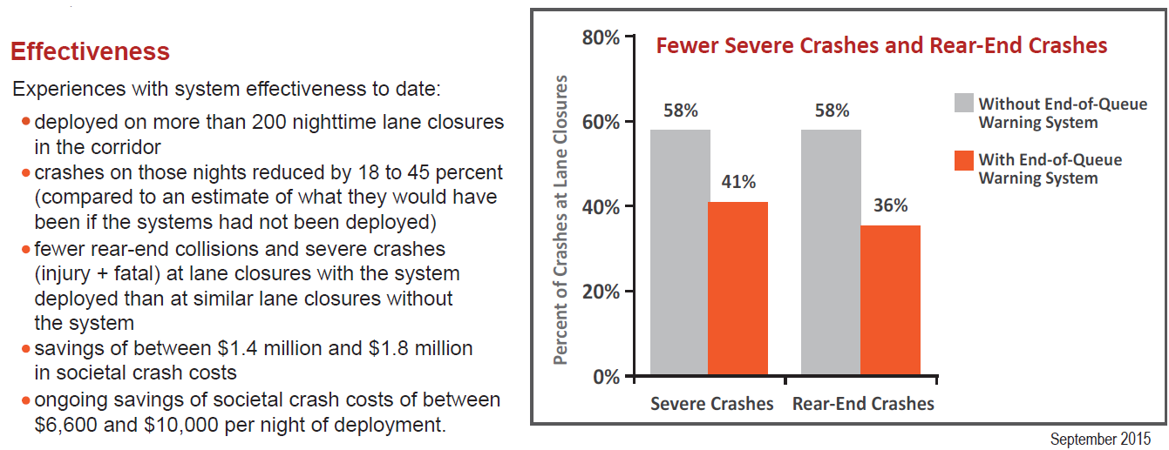

Queue warning Effectiveness
Source: ARTBA Work Zone Safety Consortium (Sept 2015)
Notes:
The AQW (Queue Warning System) system was tested and proven on the i35 widening project through central Texas.
Frequent Temporary nighttime closures were creating queues upstream from the taper point and ultimately causing rear-end collisions.
During this project, across approximately 200 deployment nights, total rear end crashes where reduced 18 to 45% when an AQW system was deployed.
This reduced crash costs between $6,600-$10,000 per night.

Slide 16
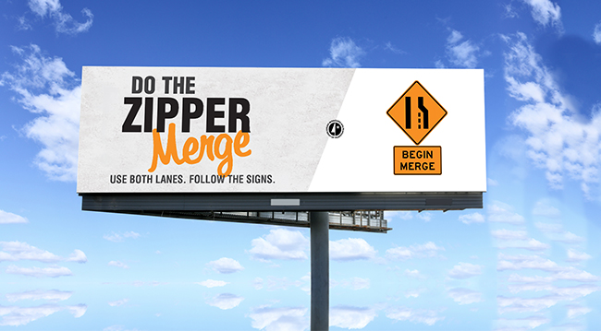
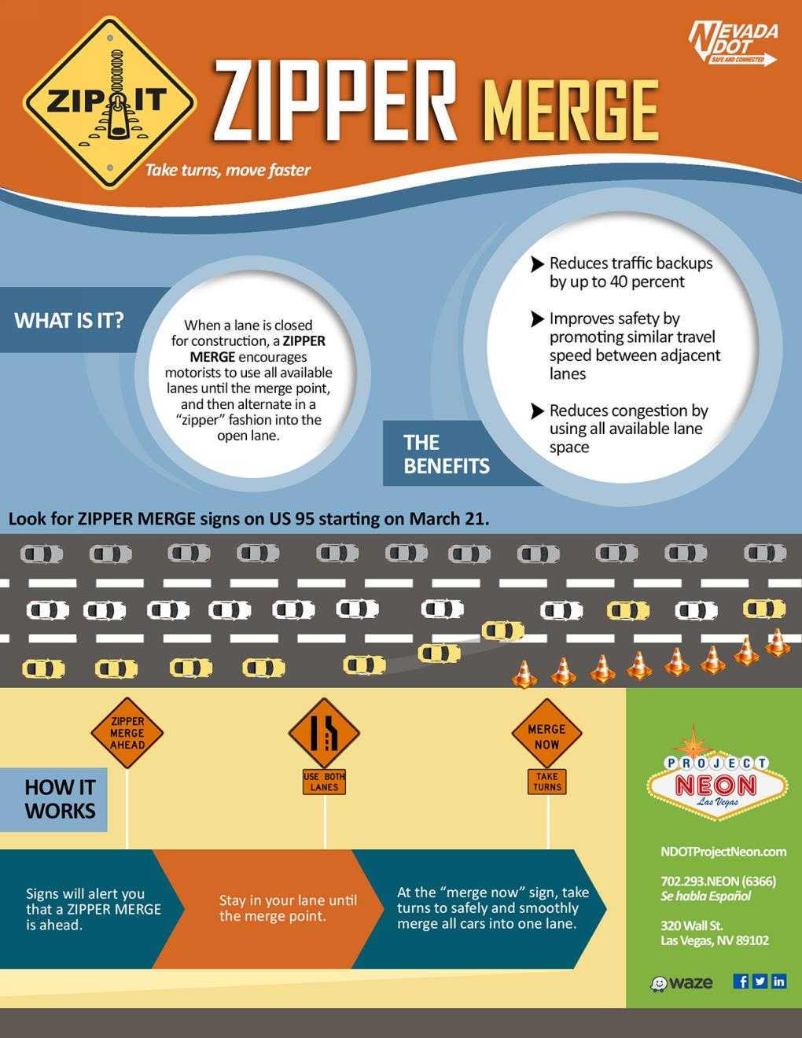
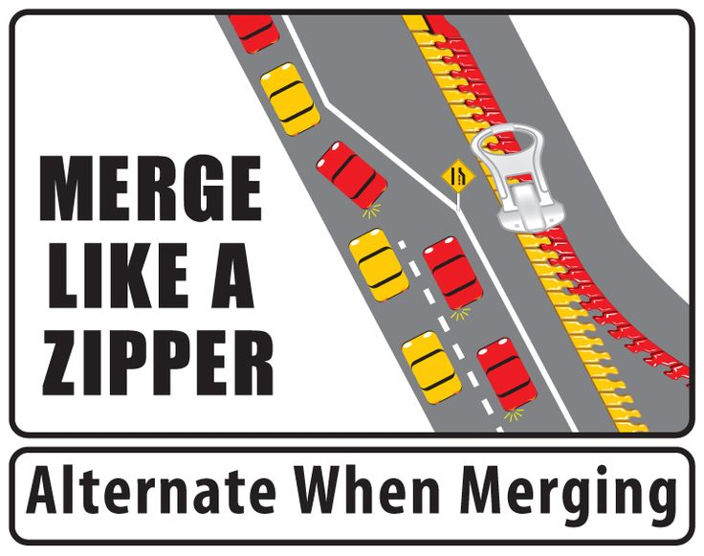
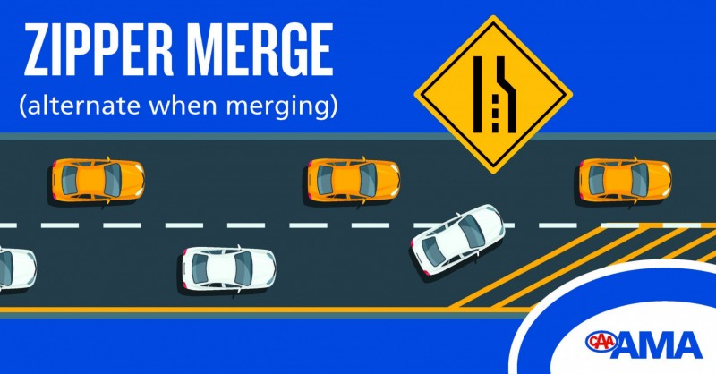
Dynamic merge – zipper merge
Notes:
The second example is Dynamic Merge or as you can see, more commonly known as Zipper Merge.
It is really an educational campaign to the traveling public to make like a zipper at a taper point.
This is great however there is a time use it and a time not to.
(early vs late)

Slide 17


DYNAMIC MERGE (Zipper merge) SYSTEMS
Early Lane Merge
Late Lane Merge
(a.k.a. the Zipper merge)
Advises drivers to move out of closed lane well before the forced merge point
Works best when there is a low traffic volume combined with high average speeds
Benefits:
  Less aggressive and unsafe merging
  Advanced warning allows drivers adequate distance to merge
  Gives positive instructions on lane usage
Advises drivers to use both lanes up to the merge
Works better for high traffic volumes, where queueing upstream is expected to occur
Benefits:
  Maximize available storage upstream of work zone for reducing total queue length by up to 40%
  Reduces confusion between drivers who think they should merge early vs. drivers that use open lanes as far as possible
  Clarifies right-of-way at merge point (“alternate merge”)
  Actually allows 15% more traffic to pass through in a given time period
Source: https://www.workzonesafety.org/fhwa_wz_grant/atssa/atssa_dynamic_lane_merging
Notes:
****However there is a time use it and a time not to.
Early Merge is most natural and works great when there is little traffic.
It has its own benefits:
Advanced warning/signage allows drivers to adequate distance to merge
Resulting in a less aggressive or unsafe merge
Late Merge is for the opposite scenario. When there are high traffic volumes and queueing.
Without using both lanes queues can build beyond the advanced signage
Unsafe speed differential
Speeding vehicles open lane/approaching queue
By maximizing both lanes it has proven to reduce the total queue length by up to 40%
Allowing approaching vehicles to see advanced signage
And studies have shown that by using both lanes it allows 15% more traffic to pass in a given time period.
Having the dynamic automated system on a project will allow for instruction to the motorist, in both situations when suited.

Slide 18
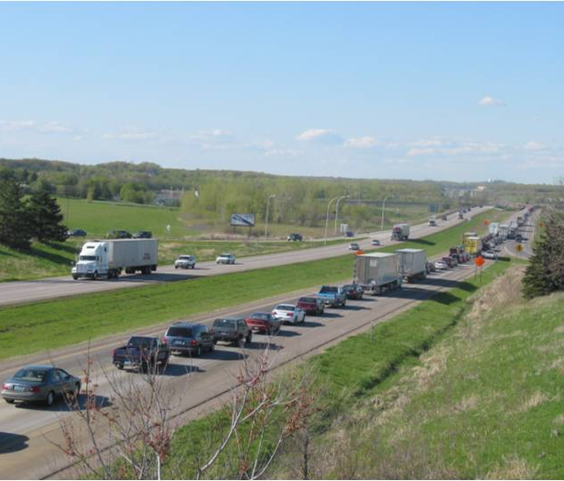
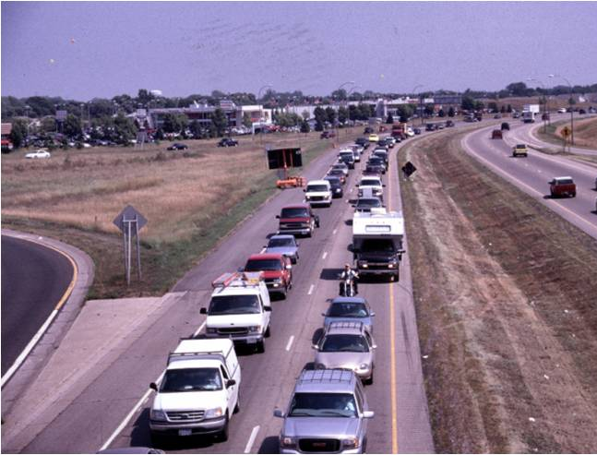
DYNAMIC MERGE (Zipper merge) SYSTEMS
Before zipper Merge
2-3 mile single lane queues
after zipper Merge
Often <1 mile queues
Notes:
Here are a couple examples of each.
On the left it shows drivers only using one lane and a massive queue.
It is hard to see but there is a Semi Truck blocking the open lane. A recipe for road rage.
On the right you will see a message board that is part of a Zipper Merge system telling the drivers to use both lanes.

Slide 19
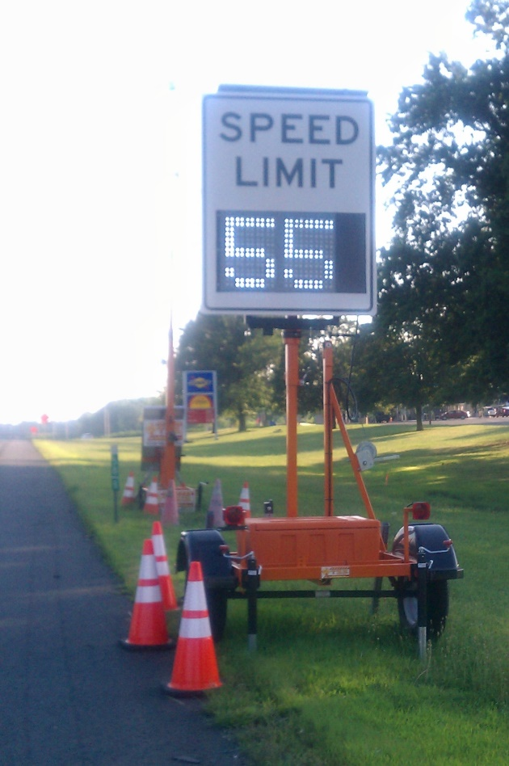
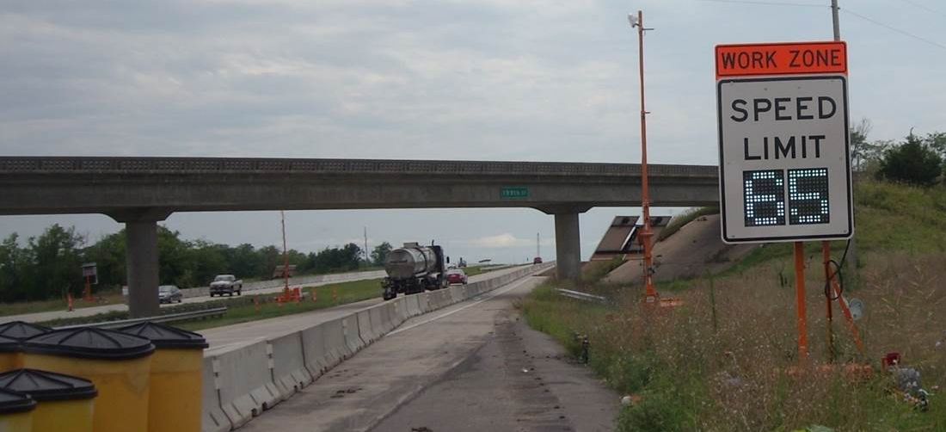
Portable variable speed limits
Goals:
Speed Harmonization (<15 mph of median speed)
Respect Times/Locations Where Speeds Can Be Raised
Lower Speeds When & Where Workers are Present
Ensure WZ Speed Limits are Correct without Driving Job
Electronic Record of Speeds w/Time/Date Stamps & Location
Easily Relocate Signs to Follow Work Progress
Modes:
Manual/Scheduled by T.O.D.
Semi or Fully Automated (based on speeds downstream)
Notes:
Portable Variable Speed Limits
I don’t know how this works in NZ but in the US we are notorious for setting a un reasonably low speed limit at the beginning of a project and only increasing it again at the end.
Both the traveling public and road agencies agree that no one was in compliance.
The contractors will use the method of turning or covering up static signs which is hard to manage.
The push for this system was actually from the contractors.
Project was on 80 MPH (128 kph) highway
Motorist would be driving through a 20 mile project with speeds set at 55MPH
Very low compliance
They felt unsafe
Requested road authority to help reduce speeds
This type of smart work zone was designed to have a higher level of control and focus when reducing speed limits in work zones.
Make sure it was only where workers were present
Control the time of day when reductions happened
Portable Variable Speed Limits allow:
Ease of controlling speeds remotely Manual or Scheduled
Manual from a PC or Laptop
No longer having to physically do it
Scheduled meaning
Set time frames
Automatically change
Semi or Fully automated
These types of trailer can easily be equipped with a radar and used as a sensor.
When the queue is detected it will trigger the VLS trailer upstream to reduce the SL
Slowing down the approaching traffic
Benefits to all of these types:
Ensure WZ Speed Limits are correct without driving the job
Keep electronic record of speed limits w/Time/Date/Location (enforceability)
Pull reports of motorist speeds within the work zone (1sec Intervals) Time/Date/Location

Slide 20
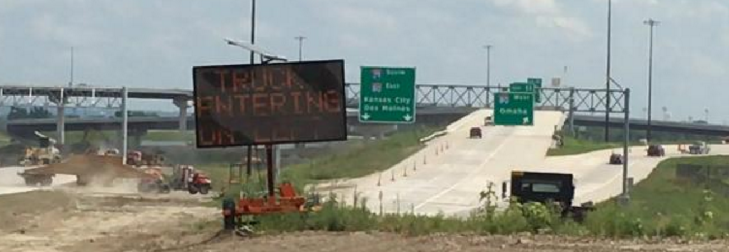
Truck entry warning systems
Warn motorists upstream of slow trucks entering traffic and providing PREPARE TO STOP or SLOW TRAFFIC warnings only when appropriate
Typically a single sensor & single warning sign (RF communications)
Optional Event Logging & Remote email/text Alerts available
TRUCKS EXITING – DO NOT FOLLOW systems are less common
Notes:
Truck Entry System – They just are as they sound
They warn to traveling public that a truck is entering traffic
Truck entering / Prepare to stop
Slow Traffic
System is stand alone RF system
Option Modem for event logging
Event logging can be important when an incident does occur
Protection in court

Slide 21
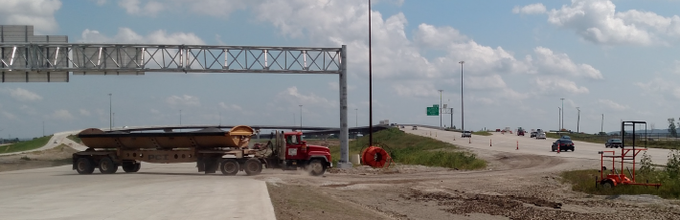
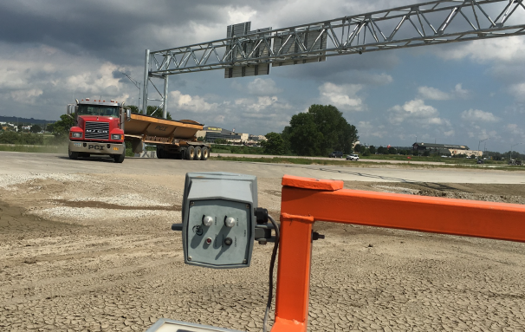
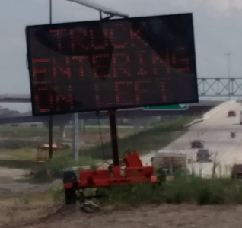
Truck entry warning systems
Typical Spacing
between the Sensor & Sign
= ~ 0.2-0.5 miles
Notes:
BTW = Between
Here is an example of a stand alone system.
2 pieces of equipment
One message sign
One sensor trailer

Slide 22
Other SWZ Systems
Over-height Vehicle Detection
Utilizing over-height detection sensors, the system automatically alerts drivers in advance of an alternate route or to stop if they have passed the route.
Benefit: preventing collisions to structures that cause significant damage and delays.
Hazardous Roadway / Weather Condition
Utilizing a variety of weather and roadway sensing devices, these systems dynamically caution motorists about dangerous or unexpected roadway conditions.
Benefit: the system provides the motorist with real-time potentially life-threatening conditions and instructions to safely travel.

Slide 23
SWZ system features / Specs

Slide 24
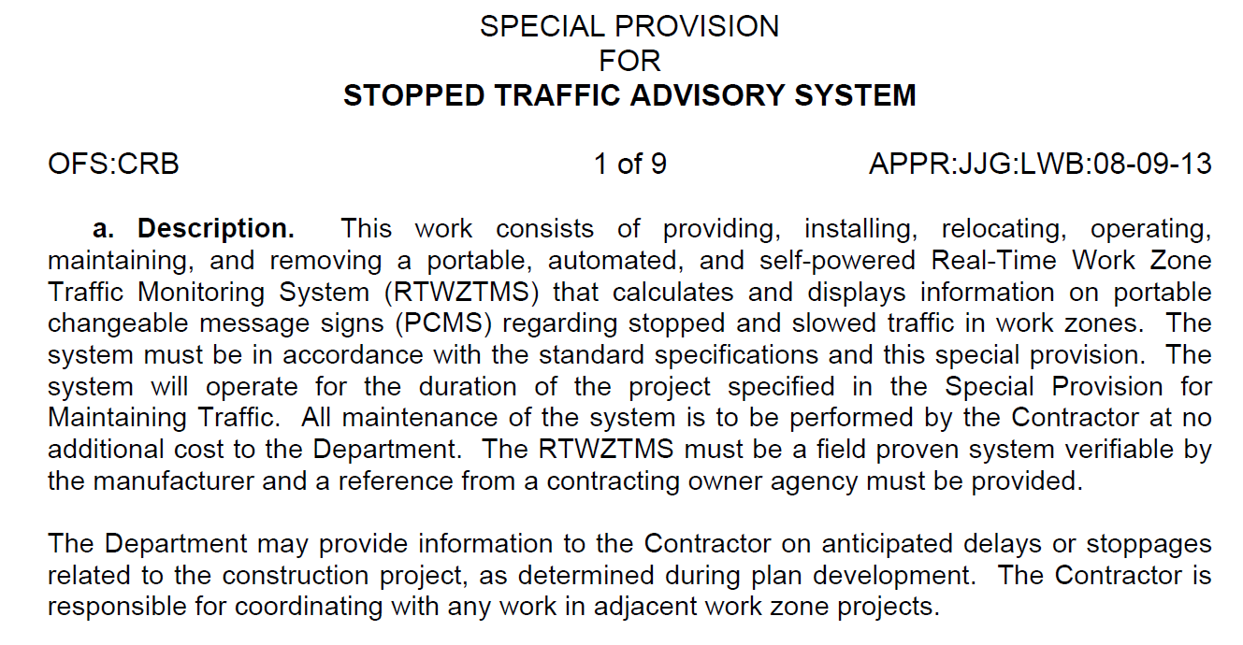
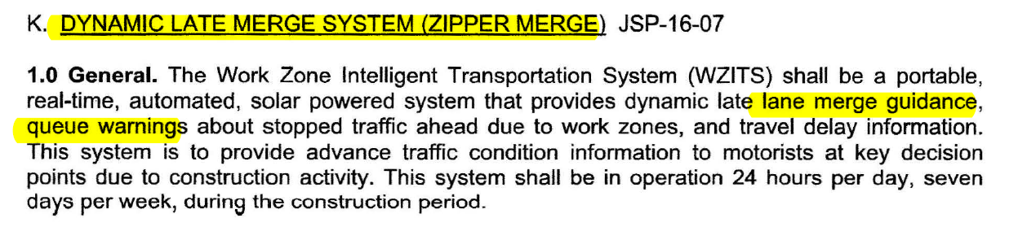
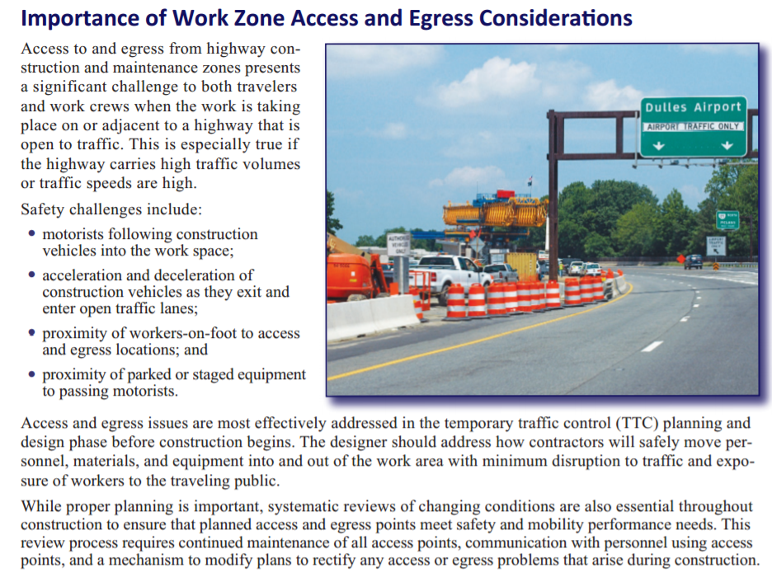
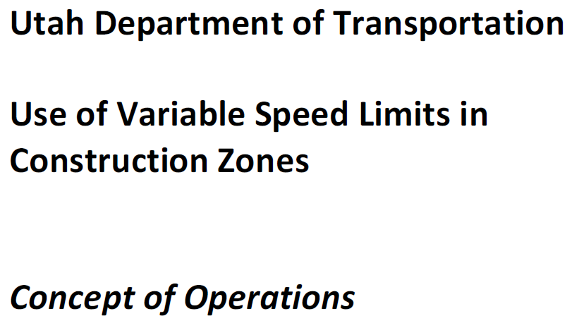
IWZ Specifications – share with others
Notes:
Where to start on spec’s -
Consultants & DOT’s can go to SWZ system providers for additional info and knowledge base
Easy (Off the Shelf) Applications Specs are Needed to Make Use of SWZ’s Easier when needed.

Slide 25
SWZ Specification considerations
SWZ SPECIFICATION CONSIDERATIONS:
Central SWZ System (cont.)
  System Data (Access, Graphing, Exporting) & Customization & Device Merging
  Interactive List & Map Views
    Common mapping program
    GPS Icons for all field devices
    Real-Time Device Status (NTCIP Sign Status & Logging)
  Deployment & Operational Testing
  On-site SWZ supervisor & Response Times/Penalties, Spare Equipment/Parts
  Training
  Measurement & Payment Terms
    Mobilization
    System (Monthly)
    Equipment (Unit-Months)
    Relocations/Recalibrations (Each)

Slide 26
SWZ Specification considerations
SWZ SPECIFICATION CONSIDERATIONS:
Performance-Based Specifications
Proven & Experienced Providers
System Submittals
System Components
  Signs (NTCIP), Sensors, Cameras, System (NTCIP), Communications
Malfunction Alerts & Remote Resets
Traffic Alerts (Condition Change Alerts, Speed Alerts, Travel/Delay Alerts)
Transparent Systems
Public Web Site (Optional)
Central SWZ System
  Security & Levels of Access
  System Logic
  System Logs (Messages, Data, Actions, etc.) 24/7 access
  1:Many Control & Simultaneous Control
  Mobile Access to All Current Status (Message, Video, Speeds) & Overrides

Slide 27

Questions?
Sandon Button
Sandon.Button@ver-mac.com

