Slide 1
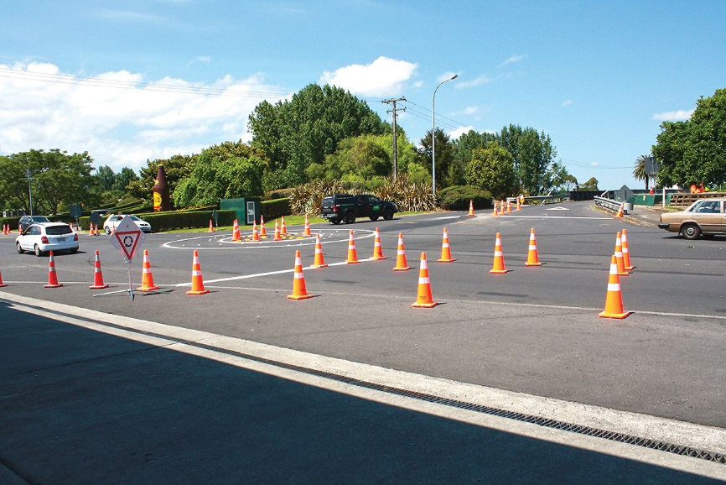
TTM Conference 2018
Temporary Roundabouts for Paeroa and Kopu over Summer
Presented by:
Ben Burrowes
MEngSt (Transportation), CPEng, _{CMEngNZ}

Slide 2
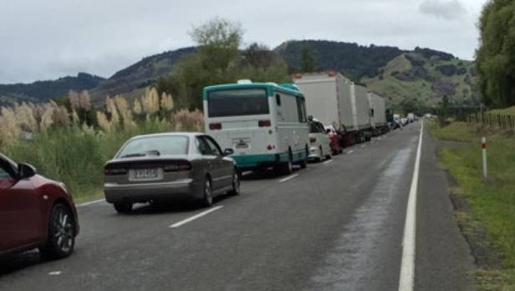
Temporary Roundabouts
The challenge
Queuing during holiday peak periods
Safety issues, particularly at Kopu
Notes:
Why did we recommend this?
NZTA or Higgins suggestion?
Known queuing problems in long weekends / holiday peaks

Slide 3
Temporary Roundabouts
Objectives
Improve congestion during holiday periods
Improve safety
Rapid installation
Utilise existing pavement

Slide 4
Implementation strategy
Ability to be removed quickly
Initial Trial period to run for 2 weeks
Safety and function to be assessed in operation
Potential for permanent installation if successful

Slide 5
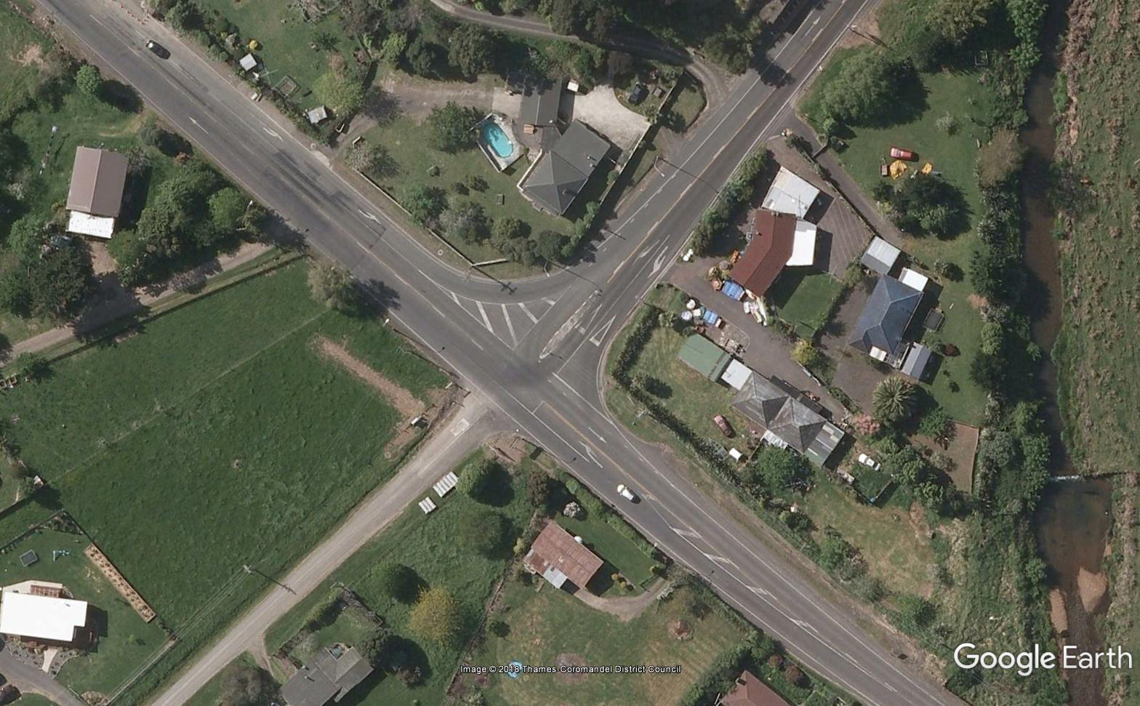
Kopu Site
Intersection of SH25A and SH26
Key route for holiday traffic from Auckland to Coromandel coast
High volumes of traffic during holiday periods
Queuing on the return to Auckland
High speed intersection (70 kph)
with give way control on SH25

Slide 6
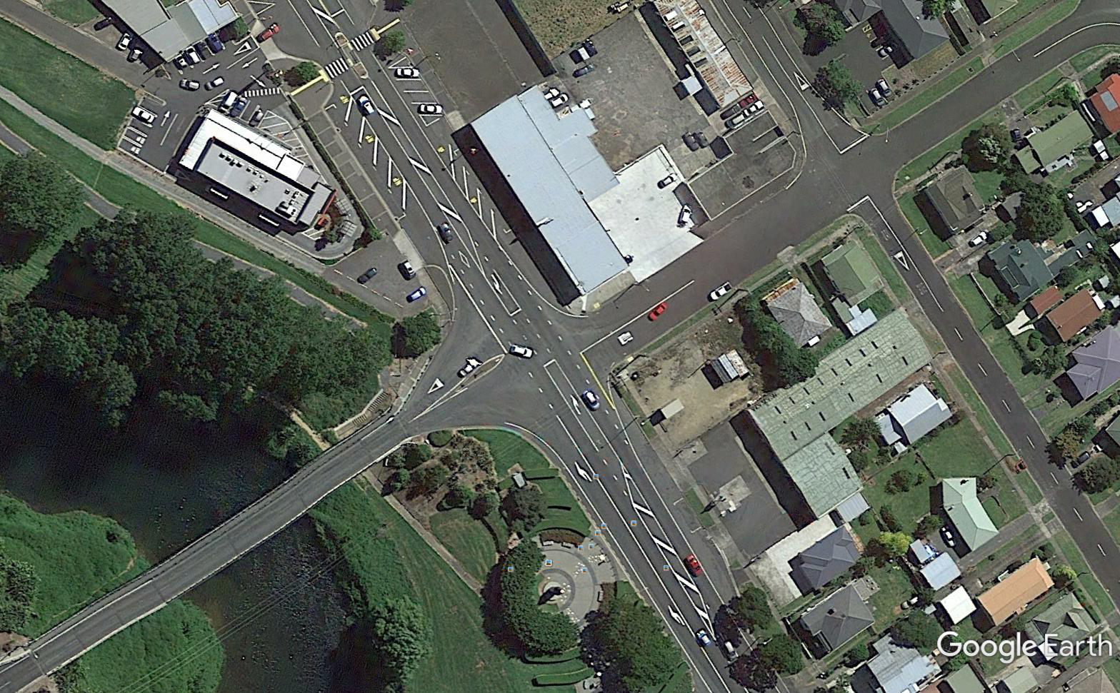
Paeroa Site
Intersection of SH2 and SH26
Key route for holiday traffic from Auckland to Tauranga
High volumes of traffic during holiday periods
Queuing to get into / out of SH26
Narrow bridge structure on SH26
Low speed intersection (50 kph)

Slide 7
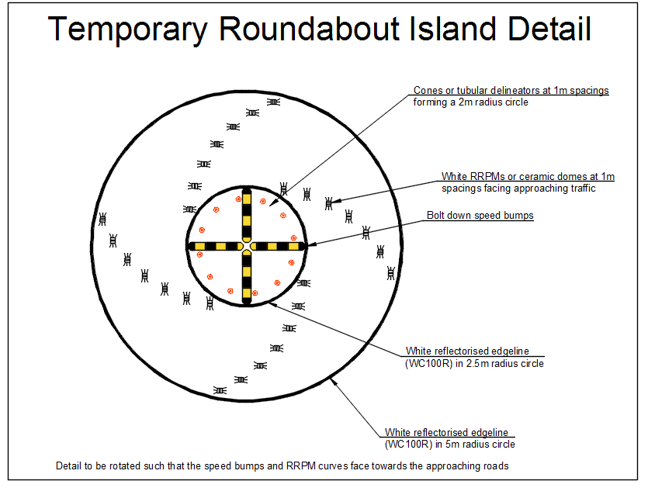
Temporary Roundabouts
Design
Intersection modelling
COPTTM signage
Vehicle tracking
Small inner island with encroachment area
Design review by NZTA & Beca

Slide 8
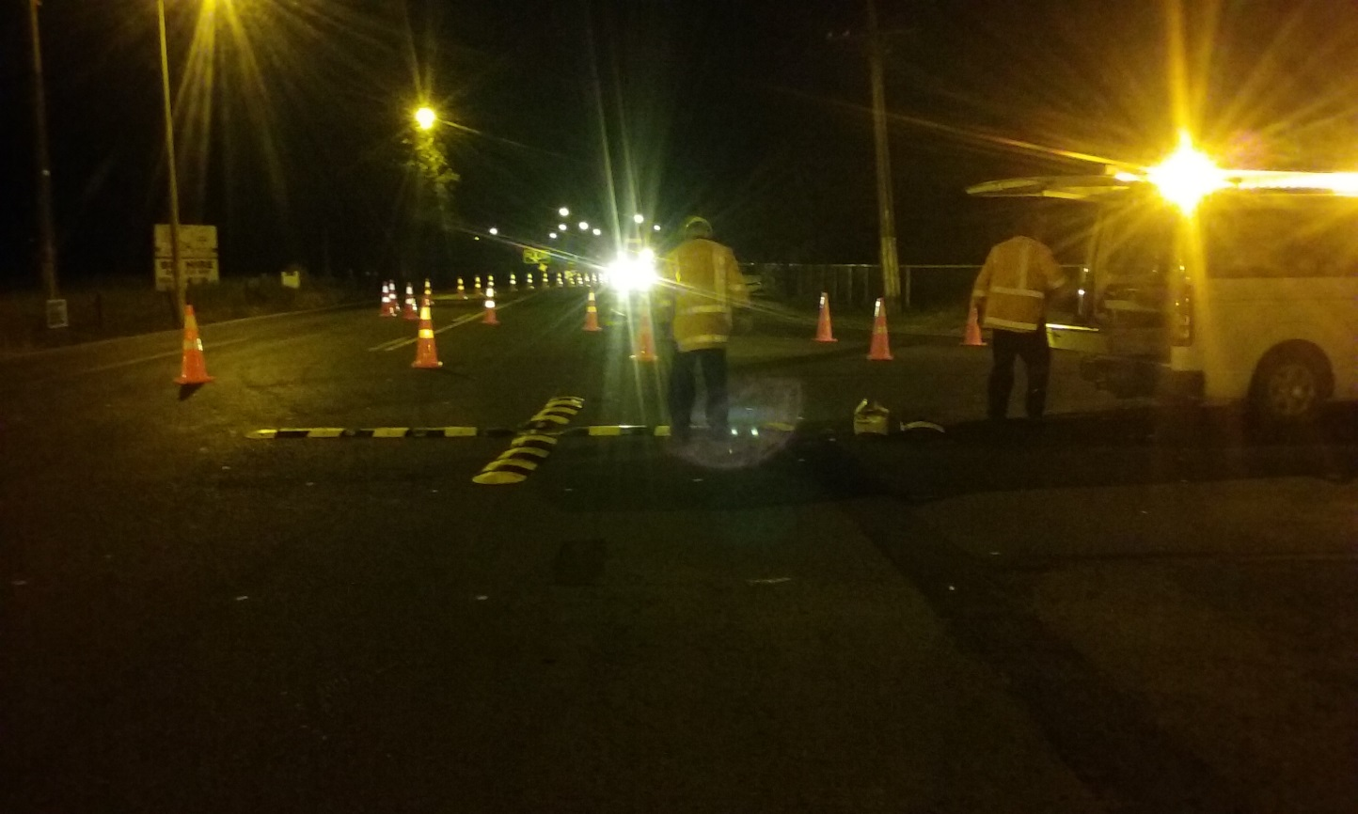
Temporary Roundabouts
Installation
Day works to modify traffic islands
Both temporary roundabouts installed overnight on Dec 5
Initially installed with road marking
tape and cones
Changed to paint markings and
safe-hits after an initial trial period

Slide 9
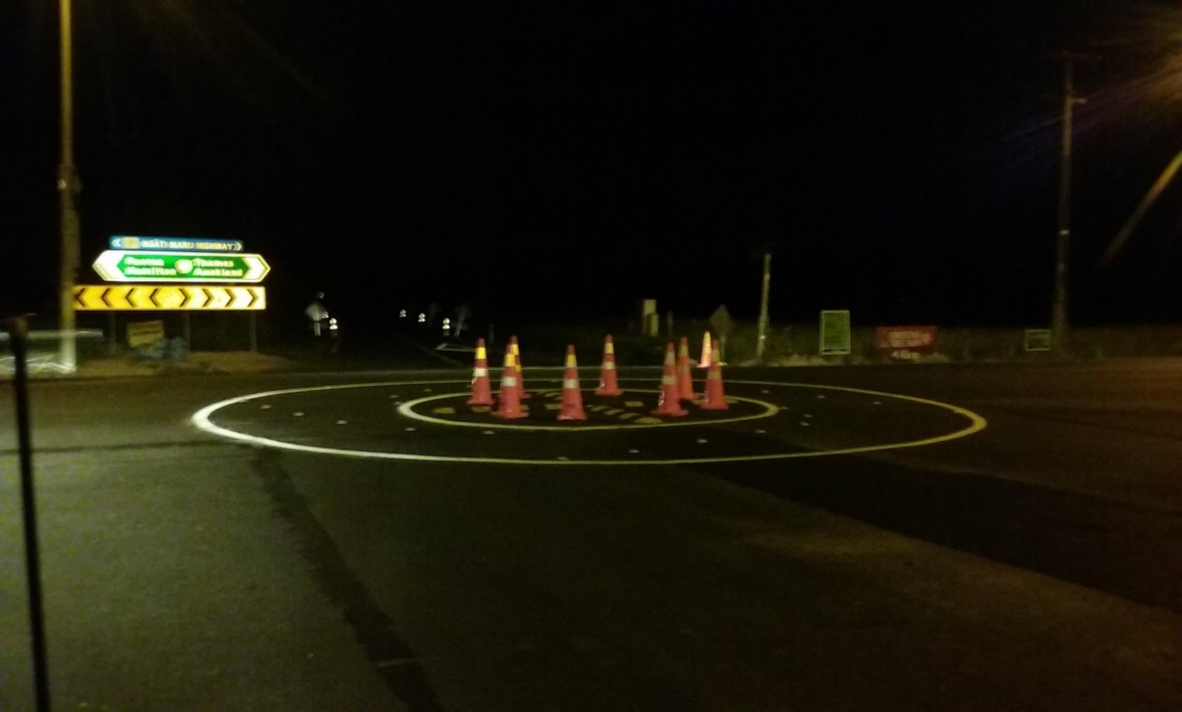
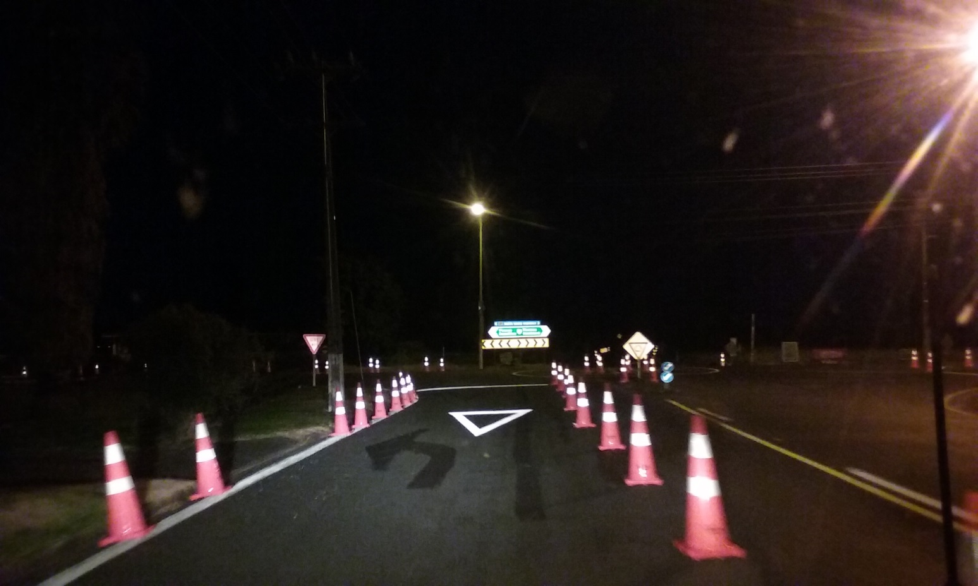
Temporary Roundabouts
Installation

Slide 10
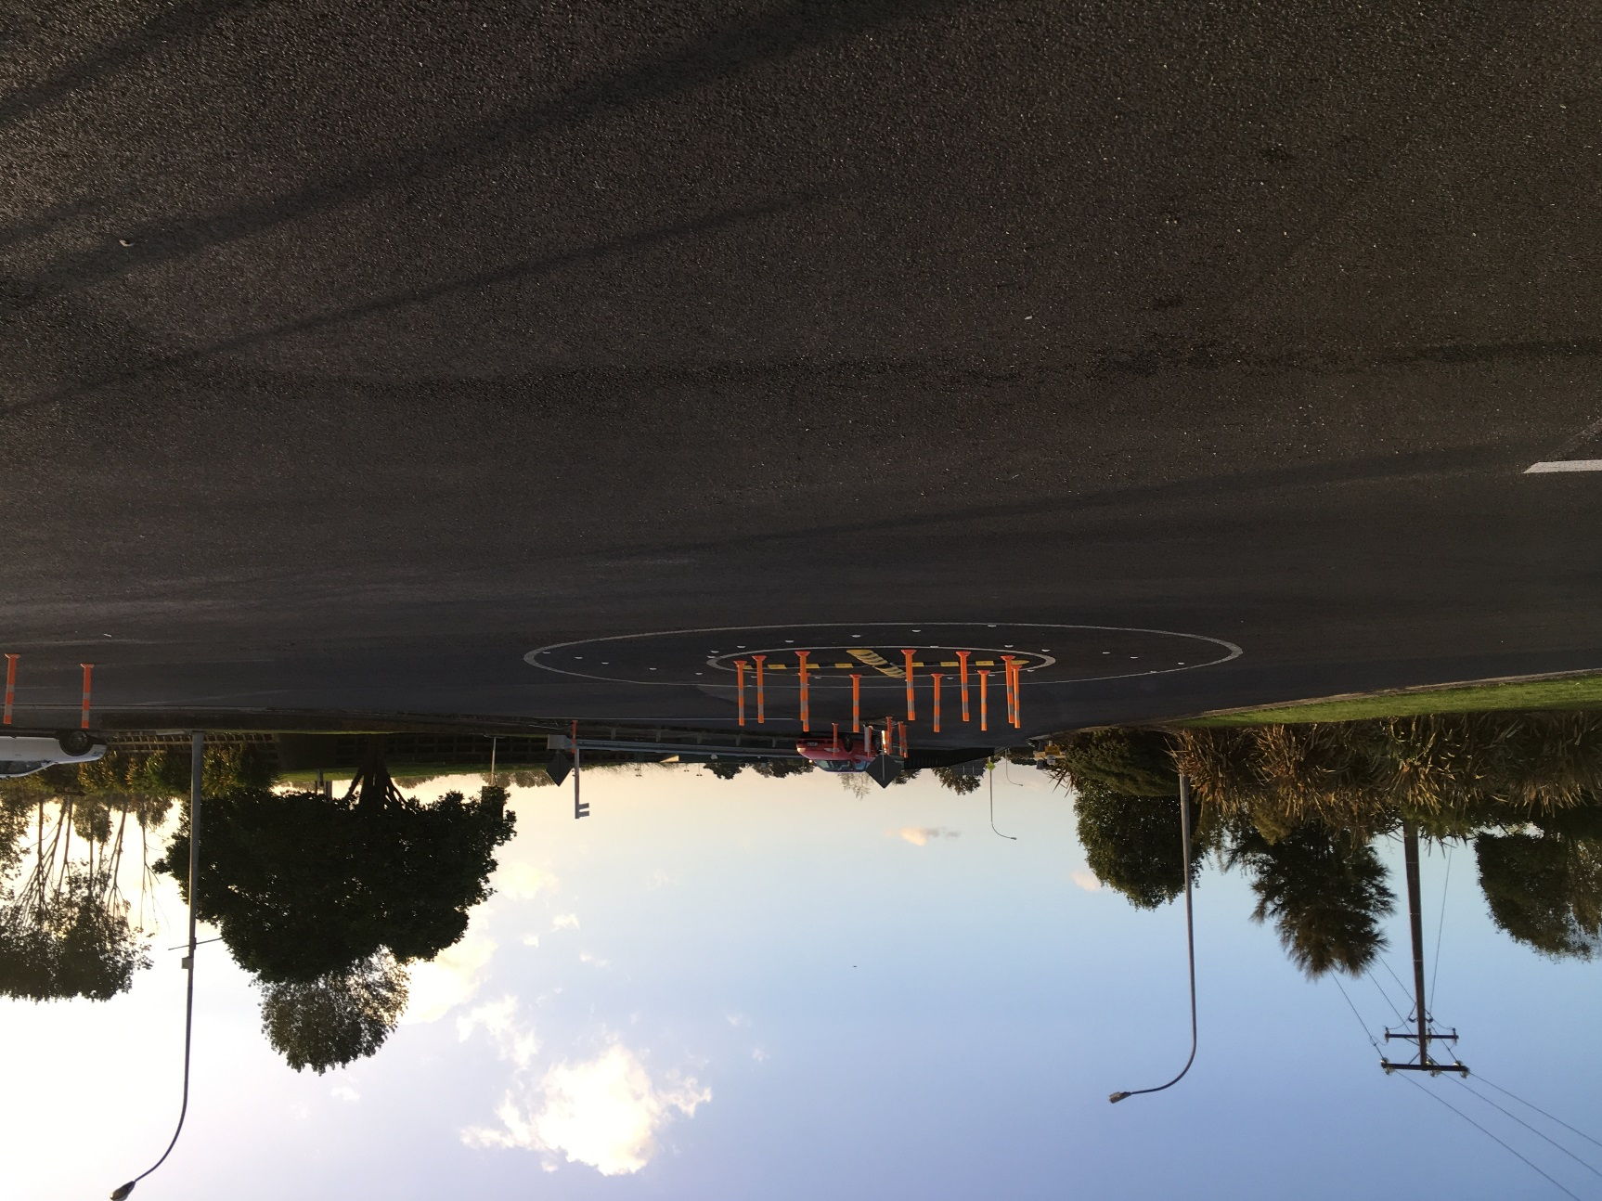
Trial Period
Sites were monitored for safety issues following installation
No significant issues identified
Cones were replaced with
fixed delineators

Slide 11
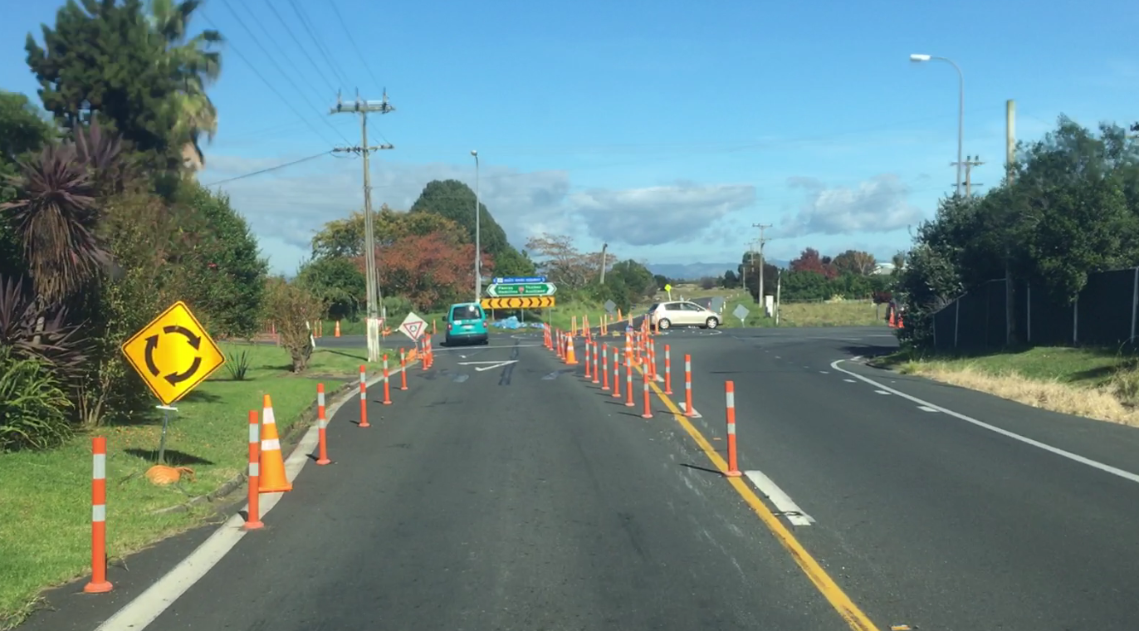
Christmas / New Year Holidays
Kopu
Trial was successful
No major queuing observed
No safety issues observed
Positive public feedback
Capital project coming to build permanent RAB
Notes:
Talk about benefits
Longest queue observed on SH25A was a group of vehicle stuck behind a campervan

Slide 12
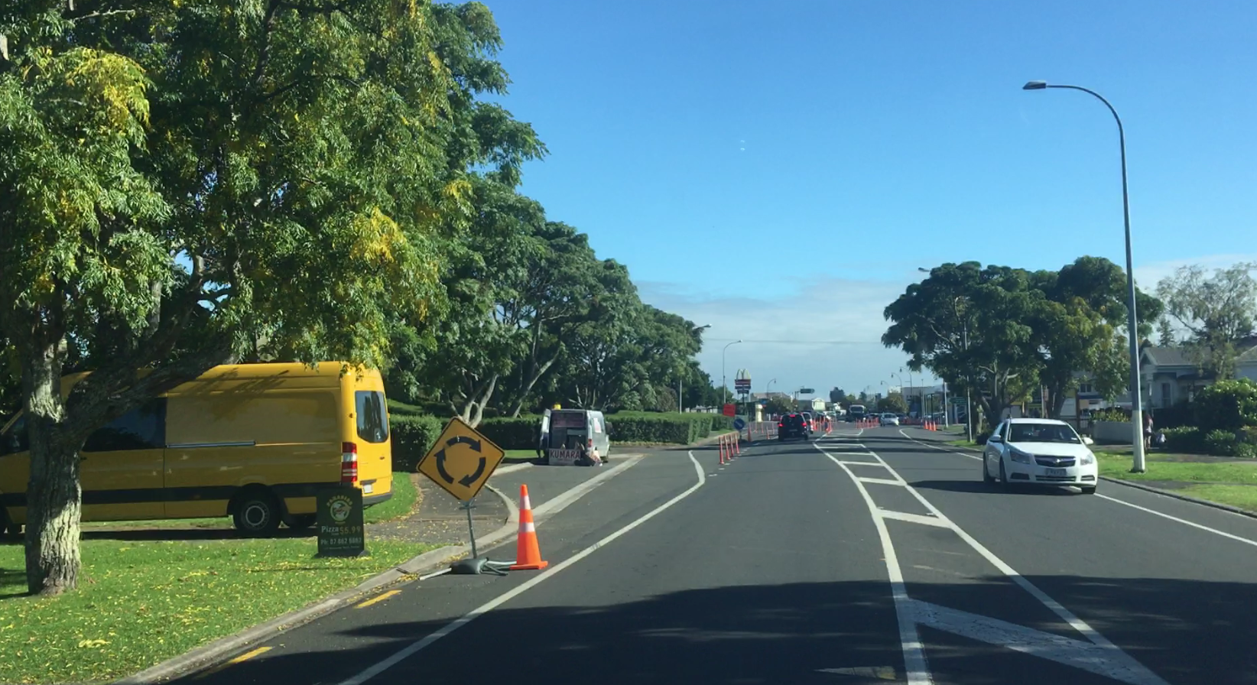
Christmas / New Year Holidays
Paeroa
Trial was successful
Some queuing observed – to be manually controlled over holiday periods
No safety issues observed
Positive public feedback
Further trials in progress
Notes:
Queuing observed when RT onto bridge structure blocked westbound traffic towards Auckland.
Gull station attendant and local police sergeant keen to see roundabout stay when they saw us at the meeting to modify the site

Slide 13
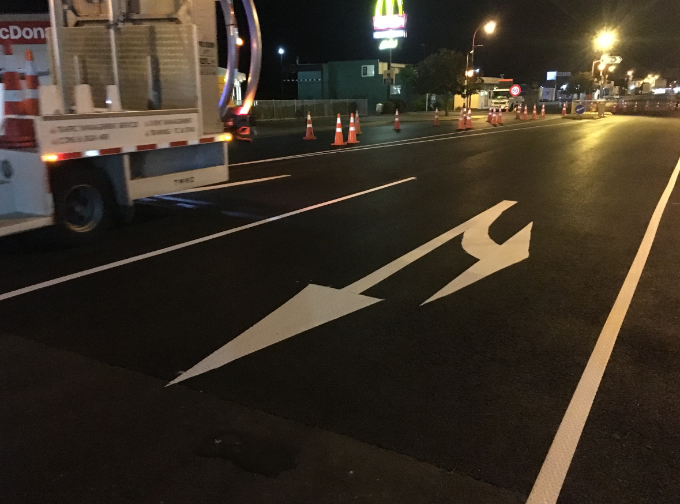
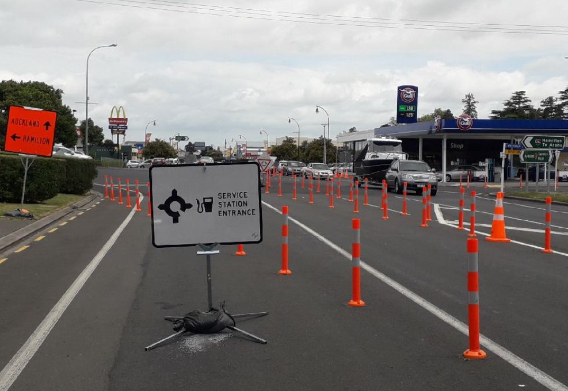
Paeroa Trials Continued
EB right turning lane added in April
WB left turning lane being considered
Notes:
Queuing observed when RT onto bridge structure blocked westbound traffic towards Auckland.
Gull station attendant and local police sergeant keen to see roundabout stay when they saw us at the meeting to modify the site

