Slide 1
Signalling Excellence through Innovative Solutions in TTM

Slide 2
Contents
NX2 Project
Northern Busway cabling Project
Atiamuri Bridge Replacement Project
Tauranga Eastern Link
Auckland Airport
Questions

Slide 3
NX2 Project
New motorway between Pūhoi to Warkworth
Narrow windy roads & safety of staff and road users is of highest importance
Reliability and Cost are also huge factors
Called for an innovative Traffic Management solution

Slide 4
NX2 Project
Solutions provided at various sites
Countdown Timers
Keeps the vehicle users informed of waiting times
Haul route crossings
Using Remote Control
Stops the traffic to allow the Moxy trucks to cross safely
Operators have been provided full training

Slide 5
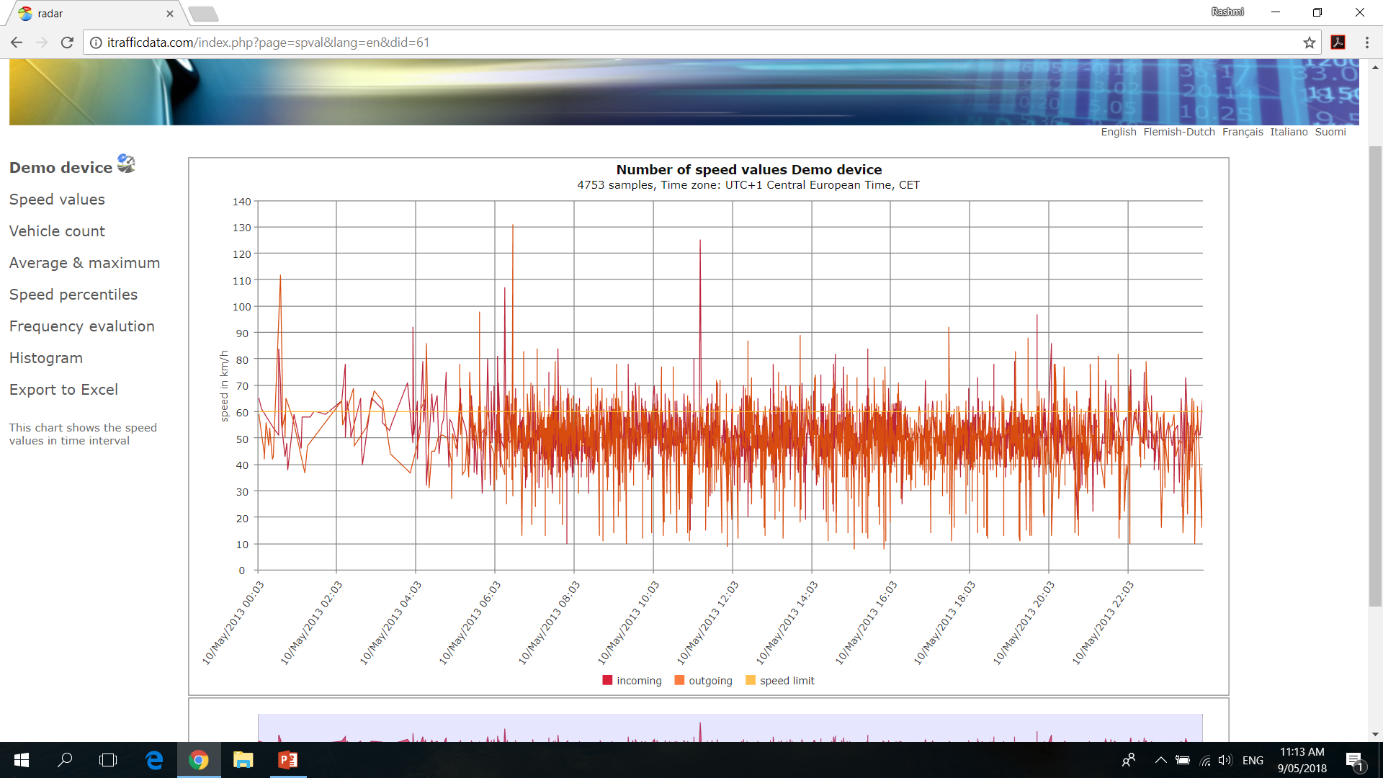
NX2
Trialling the Speed Signs
First response vehicles
Safety of the site is top priority
Data Logging capability available

Slide 6
Northern Busway Cabling Project
Tranzpower was laying underground cables on the Northern Busway
2 year project
NZTA, Auckland Transport and Auckland Motorways were all involved in this project
Buses couldn’t be delayed for more than 90 seconds
We were approached 2 weeks before the start of the project
Called for an innovative solution

Slide 7
Northern Busway

Slide 8
Atiamuri Bridge replacement
NZTA project
Haul route crossing
SH1
Trucks coming up to the Haul route from a ravine
below
Long term solution needed
Consultation with the client started 2 months
before the Project started

Slide 9
Atiamuri Bridge Replacement
One set of MPB4000 traffic lights
Built in timer module timed for the lights to go Red for the time it took the trucks to cross the haul route
4 x Moxys with each driver using a Remote Control with a range of upto 800m
Lights were connected via Cable & Orange Flashing lights were put on each light
Lights were connected to the Mains Power & in place for 2 years
Each time the button was pressed, the lights went red
For “x” seconds and if the button was pressed again
Within this time, it would extend for another “x” seconds.
At the completion of “x” seconds, the lights would go
Back to being Green

Slide 10
Tauranga Eastern Link
NZTA Project
Haul Route Crossing
Too many trucks crossing , so remote control wasn’t an option
Truck Drivers needed an indication of when it was safe to cross

Slide 11
Tauranga Eastern Link
MPB4000 lights
Installed the Radar Sensor 30m ahead of the lights
A dummy Green LED was placed in view of the trucks
When the Sensor detected the trucks, the lights on the Main Rd went Red
The dummy Green LED lit up and indicated to the trucks that it was safe to cross
Lights on the Main Rd remained Red until the trucks had crossed and then went back to Green

Slide 12
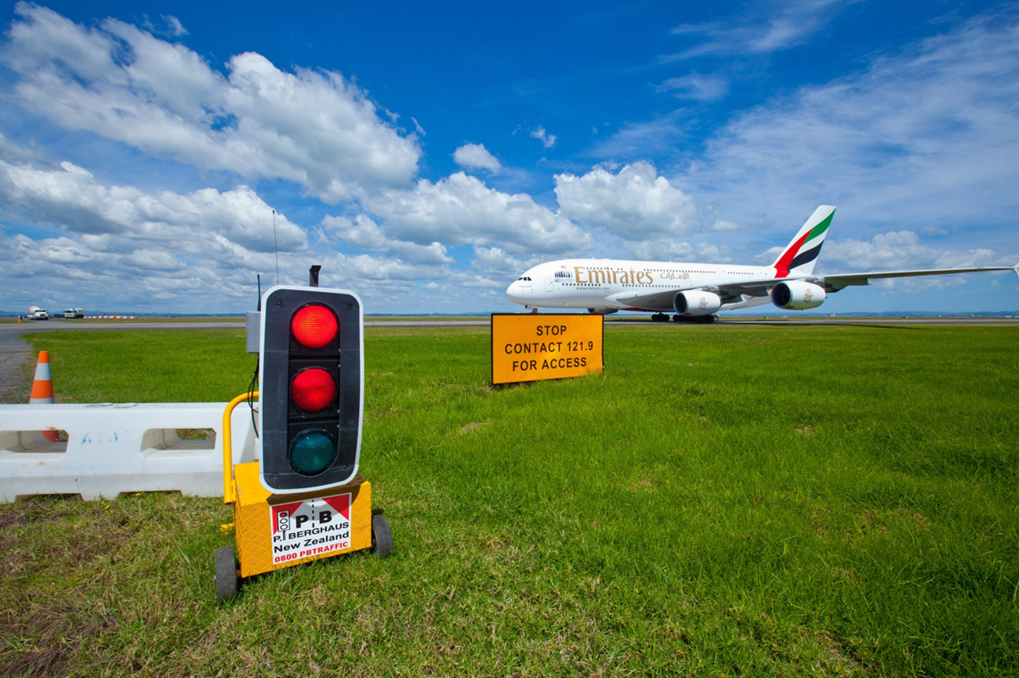
Auckland Airport
Runway slab replacement project
Trucks could only cross the tarmac when the lights were Green
Remote Control was with the Airport official in contact with the ATC and used it to turn the lights Red or Green
Special software was created for the lights to reduce the reaction time

Slide 13
Summary
Traffic lights can do much more than the standard Stop/Go traffic configurations
With the new H&S requirements and the staff shortage in NZ, traffic lights are becoming more of a preferred option
The key is to work closely with customers to understand their traffic management objectives for us to design and deliver innovative solutions

Slide 14
Questions

