Slide 1
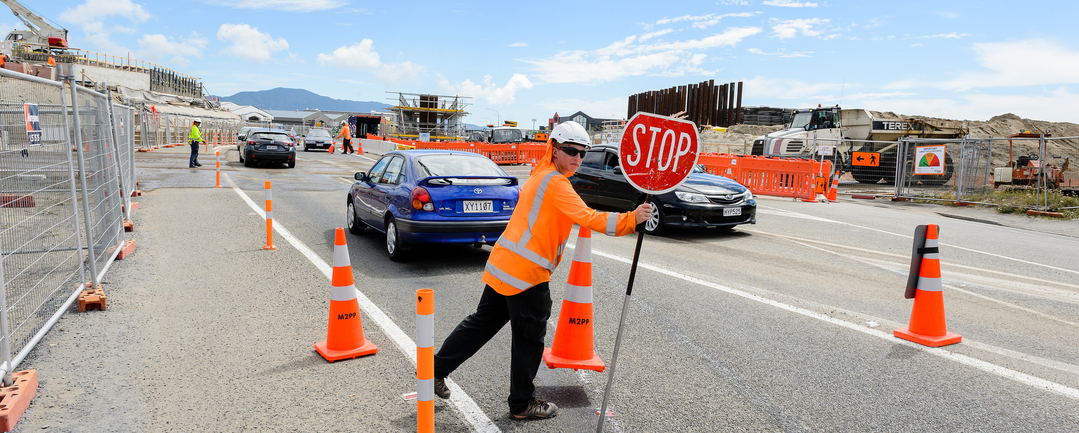
Mackays to Peka Peka (M2PP) Expressway
TTM Experience and Travel Time Technology

Slide 2
The M2PP Alliance
The Mackays to Peka Peka (M2PP) project was delivered under an Alliance. The Alliance is made up of the following organisations:
NZ Transport Agency
BECA
Fletcher Construction – Infrastructure (FCI)
Higgins
These organisations formed a single, integrated team that operate in a high performance culture to deliver exceptional value for money. They do this by break-through thinking, pro-active risk management, excellent communication, determined planning and the disciplined application of systems and procedures.

Slide 3
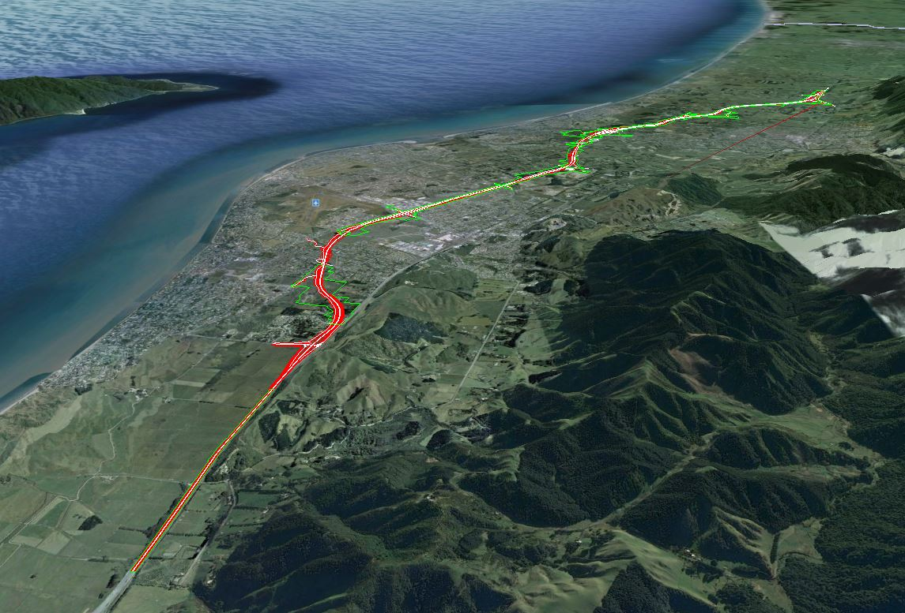

Slide 4
The Delay Requirements
In managing construction activities, the M2PP Alliance Project Team will comply with the following standards:
Local traffic on local routes will not be held up by construction activities by any longer than 2 minutes except in regard to bridge construction when the structure components are being put in place, when the maximum delay shall not exceed 5 minutes

Slide 5
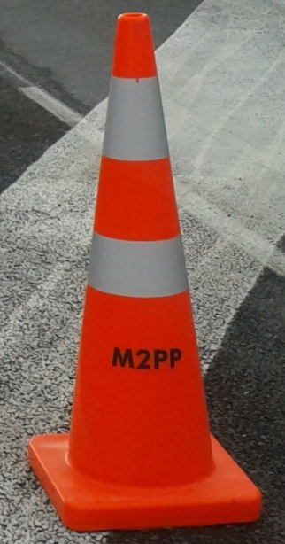
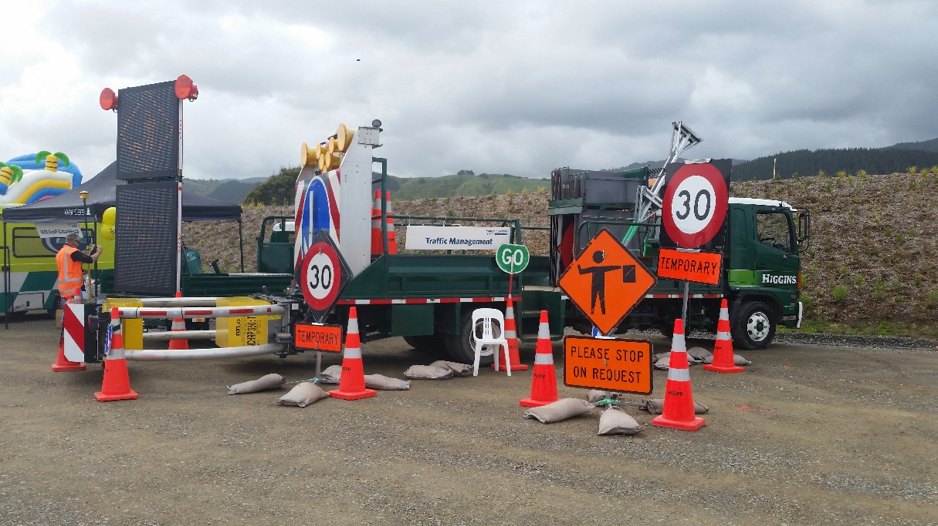
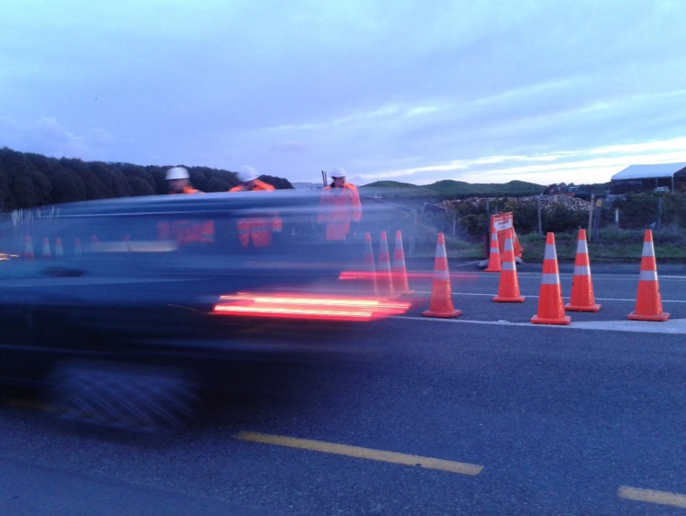
Temporary Traffic Management
CoPTTM describes best practice for safe and efficient management of roads – however we found this is not always achievable.
The challenge was that we could not close any roads other than for short periods – i.e. single shift periods generally at night.

Slide 6
Temporary Traffic Management
CoPTTM compliance not always achievable – many times we have faced these challenges:
Safety Zones – at times less than 1m due to consent need to keep roads open
Pedestrian Management – not “by the book”
TSL’s – need to keep higher than desired – NZTA Journey Management requirements
TSL duration – C4 limits to 6 months installation – we have had some installs over 2 years now – redo TMP approval every 6 months. Needed for long term project works. – This has now been updated to 12 months since the Project completed main works.
How we have mitigated risk:
Extensive use of Temporary Concrete Barriers – SH and Local roads – JJ hook – faster and easier to move than pin and loop
Pedestrian TC’s – manage peds through work sites – particularly Kapiti Rd
TSL’s – concrete barriers have helped plus cone spacing decreased to as low as 1.5m causing side friction.
- also a good local relationship with Police for enforcement.
Temporary line marking using 3m Adhesive tapes rather than paint – reflectivity higher – faster removal with no ghosting

Slide 7
Temporary Traffic Management
Community involvement
Rather taking an authorative “we will” approach, the TM approach was one of consultation prior to final TMP development with the likes of:
Local Council
NZTA – TMC and the Network Planning Group
Local Community groups such as cyclists and public forums.
Emergency Services Meetings
We took their concerns and implemented most of them into the TMP development so all road users were catered for along with construction needs.
In some cases we have provided better cyclist and ped facilities than some roads had pre-construction.
As expected we could not please every body and there were still complaints around the TTM.

Slide 8
Temporary Traffic Management
Use of technology – BLIP TRACK
Purchased/Installed 5 Blip units at the start of Project – we had some mobile units so they could be easily relocated.
Instant data on traffic counts, speed and travel times.
Allowed TMP development with work times not normally approved – this data showed actual vs perceived demand on local roads and SH1 and adjusted work hours to suit.
Powered by either connecting to Street Lights or to
Solar to charge the onsite 12V battery supply.

Slide 9
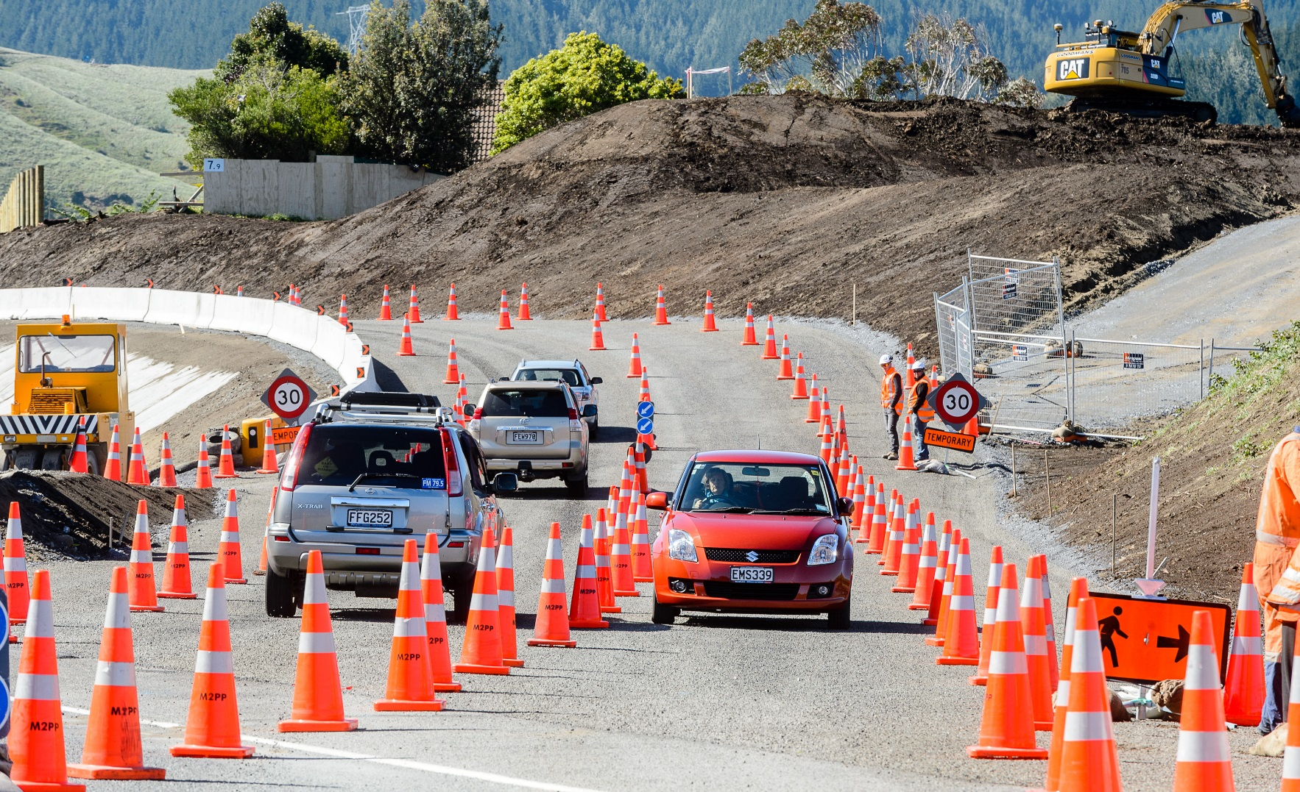
Blip Track
Utilising the Blip Track Sensors placed strategically on the existing state highway and also portable units on major local roads allowed the Project access to real time data on travel times between fixed points.
Some of these units are now integrated permanently into the Wellington network of Blip Sensors.
The advantage of using this real time data
allowed remote monitoring of individual
worksites as well as travel times across
the extents of the wider project.
This led to adjusting work hours and site
Setup times to meet local real time conditions
rather than relying on historical and usually
out of date data.

Slide 10
Optional download of video
W-15a M2PP Blip track video

Slide 11
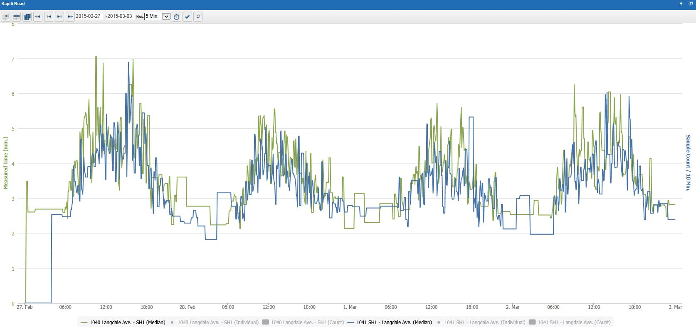
Blip Track – Data

Slide 12
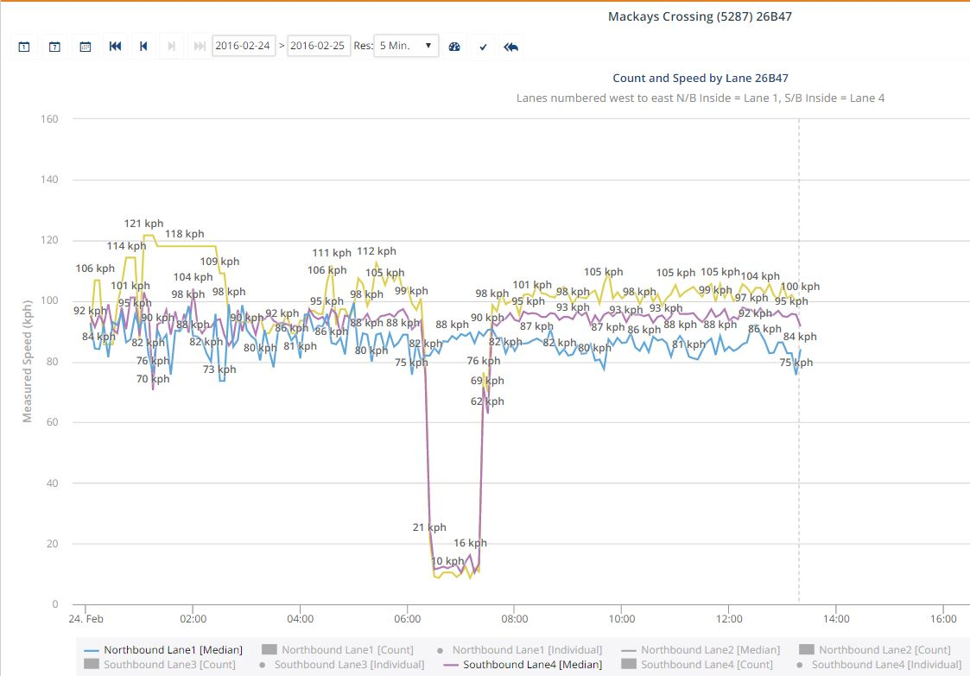
Blip Track – Speed Monitoring

Slide 13
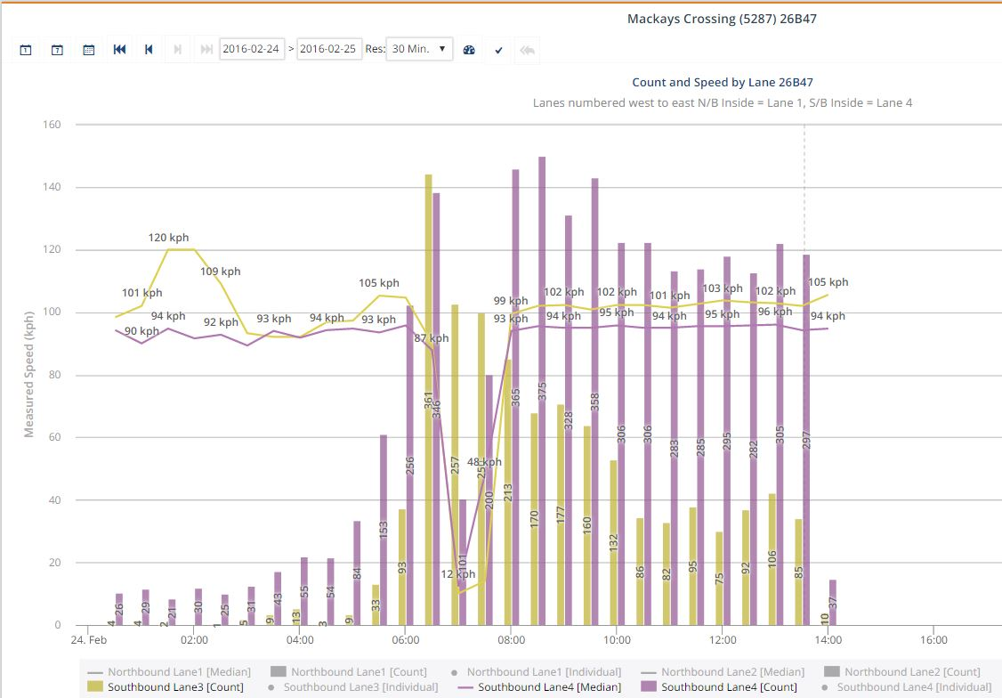
Blip Track – Speed / Traffic Counts

Slide 14
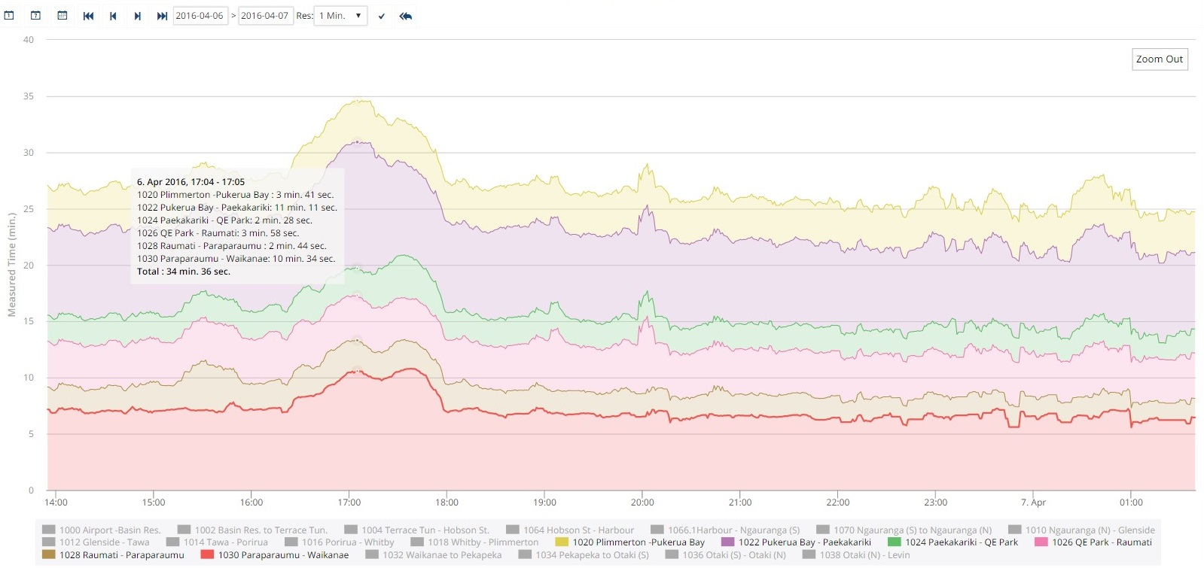
Blip Track – Travel Time – multiple sectors
By combining sectors the area of delay can be identified for overall journey management

Slide 15
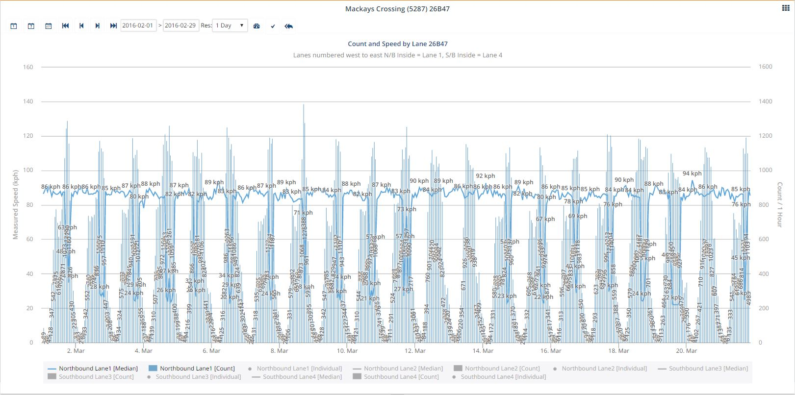
Blip Track – Trends

Slide 16
Blip Track – Trends
Friday
Wednesday

Slide 17
Blip Track – Site Specific Example
Blip units either side of work area – measured over 3.45km – Te Hapua Rd – Te Moana Rd – SH1 – AADT 19,688.
Speed limit was 100 for full length – Project reduced to 70 km/h for 1.9km of this length of road.
Original Travel Time was approximately 2mins 18 secs (1hr average)
With TSL in place time was approximately 2 mins 35 secs (1 hr average)
Delay Calcs show increase in time should be approximately 29 secs – reality shows 17.

Slide 18
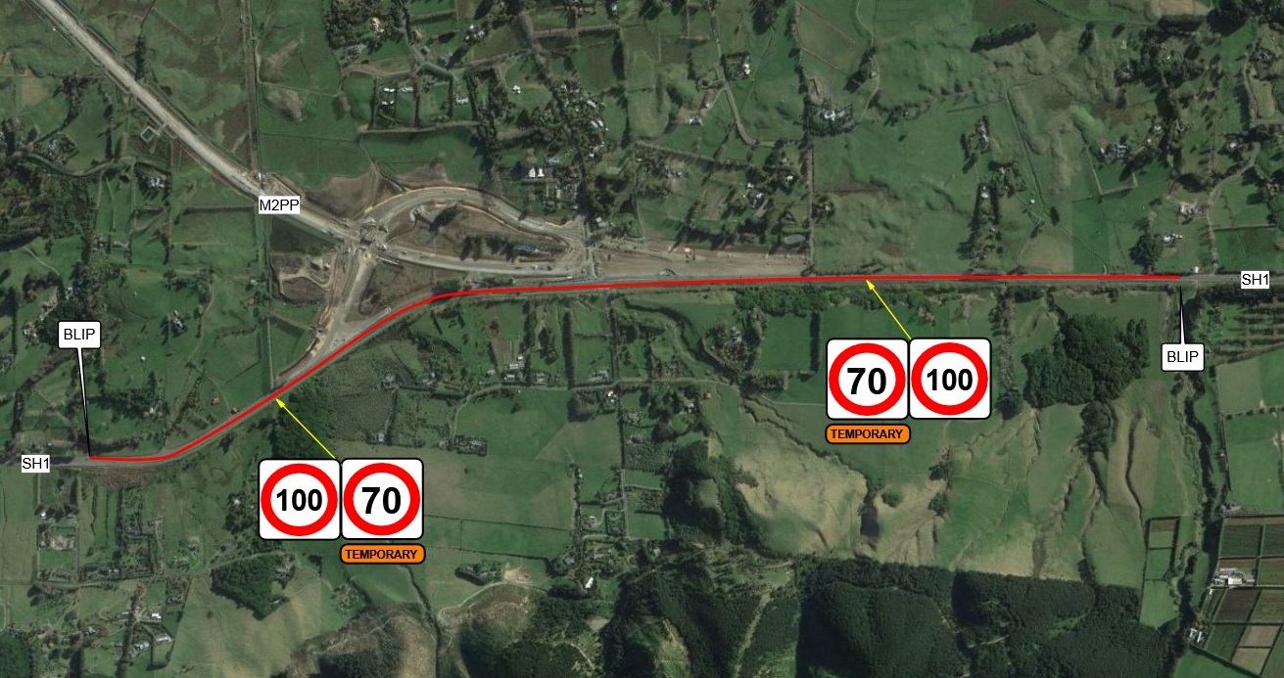
Blip Track – Site Specific Example

Slide 19
Blip Track – Site Specific data
70 installed 24/7 on 26 April
30km/h Contra Flow
100km/h
70km/h TSL

Slide 20
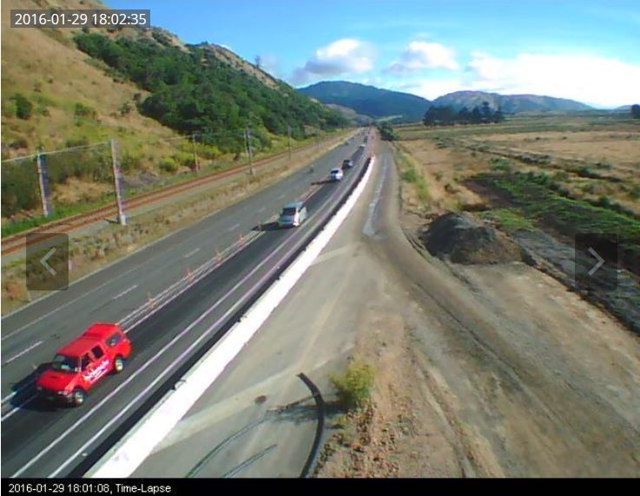
Blip Track – Cameras
Trial of new Time Lapse Camera allowed visual confirmation of Blip Data at SH1 Raumati Straights – merge pinch point.
Delay between images programmable
with images online
Portable / Solar Powered – sort of -
8m high on old light pole
mounted on 3.6m concrete barrier

Slide 21
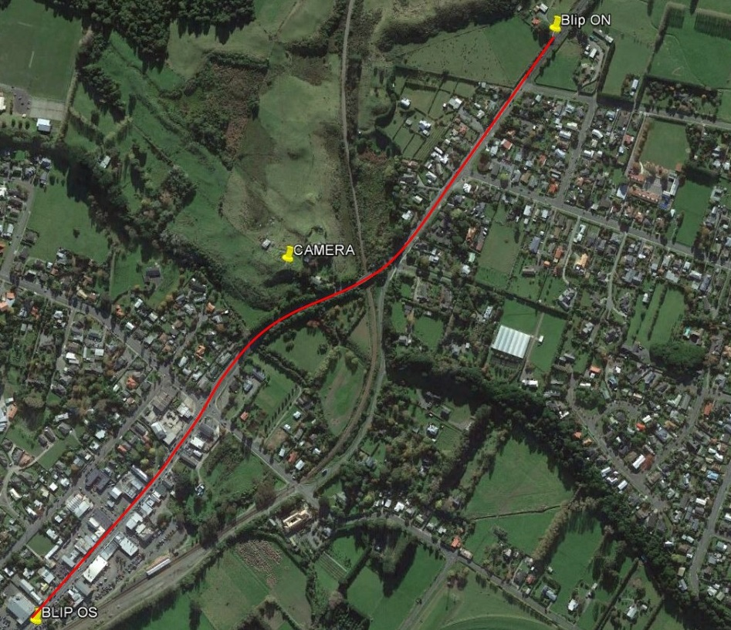
Blip Track – Cameras
Current project – PP2O - has 2 full live streaming cameras along with network Blips either side of the camera at Roundabout Pinch Point
Blips – 1.4km apart
Roundabout Pinch Point

Slide 22
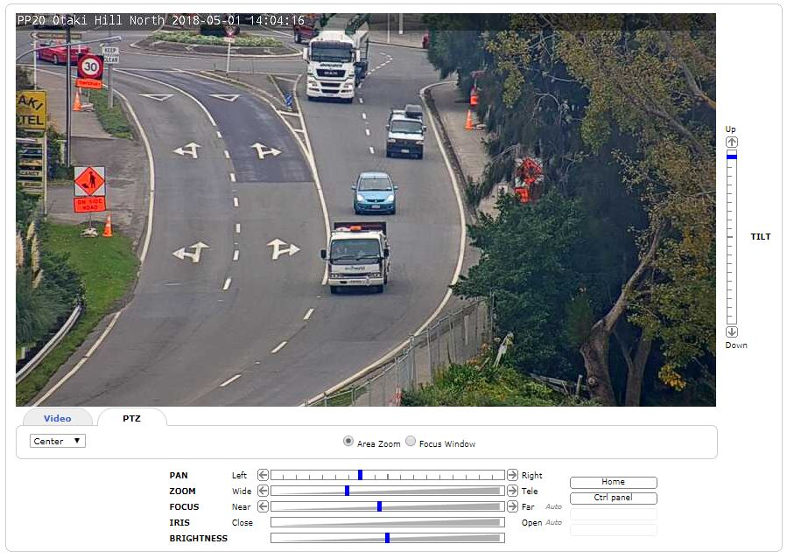
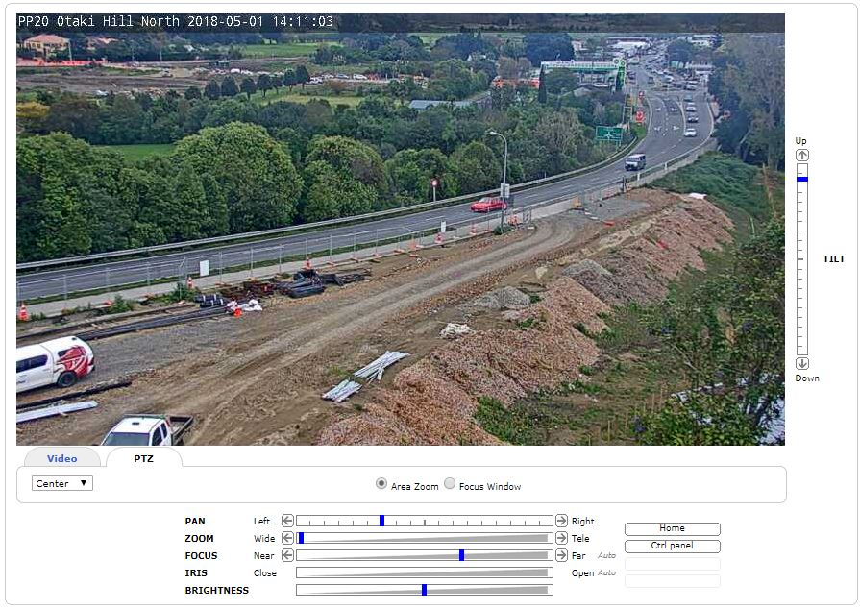
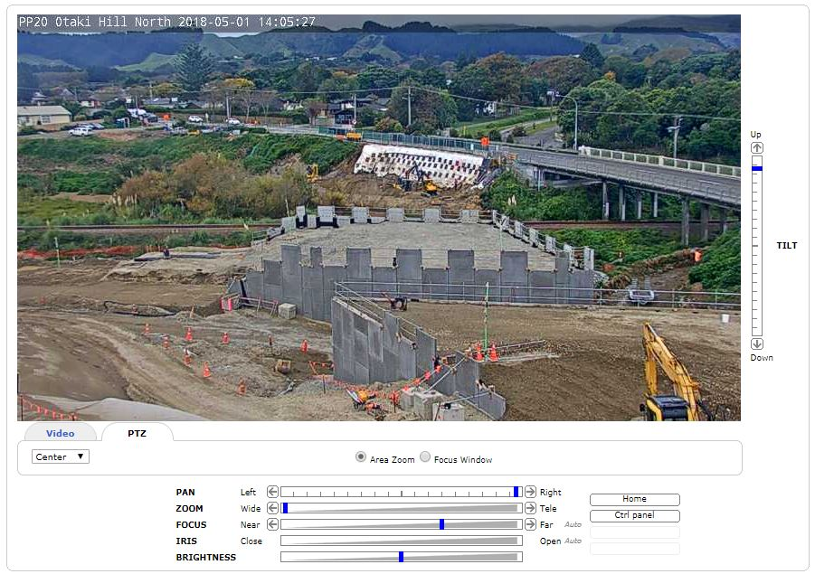
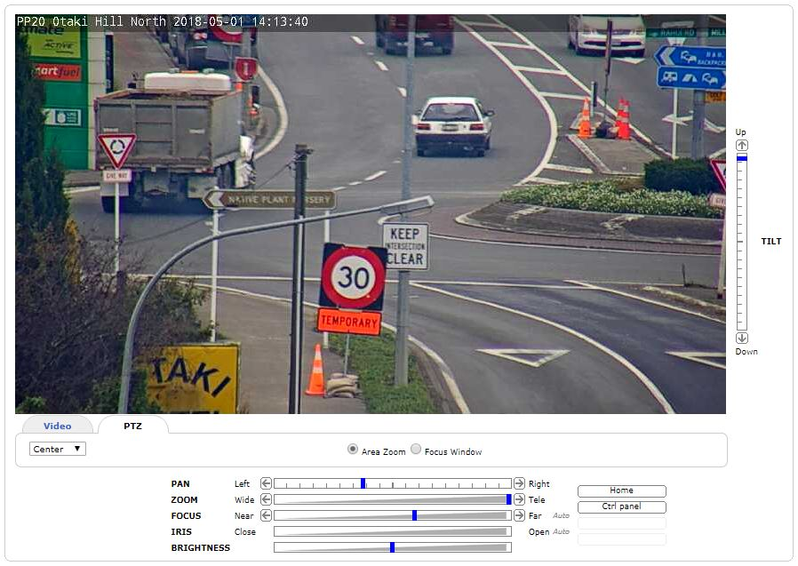
Blip Track – Cameras

Slide 23
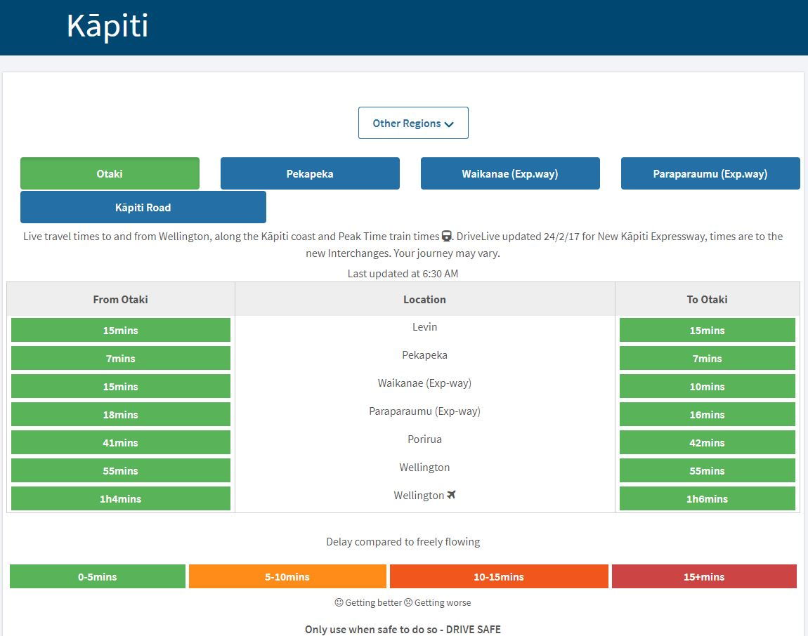
Blip Track – Drive Live
The integrated wider network is also where we get the Drive Live times from.

Slide 24
Summary
Where does this all fit with the theme?
COMPETENCY and CUSTOMER SATISFACTION in Temporary Traffic Management
Technology –
Blip Track, Cameras and VMS have proven in our experience to be great tools provided they are monitored and used to adjust work patterns to meet local conditions.
Customer satisfaction achieved through less delays
TTM –
Get external stakeholders involved early and listen to them.
Competency of the TTM crews setting out clear, well planned sites providing minimal delays which = a positive outcome for the public.

