Slide 1
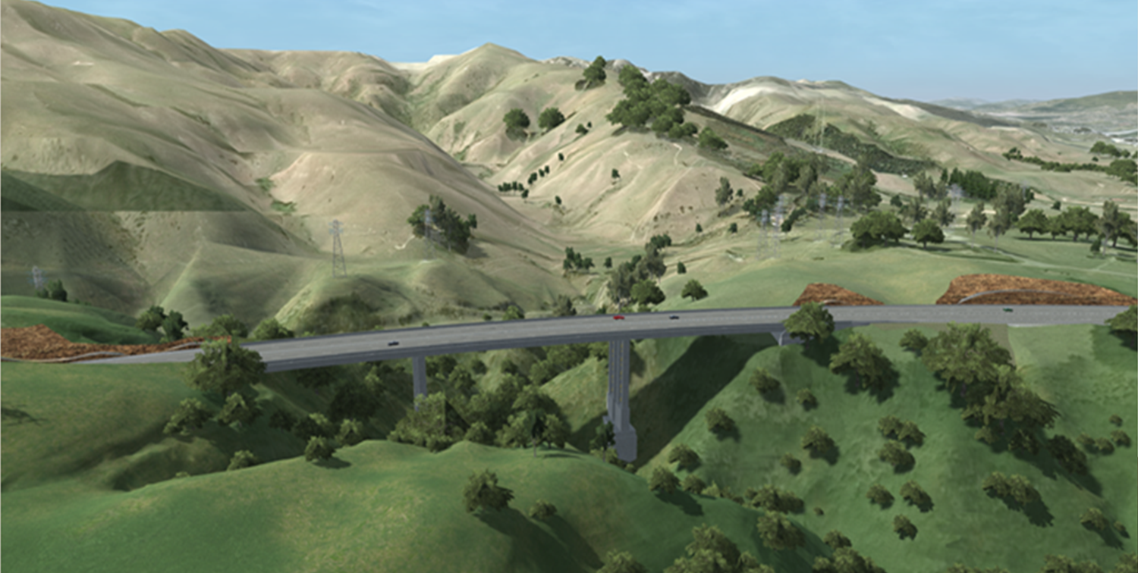
Transmission Gully
Opening May 2020
Presentation to the 3rd TTM Conference 2018
Jessica Jenkins & Desiree Craike
Notes:
Good Morning,
If we haven’t had the opportunity yet to meeting, My name is Jessica Jenkins and this is Desiree Craike. We are here today to talk to you about Transmission Gully in general, and how the project is going, some key engineering projects that we have been working on, as well as some of the TTM challenges and compliance key points that that TG is implementing across the project.

Slide 2
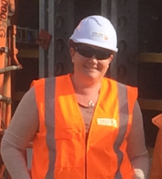
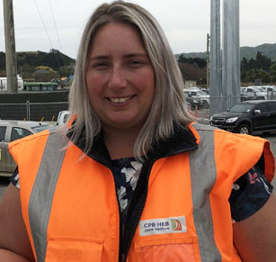
Transmission Gully
Jessica Jenkins
Area Manager (BEng CIVIL)
Desiree Craike
Traffic Manager
Notes:
A little bit about us –
Jessica Jenkins (Area Manager at Transmission Gully Responsible for:
Permanent Guardrail, Signs Lines, Gantries and ITS (Intelligent Transport Systems)
MSE Walls, Landscaping, Mitigation Planting, Operational Boundary Fence, Legal Protection Mechanisms for NZTA and GWRA.
Desiree Craike
Traffic Manager Transmission Gully
TTM Design Management, Supply and Installation
Permanent Signs and Lines Installation
Temporary Traffic Barrier Design and Installation
Workforce Management
Team Leader
Leading and Communicating Traffic Management importance across multidisciplinary teams.

Slide 3
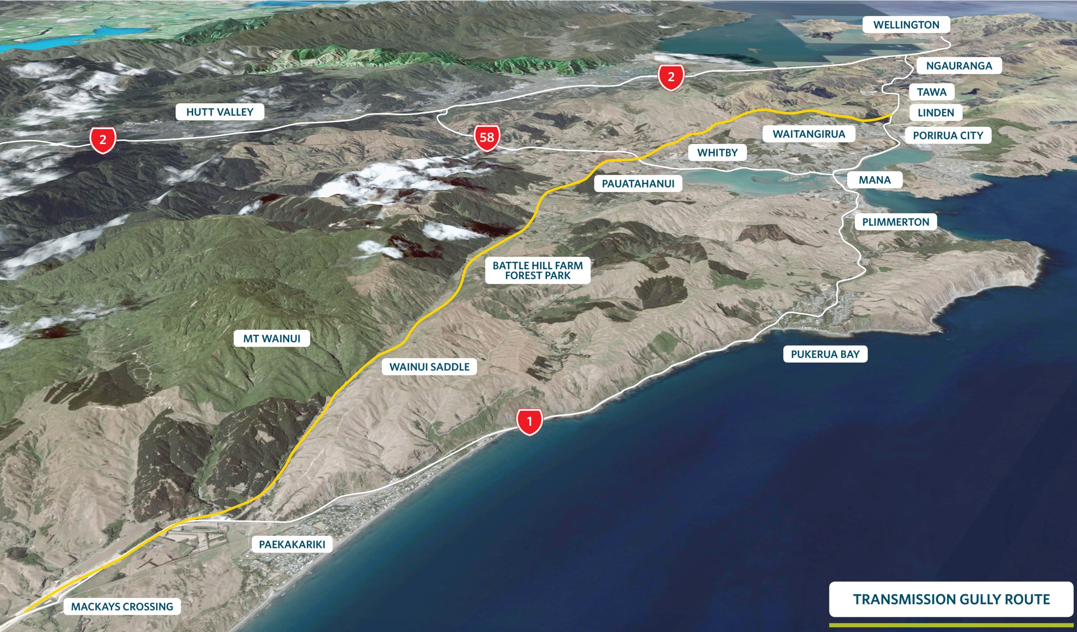
The Route
Notes:
Transmission Gully is 1 of 4 projects that make up the northern corridor from Wellington to Levin. The first section Mackay’s to Peka Peka is now complete, and Transmission Gully is stage 2 of the over all project being delivered by NZTA. Upon completion there will be 4 lanes from Wellington City through to Levin.
Transmission Gully is different from the other 3 parts of the project, as it is a PPP (Public Private Partnership) contract being delivered by Wellington Gateway Partnership. Desiree and I work for HEB Construction as a part of the CPB HEB Joint Venture that are delivering the build of the project. There is another company called Ventia that takes responsibility of the maintenance of the alignment for 25 years post road opening. Upon completion of the maintenance period, the asset is returned to NZTA for maintenance and operation responsibilities.

Slide 4
Key Features
PROJECT SCOPE
Mackays Crossing to Linden (28km) plus associated link roads
Minimum of two lanes in each direction
Extra “crawler lane” on steep uphill sections
“Motorway” design standards
Interchanges rather than intersections
110 km/h design speed
3.0m shoulders
Full length median barrier and side protection barriers

Slide 5
Construction Challenges
MAJOR CONSTRUCTION CHALLENGES
Scale of the project:
Earthworks ~ 9 M m³ cut and fill
Cut heights up to ~ 70 m
Significant lengths of reinforced soil embankments (~ 4 km), up to 40 - 50 m high
27 bridges and major culverts
Cannons Creek Bridge 230m long, ~ 60m high
58 Retaining Walls
Access constraints
Impact on other Infrastructure and the Community of Wellington
Notes:
This Earthworks Season (September 2017 – March 2018) we completed our largest earth moving season to date.

Slide 6
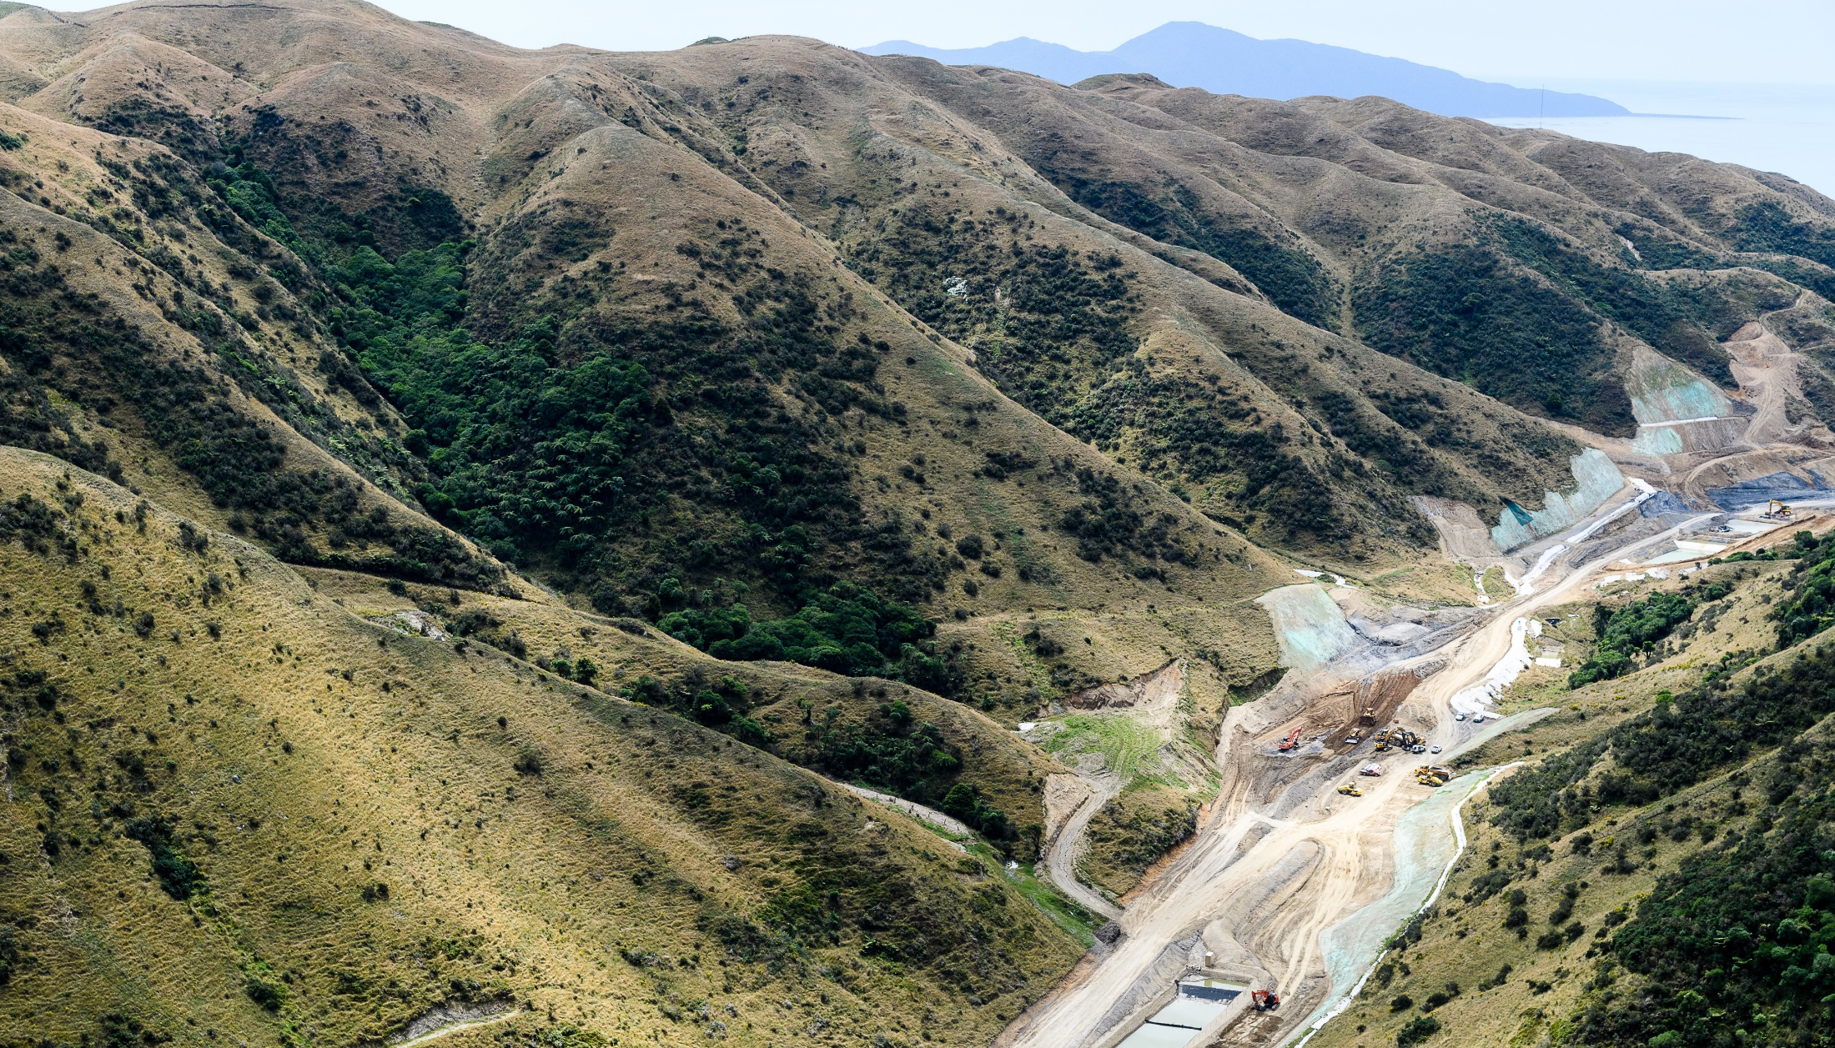
Progress To Date
Notes:
This picture is to give you an idea of the terrain we are working in. Most of the project looks like this, and the public often doesn’t get to see what we are doing.

Slide 7
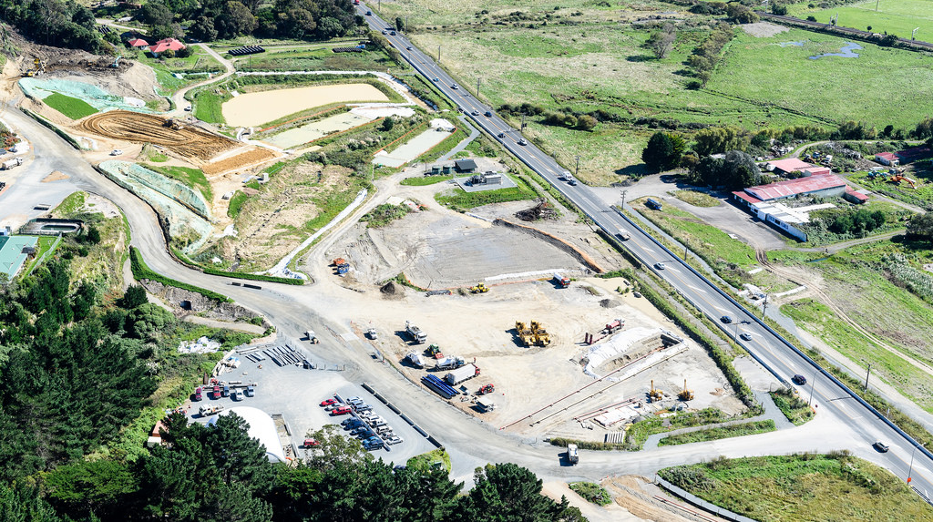
Northern tie in - Paekakariki
Notes:
This is the northern tie in of the Transmission Gully Project. Desiree is currently working with the team in this area detailing the traffic switch which will switch the current SH1 traffic onto the new Coast Road in August this year.

Slide 8
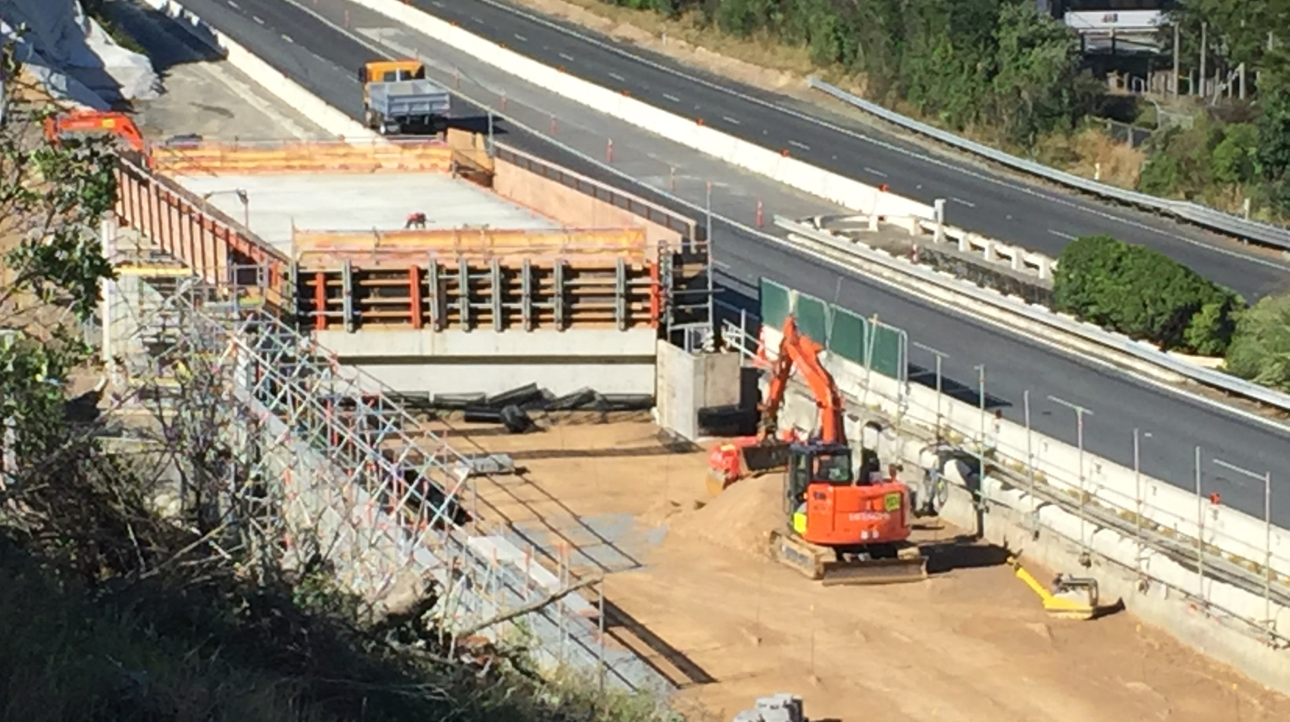
Southern tie in - Linden
Notes:
This is the southern tie in at Linden. Desiree and her team are currently working through the requirements to switch the current southbound traffic onto this new Bridge at Collins Ave. This requires a geometric design for the lateral lane shift onto the bridge. The temporary speed of this road will then be reduced to 70km / hour due to sight line issues associated with Bridge construction.

Slide 9
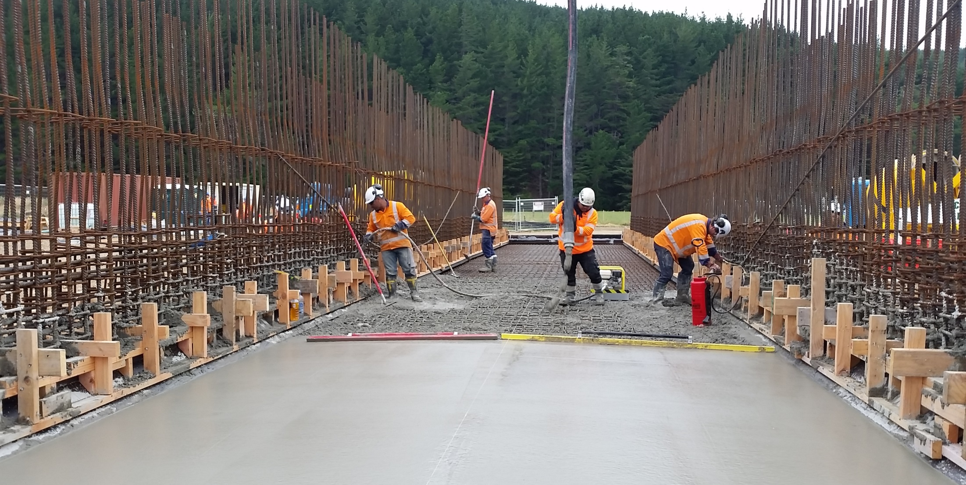
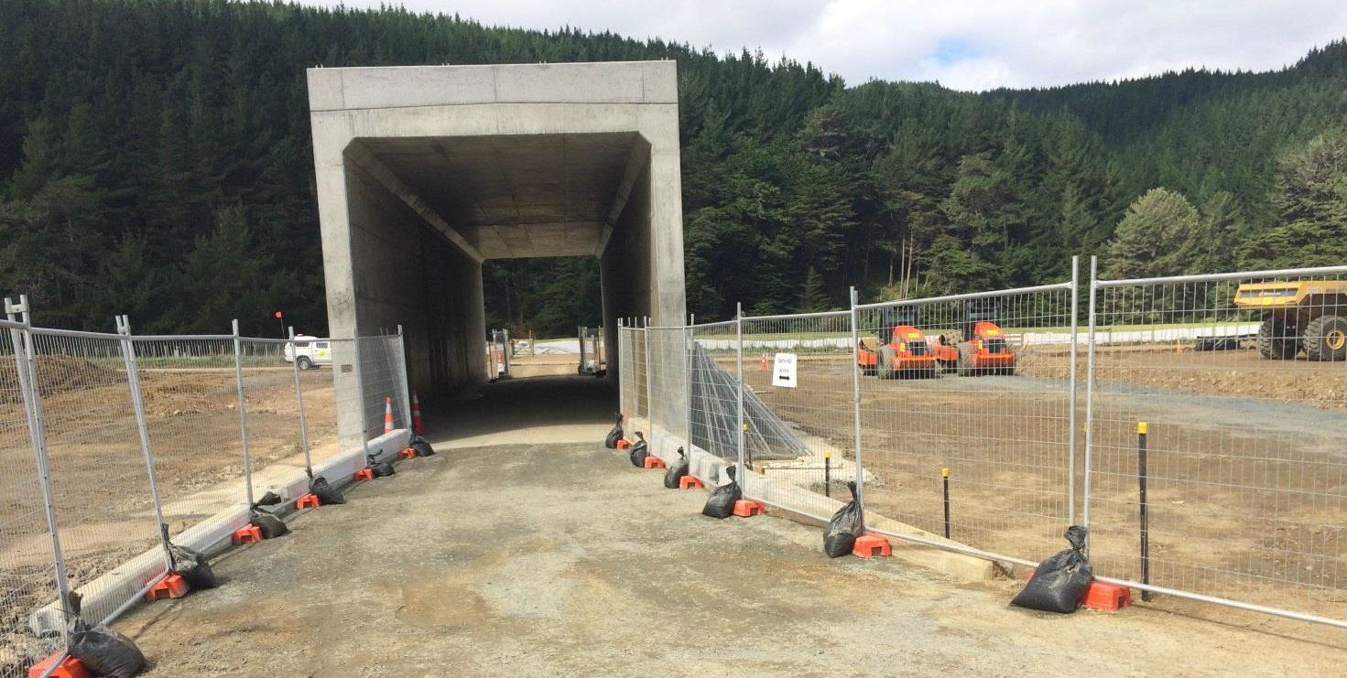
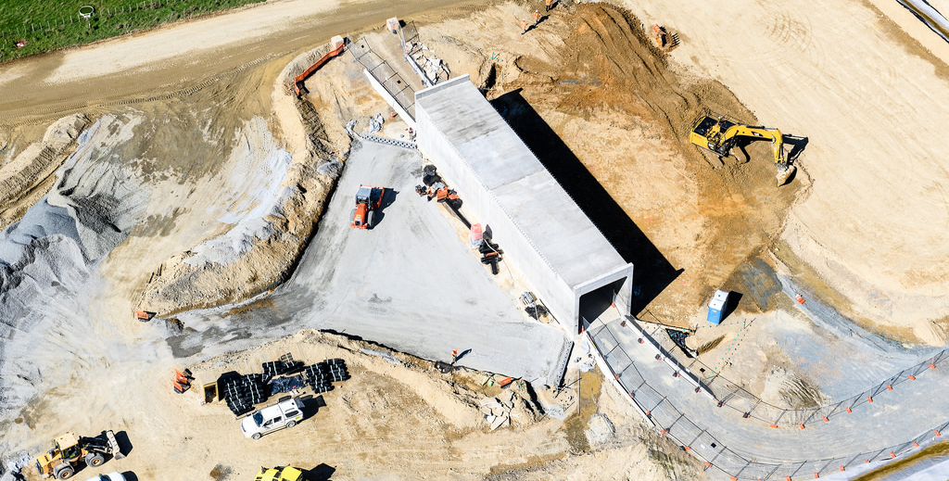
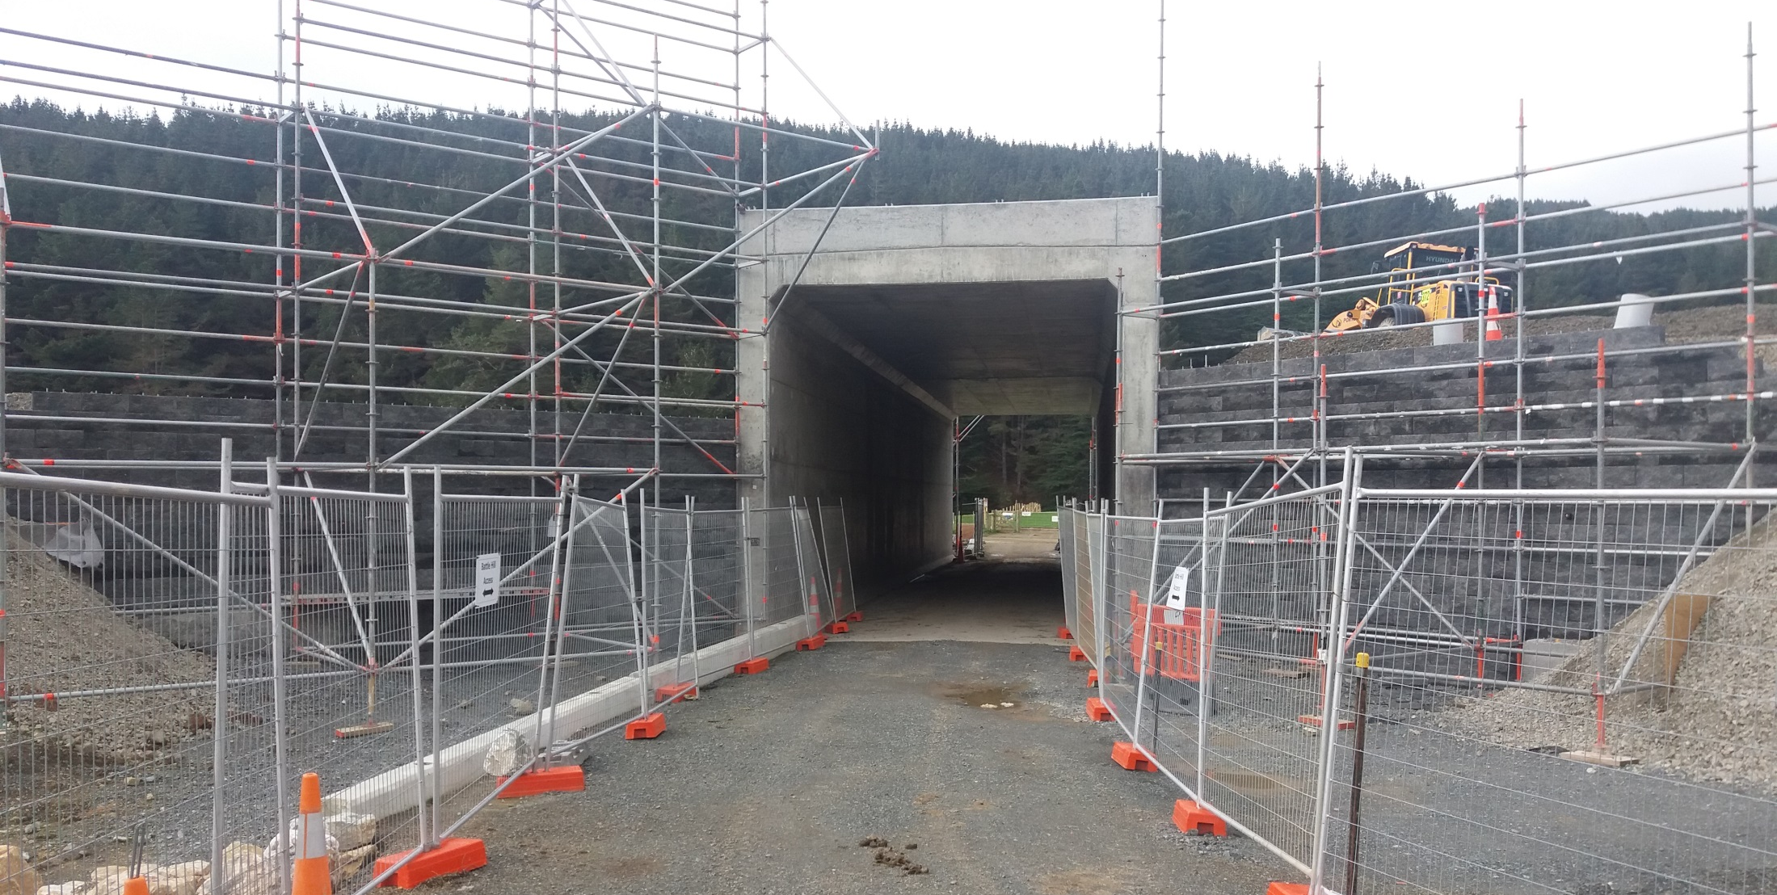
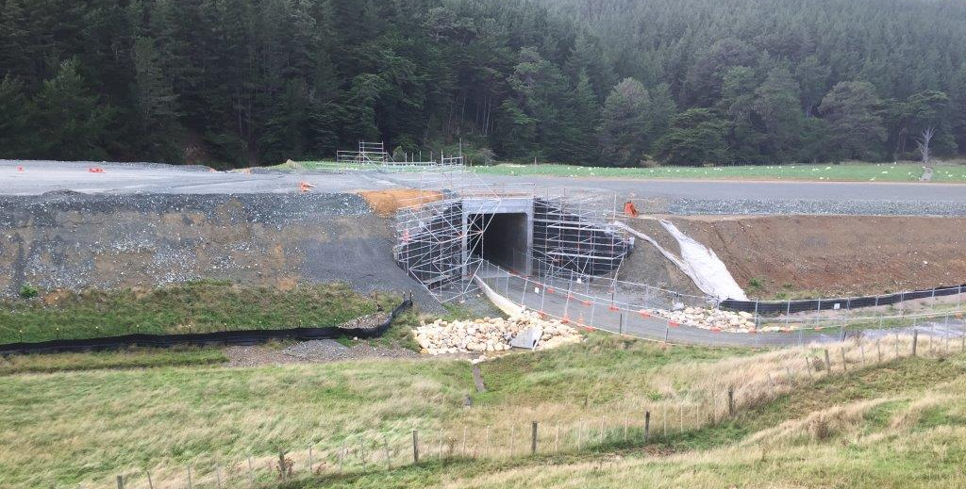
Battle Hill Access Underpass
Notes:
This is the battle hill access underpass. This is the permanent access for pedestrians, horses mountain bike riders and hikers. As a part of the project we must maintain full access across the alignment at all times so that users of the park can continue to enjoy Battle Hill Regional Park. For this reason, this was the first bridge that was built on the project.

Slide 10
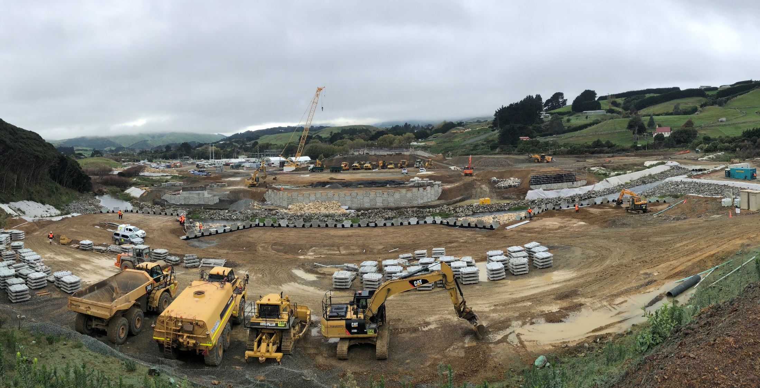
SH58 Interchange
Notes:
This is the SH58 Interchange, The current SH59 goes around our site on the right hand side of this photo. WE are busy building 4 bridges in this location which will enable us to switch the traffic of SH58 through our site, which in itself will provide a unique challenge for us moving forward at TG.

Slide 11
Cannons Creek Bridge
Optional download of video
W-14a Cannons Creek Bridge
Notes:
Now for some cool engineering stuff. This is Cannons Creek Bridge, the Crown Jewel of the Transmission Gully Project. The bridge is 230m long and approximately 60m above the Creek at the base of the Gully. The bridge is cantilever construction, launched on a Teflon surface, pushed from the southern side of the alignment over to the north. Some special features about this bridge is that it is designed on a super elevated curve which gives it interesting challenges for the bridge launch. The launch nose has had to be designed in order to make sure we land on the pier on the other side, which given the curve has meant the launch nose is longer than that for a straight bridge. There are only 2 supports, which makes it the longest incrementally launched bridge not only in New Zealand but also in the world. We are currently busy preparing the launch pad, and assembling the launch nose. Girders have started to be delivered and are being delivered at night so as to minimise the effect on the costumers on SH1 at Linden. Desiree is managing this with a double rolling block closure on the southbound lane at the southern tie in.
Desiree will now talk to you more specifically abouth the TTM Challenges Compliance key points that are being implemented at TG.

Slide 12
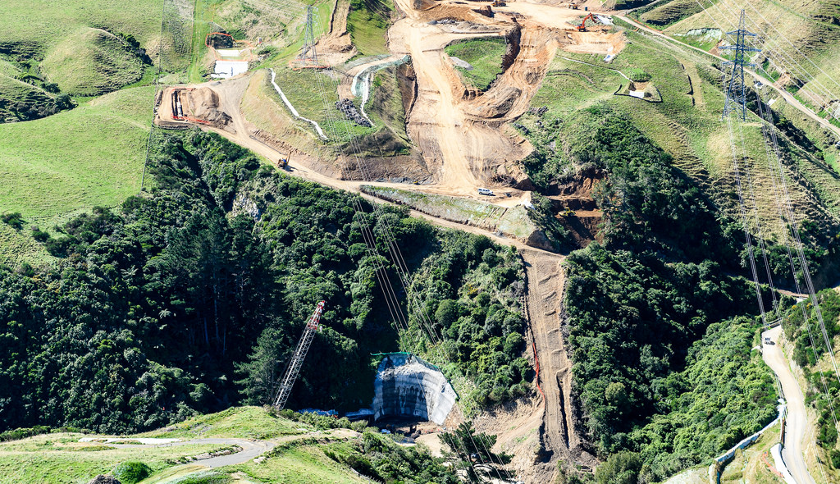
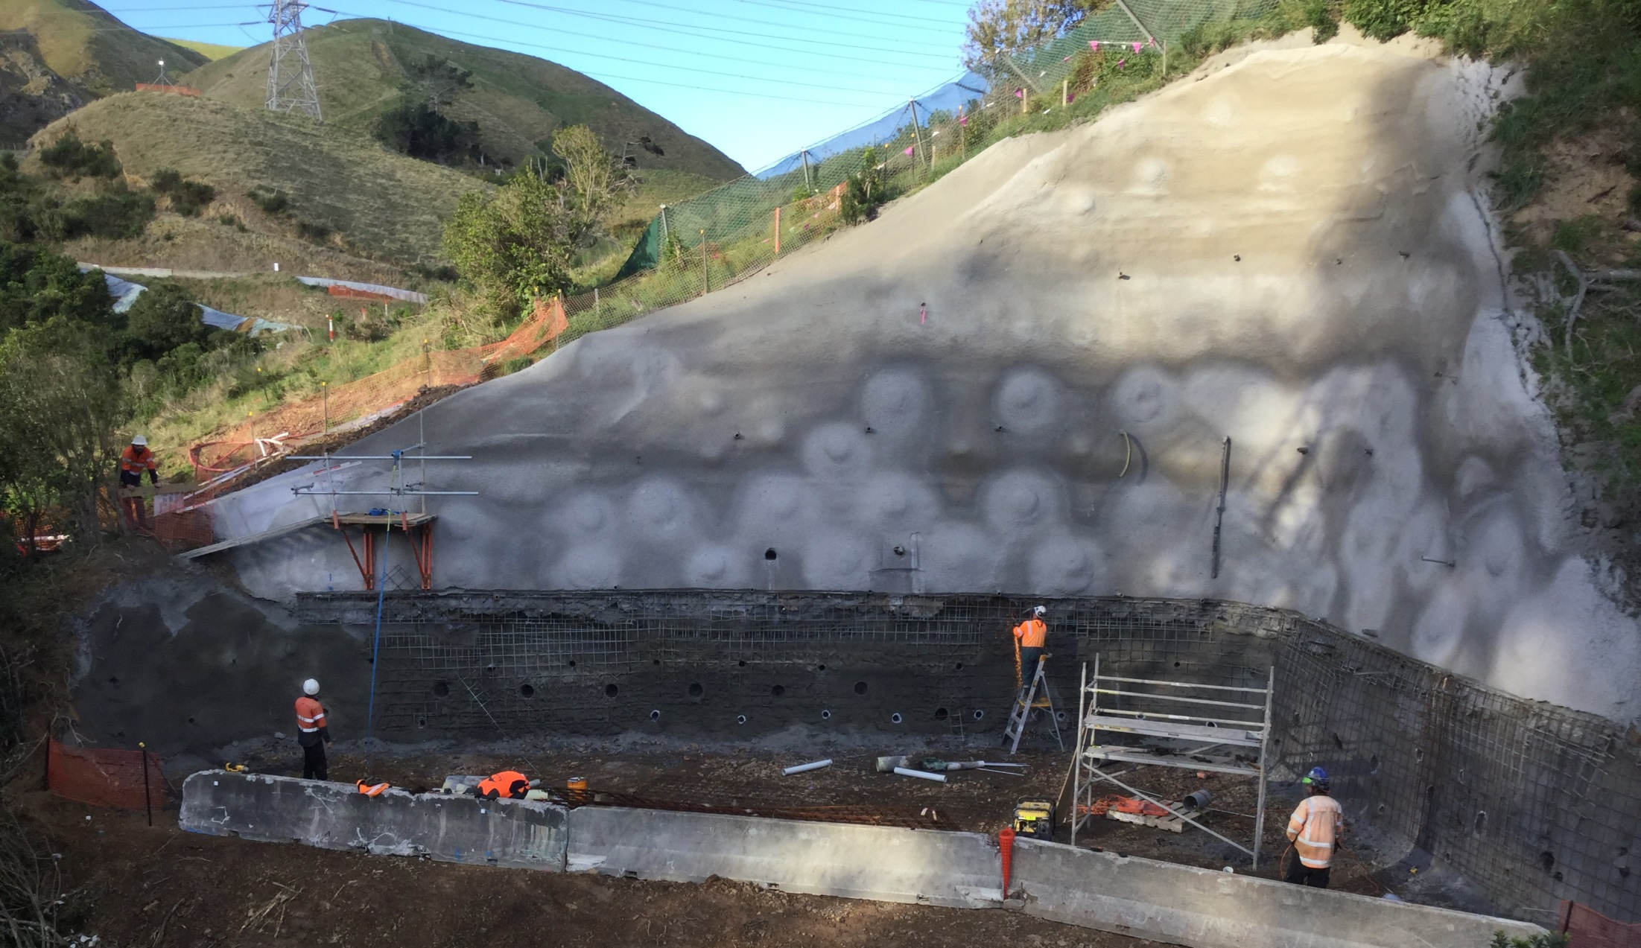
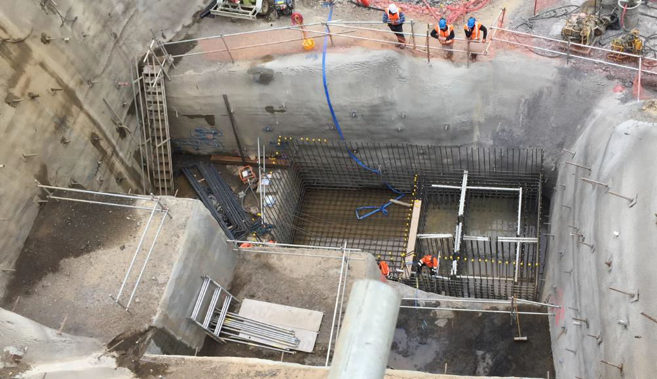
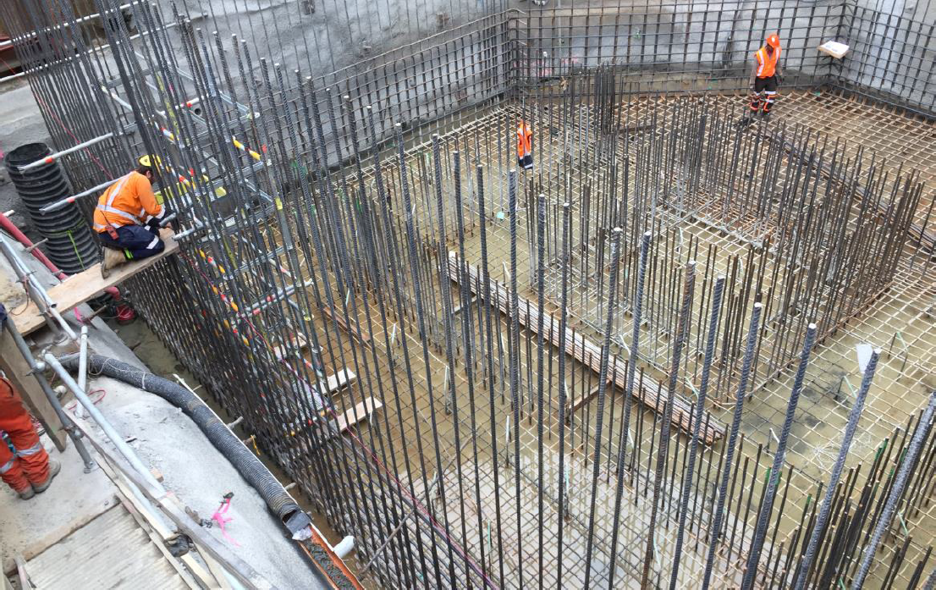
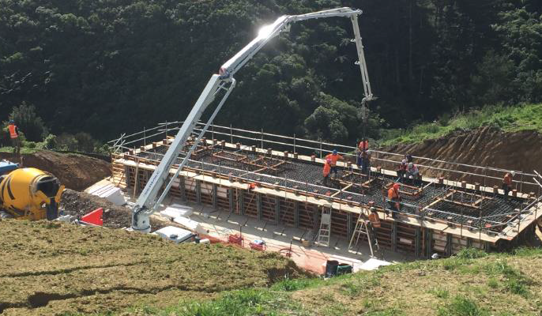
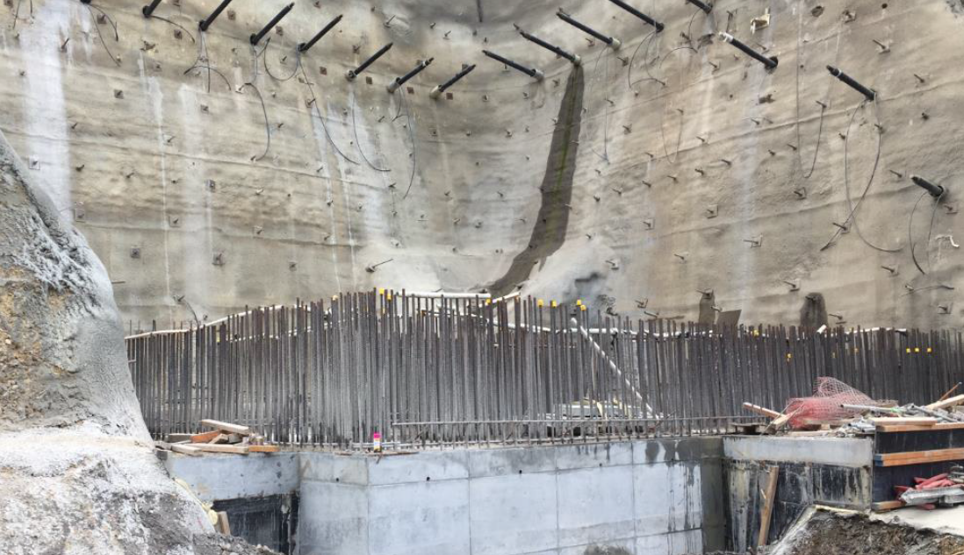
Cannons Creek Bridge
Notes:
Now for some cool engineering stuff. This is Cannons Creek Bridge, the Crown Jewel of the Transmission Gully Project. The bridge is 230m long and approximately 60m above the Creek at the base of the Gully. The bridge is cantilever construction, launched on a Teflon surface, pushed from the southern side of the alignment over to the north. Some special features about this bridge is that it is designed on a super elevated curve which gives it interesting challenges for the bridge launch. The launch nose has had to be designed in order to make sure we land on the pier on the other side, which given the curve has meant the launch nose is longer than that for a straight bridge. There are only 2 supports, which makes it the longest incrementally launched bridge not only in New Zealand but also in the world. We are currently busy preparing the launch pad, and assembling the launch nose. Girders have started to be delivered and are being delivered at night so as to minimise the effect on the costumers on SH1 at Linden. Desiree is managing this with a double rolling block closure on the southbound lane at the southern tie in.
Desiree will now talk to you more specifically abouth the TTM Challenges Compliance key points that are being implemented at TG.

Slide 13
Compliance
“The act of being in accordance with established standards, guidelines, or legislation”

Slide 14
Transmission Gully (TG) Motto
“100% compliance, 100% of the time”
COMPLIANCE for a project the size of TG is not covered by CoPTTM but does follows the principles of CoPTTM. However we need to take into account:
Fit for purpose
Suitable for the nature of the works
Accordance with the approved TMP
Installed, setup and used correctly
Duration of the work
Activities on any road must be planned so as to cause as little disruption delay or inconvenience to road users as possible
Notes:
Fit for purpose
Suitable for the nature of the works
– this has been a challenge for one of our locations where we are working on either side of the local road as well as above the road, on any given day we can go from a stop stop operation to stop go to site management, this can involve at least 30 different staff members coming and going throughout the day, the STMS has had to be a lot more alert and aware of the activities and ensure that the installation is appropriate every minute of the working day. This is a change for some STMS’s.
Duration of the work
Activities on any road must be planned so as to cause as little disruption delay or inconvenience to road users as possible
this is a tough one to manage not in the sense of re occurring closures but the fact that the construction has been going for 2 years and has another 2 years approx. to go, our effects ranges from temporary concrete barriers to temporary speed limits and heavy vehicles accessing various areas of the network are in place in most areas for the entire length of the project.
Accordance with the TMP that has been approved
Install, setup and used correctly
Reminding STMS’s to read and understand the TMP has been challenging, historically STMS’s will look at the diagram and begin installing the closure, our TMP’s have project specific requirements and in some cases outside of CoPTTM however approved by the RCA for example there are multiple instances where our traffic design is not able to meet CoPTTM or Austroads guidelines due to construction and environmental constraints, if the STMS does not completely comprehend the TMP then they are unable to provide compliance.

Slide 15
Ensuring Compliance at TG
For each traffic installation the following process has been implemented:
Prestart Meeting
Onsite Toolbox
Closure installation
Installation audit
STMS mentoring and coaching
Notes:
Prestart meeting
Lead by the engineer provides the point of contact for the STMS to meet all foreman, and staff that will be working within the closure for that shift, during this meeting the engineer will work through the TMP with the STMS ensure that he/she understands the requirements, this is done daily even if the ttm is repeated each day, repetition can cause complacency so to ensure that we are not cutting corners or assuming that the STMS remembers from the day before which can lead to unsafe behaviour's, once the STMS understands the activity or activities that will be happening for that day the STMS then will decide the appropriate closure to install from the approved Generic TMP for that location and RCA. The engineer will then asses the STMS equipment to ensure all signs, stands, cones etc are in accordance with CoPTTM specifications, assess the STMS’s paper work to ensure that the STMS has the appropriate on site record hazard id and generic tmp checklist.
Onsite Toolbox
The STMS will advise the foreman and staff what the closure is going to be, site access points and any site specific information about how they are going to manage the site, this has been a change for STMS’s also even though CoPTTM gives them the power to manage the site this is not typically done, so we have encouraged and enforced that power to them they are the ones ensuring all road users and works are safe so they have the final say.
Closure installation
Following the projects safety procedures and CoPTTM guidelines the STMS is then tasked with installing the closure, safely, appropriately, and at the speed required to complete this, the STMS is not encouraged to rush to open up the working space.
Installation audit
the traffic engineer will then audit the site to confirm compliance with the STMS, suggest adjustments if any and discuss the closure to confirm it is going to be fit for purpose for the activities that are planned.
STMS mentoring and coaching
Through out the day the traffic engineer will meet or ring the STMS to see if there are any issues or concerns that may be come up during the shift and help and guide them to come up with the solutions, the engineer will also test and question the STMS’s knowledge against CoPTTM guidelines, coach them to be compliant with CoPTTM, the TMP and regulations rather than relying on how the last STMS set the site up or taught them knowledge, encouraged them to have a CoPTTM on them at all times so they can re assure themselves with the requirements.

Slide 16
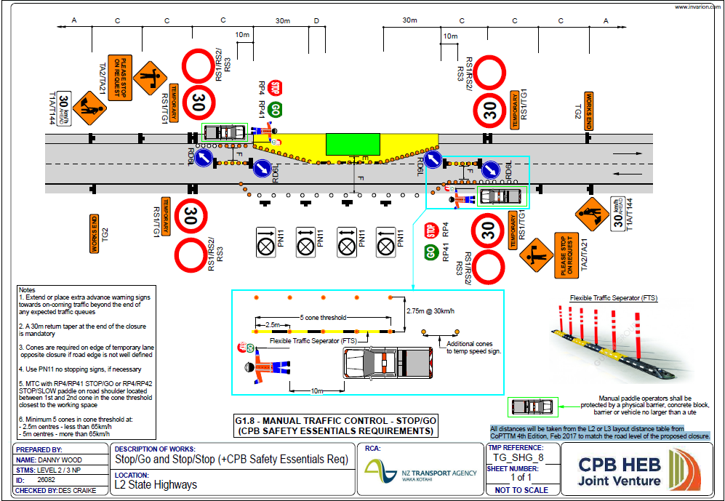
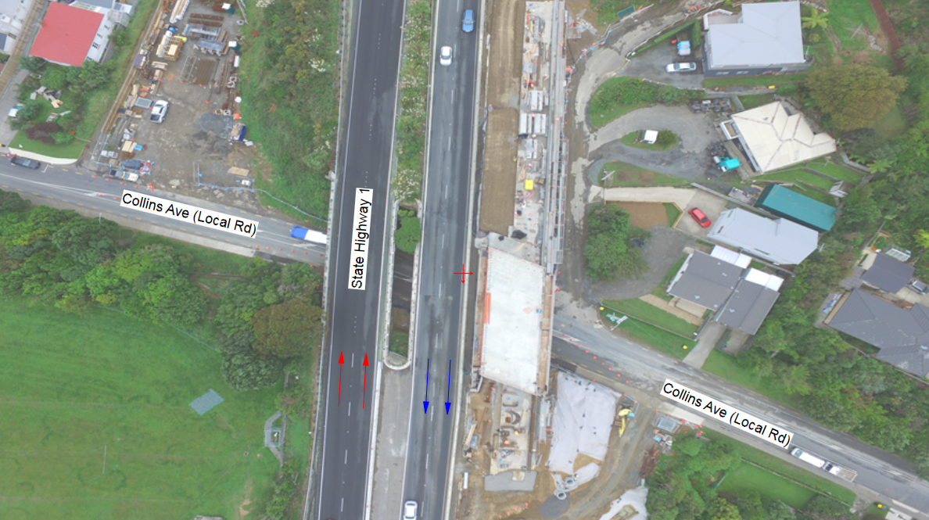
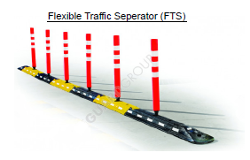
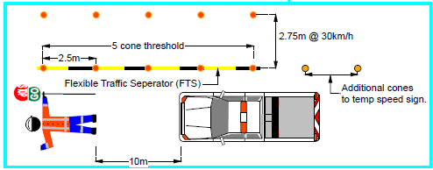
Improving Compliance
Notes:
This is our site that I was referring to where we have works on both sides of the local road as well as above on the state highway.
On an almost daily basis we have got either stop/go or stop stop for various types of activities.
Due to the repetition of the setup travelling public are starting to get complacent, ignoring temporary speeds, and not paying attention to the works adjacent to the footpath.
In the next month we are going to improve our installation set up by adding in a traffic separator to enhance the thresholds and working space delineation.
We are looking to see positive results from the travelling public responding to the setup, this will increase safety for our stop go operators and the working space.
You may notice in this design we also have a ute pictured with the stop go operator, or project internal safety requirements require either the stop go operator to not be there as in use traffic lights instead or be protected by, approved barrier system or something as effective, in this location a approved barrier system would not be effective, traffic lights have a limited capacity with allowing us to swap from stop stop to stop go throughout the day. So we have put in place a small ute as the protection at this stage.
A design is in process to have the stop go operator off the carriage way we hope to have this approved in the coming month.

Slide 17
TTM Challenges
MAJOR TTM CHALLENGES
Design Constraints
Site Access design
LV vs. HV design
Semi Permanent Access vs. Temporary design in CoPTTM
Increase in traffic volumes associated with construction.
Imported Materials Traffic
Quarry Products (Pavements and MSE Walls)
Super T and Girder deliveries
Clean Roads Initiative
Ensuring debris is kept in site

Slide 18
Design Constraints
Temporary Design
“lasting for only a limited period of time; not permanent”
Permanent Design
“lasting or intended to last or remain unchanged indefinitely”
Semi-Permanent Design? “not permanent, but involving some stability or endurance”
Notes:
This project has two temporary traffic management design categories
Designs in accordance with CoPTTM ie Stop go, Lane Closures, Mobile operations.
and
Road re alignment designs utilising Austroads MOTSAM Sate Highway Geometric Design Manual.

Slide 19
CoPTTM Design
Notes:
Our largest CoPTTM based design is to allow us to contraflow State Highway 1 in between Porirua and Tawa, this closure is 3.2km long, the longest time we are looking to have this installed is 12 to 14 hours and this will enable us to lift the girders onto Bridges 25 and 27 which span both north and south bound lanes.
When lifting the southbound girders northbound will become a 2 way road
When lifting the northbound girders southbound will become a 2 way road.

Slide 20
Austroads and Geometric Design

Slide 21
Austroads and Geometric Design
SH1 Linden – Phase 1
Notes:
Phase 1, construct new bridge deck beside current state highway southbound lane

Slide 22
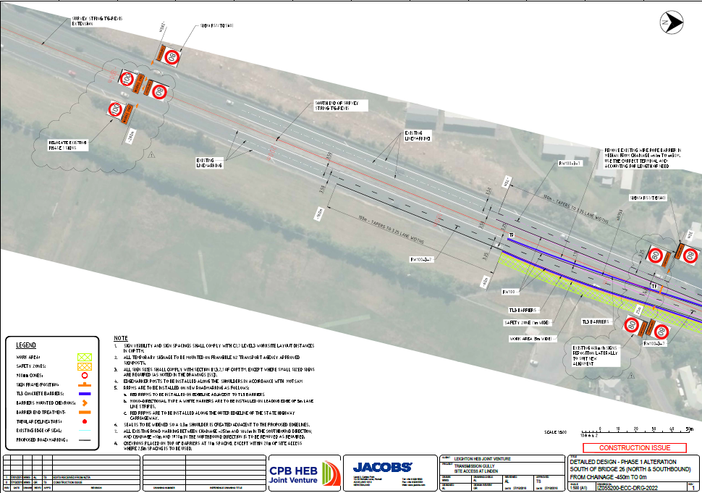
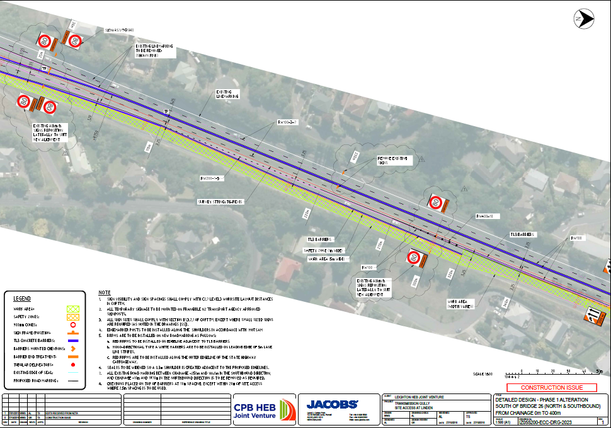
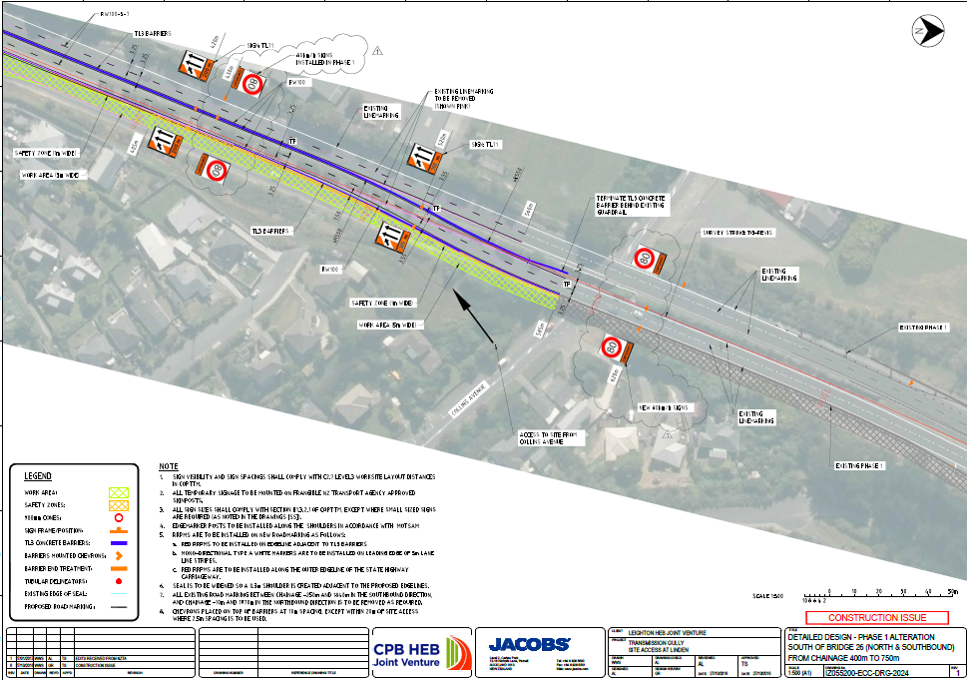
Notes:
Key areas, establishing site decel and excel lanes northbound and southbound, these have been designed to light vehicle standards even though heavy vehicles are the main user of these, reason for the lower design there is no space to install excel lanes as per Austroads with the construction bridge piers, retaining walls, MSE walls and final road alignment for the new bridge southbound.

Slide 23
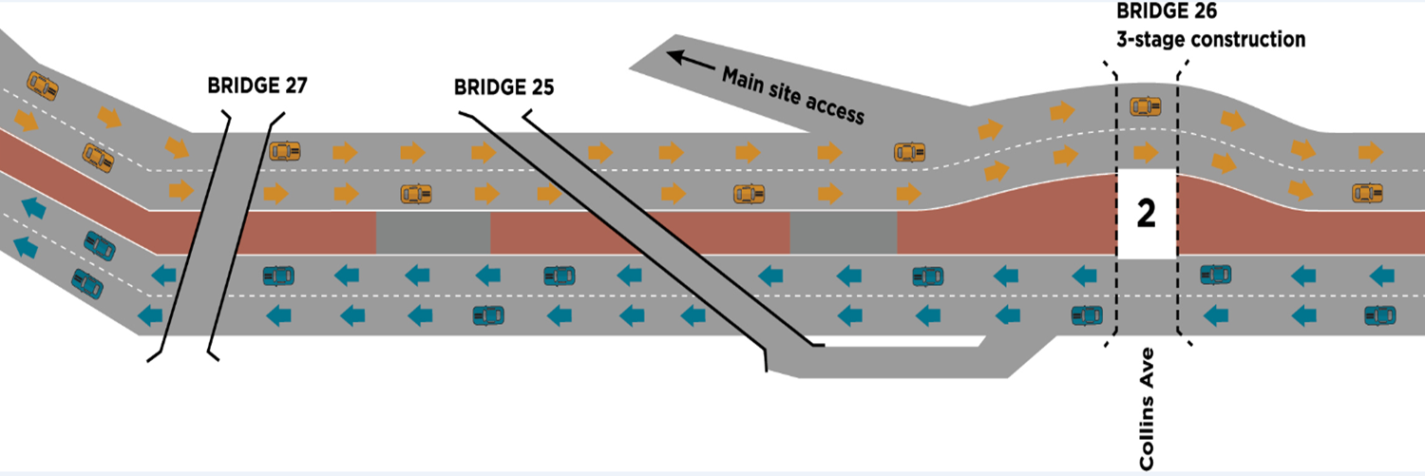
Austroads and Geometric Design
SH1 Linden – Phase 2
Notes:
Phase 2
Construct bridge piers in the central median, demolish current southbound lane and construct new bridge

Slide 24
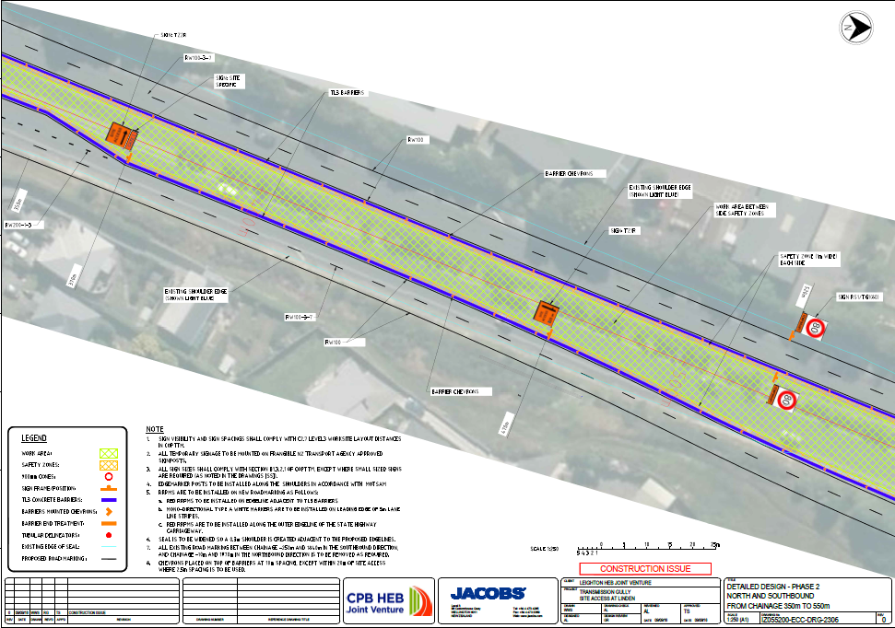
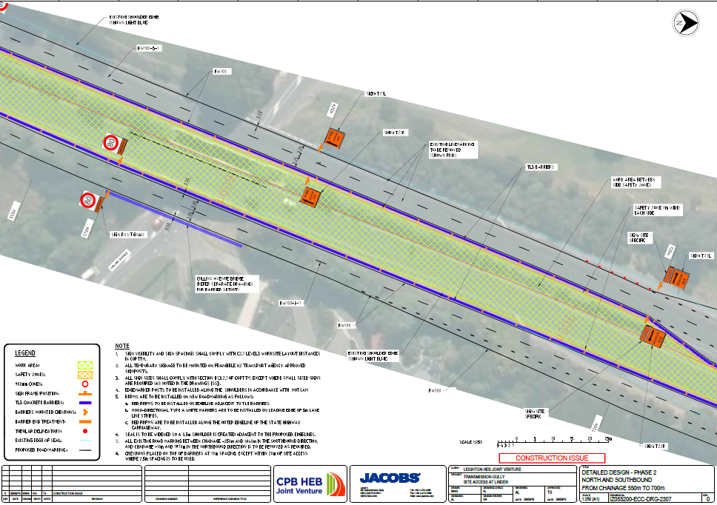
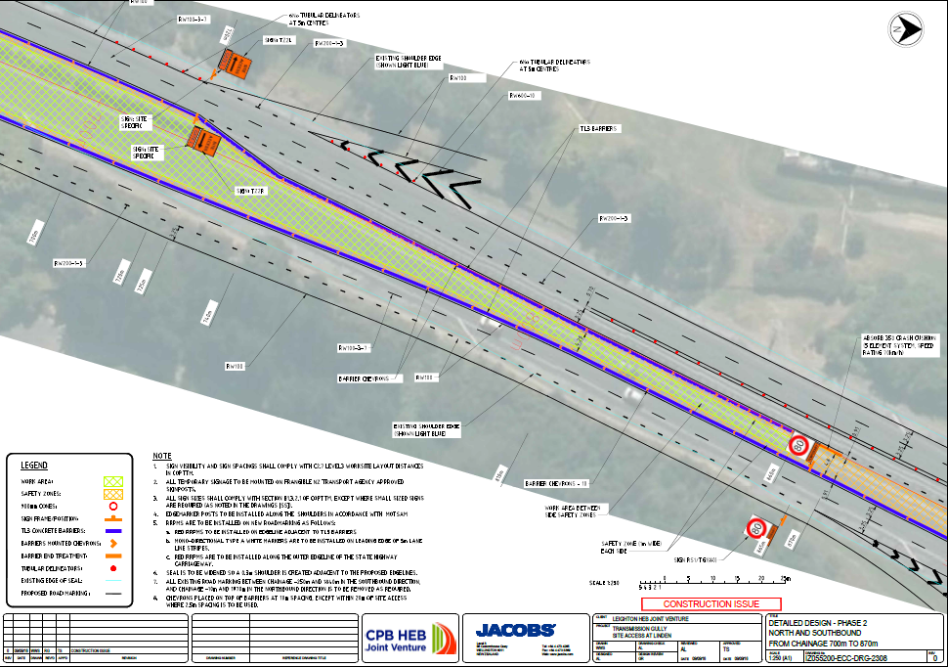
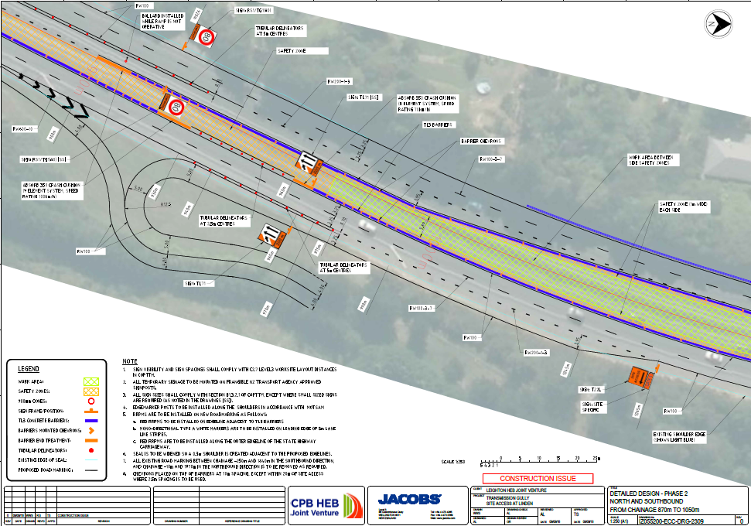
Notes:
There is a long list of design constraints here that are far too long for us to talk about now but the area here gives you an idea of the complexity of the bridge construction. This show’s the new southbound lane and the working site for the new bridge, this required the southbound lane to be realigned for the full 3km. Multiple site line issues were identified as a part of the design. Along the northbound and southbound there are #6? site accesses. #18 end crash cushions #693 barriers #32 temporary speed signs just to name a few statistics.

Slide 25
Austroads and Geometric Design
SH1 Linden – Phase 3
Notes:
Phase 3
Construct the northbound bridge complete any final alignment works

Slide 26
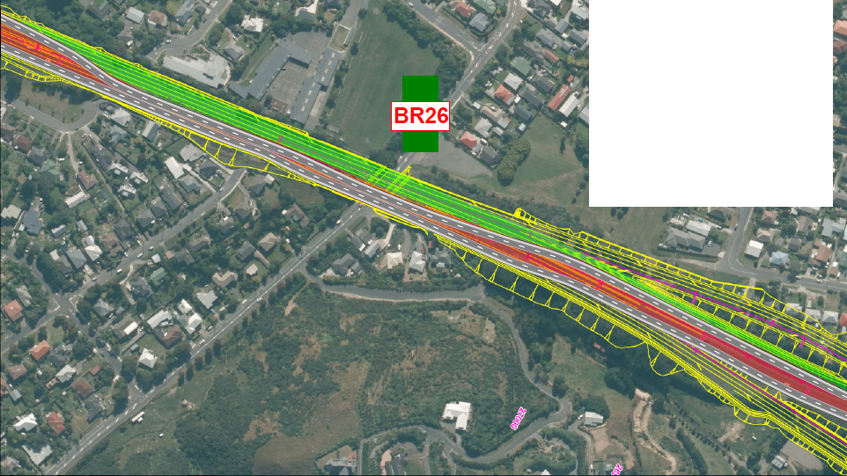
Design Concept Only
Planned for Dec 2018.

Slide 27
Kenepuru
Optional download of video
W-14b Kenepuru Bridge
Notes:
Time for another video. This was a pretty well managed piece of the project in order to reduce the impact on the users of the railway at Keneperu. This is Bridge 28, and was constructed in 8 days during a kiwi rail shut down over Christmas this year. There was a lot of planning that went into this operation, and when the time came to commence, we were rewarded with 2 days of high winds, which mean we had to delay the commencement as the crane was not able to operate. Never the less, turns out we had a bit of float in the program, and managed to get the girders up over the railway without to much disruption to the public.

Slide 28
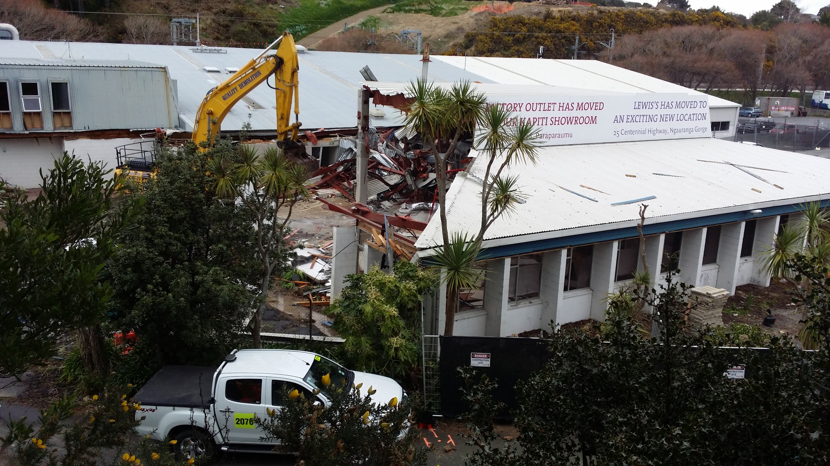
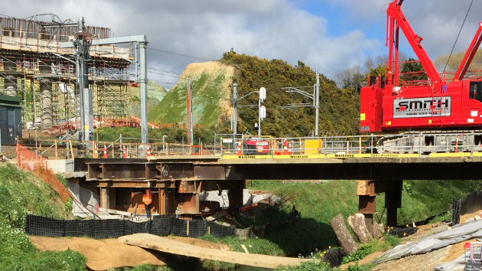
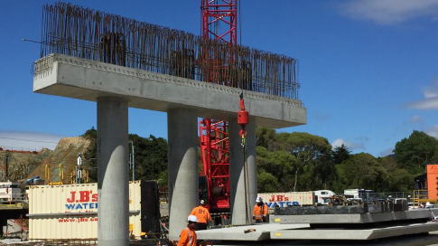
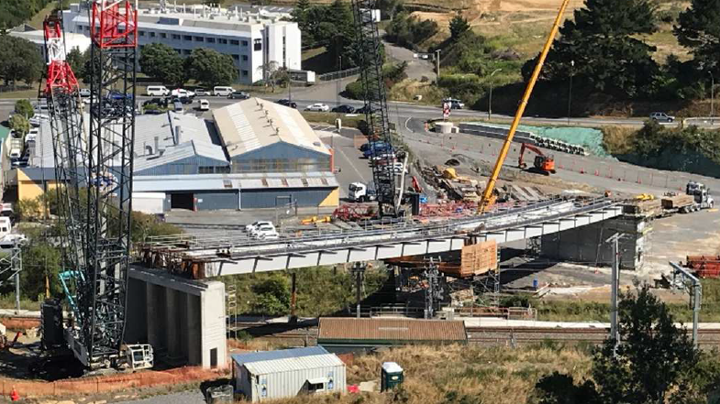
Kenepuru
Notes:
Time for another video. This was a pretty well managed piece of the project in order to reduce the impact on the users of the railway at Keneperu. This is Bridge 28, and was constructed in 8 days during a kiwi rail shut down over Christmas this year. There was a lot of planning that went into this operation, and when the time came to commence, we were rewarded with 2 days of high winds, which mean we had to delay the commencement as the crane was not able to operate. Never the less, turns out we had a bit of float in the program, and managed to get the girders up over the railway without to much disruption to the public.

Slide 29
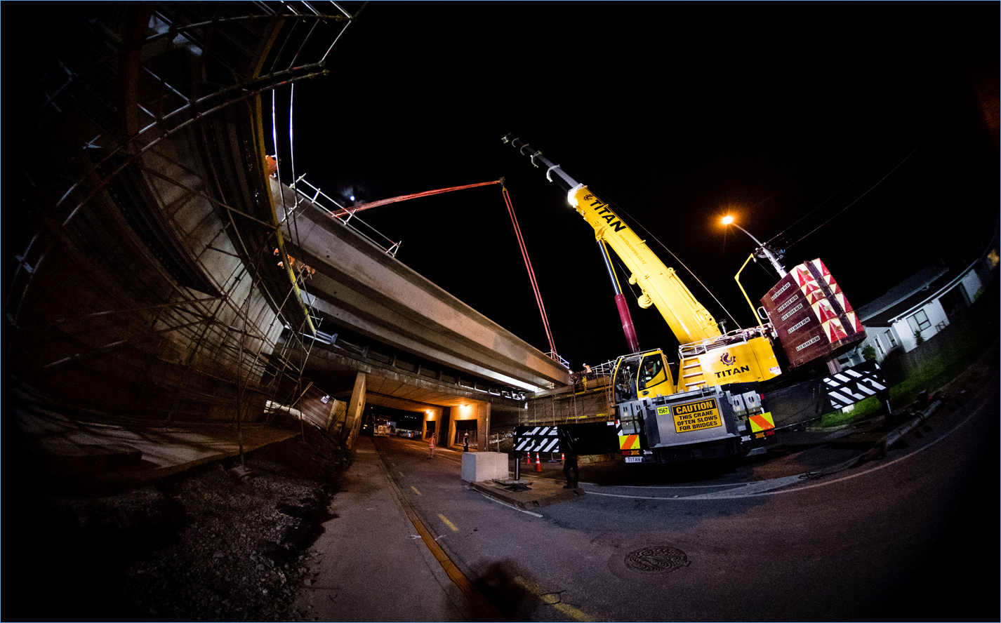
Tours arranged upon request

Slide 30
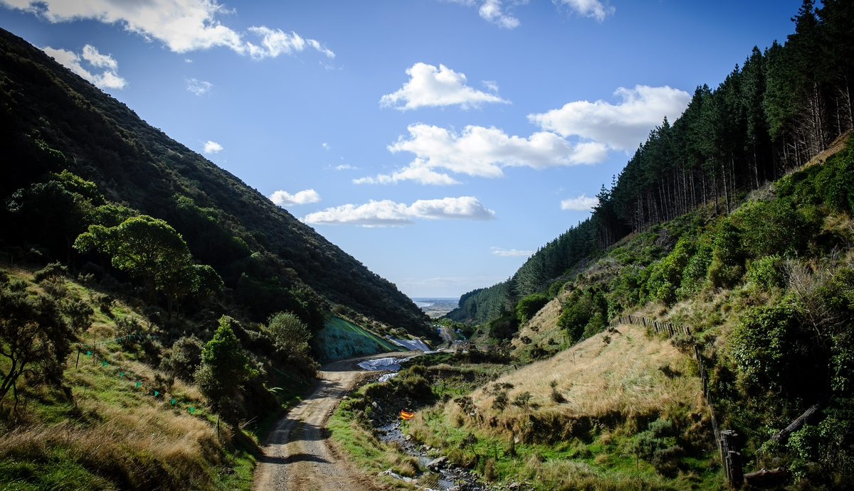
Any Questions?

