Slide 1
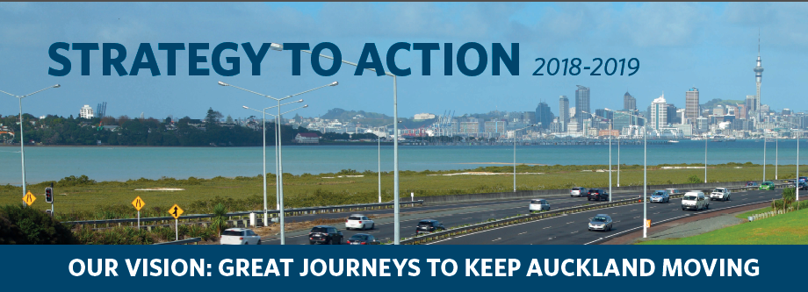
Mobile Barrier MBT-1
Notes:
Introduction: I am an electrical engineer by degree and have been working in the AMA for the past two years. I am responsible for the maintenanance of Non ITS assets in the corridor with a team of around 40 people working around the clock.
As I was being inducted I spent a night with our night crew and we were called out to crash on SH1 where a car car had hit the guard rail and damaged the centre median

Slide 2
Our Daily Challenges
Crew Feedback
A car drove down into our closure. …the driver was drunk, had learner licence and carrying passengers
A Member of public drove through a road closure sign.
A Car rolled over while we were setting up a closure at Ellerslie to Mt Wellington
Whilst setting up the closure … we had a car incident onsite involving 4 cars nose to tail at the point of installing our chicane taper
Vehicle lost control at Northcote on ramp closure and hit a sign.
Truck driver hit a parked car outside closure but within signage
TTM Closure breach by drunk driver Hitting the front of a subcontractors traffic management vehicle – 8 month LTI.

Slide 3
What’s the problem?
Decreasing working window
Increasing third party incidents
Customers expectations are increasing
Additional and more expensive assets that require maintenance but with restricted working space
As a PCBU we must ensure the health and safety ‘so far as is reasonably practicable’

Slide 4
Tiaki – Mobile Barrier
- A highly mobile 20m TL3 barrier that provides lateral intrusion protection as well as rear protection.
- A workshop on wheels.

Slide 5
How does it stack up?
In time the barrier will be more efficient and safer than our current practices
It will cover its costs and we get the safety benefit for free
It will reduce the number of full motorway closures (and minimise diversions)
Working windows can be increased
Worker exposure time is limited

Slide 6
How does it stack up? (2)
Provides positive side impact protection
Improves Traffic Flow in Work Zones
Greatly enhance Work Zone Efficiency
Require less collateral equipment
Improved staff confidence whilst working in Live Traffic
Change the way Tunnel and Motorways Closures for maintenance operations are conducted. Modern tunnels may avoid the need to close for all but heavy maintenance

Slide 7
19m
19m

Slide 8
What Work Can it do?
Ramp Closures
Centre Median Repairs
Right, Left & Centre Lane Closures
Enable Single/Multi Lane Tunnel Closures
Drainage Repairs
General Maintenance
Bridge Inspection/Deck Repairs
Pothole Patching/Crack Sealing
Guard Rail/Flex Fence Repairs
Concrete Repairs
Overhead Sign Repairs
Landscaping Works
Practically any job that needs a short term closure

Slide 9
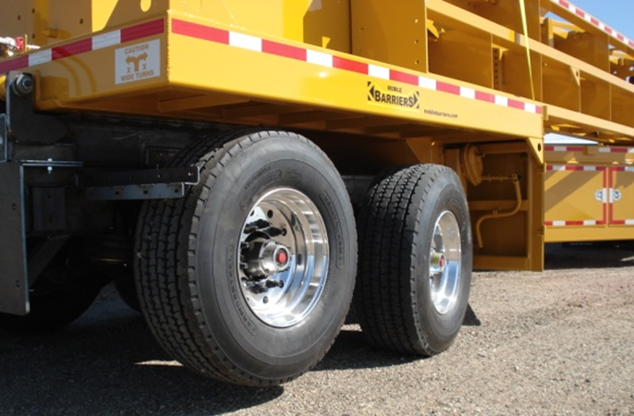
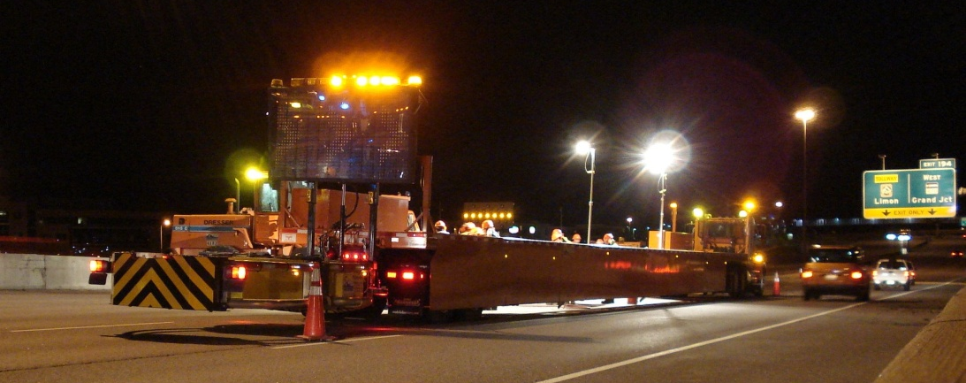
Whats On it?

Slide 10
How Does it work?

Slide 11
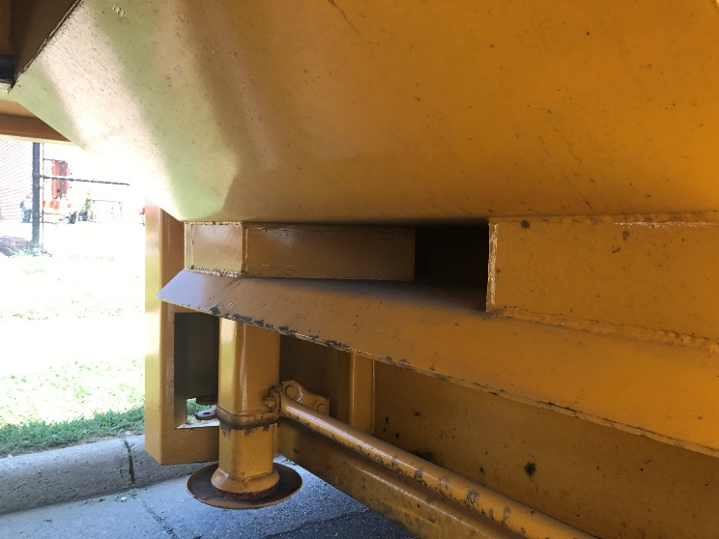
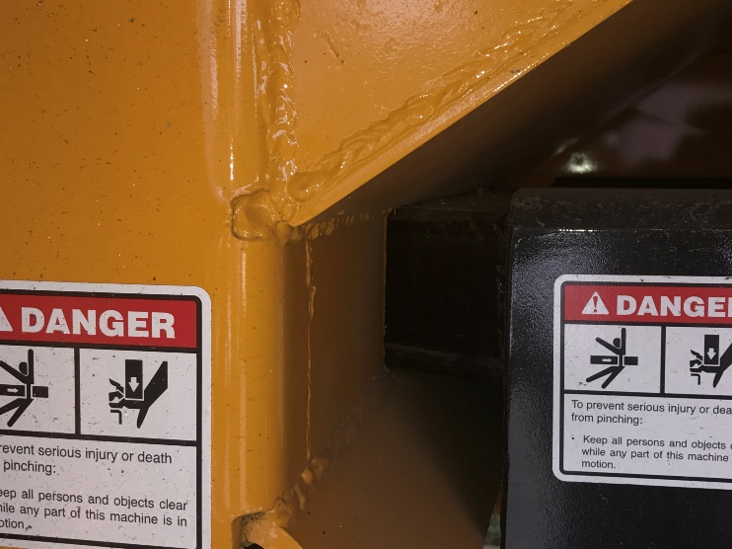
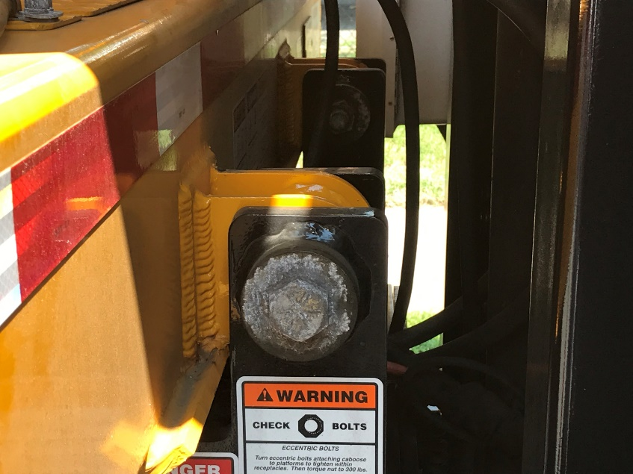
How Does it work?
reconfiguration link

Slide 12
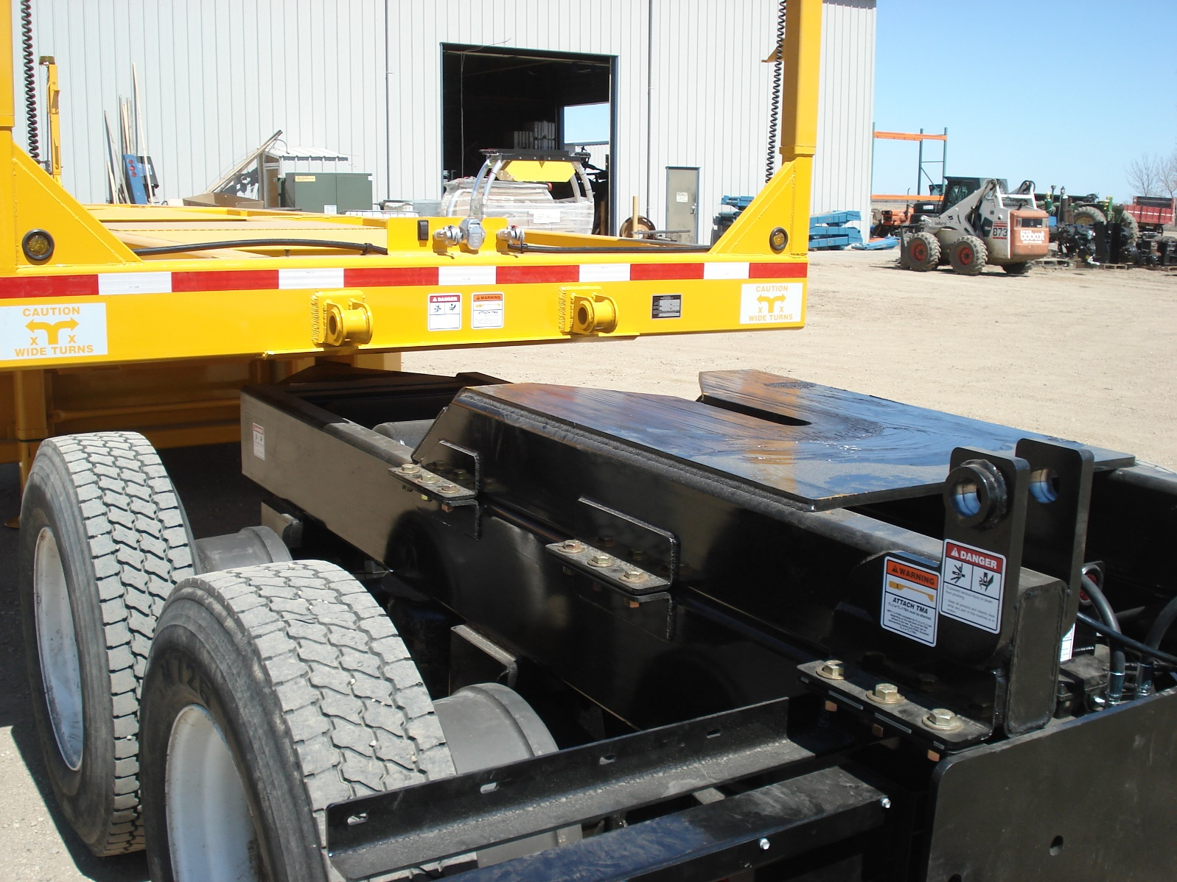

Slide 13
How will we use it (VPT)?
Victoria Park Tunnel - Full tunnel.
TMAs: 10 - 11 units
Start time: 1900
Closure in: 22:30
Work start: 2300
Work Finish: 0330
Uplift Finish: 0500
Working Window 4.5 hrs.
TTM Time 10 hrs.

Slide 14
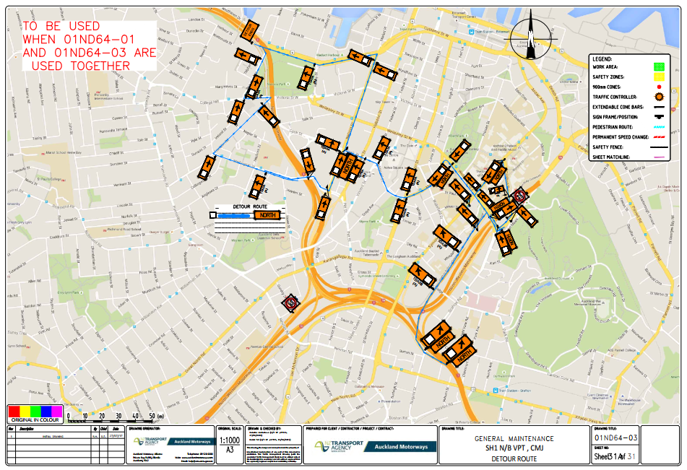
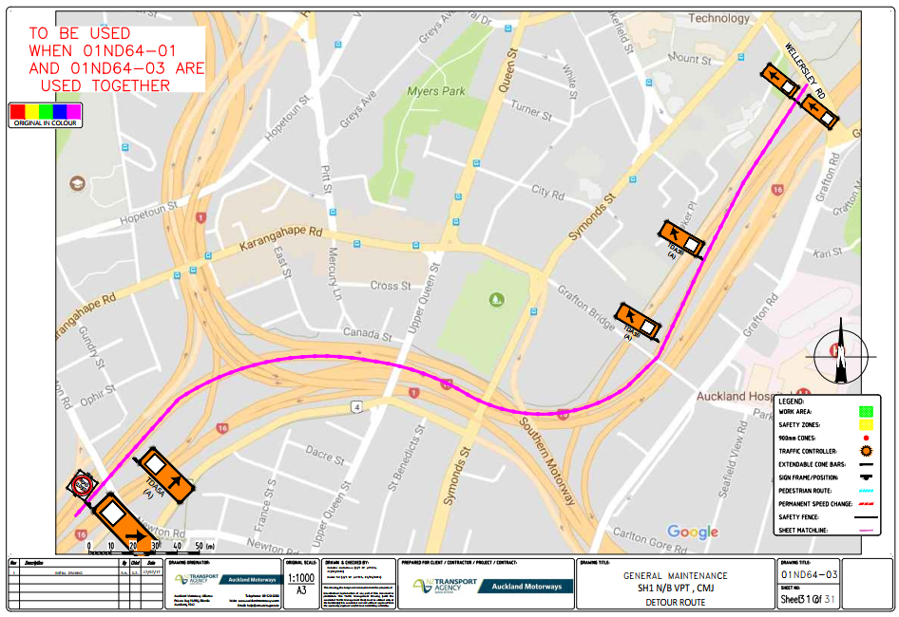
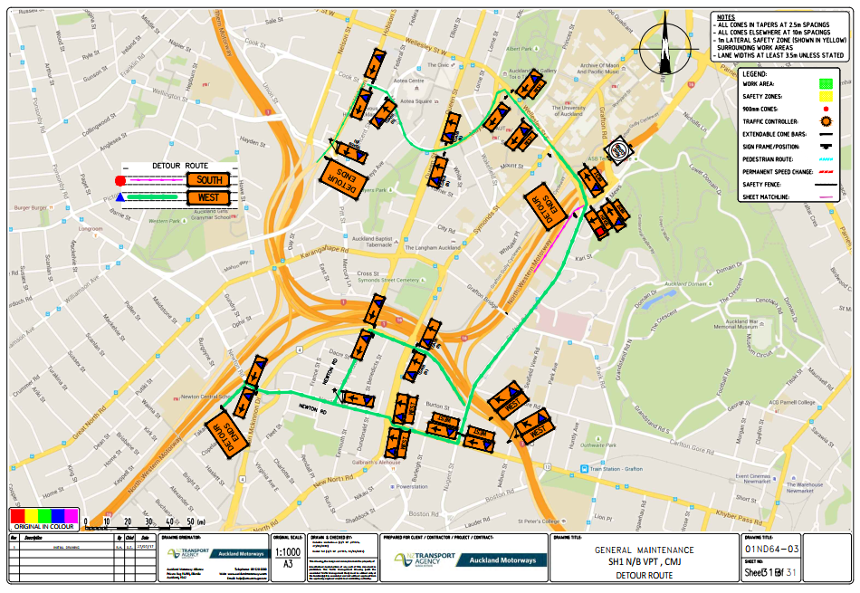
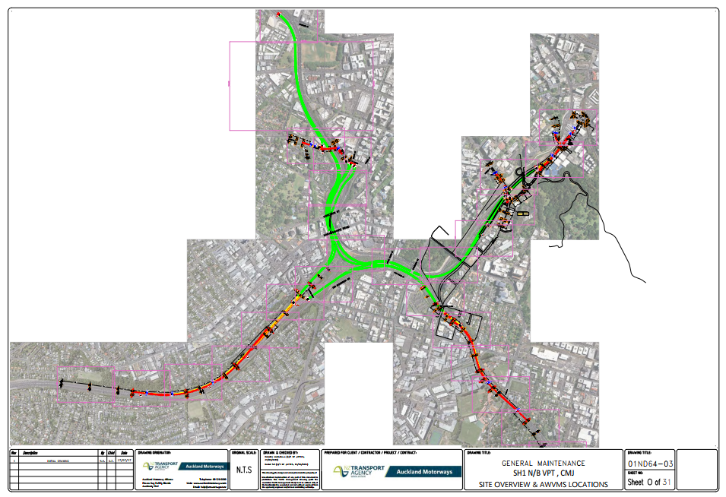

Slide 15
How will we use it (VPT) ?
Mobile Barrier
CMJ – 5 units
Start time: 22:30
Closure in place– 22:30
Work start: 22:35
Work Finish: 04:50
Uplift Start 0500
Working Window 6.5 hrs.
TTM Time 7.5 hrs.

Slide 16
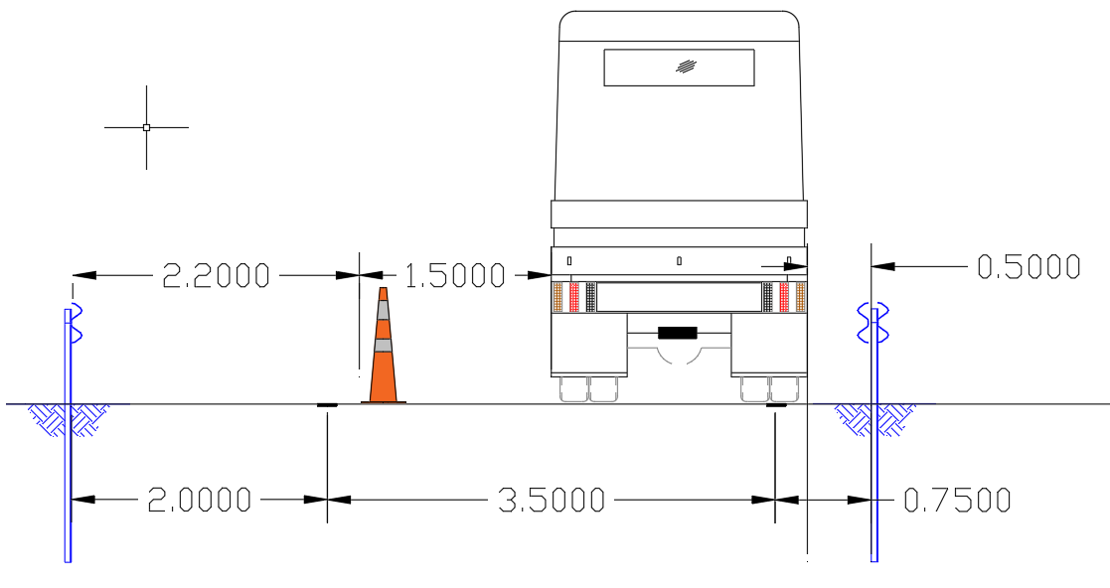
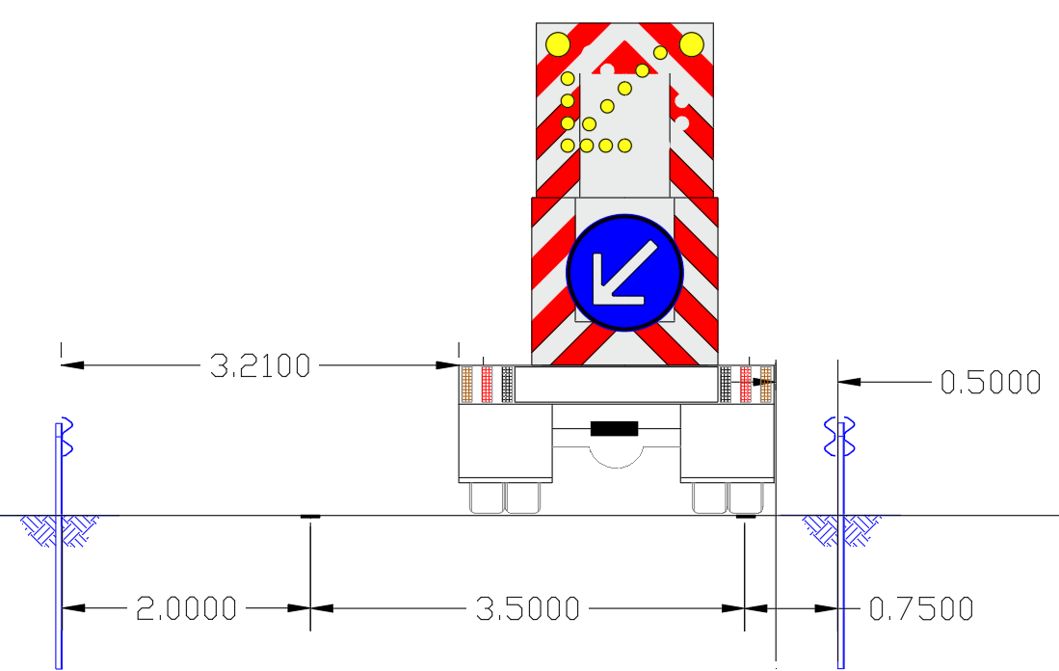
How will we use it (SH22)?
Safer Roads Project on SH22.

Slide 17
What do we Expect
Safer for workers and road users
Reduced time onsite
Minimise closures
Minimise diversions
Enhance the customer experience
Improve connected journeys
Change the way we work is planned, designed and delivered
Create its own chapter in CoPTTM
Help shape the future for TTM safety
KEEP PEOPLE SAFE
IMPROVE CUSTOMER EXPERIENCE
ACHIEVE ORGINISATIONAL EXCELLENCE

Slide 18
Videos
Crash Test:
https://www.youtube.com/watch?v=uk1rPfeBCqo
Worksite:
https://www.youtube.com/watch?v=unV9c368Lmk
Website:
www.Mobilebarriers.com

