Slide 1
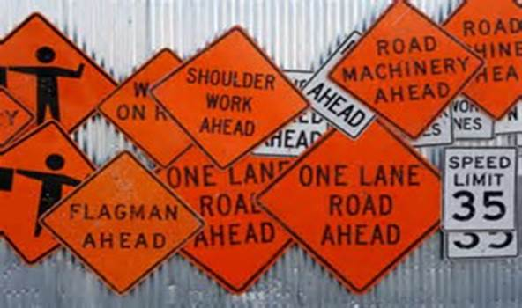
Closure Breaches
Prevention of full motorway closure breaches

Slide 2
Agenda
  Introduction
  Challenges
  Case studies
  Planning
  Controls

Slide 3
Introduction
What is the AMA?
The Auckland Motorway Alliance was established in order to manage and deliver the maintenance and operations of our 250 km network.
The volume of vehicles travelling on our network is 1.1 million trips in a day and increasing. This is an estimate of 12.5 million km,s travelled per day.
Our objective is to maximise the efficiency of the motorway and wider Auckland transport network and in achieving this we need to put Safety first and everything else second.
This objective is being severely challenged on a nightly basis and due to the facts above the risk of closure breaches has become increasingly challenging.

Slide 4
What is a Closure Breach
A closure breach occurs when a person or vehicle, whether intentionally or unintentionally enters a traffic managed closure.
A closure breach can occur:
Wilfully by criminals;
Members of public not wanting to follow diversions;
Unintentionally by confused drivers;
Wrong way drivers. (Criminally or confused)
Notes:
So lets go back to the beginning of what is a closure breach? Wilfully by criminals attempting to escape during a police chase;
Members of public not wanting to follow the diversion;
Unintentionally by drivers not paying attention, Confused or elderly;
Wrong way drivers.

Slide 5
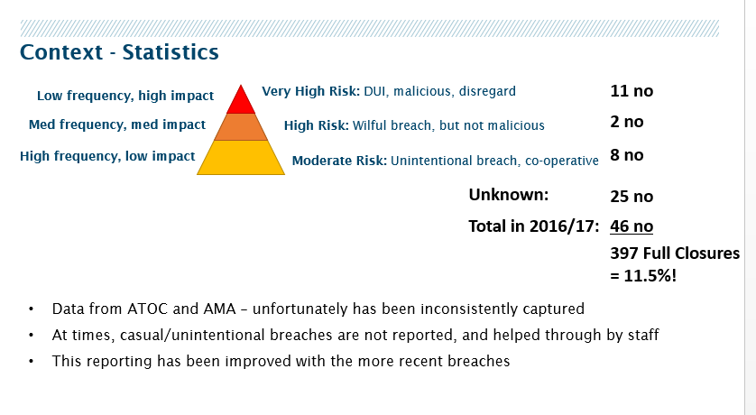
Explore Case Studies of Breach Events

Slide 6
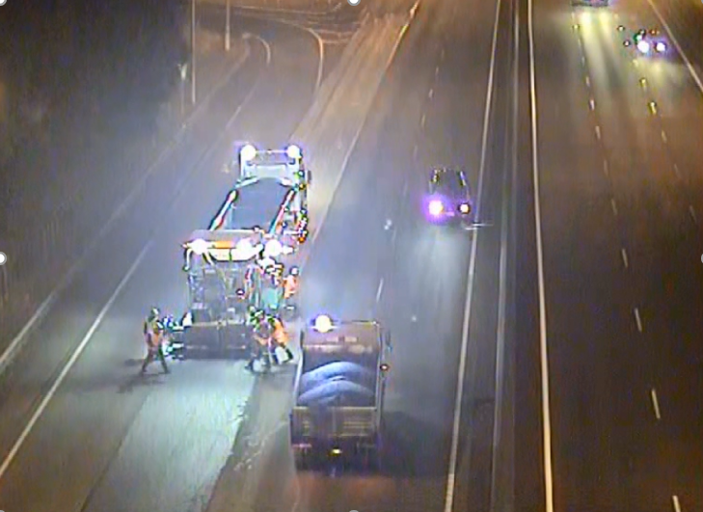
SH 1 – Stolen Vehicle – Wrong Way Driver
East Tamaki Interchange

Slide 7
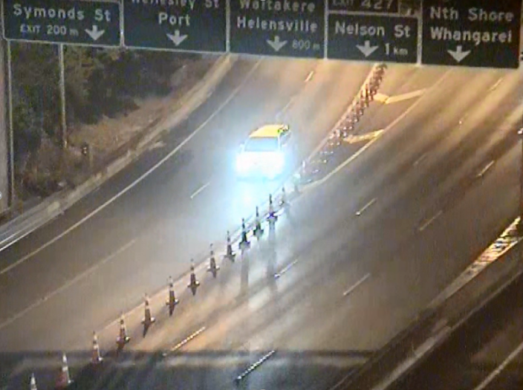
CMJ – Gang Induction – Wrong Way Driver
Symonds Street

Slide 8
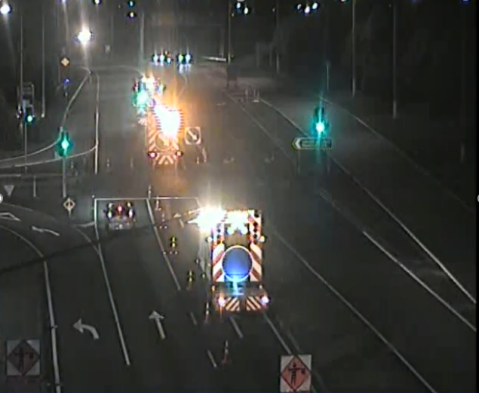
SH 18 – Confused Driver
Paul Matthews Road

Slide 9
Pre-empting a closure breach
Factors to consider
TMP
Location of the closure and history of breaches in the location
Activities within the closure
Length of the closure
Activities surrounding the area of the closure, site entry and exits
Signage and other delineation of the closure
Once the abovementioned factors have been considered and the risks have been identified, defences need to be considered to lock the site down.

Slide 10
Closure Breach Defences

Slide 11
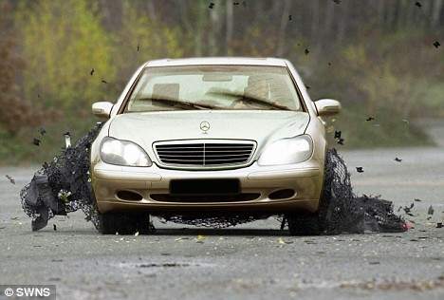
X-Nets
A portable, non-lethal vehicle arrest system to bring vehicles to an involuntary standstill

Slide 12
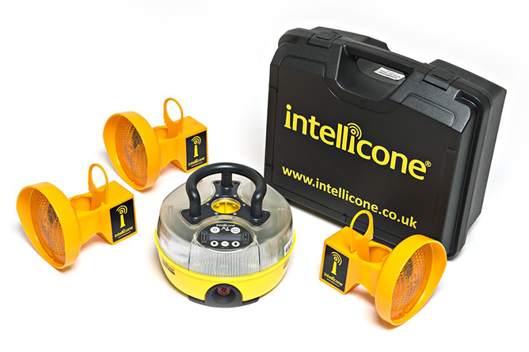
Intellicone Site Alarm
The implementation of the intellicones are intended to immediately alert staff when a cone has been knocked over.

Slide 13
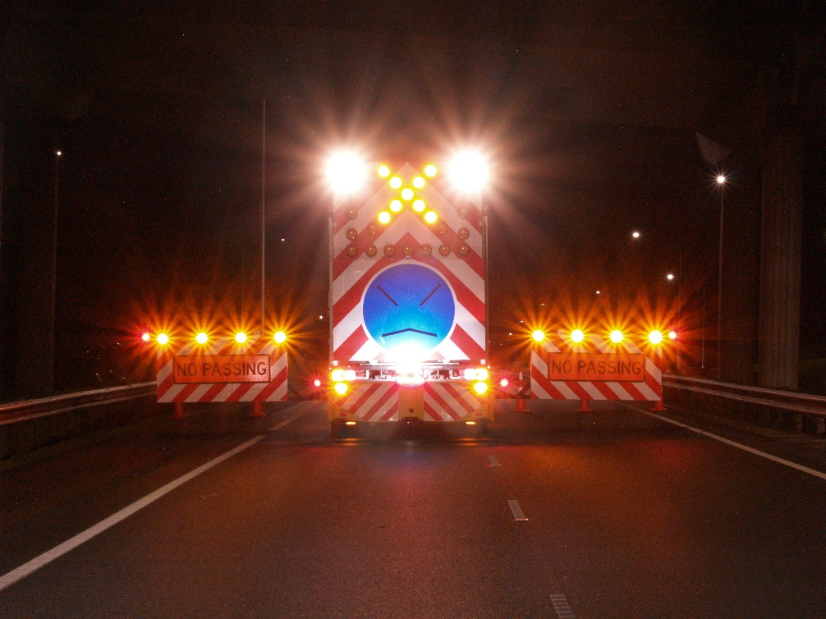
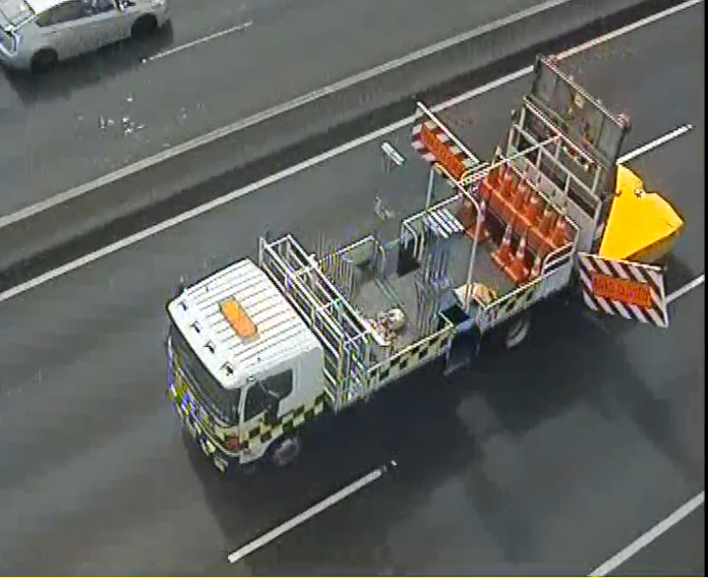
TMA Outriggers
The use of the outriggers mounted on the TMA’s aids to extend the protection area or for site access control.
Notes:
This little invention has recently won the AMA the 3M innovation award of which we are very proud.

Slide 14
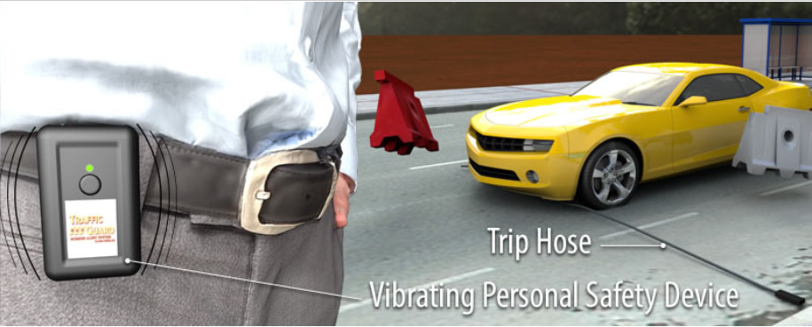
Traffic guard worker alert system
This provides personal alerts for workers when a vehicle crosses a tube laid across the road.

Slide 15
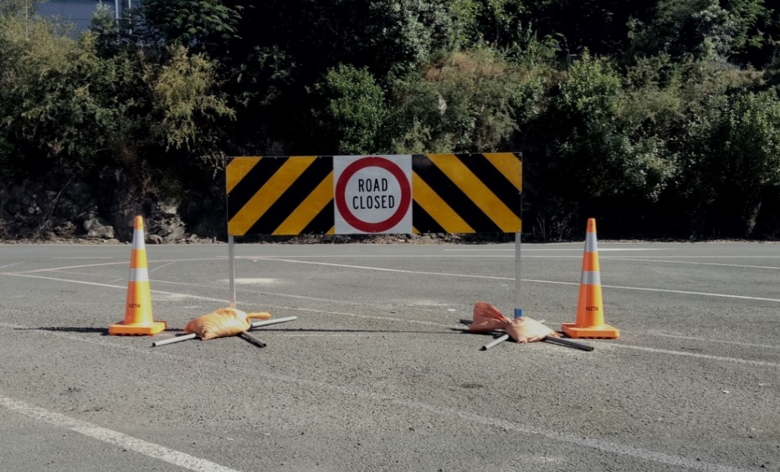
Aluminium reflective message barriers
Provides sufficient deterrent to keep errant drivers out of the worksite

Slide 16
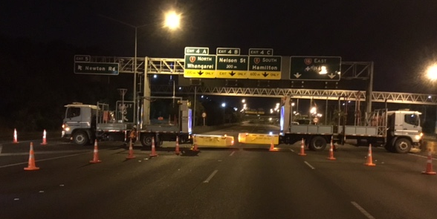
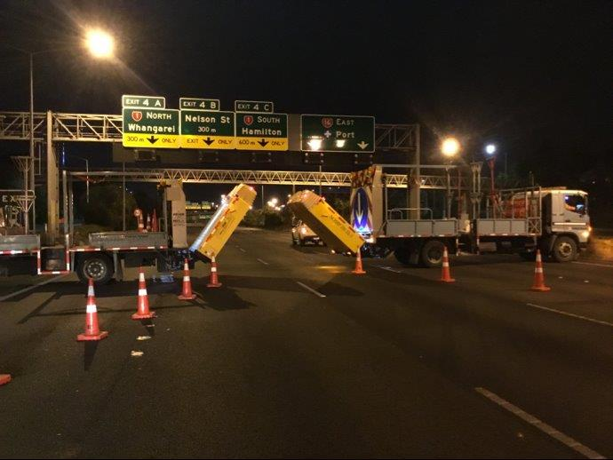
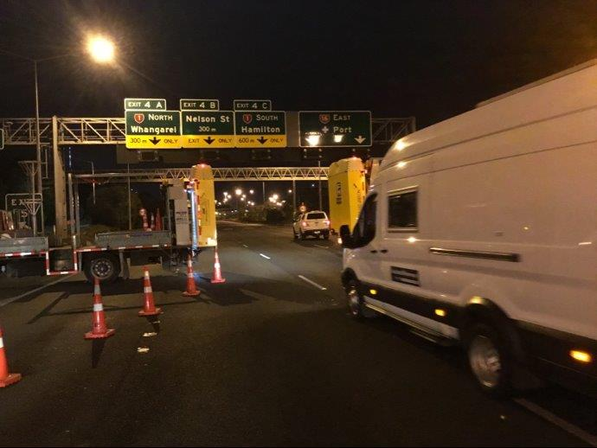
Traffic Management Attenuators
TMAs used as a physical barrier, parked across the road within work zone acting as entry/exit gates

Slide 17
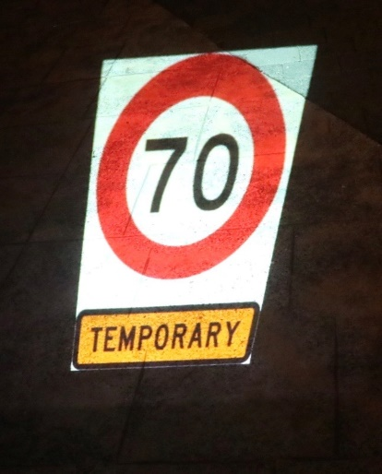
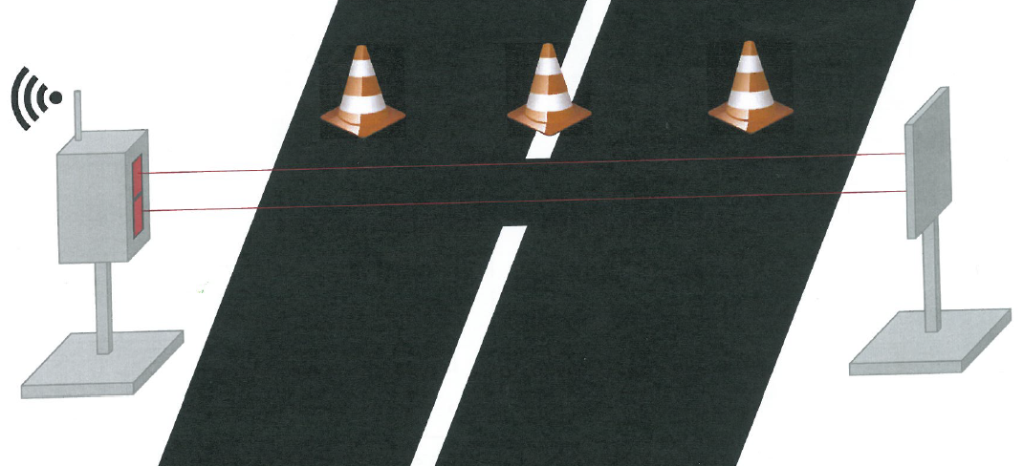
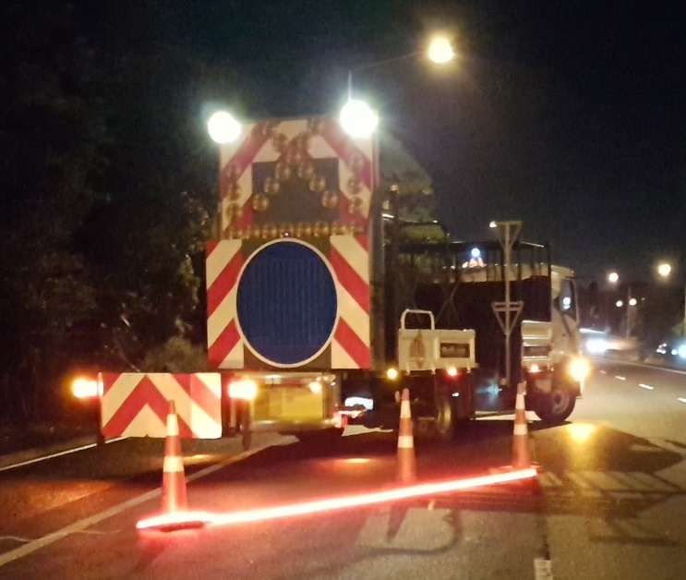
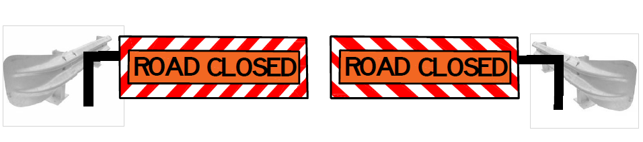
More and future defence considerations for visibility and protection
Notes:
1. Mobile “STOP” Barrier; LED lane separation Strips, judder bars, Gibney paddle and halogen balloon lights, laser detection, JAW Speed hump,, Road surface signage projection

Slide 18
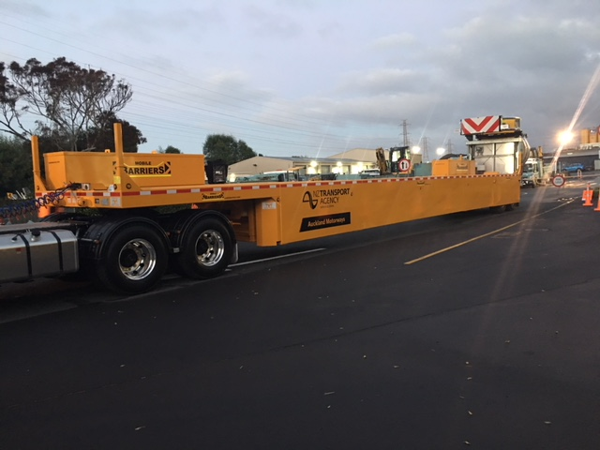
Future Breach Defence
Primary usage for mobile and semi-static operations, but could be used for static closures
Expected deployment June 2018

Slide 19
Thank you
Have a great day, be safe and enjoy the conference!

