Slide 1
Update on the On-Site Record 2 hourly check phone App
Now includes the following:
$49 per device
(one off cost)
Yes you’re reading right
Existing - 2 hourly checks, recording TSL & GPS tracking
New - Site Handovers
New - Tool Box briefings
New - Generic TMP checking process form (E1.8)
Coming soon -Report on incident at roadworks site (E11 Appendix K)
Coming soon – Server based system that manages all incoming checks and links in with the E Board system

Slide 2
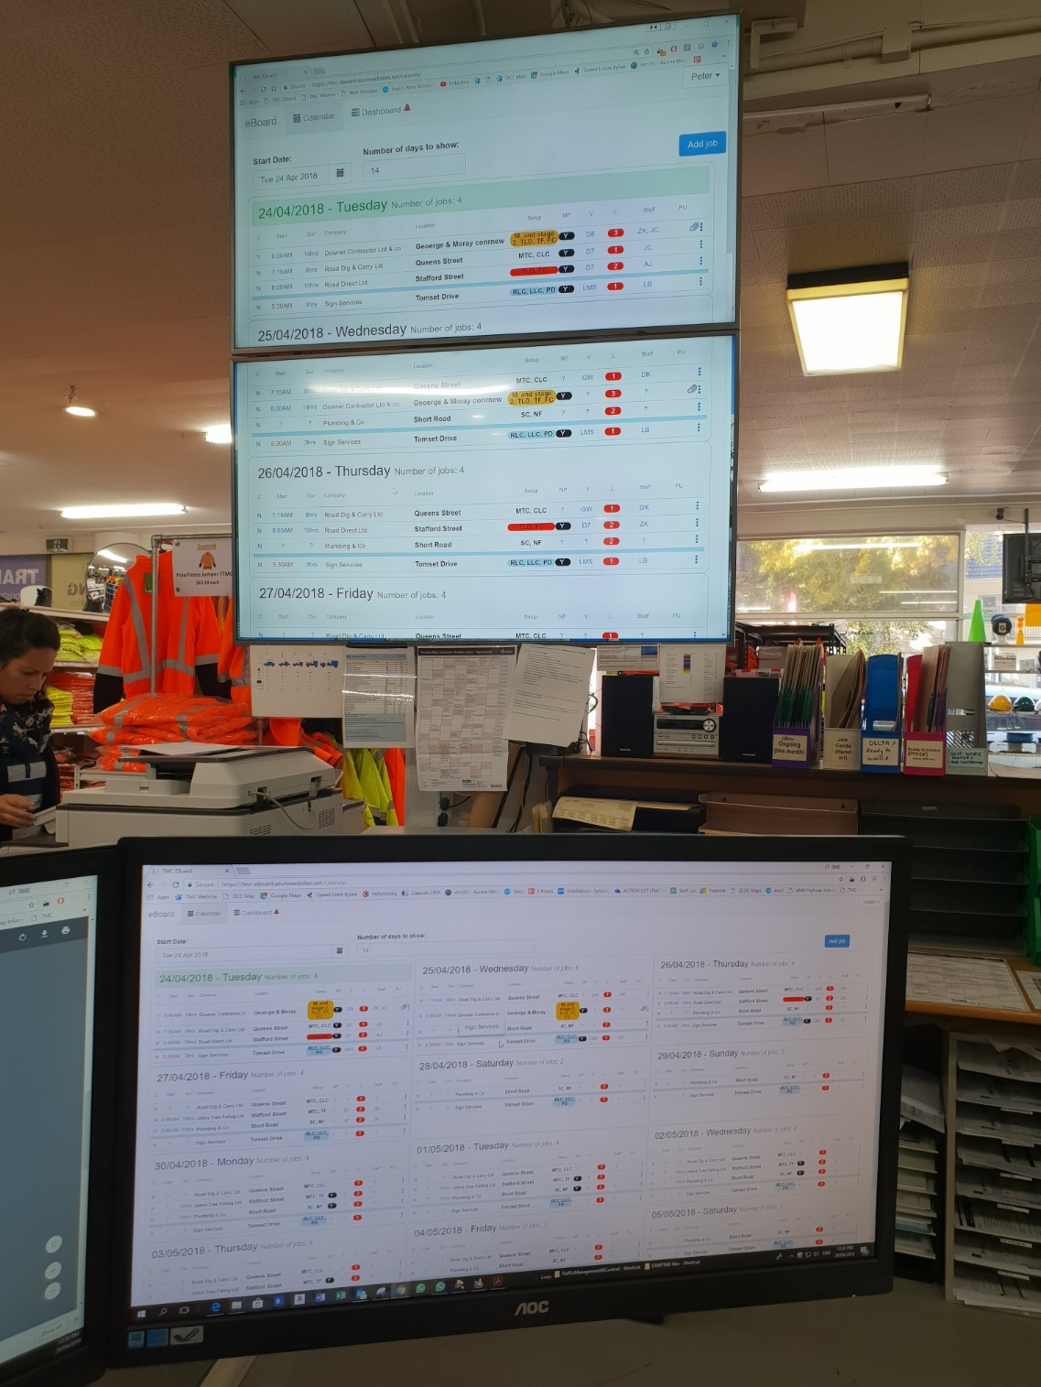
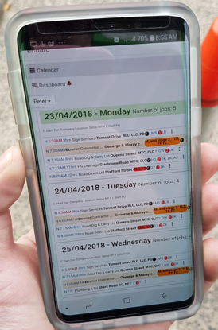
Introducing the E-Board www.roaddirect.co.nz
Electronic Booking System (E-Board) that manages your key traffic management resources in one central location.

Slide 3
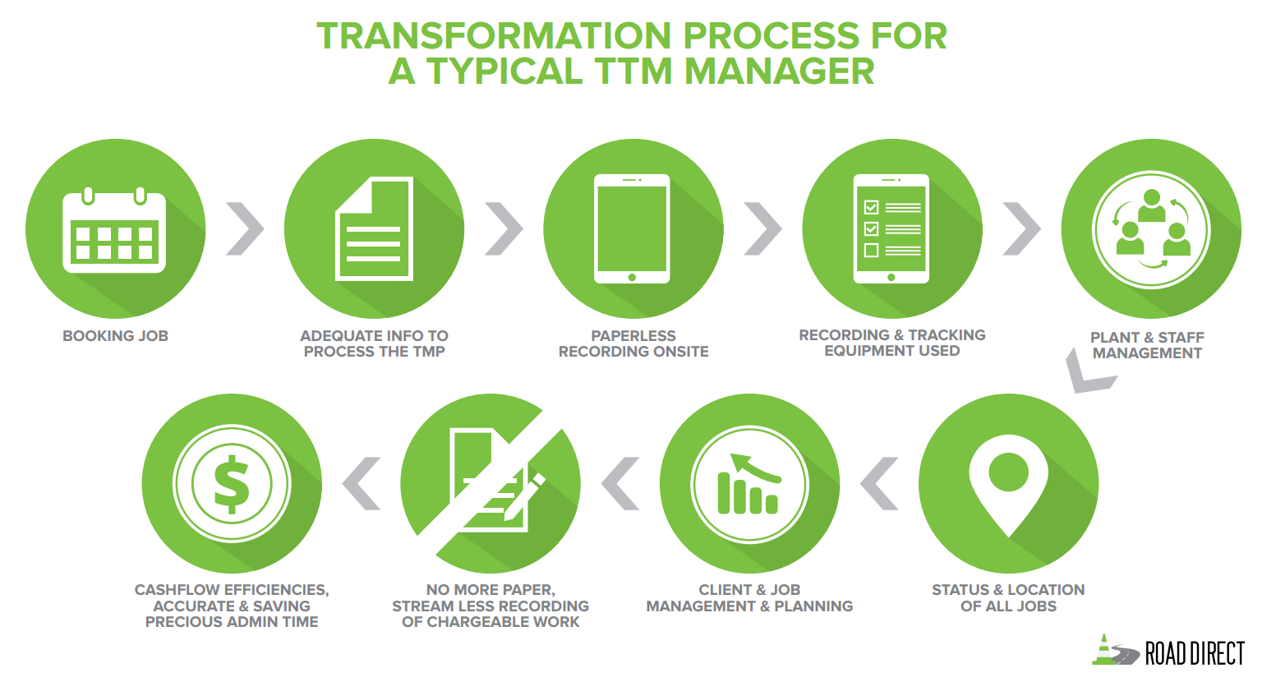
This is what we endeavour to capture using this system

Slide 4
This is why we have created the E-Board
Lets take a look at the many different moving parts that occur from the initial booking phase through to the job being billed out.
In the TTM industry we have many different aspects that need managed, both prior to and during the job.
Whether it’s taking a job booking from scratch on the phone, designing TMPs, managing daily TTM activities or setting up jobs, there are many different elements to this process. As we have seen NZTA this year also looking into the various competencies that we need in each career path/role (learning blocks), we as TTM managers need to consider this as well.
Therefore the importance for one central system has grown, so all roles can use this information to ensure high standards and quality are met and at the same time saving valuable time & money.

Slide 5
This is why we have created the E-Board
The information taken with your client during the booking stages in order to setup a site is not always the same as what the TMP designers need through to the vital information the Operations team need for planning the job that allocate things like staff and resources to ensure staff who will be onsite doing the job have the info they require on the day.
The recording of all this information is important so that any one person in the office or from any location can plan the following days & weeks, and at the same time track equipment left onsite so the invoice team have the data they need to bill out the job without the painstaking task of pulling information from hard copy forms that can be easily lost or pile up on your desk.
One platform that captures and links it all!
Custom made for the industry we have here today.

Slide 6
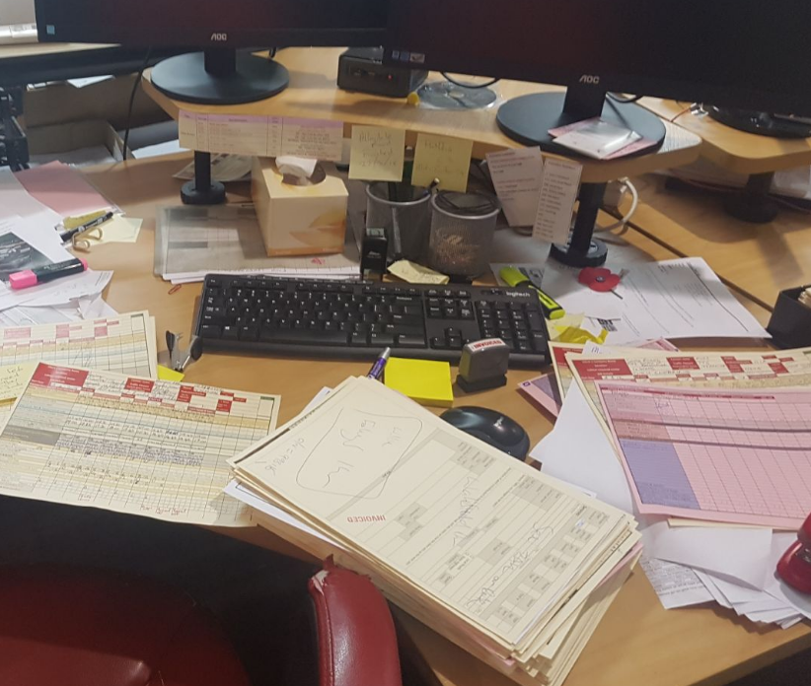
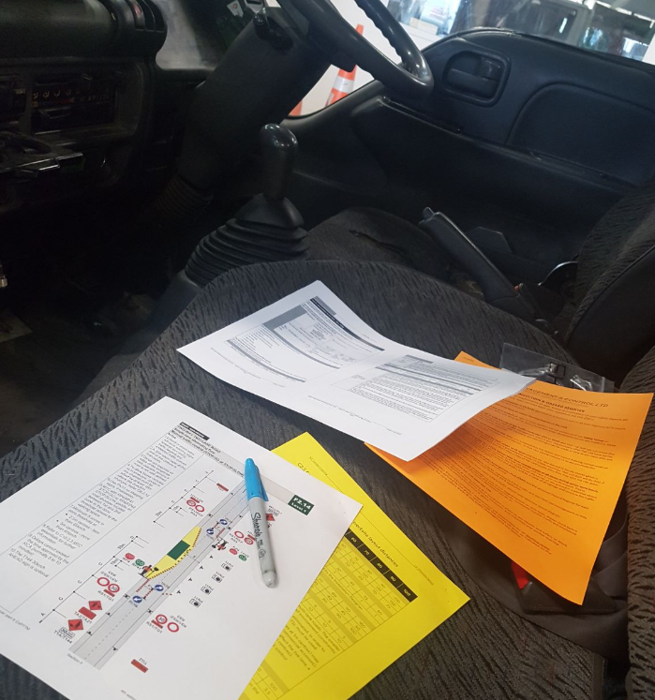
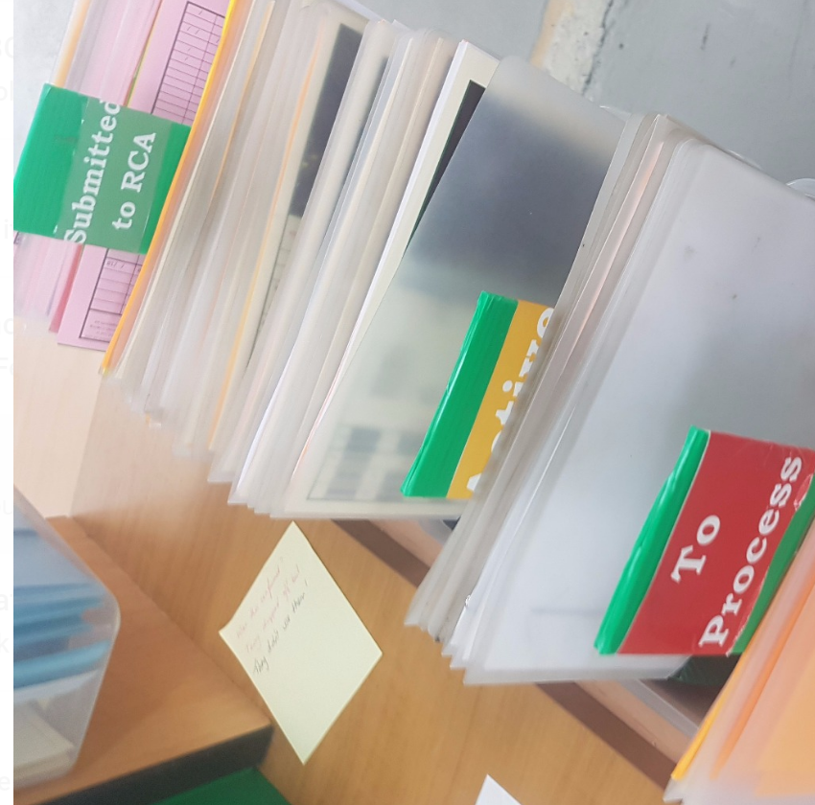
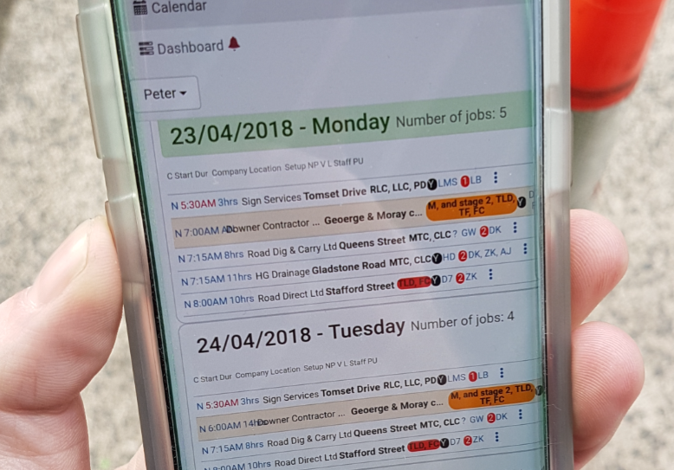
Even if we like doing things the hard or old way, sometimes we need to think is this the most cost effective approach?
Be smart

Slide 7
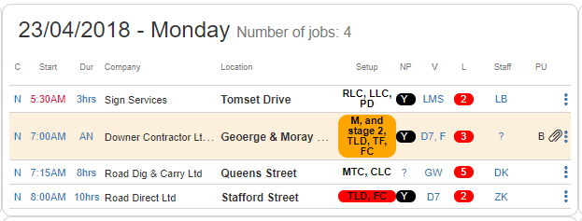
Custom TTM overview showing essentials displayed for TTM managers & staff onsite
The custom made Calendar view gives your staff and operations team an overview of the job at a glance. This includes, time, location, if it requires no parking, brief description of setup required, staff/vehicle allocation and visually seeing the quantity of staff needed. See if jobs have the TMP attached and movement status knowing if staff have setup or are returning to base. One Display!

Slide 8
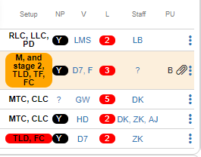
TTM calendar view – added features that the system manages
Functions built in which advise when the TMP will expire. Paperclip symbol changes to orange near expiry and red once expired.
Staff competencies ensure Operations know what staff are competent to do various types of jobs, as well as giving you the ability to mix new staff with the most experienced, increasing overall quality and enhancing training.

Slide 9
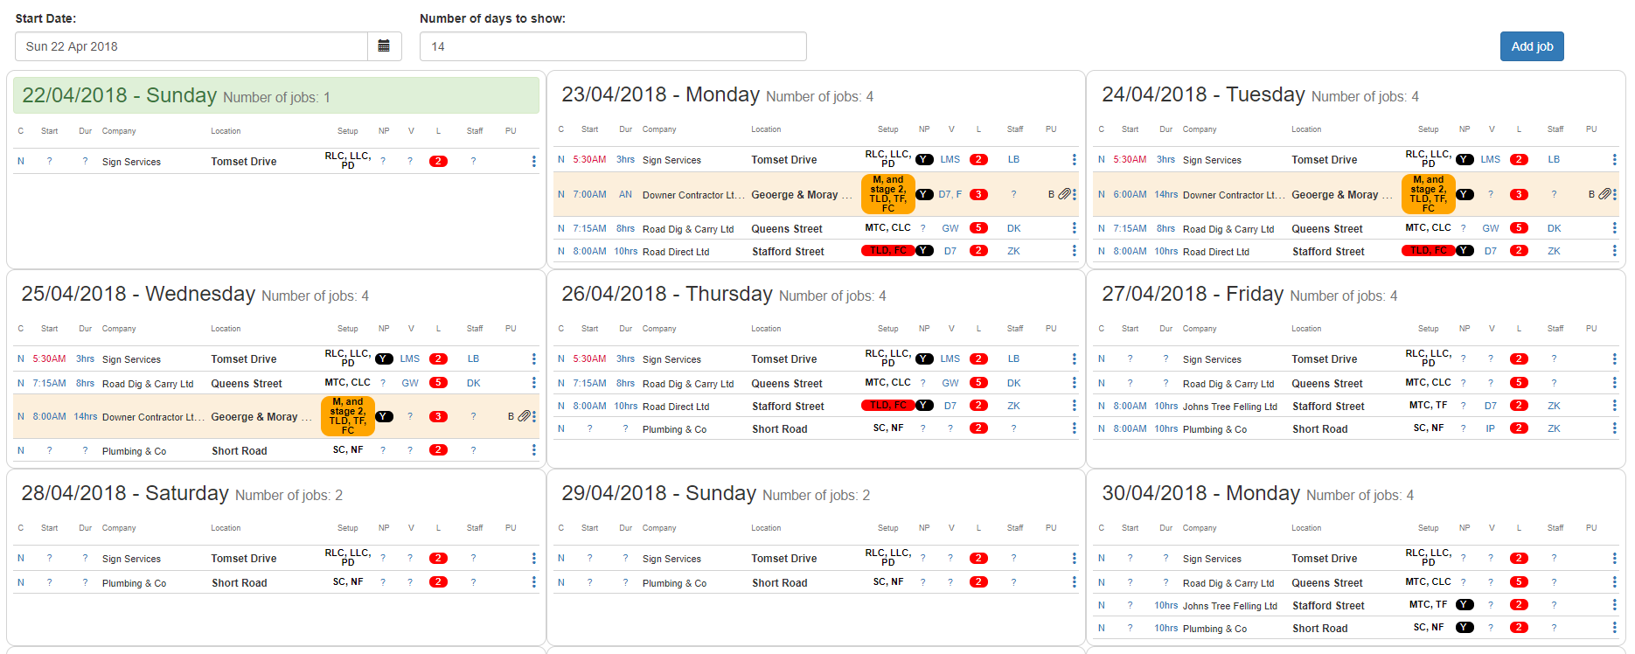
Plan ahead, be smarter, and make the most of the resources you have
Identify staff and plant shortages when your operations team take on a new job. Know when and where to plan strategically with jobs, staff and core TTM resources.
At the same time, your workers who will be doing the job onsite can remotely access the job information from their phone / tablet so they can pre-plan their job ahead of time and view key information like the TMP and site pictures.

Slide 10
Lets take a look at some of the key features this system will provide
(a demonstration video will follow later on in this presentation)
Its important to remember that its many systems within one system from the office to the road and back again.
If you have the printed version of this you can find the videos at www.roaddirect.co.nz

Slide 11
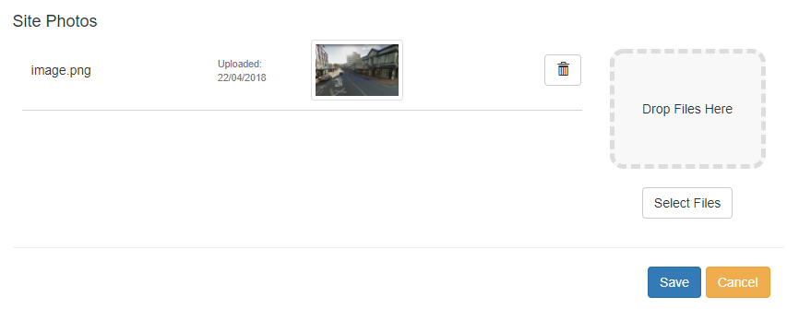
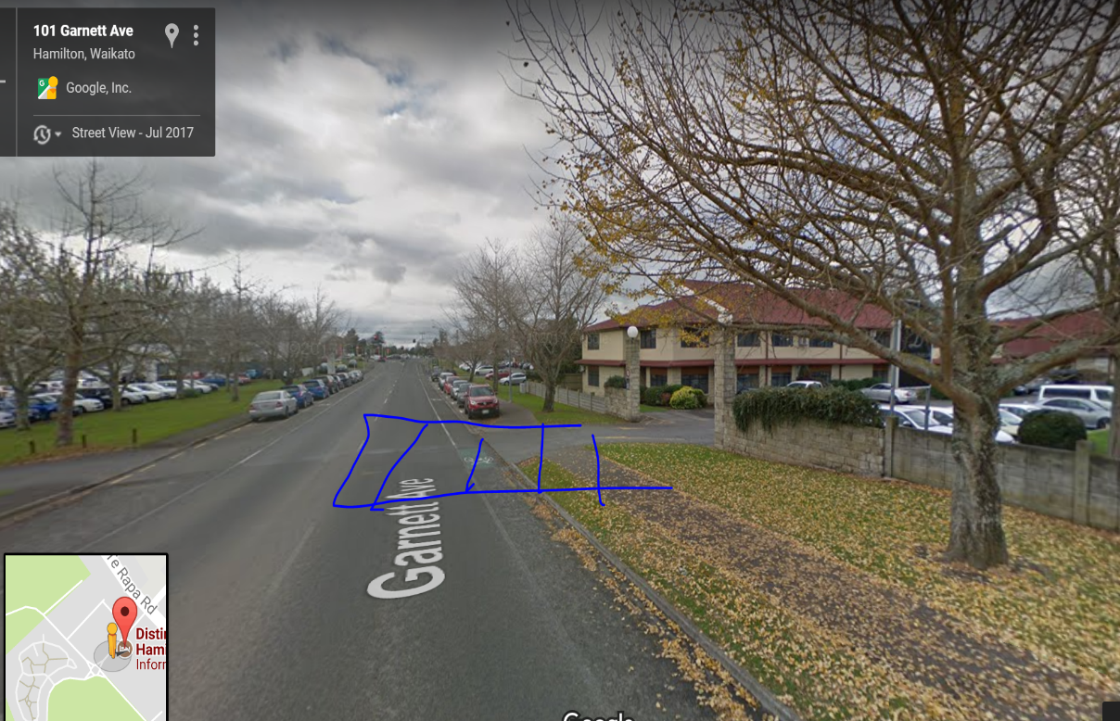
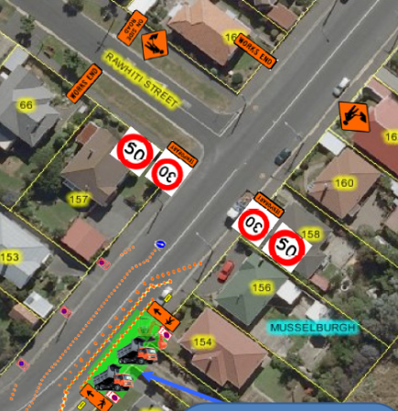
Upload key documents and job information
Site pictures &
other documents
TMP
electronic copy

Slide 12
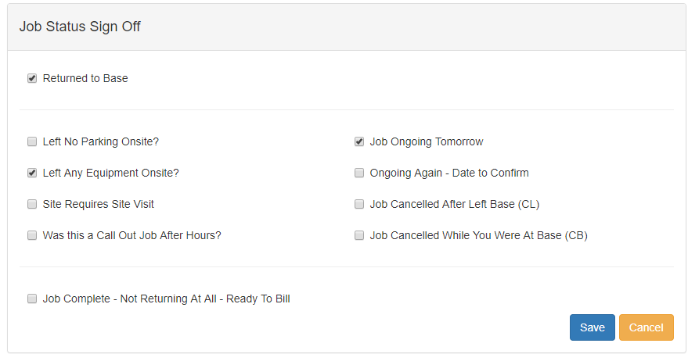
Job Status management
Staff complete checks below, if any of these boxes are ticked then the job highlights in orange indicating to your TTM managers that it needs their attention before it’s signed off for billing or rolled over to the following day.

Slide 13
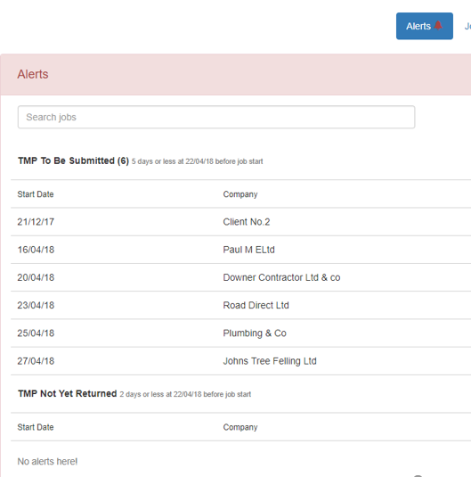
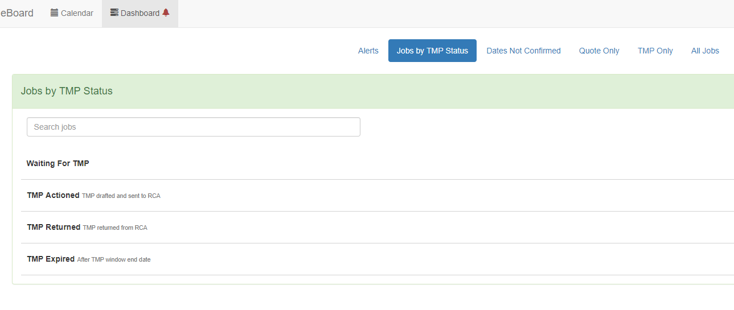
Dashboard overview for the TMP designers and office staff
Once the job is loaded this is tracked automatically on your dashboard so you know what TMPs need processed now, which ones are nearing expiry, prioritise office workloads.

Slide 14
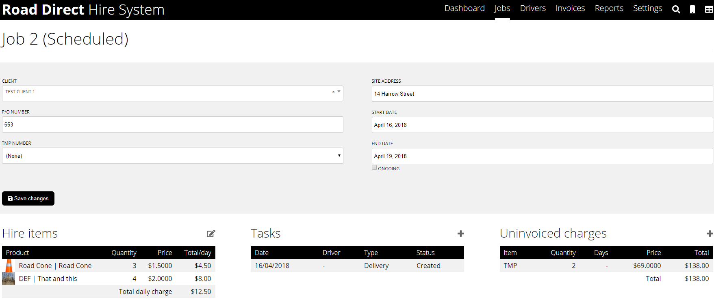
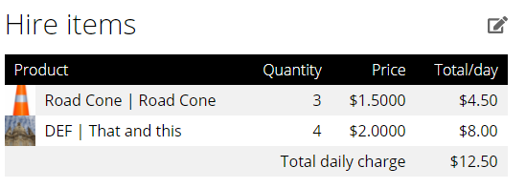
Chargeable Tracking, recording time and equipment in an intuitive system
Each item gets tallied to each job, including labour and vehicle times, signs and other chargeable items. The system will collate hours onsite and items used, ready for entering straight into your preferred invoicing software. Xero users will be able to sync straight to Xero. Or your can use this system.

Slide 15
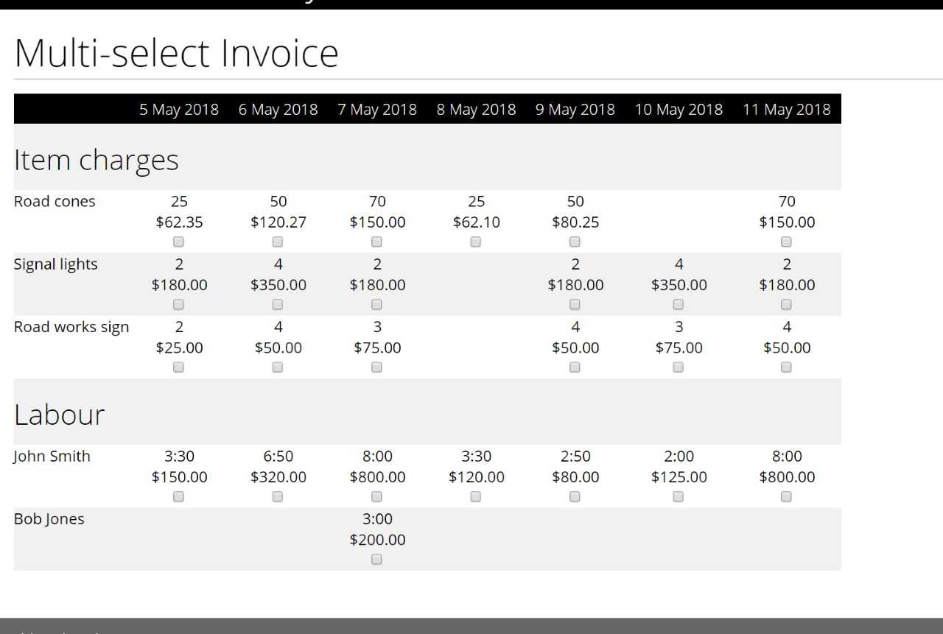
Billing out chargeable work
Once you decide you want to bill the job, the system provides you with many options of how you may want to go about that i.e. you can choose to charge a set rate based on hours spent onsite or equipment used each day or a combination or however you wish.
No more painstakingly adding up times from a piece of paper, its ready to go!

Slide 16
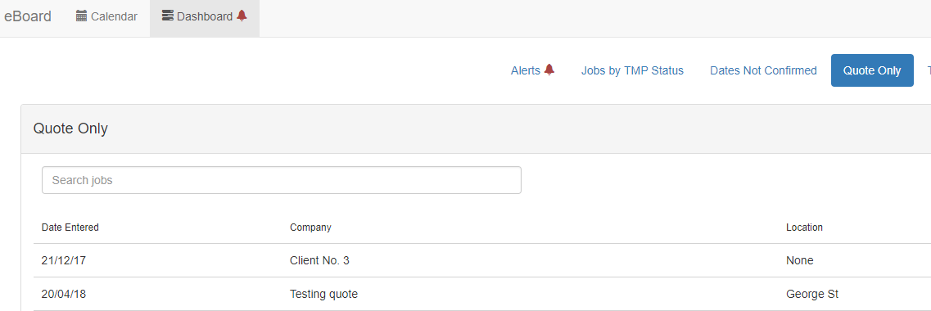
Quotes & Pending jobs
Save quotes or jobs that are pending dates. Your job is saved ready to use at later date to make the TMP and book the job once the client confirms it’s going ahead.

Slide 17
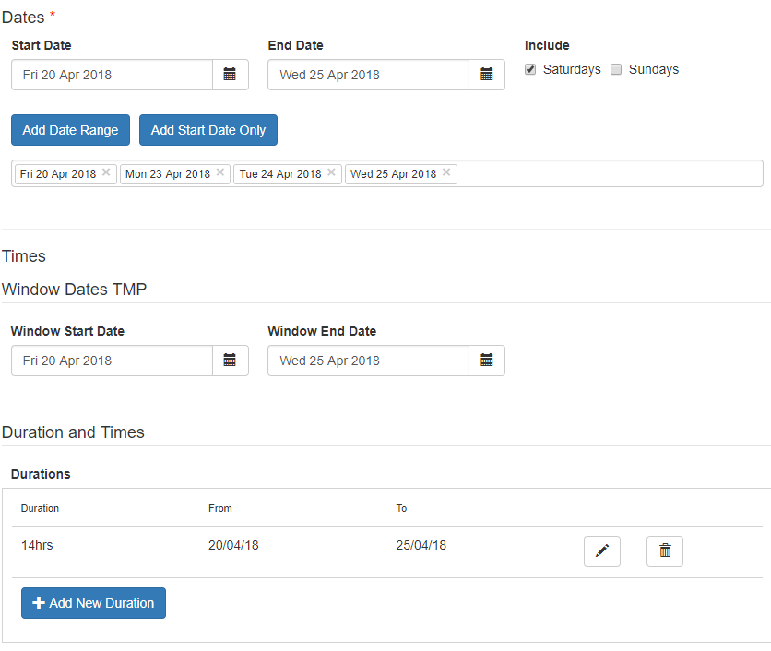
Dates/Times
Gathering key information about start times and duration for both TC/STMS in charge, as well as for the management and operations team for planning purposes.
Drop down options and easy functionality to speed up office time spent loading new jobs. This information is then used again for TTM managers and the TC/STMS onsite.

Slide 18
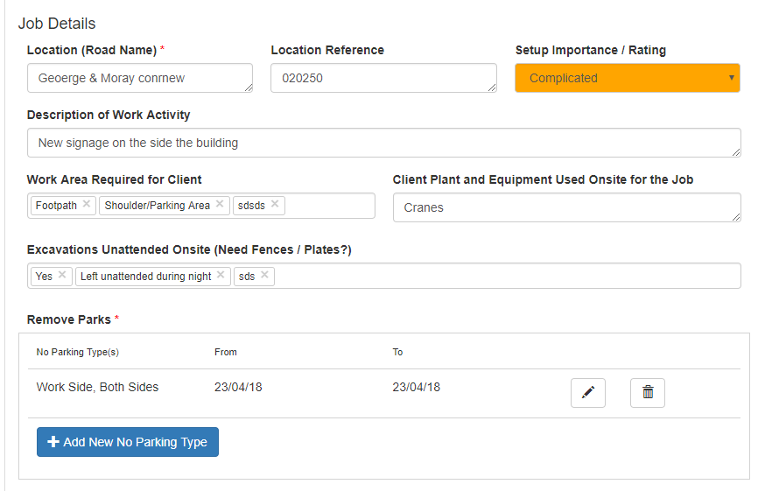
Job Details
Key information stored about what type work is being undertaken, areas of carriageway affected, using what plant and machinery, locations and setup importance to reflect the significance of the job on the calendar view.
- This information is again used for staff setting up as well the TMP team who create the plans.

Slide 19
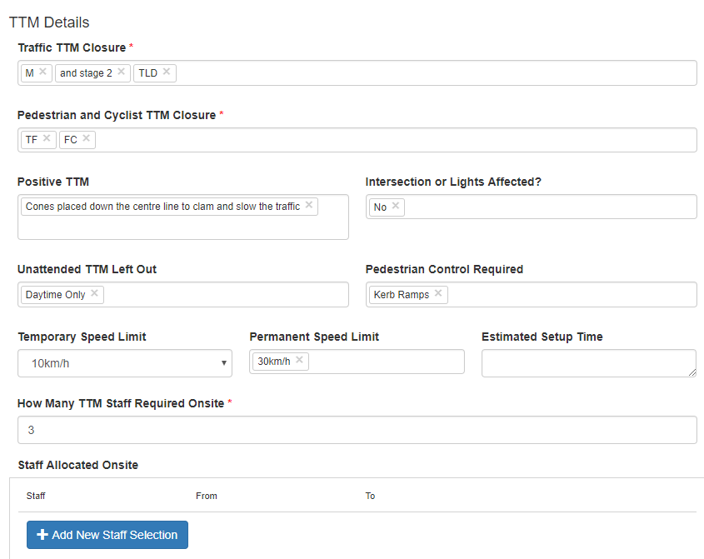
Traffic Management Details
Capturing closure types and fields that are relevant for TMP design as well as on the day information required for planning the jobs in your business.
Quick and easy drop down select menus pre loaded options

Slide 20
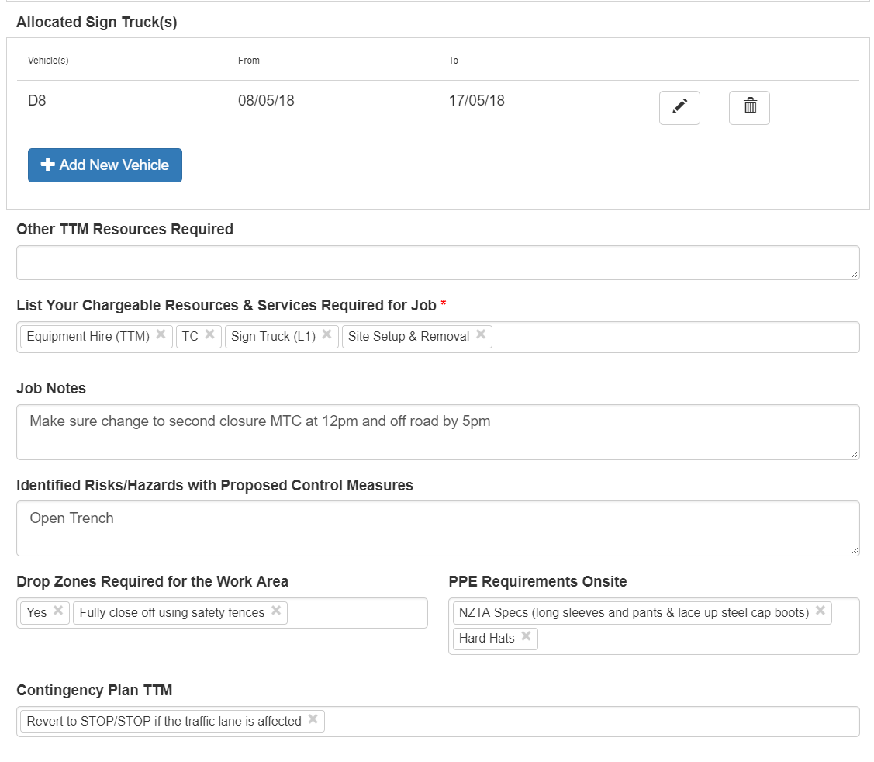
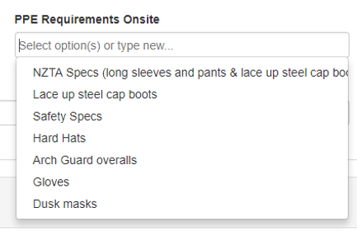
Traffic Management Details
Tracking chargeable work, risks and allocation the correct signs trucks and staff
Custom Fields to increase safety and notes for staff

Slide 21
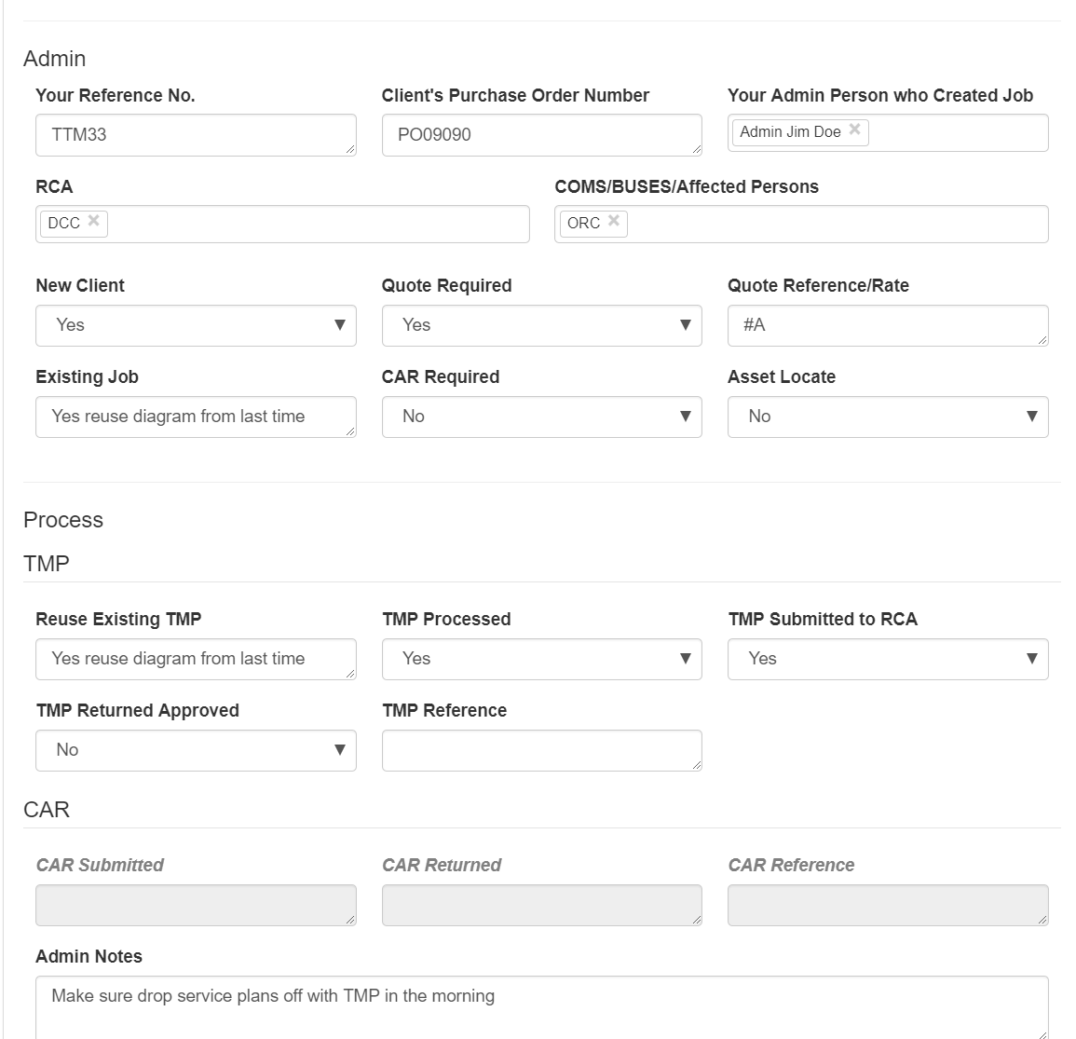
Admin information
PO numbers
Quote & references
Corridor access requests
RCA & COMM's information
Admin information
PO numbers
Quote & references
Corridor access requests
RCA & COMM's information

Slide 22
Time to watch the demonstration videos
If you have the printed version of this you can find the videos at www.roaddirect.co.nz

Slide 23
Lets recap with the following slides how this system performs on so many different levels

Slide 24
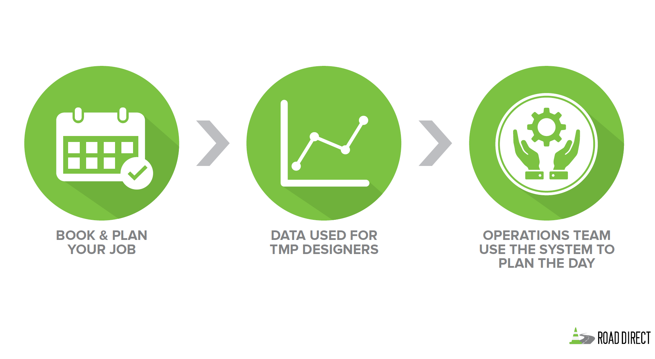
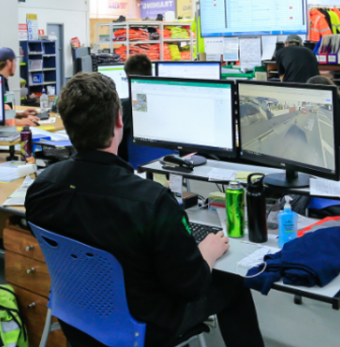

Slide 25
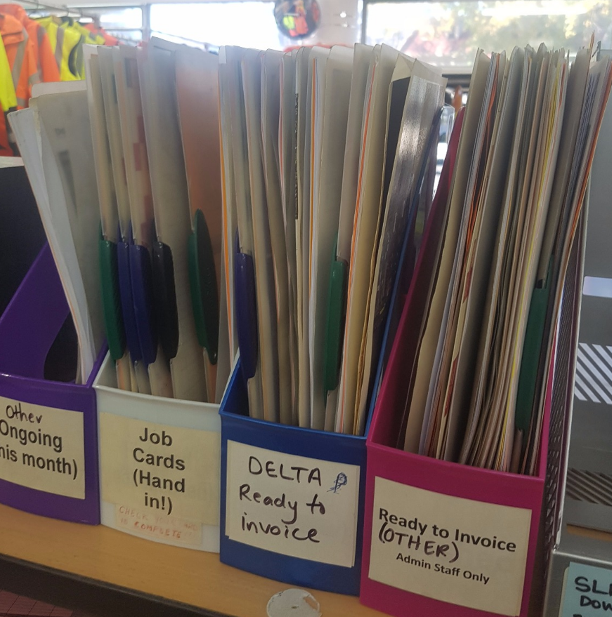

Slide 26
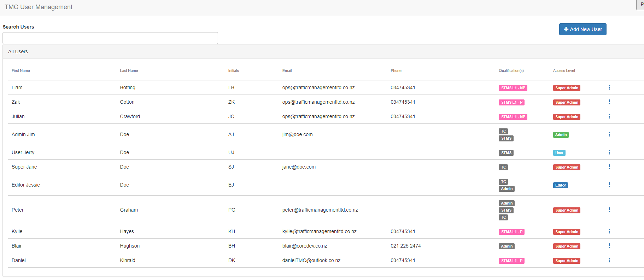
Manage your staff and qualifications, as well your core resources like sign trucks (vehicles)
The result being your operations/management can allocate to jobs with a better understand of who has what competencies

Slide 27
SUMMARY
One system or use alongside your own
Multiple functions, capturing everything related to your job in a central place for all to use
Streamlining your office and TTM logistics
Custom made for your TTM managers and businesses
Multiple users and settings for different user levels
No need to wait or hunt for lost paper work
Know your inventory levels for of all TTM equipment at any time
Visual overview for planning of staff, trucks, and expiring TMPs within your business
Give your Operations staff full control and maximize your resources. Increase the quality of your service all while saving time and money.

Slide 28
Future plans
Automatically pre-populate the TMP fields through TMP program that links in with E Board
Connect to Road Direct On Site Record app for two hourly checks

Slide 29
Question: If a new or ongoing job today happens again tomorrow or in the future what would be the traditional steps performed to make this happen?
Find old job card or make new one
Reprint the TMP / diagram
Check expiry dates
Inform the operations/TTM manager
Inform / brief the workers undertaking the job
Make notes of recourses needed
Notes for admin and invoice team
A lot of internal & external communication, knowledge or remembering!
That’s a lot of time and energy, with Road Direct’s E-Board no more double handling.

