Slide 2
Stop/Go is one of the most
Dangerous jobs on the road
Notes:
Show of hands
Who here has done stop/go before?
Who here has done stop/go at night before?
Don’t worry about looking tough here, but out of those with their hand still up, who has felt unsafe doing stop/go at night?
When you break it down, the procedure is simple, you get a paddle and some kind of overhead lighting.
The single most common complaint from “Runners” (If you manage to catch them) is “I didn’t see the sign!”
WHAT IF YOU COULD HAVE A BETTER TOOL?

Slide 3
Notes:
There are a few basic aspects that are involved that can have a massive impact on how stop/go works:

Slide 4
Safety
Notes:
There are a few basic aspects that are involved that can have a massive impact on how stop/go works:
1 – It’s all about safety
But how are we going to improve this??

Slide 5
Safety
Increase Visibility
Notes:
There are a few basic aspects that are involved that can have a massive impact on how stop/go works:
1 – It’s all about safety
But how are we going to improve this??
2 – If you can’t educate the public and have them behave accordingly, you could increase the visibility of your stop/go workers

Slide 6
Safety
Increase Visibility
Staff feel safer because they’re more noticable
Notes:
There are a few basic aspects that are involved that can have a massive impact on how stop/go works:
1 – It’s all about safety
But how are we going to improve this??
2 – If you can’t educate the public and have them behave accordingly, you could increase the visibility of your stop/go workers
3 – When visibility is increased, they feel safer

Slide 7
Safety
Increase Visibility
Staff feel safer because they’re more noticeable
Staff that feel safe gain confidence
Notes:
There are a few basic aspects that are involved that can have a massive impact on how stop/go works:
1 – It’s all about safety
But how are we going to improve this??
2 – If you can’t educate the public and have them behave accordingly, you could increase the visibility of your stop/go workers
3 – When visibility is increased, they feel safer
4 – When staff feel safer, they become more confident in their role

Slide 8
Safety
Increase Visibility
Staff feel safer because they’re more noticeable
Staff that feel safe gain confidence
Confident staff work better
Notes:
There are a few basic aspects that are involved that can have a massive impact on how stop/go works:
1 – It’s all about safety
But how are we going to improve this??
2 – If you can’t educate the public and have them behave accordingly, you could increase the visibility of your stop/go workers
3 – When visibility is increased, they feel safer
4 – When staff feel safer, they become more confident in their role
5 – More confident staff do a better job

Slide 9
Safety
Increase Visibility
Staff feel safer because they’re more noticeable
Staff that feel safe gain confidence
Confident staff work better
Sites run smoother, happier “customers”
Notes:
There are a few basic aspects that are involved that can have a massive impact on how stop/go works:
1 – It’s all about safety
But how are we going to improve this??
2 – If you can’t educate the public and have them behave accordingly, you could increase the visibility of your stop/go workers
3 – When visibility is increased, they feel safer
4 – When staff feel safer, they become more confident in their role
5 – More confident staff do a better job
6 – Better job means happier customers (road users)

Slide 10
Safety
Increase Visibility
Staff feel safer because they’re more noticeable
Staff that feel safe gain confidence
Confident staff work better
Sites run smoother, happier “customers”
Happier road users make for a good day at work
Notes:
There are a few basic aspects that are involved that can have a massive impact on how stop/go works:
1 – It’s all about safety
But how are we going to improve this??
2 – If you can’t educate the public and have them behave accordingly, you could increase the visibility of your stop/go workers
3 – When visibility is increased, they feel safer
4 – When staff feel safer, they become more confident in their role
5 – More confident staff do a better job
6 – Better job means happier customers (road users)
…and in MOST cases – 7 – Happier customers increases job satisfaction

Slide 11
Notes:
Bring in “illumi-STOP”
Turn lights off and demonstrate for a minute or so.
When I set out to create something that does all this, I had an idea in my head and I spoke with a few people about the possibility
MOST people told me it had already been tried and couldn’t be done.
If you know me, don’t ever tell me it can’t be done, because a challenge is a challenge, and that means GAME ON

Slide 12
- Can’t be done
Notes:
When I set out to create something that does all this, I had an idea in my head and I spoke with a few people about the possibility
MOST people told me it had already been tried and couldn’t be done.
If you know me, don’t ever tell me it can’t be done, because a challenge is a challenge, and that means GAME ON

Slide 13
Can’t be done
CHALLENGE ACCEPTED
Notes:
When I set out to create something that does all this, I had an idea in my head and I spoke with a few people about the possibility
MOST people told me it had already been tried and couldn’t be done.
If you know me, don’t ever tell me it can’t be done, because a challenge is a challenge, and that means GAME ON

Slide 14
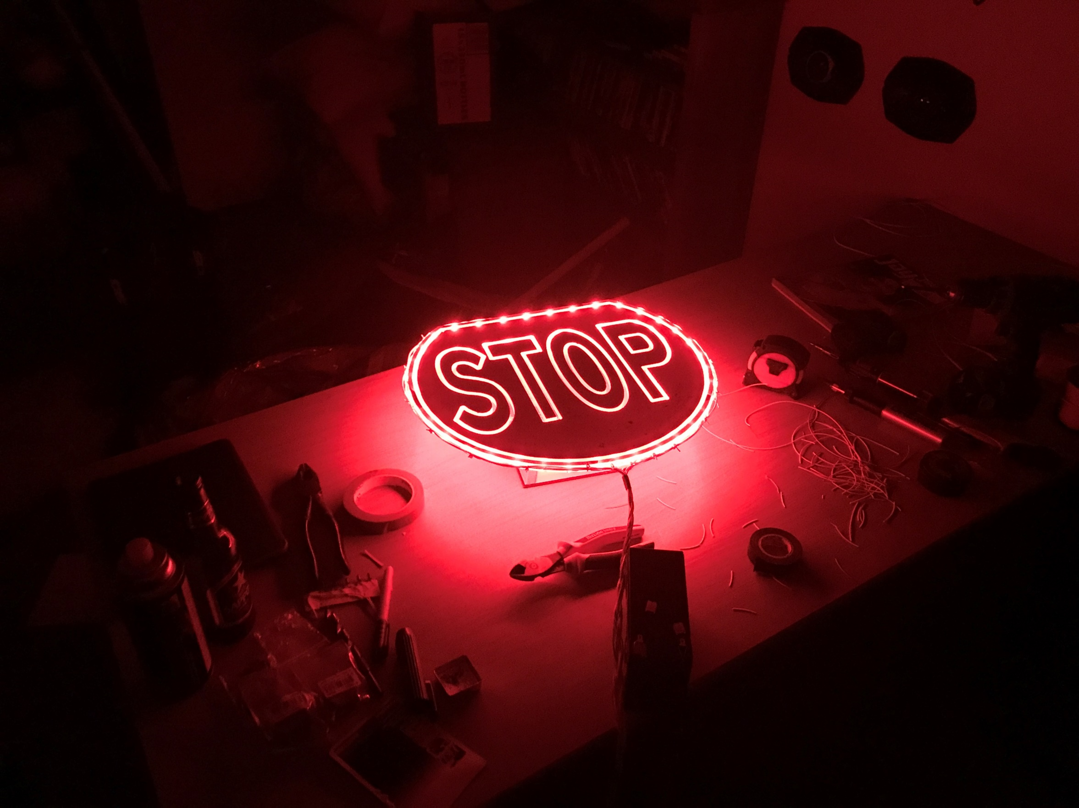
Notes:
Version 1.0 in it’s infancy. IT CAN BE DONE
Just ask my wife who got woken up at 1am to see I was right! (She let me claim THAT one, which was nice..)

Slide 15
Notes:
From there it went through several versions and has become what you see today.
With some field testing, we’ll really know the effects it will have on site. - Both for the road user and for the Paddle user.

Slide 16
Optional download of video
W-07 IllumiSTOP

