Slide 1
Engaging with the Heavy Haulage Industry Within the North Canterbury Highways NOC Operation
James Park
NOC Traffic Management Manager
NZTA TTM Conference
9 May 2018
Notes:
Made up title: TMC Approving Engineer and whipping boy working to get TTM across the NOC work scope compliant and right.

Slide 2
The Map
Who is the North Canterbury NOC?
Canterbury Freight Profile
OD Loads and Traffic Management
Consultation Process
3 Worksite Cases
Consequences of Poor Engagement
Summary Thoughts
Notes:
Introduction

Slide 3
Who is the North Canterbury NOC?
The NZTA North Canterbury Network Outcomes Contract (NOC) Team comprises:
Client: NZ Transport Agency
Main Contractors: Downer Ltd/WSP-Opus Ltd
Sub-contractors: BroadSpectrum, GHD, GSL, Isaac
Team has been in place since April 2017 – 1 year old.
Notes:
Main works joint venture
Sub contractors include:
- operating the Lyttelton Tunnel
- other physical works

Slide 4
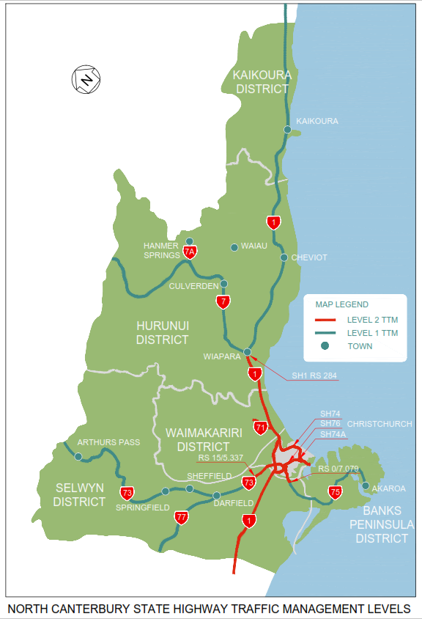
Network Features
Key features include:
Christchurch City (CTOC)
SH 1 north/south freight
Christchurch Airport
Lyttelton Port
Alpine passes to West
Lyttelton Road Tunnel
Notes:
Christchurch City – Level 2 - arterial network
Christchurch City acts as a hub for Canty both north, south, and west
Canterbury wide vital link to Christchurch Airport – perishable and high value export opportunities
Rural Canterbury vital link to Lyttelton Port – export opportunities
West Coast via Lewis and Porters alpine passes
Lyttelton Road Tunnel – 2 lane/2 way single bore tunnel to Port of Lyttelton…

Slide 5
Canterbury Freight Profile
Christchurch City is upper South Island heavy transport hub:
Over-Dimension load movers
Heavy Haulage (over-weight) load movers
HPMV freight transport
Jim Harland at NZTA noted (2013) :
2012 -2042 expected almost 100% incr in freight
33 M t/yr to 61 M t/year, for Canterbury
Airport and Port are key hubs
Notes:
WHO HAS HAD ISSUES OR CONFLICTS WITH OD OR VERY LARGE VEHICLES EITHER GETTING THROUGH OR CAUSING DAMAGE TO A WORKSITE???
OD movers notably houses. Over 550 Houses now Crown owned were moved from the red zone (East Chch) by April 2016 – average of 10/month! Some to Rolleston Prison and return being repaired as seen recently on TV news
Lyttelton Port is an international access point for new heavy machinery, and large pieces of infrastructure serving the whole South Island
Road transport carries the bulk of freight across Canterbury and more of this is being carried by longer and heavier HMPV registered vehicles.
Chch has seen dramatic growth in HPMV permits over recent years mainly for linehaul north and south, with around 1550 current permits operating across the Canterbury region.
Airport and Port are critical points in the local freight network as the start or end of freight movements

Slide 6
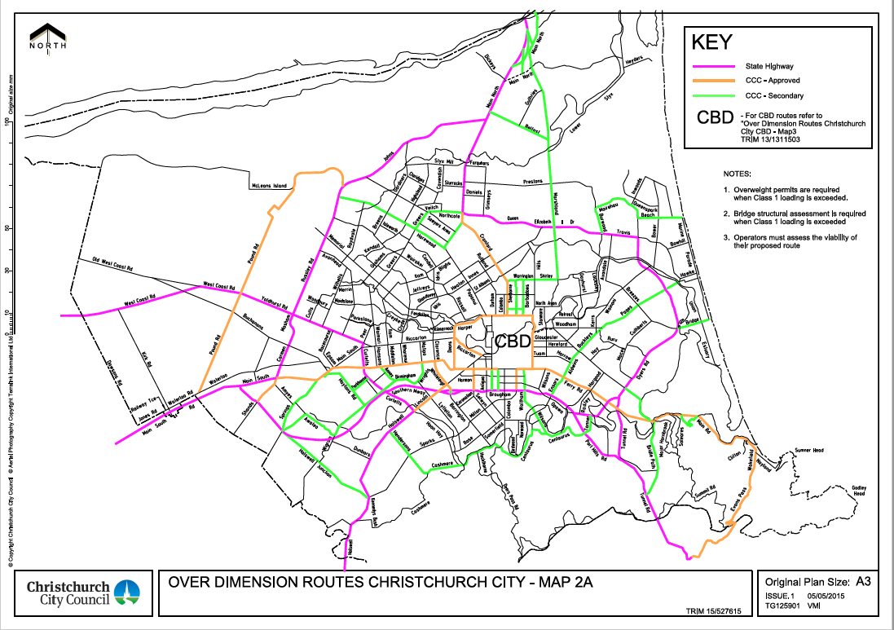
Christchurch Key OD/Haulage Network
asasaadfafdsa
Notes:
Ring road forms the core of the network – wide and mainly 4 lanes this route has minimal median and close roadside restrictions
The major links outward from this ring are then:
= North to Nelson and Picton
= South to the Lyttleton Port
= South West to Queenstown and Dunedin
= West to the West Coast
As you can see the Airport lies directly on the western perimeter of the ring route.
The main base for logistics and freight are in the Southwest corner of the City.
Trucking use these routes 24 hours a day for access and ease of movement. Night movement is especially important for OD loads such as houses.
As we move to increasing nightworks the possibility of conflict increases – especially on these recognised OD routes.

Slide 7
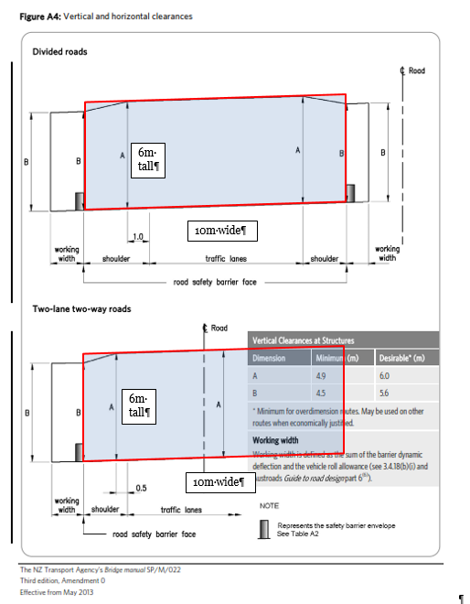
OD Loads and Traffic Management
VDAM Rule 2016 compliant vehicle features:
Move at night through City
Move night and day in Rural
Permits note specific routes
Load height normally 900mm
Up to 11m wide (5.5m off CL)
Up to 6.5m tall (Cat 4)
Usually 3m wide trailer
Notes:
VDAM Rule 2016 enlarged the scale of OD vehicles following the original 2002 version.
Basic features remained however in terms of compliant vehicle features:
- Largest Loads in Category 4 up to 11m wide * 6.5m tall
- Longest loads have trouble turning through tight curves and intersections
- 3m wide trailer fits OK into normal lane width of 3.5m on the SH network. A problem for narrow lanes.
- Normal Load travel height of 900mm off road surface. Just taller than a standard cone (and a standard permanent RG sign mounted on a splitter island)
- VDAM has specific requirements on time of load movement (schedule 9).
Largest loads are restricted to Sun to Thurs nights --10.30pm to 6.30am through Chch City. Paving time in Chch City area!!
- across NZ OD loads can move widely during daytime in rural areas – only difference in this case is that likely these daytime worksites will be active or attended
Loads moving on permits are restricted to the route on the permit, using informal detours exposes the load mover to a risk of prosecution if caught.
Long loads exceeding 25m require permits to cross railway level crossings (sec 6.13), a level crossing on a detour = problem.

Slide 8
OD Operators Rights
From the VDAM Rule the load mover can:
6.10(2) “ A traffic control device may be removed temporarily to allow safe passage of an over-dimension motor vehicle if the traffic control device is immediately re-erected in its original position after the vehicle has passed that position on the road.
AND: 6.10(3) “If a traffic control device that has been temporarily removed to allow safe passage… is not re-erected in its original position, the operator of the vehicle must notify the road controlling authority or the person responsible for the traffic control device.
Notes:
Hard to read but an extract from the VDAM Rule notes that operators can remove temporarily control devices such as signs and cones.
They should replace them after passing and if these are not replaced notify either the RCA or the asset owner
For a TTM site this means that unattended sites are vulnerable to being rearranged by passing load movers.

Slide 9
Consultation Process
As works get closer:
From wider general contact
To definite and targeted detail
Notes:
Initially Southernlink promotes work at a programme level to general Freight forums and other specific recurring meetings
Cover annual programmes of planned work with a number of key contacts
This is an initial point of raising especially complicated or high impact sites – maybe at key locations as noted previously
Discussion day versus night operations at key locations

Slide 10
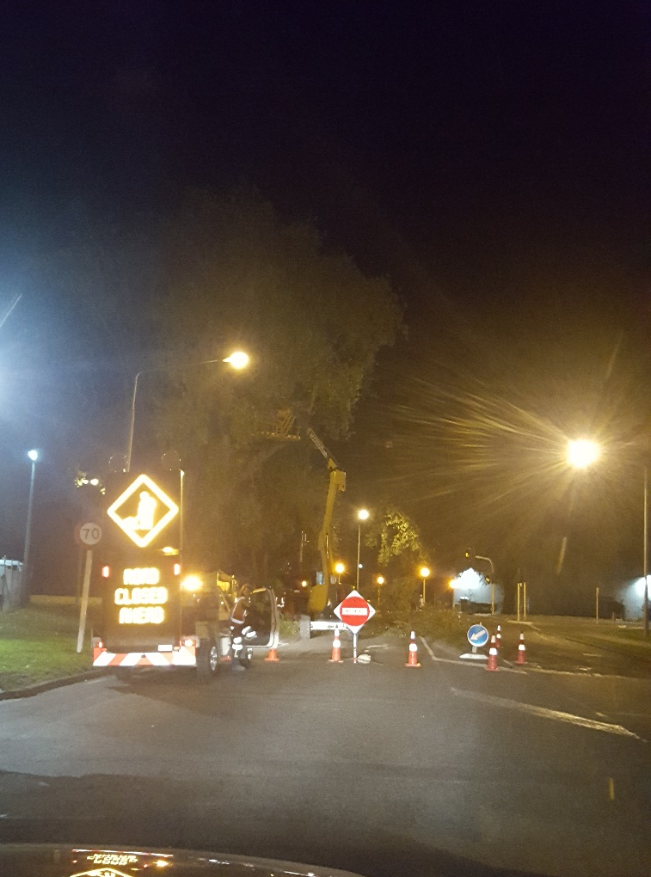
Industry Wide Consultation
Key contacts, planning level - months before work:
NZTA Permitting Contacts
NZ Heavy Haulage Association
Lyttelton Port Company Ltd
Lyttelton Tunnel Operations
Chch International Airport Ltd
Councils, incl Christchurch City
Notes:
At a planning level Southernlink is seeking wide feedback
NZTA permitting contacts are in touch with local industry and the smaller haulage operators, mostly moving overweight plant locally
NZHH Association has a well known local rep
NZ HH Association also has a national contact (Johnathon Bhana-Thomson) well known and a great contact point
SLC makes sure to contact and consider LPC whenever work is planned in the south of the City network or around the Tunnel
CIAL are a key contact for any work in the west of the City network and especially on or around the interchanges accessing the Airport directly. Also CIAL is a RCA in its own right controlling a number of roads immediately around the Airport.
Any detours proposed will usually make use of Council Roads. The CCC CTOC and other Councils need some prior notification of this use to provide early guidance or feedback about limitations or absolute restrictions.

Slide 11
Programme Stage Consultation
Following feedback from wide consultation
Key contacts, programme level – 2-3 weeks before work:
NZTA Permitting Contacts
Heavy Haulage Association
Port/Airport as required
Councils affected
Notes:
Southernlink uses a broadcast email list, as the date of proposed work approaches - key contacts are re-notified with specific work scale and location discussed. SLC confirms the proposed TTM methodology seeking final feedback.
NZTA permitting contacts are kept informed so local industry and the smaller haulage operators know
NZ HH Association re-notified both local and national contacts
SLC contacts LPC and CIAL whenever work is planned in their areas
Coordination between/across worksites and impacts such as work affecting break bulk truck movement from the Port is important at this stage
If any detours are proposed off the highway onto Council Roads the affected Councils are notified to confirm any changes or contingencies made to address any previous feedback about limitations or absolute restrictions on these detours – esp HPMVs
Any changes needed to traffic cignals setups need to be confirmed.

Slide 12
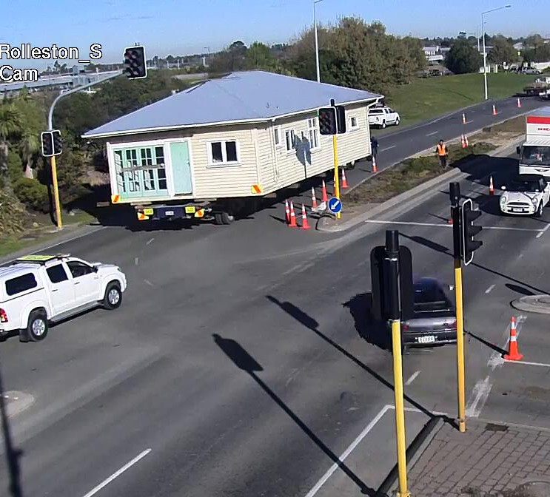
Delivery Stage Notification
Following feedback from programme consultation
Key contacts, delivery level – 1 week before work:
NZTA Permitting Contacts
Heavy Haulage Assoc
Port/Airport as required
Councils affected
Notes:
Southernlink once again uses a broadcast email list of 72 contacts as the work starts draws closer
Key contacts are re-notified of the proposed date of works in the week ahead
Details updated weekly - every Monday - SLC confirms the likely impacts on traffic in a more detailed sense, site by site.

Slide 13
Delivery Stage Notification
Notes:
Site by site any detours or road closures proposed are clearly marked as “red” sites where traffic impact will be the highest.
Where work will impact commuter links at peak traffic this is again highlighted.
Nightworks have a lesser impact due to less traffic affected
Dates of work are reconfirmed so all road users – especially Heavy Haulage – can plan around the timing of upcoming impacts on major routes.

Slide 14
In Progress Notification
Providing current information
In Progress – <1 week before, and during work:
VMS at and near site (required by the RCAs)
NZTA TREIS updated
Contact phone on OD Permits
Local Contacts, Accurate information, Real Time, Accurate location
Notes:
Southernlink uses fixed and variable messaging to keep regular users of the site informed about upcoming and current works
VMS highlight the start date, start time, day v night works, contact phone number for more information
Local Councils are also requesting a week of warning ahead of the work dates – PLANNING IS ESSENTIAL
For nightworks it is not always obvious to OD load movers while scouting the route, for a later move, that works could be coming up and will be active at night only.
SLC INCLUDES A LOCAL CONTACT (ME) ON ALL OD PERMITS ISSUED AFFECTING CANTERBURY HIGHWAYS.
-- THIS ENSURES THAT LOAD MOVERS SHOULD GET THE BEST UP TO DATE INFORMATION ABOUT WORKSITES ALONG THEIR ROUTE.
-- I CAN GIVE LOAD MOVERS CONTACT NUMBERS FOR WORKSITE STMS’S AS REQUIRED, TO GET OD LOADS THROUGH ACTIVE NIGHTWORKS SITES.

Slide 15
Worksite 1: SH 73 Arthurs Pass
This site: Key freight route to West Coast.
Work: New Guardrail = long single lane
TTM: Daywork, Full time Temporary Traffic Signals
Alt Route: No local alternative route
Outcome: Lots of early notification no issues from works
Included over major West Coast event w’end
Notes:
As per slide intro

Slide 16
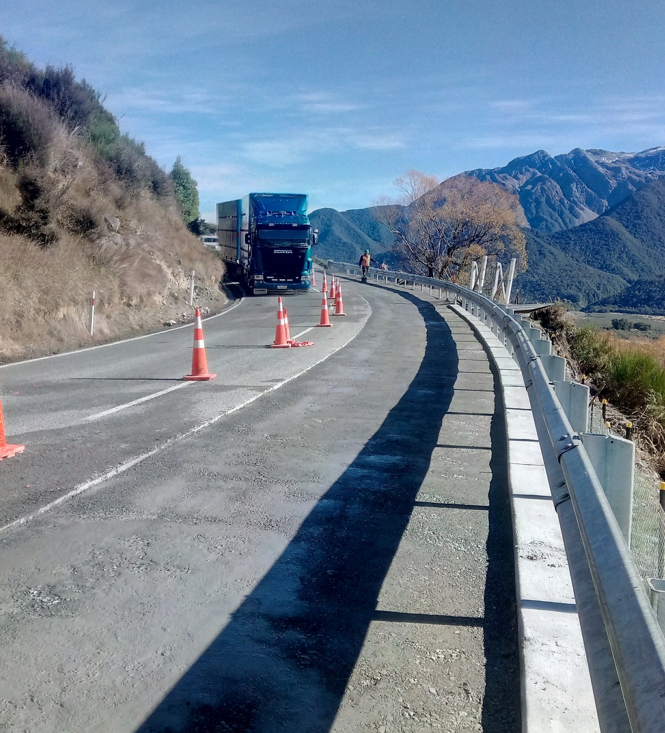
Rural Lanes
Lane alignment/narrowing:
Against a median/guardrail
Into a shoulder
Against uphill batters
On steep grades
Wider lanes are essential
Notes:
It is common in TTM deployment to narrow lanes to provide workspace - wherever lane widths are narrowed this raises problems for vehicles running at 3m wide.
OD Loads overhanging the width of the vehicle up to 4m encroach way way beyond the coned out lane.
Lanes hard up against the median or shoulder means that any features on the median or berm taller than 900mm are now in play (notably trees, signs or traffic signal poles)
Lanes pushed hard up against barriers or batters above the road will limit where the load can travel
Steep grades mean OW and HPMV loads take time to accelerate and get through the site (timing of temporary signals design needs to accommodate this)

Slide 17
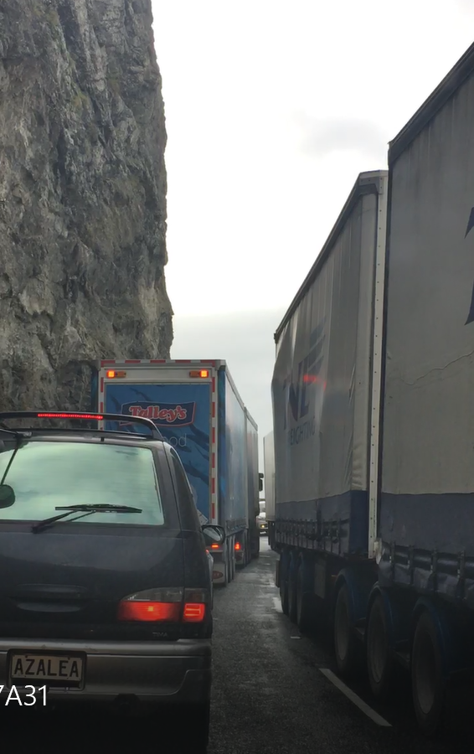
Tight Lanes
Lanes too close together and/or against a batter:
Result = ALL STOP.
Notes:
Narrow lanes here against the rocky batter require trucks to swing wide
TTM has a stop/go located ahead of the truck travelling in the opposing lane
Everything is now stopped
The queue behind our vehicle is extending back past the start of the stop/go and into the single lane section
OH NO = we all STOP

Slide 18
Worksite 2: SH 74 Port Hills Interchange
This site: Key freight route to Lyttelton Port
Work: Paving full width = single lane, MTC
TTM: Sun/Mon Nightworks with detours
Alt Route: No local freight alternative route
Outcome: Lots of early consultation around works Timing coordinated with Port strike action.
Sunday night, least freight activity
Notes:
Introduction

Slide 19
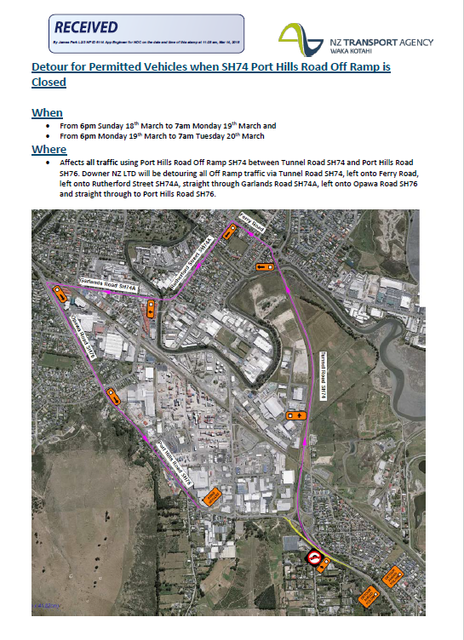
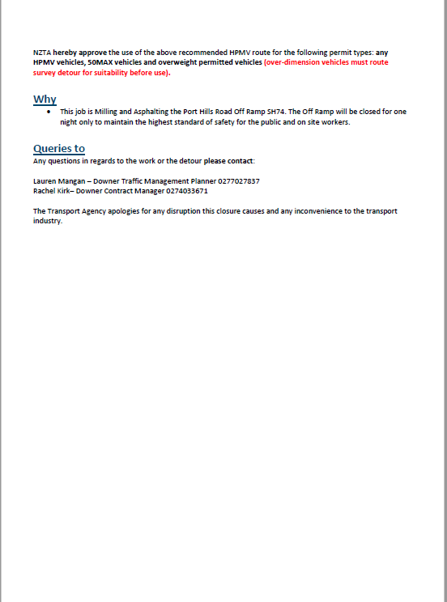
(MAP)
SouthernLink contact details
Specific guidance for HPMV users
Confirm Dates of work
Map showing TTM and detour routes
Notes:
This email attachment is distributed to inform HH road users, what is going on and the details they need to know

Slide 20
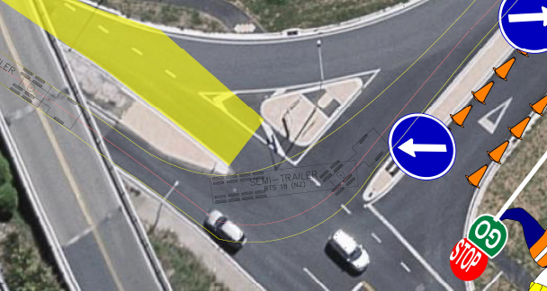
Urban Swept Paths
Lane alignment:
Contraflow lane setups
Turning circles or wrong lanes
Notes:
Lanes realigned through median island gaps may require tighter turning radius than normal.
Forcing turns from the incorrect lane can again require tight turning radius and especially hard for very large vehicles

Slide 21
Worksite 3: SH 1 Rakaia River Bridge
This site: Key freight route to Dunedin
Work: Bridge Repairs = closure with long detour
TTM: Sun/Mon Nightworks with detours
Alt Route: Detour adds 1.5 hours of travel (Key Location)
Outcome: Late notification delayed works
Industry feedback = work was changed
Notes:
Introduction

Slide 22
Consequences of Poor Engagement
Can stall or slow road programme (= avoid delays)
Freight industry dislikes uncertainty
Onsite conflict, and loss of trust
Disrupted worksite TTM (changed overnight)
Public and Press criticism
RCA Client reputation damage
Notes:
Can only plan roadworks delivery with CONFIDENCE if key stakeholders are on the “same page”
Freight industry runs to time and delays are a problem on long trips (like house moves)
PERSONNEL CONFLICT on site can arise when delays are incurred. Improving contacts and 2 way communication can avoid physical altercations here.
Loads moving overnight can move signs/cones and not reinstate them as they were originally laid out
Loads can get stuck and disrupt traffic into daytime or peak traffic periods

Slide 23
Summary Thoughts
Heavy Haulage operators are:
Road users needing special consideration
Key stakeholders in terms of TTM layout
Sensitive to uncertainty of access
Accessible for consultation
A worksite problem if ignored
Notes:
And Finally a last thought – OPIA daily reporting of approved permits could also be improved to provide better contact/links between RCAs and permitted OD operators

Slide 24
Thanks and Questions
References:
Presentation by Jim Harland, NZTA to CILT (2013): https://www.cilt.co.nz/Folder?Action=View%20File&Folder_id=47&File=Jim-Harland-Pres-Sthn-%20(4).pdf
Red zone houses (2016) http://www.radionz.co.nz/news/regional/300756/red-zone-homes-'could-have-been-saved’
NZ Heavy Haulage Association http://www.hha.org.nz/
VDAM Rule (2016): http://www.nzta.govt.nz/resources/rules/land-transport-rule-vehicle-dimensions-and-mass-2016-index/
James.Park@wsp-opus.co.nz
Notes:
Introduction

