Slide 1
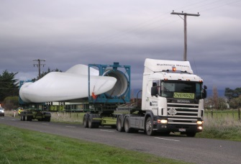
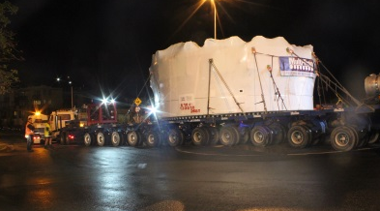
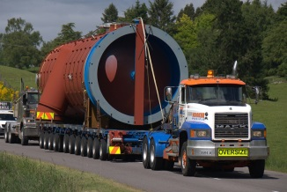
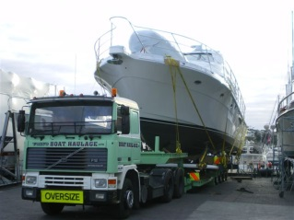
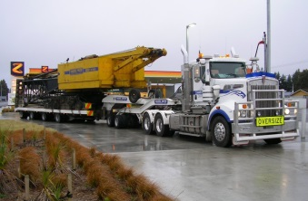
Challenges for loads with traffic management

Slide 2
NZ Heavy Haulage Association
The Overdimension and Overweight Transport Industry
Jonathan Bhana-Thomson
CEO
NZ Heavy Haulage Association
Jonathan Bhana-Thomson
CEO, NZ Heavy Haulage Association

Slide 3
The Heavy Haulage Industry
Specialist sector of the road transport industry
Transport loads for clients that are:
Wide
High
Long
Heavy
And they are “indivisible” – not easily made smaller

Slide 4
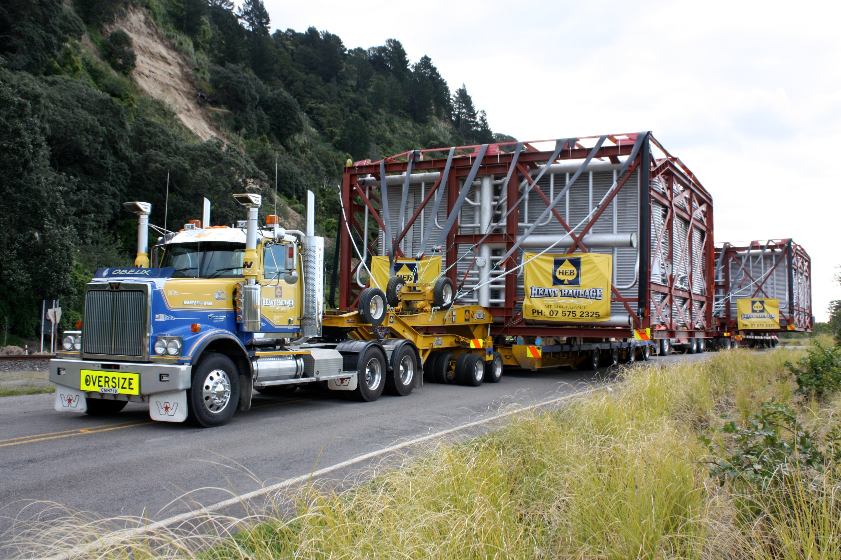
Weight of unit - 62.5T
Width: 9m
Height: 6.35 m

Slide 5
The Heavy Haulage Industry
Highly regulated industry
Approval for transporting loads is by specialist permit from:
NZTA – Overdimension
NZTA and Road Controlling Authorities – Weight
Power Line Owners – Height
Chorus & other providers – Height

Slide 6
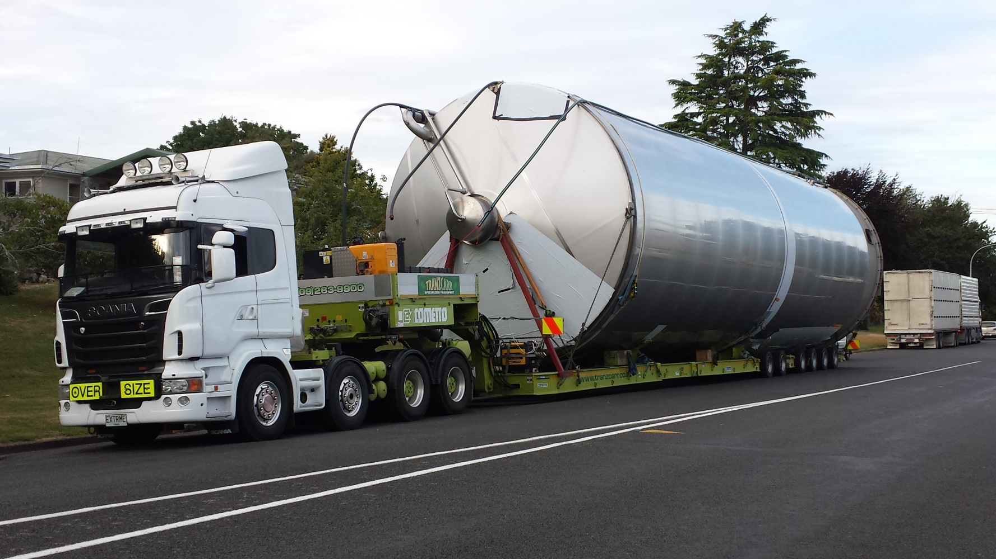
Width: 5.5m
Height: 6.3 m

Slide 7
The Heavy Haulage Industry
Need to transport loads on routes to cater for:
Dimension requirements
Structural requirements
Usually select routes that meet the specifications
BUT: Often very options for routes
A key role for the Association is to advocate for routes to be designed and maintained for OD/OW

Slide 8
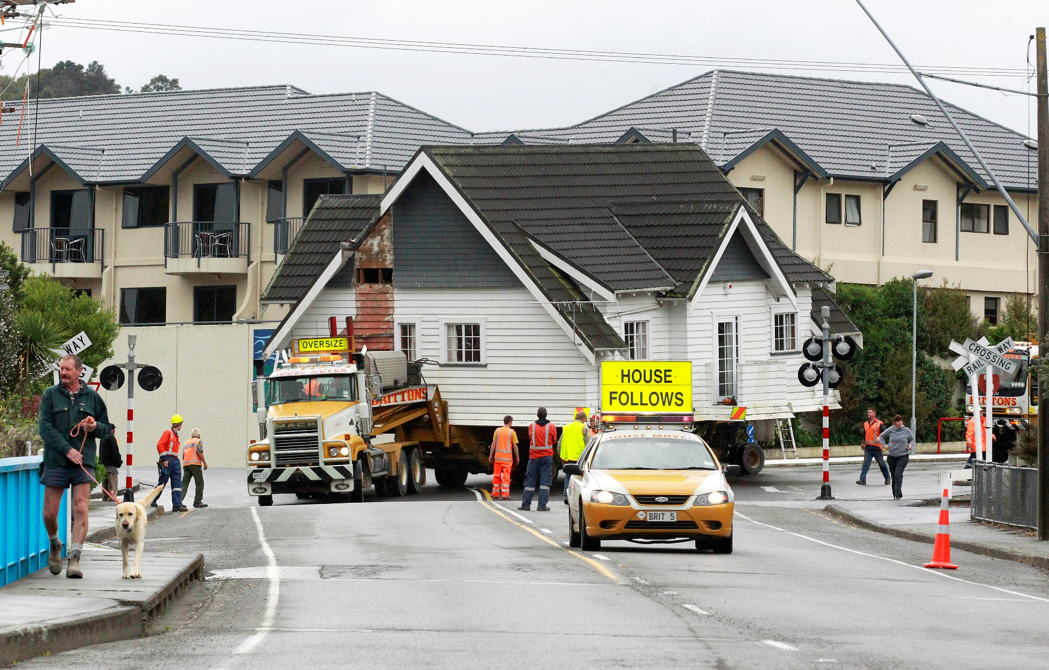
Width: 10.5 m Height: 8.0 m

Slide 9
NZHHA Design Specifications
Details the requirements sought for roading design
Width
Height
Islands & Roundabouts
Road Furniture

Slide 10
Route Requirement
The Association seeks:
11.5m wide and 6.5m high

Slide 11
Route Requirements
Divided Road Situation:-

Slide 12
Works in the Roading Corridor
Important that planned works consider whether an oversize route
With limited space in the road corridor, many works have the ability to restrict oversize loads
The TMP should include analysis of this
Make allowance for oversize loads
Have contingencies in place
Have good communication

Slide 13
Works in the Roading Corridor
(A) Maps are available that identify primary oversize routes
https://www.nzta.govt.nz/resources/overdimen-veh-route-maps/index.html
However these are a little out of date
Contact the Association

Slide 14
Works in the Roading Corridor
(B) Works will affect oversize loads if they involve:
Road closure / detour
Stop/Go (one lane)
Lane Closure / Contra-flow (if multi-lane)
Other Issues
What machinery in contractor using?
Is the shoulder being utilised?

Slide 15
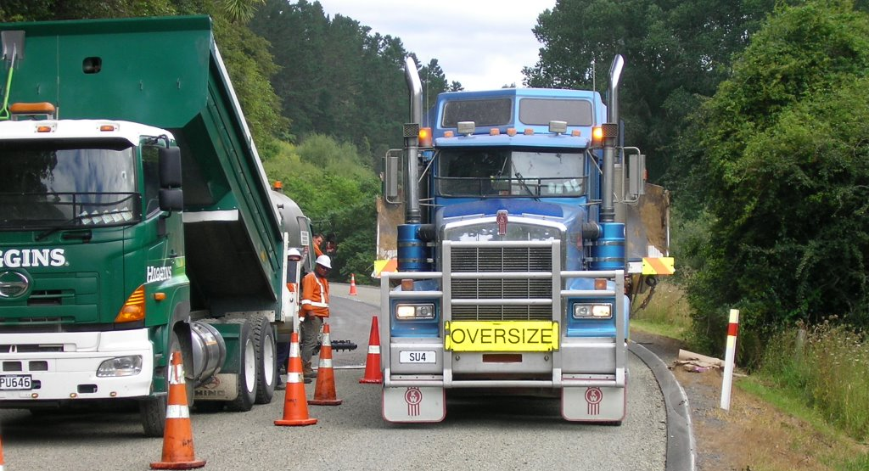

Slide 16
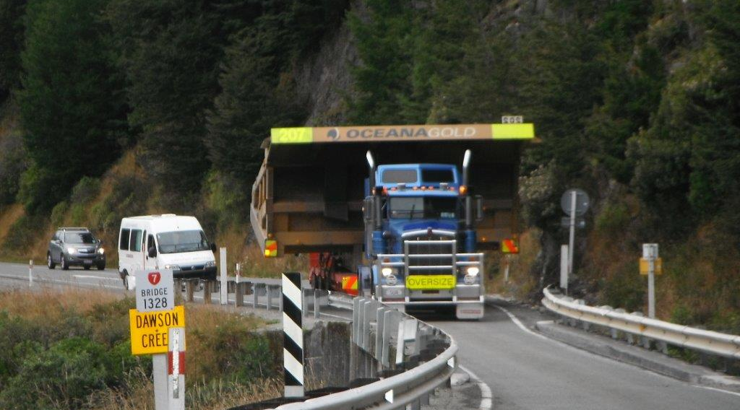

Slide 17
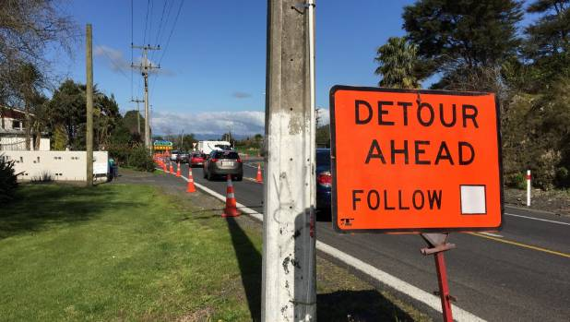
Works in the Roading Corridor
(C) Traffic Management Plans
Analyse for all road users – including oversize
Consider detour routes – not all are suitable for oversize
Consider timing: - Smaller oversize – day time
Larger oversize – night time

Slide 18
Works in the Roading Corridor
(D) Allowing for Oversize Loads
Lane width between cones:
Most transporters are at least 3.0m
Ideally we’d like to see lanes of 3.5m
Narrow lanes slow down traffic – is there a compromise?
Height of cones – 800mm?

Slide 19
Works in the Roading Corridor
(D) Allowing for Oversize Loads
Chicanes: Designed to slow down traffic
- But a transporter negotiating chicanes can easily collect cones
Is there a way to design chicanes so that this is less of an issue?

Slide 20
Works in the Roading Corridor
(E) Contingency plans
Ask – what will happen when an oversize load turns up at the worksite unexpectedly?
What aspects of the work can allow wide loads through – what parts can’t?

Slide 21
Works in the Roading Corridor
(E) Contingency plans
Park up areas for transporters
Consider a planned area for transporters to park up ahead of the works area
This could be a coned off area to allow for the work site to prepare for the transporter to come through

Slide 22
Works in the Roading Corridor
(E) Contingency plans
Radio Communication
Most load pilots have UHF radios to communicate within the transport convoy
Would it be possible to advise the UHF channel on the first advance sign to allow the lead pilot to communicate

Slide 23
Works in the Roading Corridor
(E) Advance Communication
The best overall solution is for two-way dialogue between contractors and transport operators
This can be facilitated partially through industry bodies through distribution of road works reports
Permits for oversize only required for loads over 4.5m

Slide 24
Works in the Roading Corridor
(E) Advance Communication
Reports of oversize permits issued are available, but
have at least a week long validity, and
don’t specify the route
only apply for wider oversize loads
Association has been pushing for a better system

Slide 25
Works in the Roading Corridor
(E) Advance Communication
Oversize Load Notification Website – linked to permit
Will specify the route
Will notify to interested parties in advance
Provides contact info for operator

Slide 26
Works in the Roading Corridor
(E) Advance Communication
Works Sites Notification:
Advance advice about closures/major restrictions
Confirmed closer to time with restriction info
Specific location info
Contact info for contractor

Slide 27
Works in the Roading Corridor
(E) Advance Communication
The challenge is to make this information available to both groups:
Timely
Relevant
Happy to work with ideas to progress this.

Slide 28
Jonathan Bhana-Thomson
CEO
04 4720366
jonathan@hha.org.nz

Slide 29
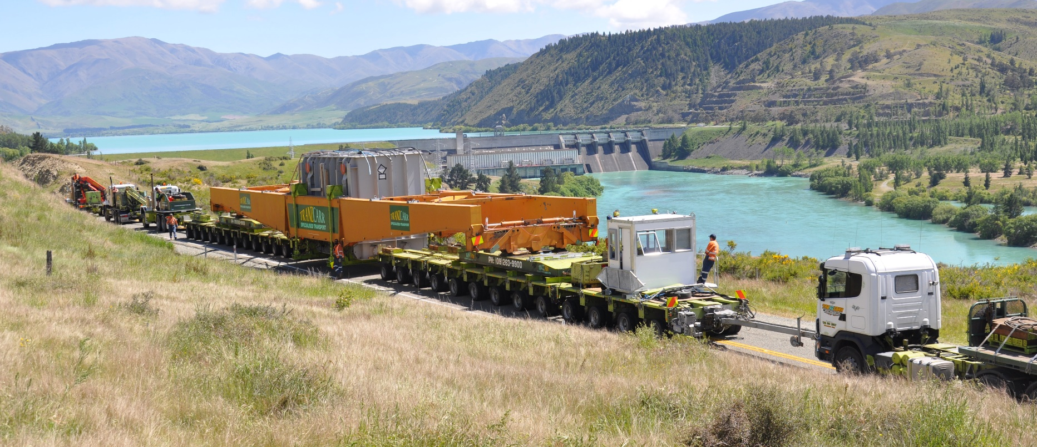
Pole 3 Upgrade for Transpower
236T Transformer on 38 axle lines using beam set to Benmore

