Slide 1
TMPs – What good are they really?
Tom Kiddle
May 2018

Slide 2
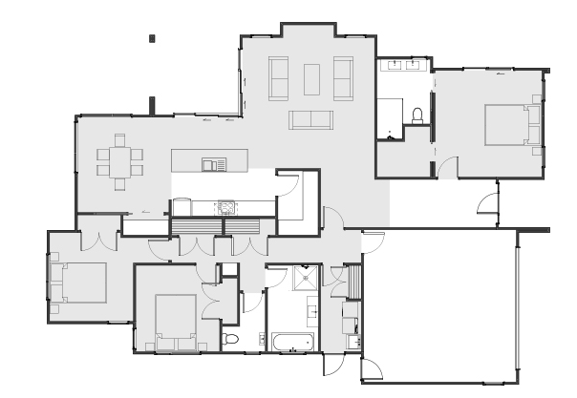
TMPs – what good are they really?

Slide 3
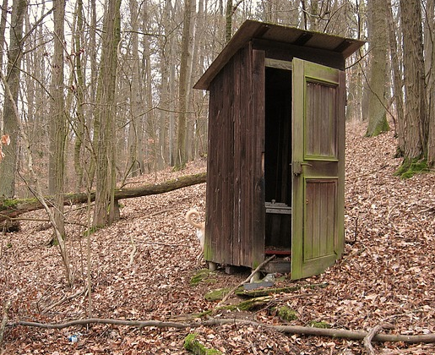
TMPs – what good are they really?

Slide 4
TMPs – what good are they really?
Good Temporary Traffic Management (TTM) planning linked to safe worksites
Data analysis of 6,626 SCRs

Slide 5
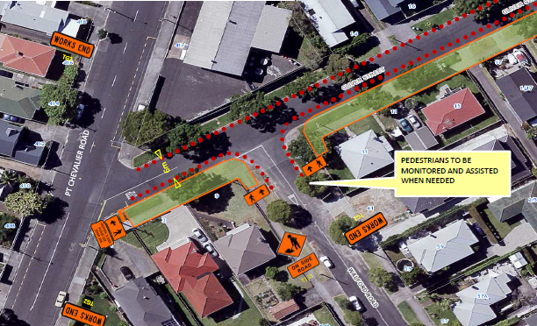
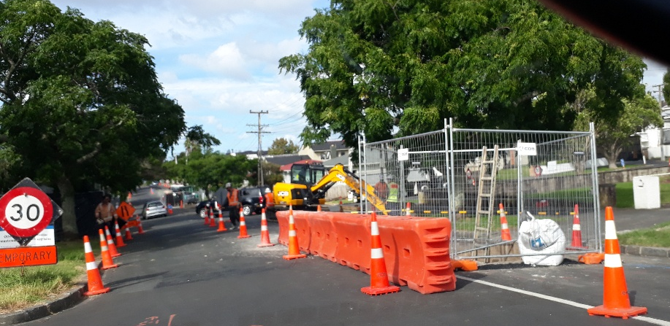
TMPs – what good are they really?

Slide 6
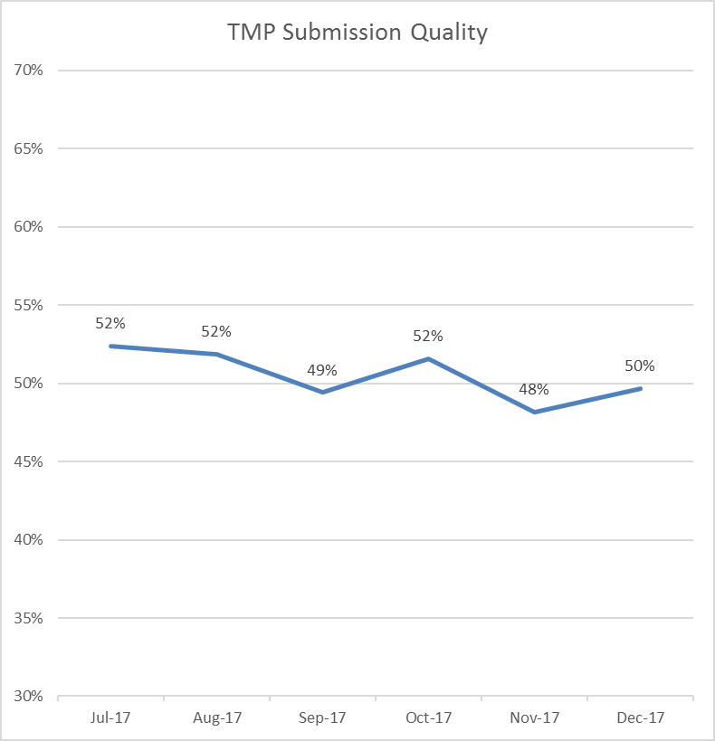
TMPs – what good are they really?
Planning performance is not as good as we might think
Internal reviews

Slide 7
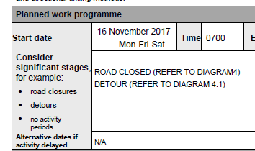
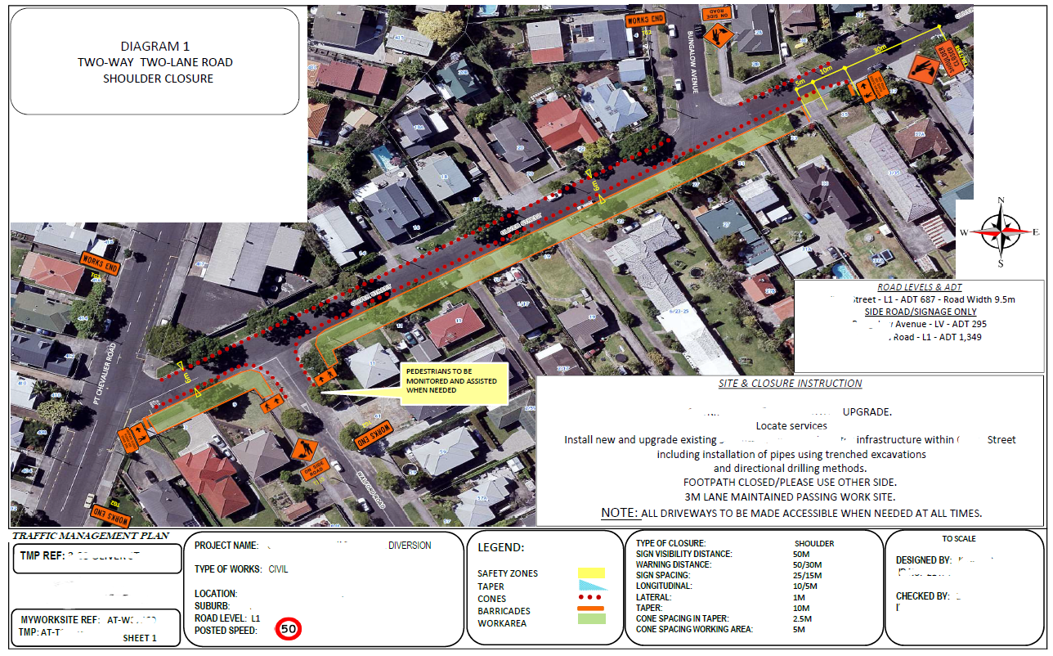
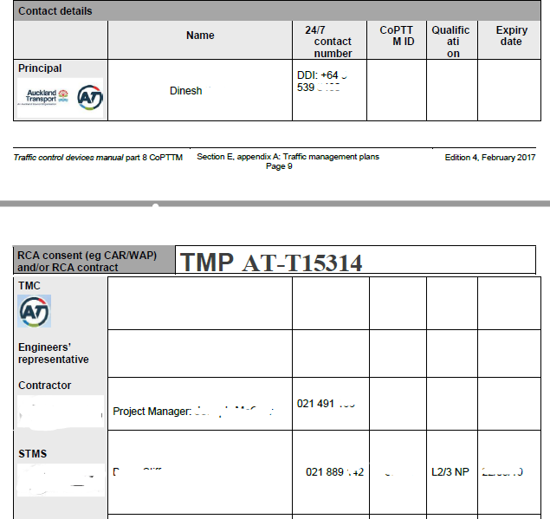
TMPs – what good are they really?

Slide 8
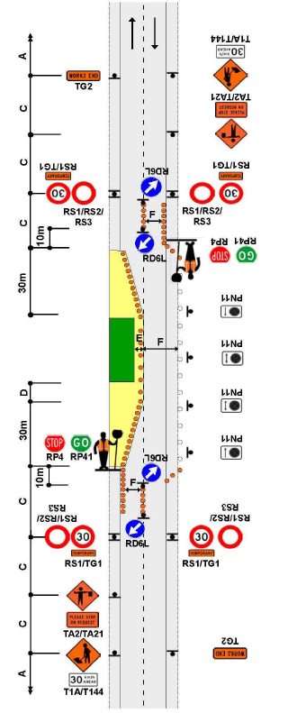
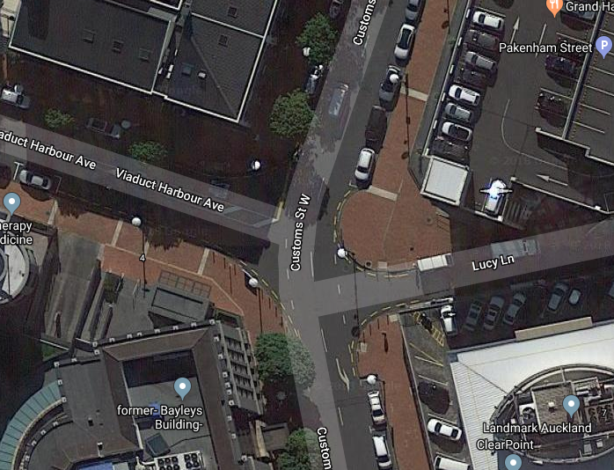
TMPs – what good are they really?

Slide 9
TMPs – what good are they really?
Who is the customer of a the TMP?
What happens if the design is wrong?
Blunders in decision making are influenced by the:
complexity of the situation
skill of the decision maker
time pressure
Exists on site?
Varies
Varies*
Yes

Slide 10
TMPs – what good are they really?
Key message
We all need to work to improve the quality of approved TMPs

Slide 11
TMPs – what good are they really?
What’s possible to improve?
NZTA Advanced Planning Workshops
Internal consistency
Continuous improvement and organisational learning
Speed TMP Reviews
COE TMP Design and Approval
Competency Working Party

Slide 12
TMPs – what good are they really?
Good Temporary Traffic Management (TTM) planning linked to safe worksites
The STMS is the customer for the TMP design phase
Planning performance is not as good as we might think
We need to improve the quality of approved TMPs
Take actions to improve

Slide 13
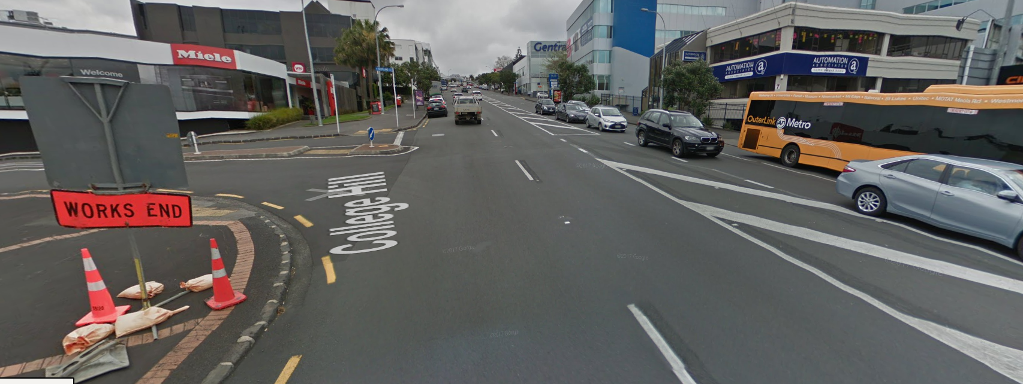
TMPs – what good are they really?
Helping friends and family get home safely

