Slide 1
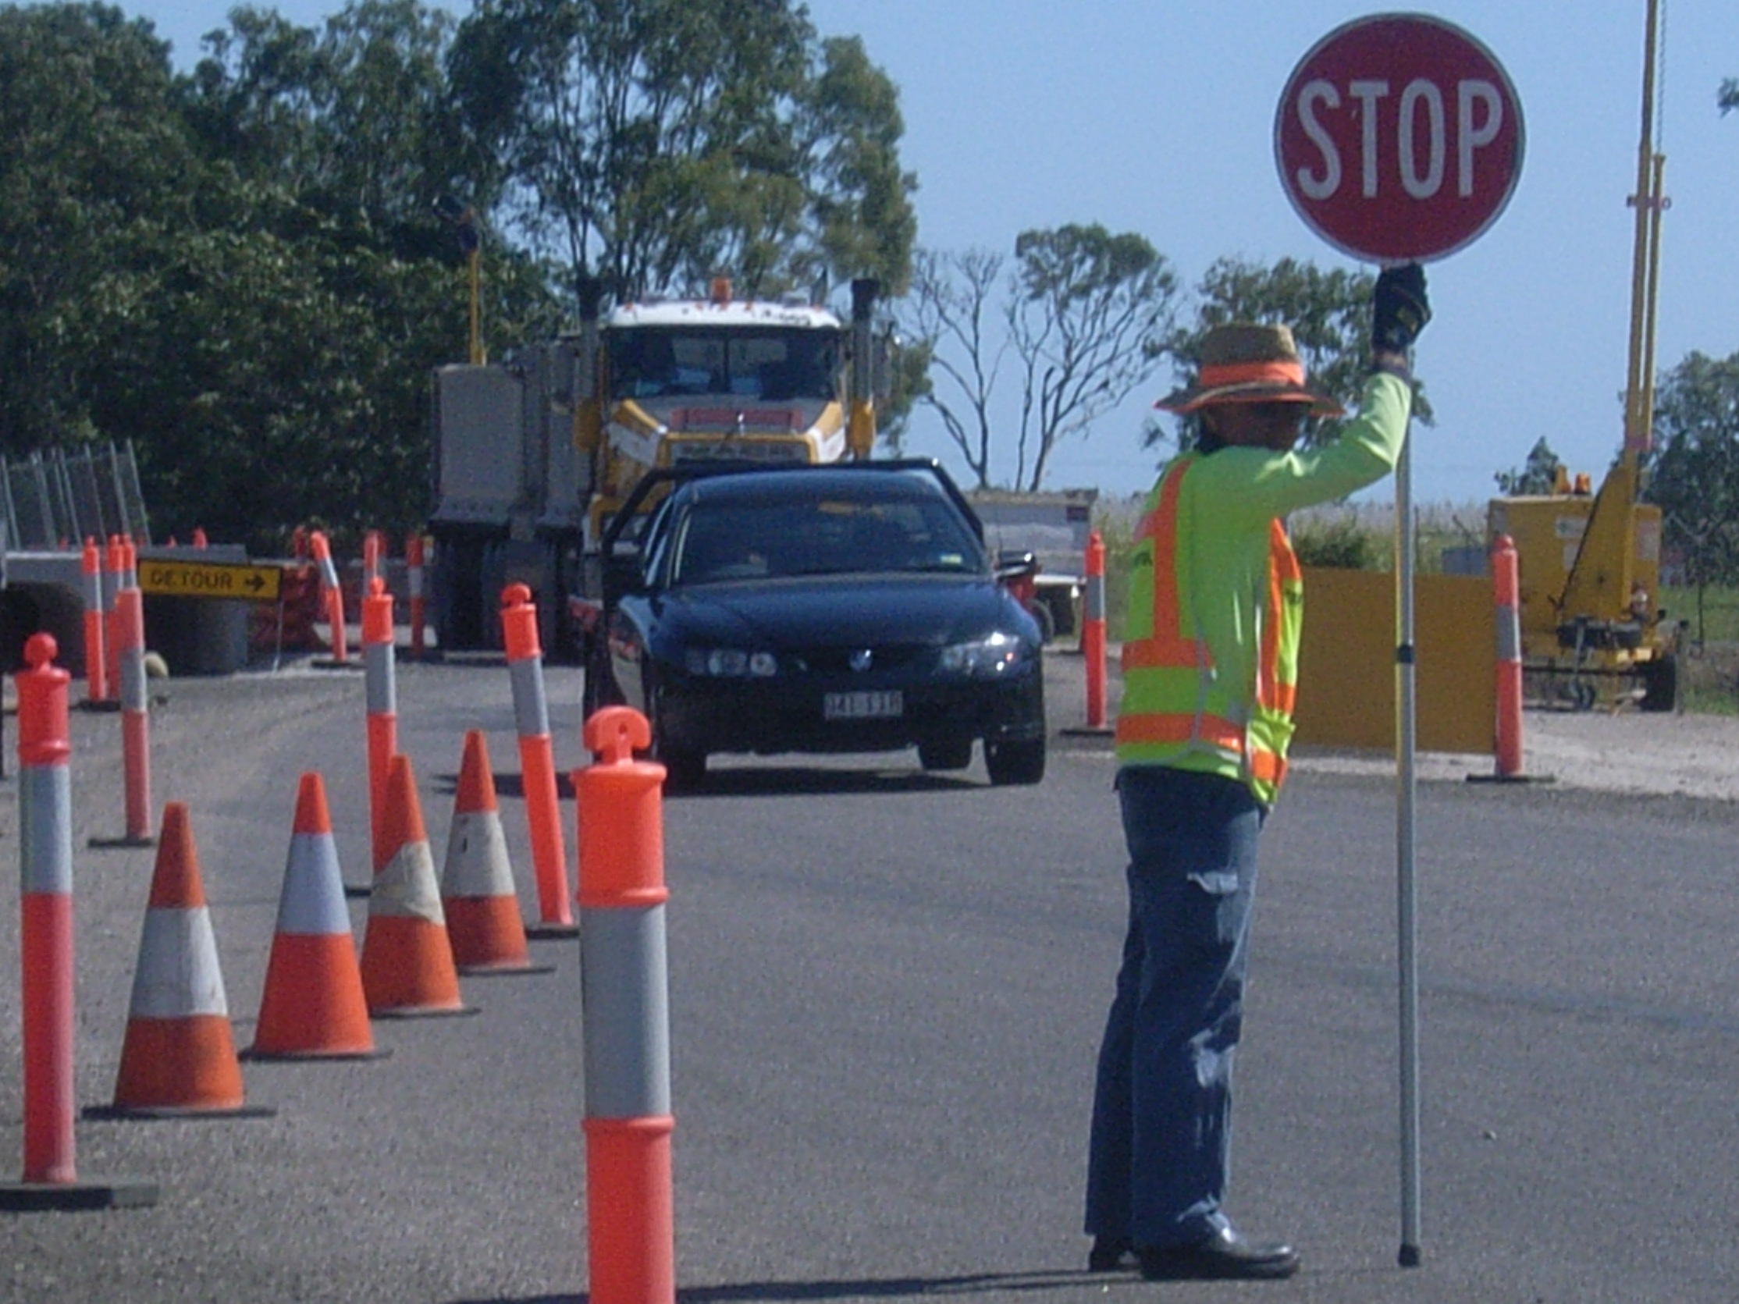
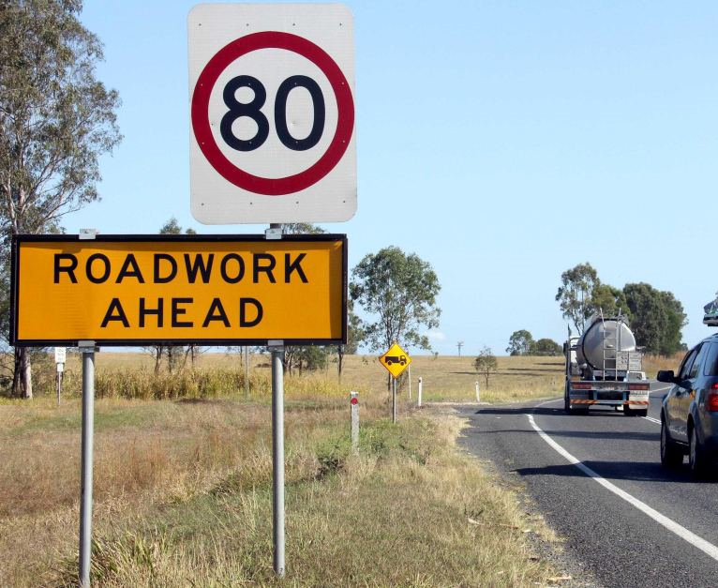
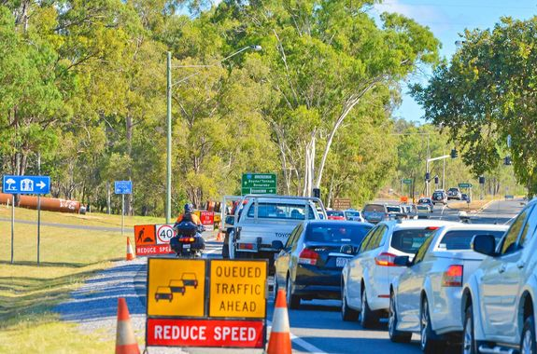
Strengthening the Thin Orange Line Evolving and Delivering Improved Safety at Roadworks
Dr Dan Sullivan
Notes:
Good morning
I would like to thank Stuart Fraser and Fergus Tate of the NZTA for the invitation to provide this keynote address and to present my thoughts on traffic management to open this conference.
Improving traffic management for roadworks has been a personal crusade for me for nearly 15 years. This followed more than 10 years exposure in the planning and development of traffic management schemes for major projects.
I am determined that we can together make a difference and create a substantially safer environment for traffic management personnel, road workers and the public.

Slide 2
What is the thin Orange Line?
Roadworks is hazardous
Working on or near roads is one of the most dangerous occupations.
Not just for traffic management staff
Also for the construction staff and for the public
The thin orange line
Temporary traffic management
Between our road workers and road users.
Defines a safe workplace for road works and a safe road environment for road users. .
Notes:
In what other occupation do we let the public operate large pieces of machinery within mere metres of our workers. Yes there are risks in other occupations, bad weather in deep sea fishing, explosives in mining, working at height on high rise buildings. But we have a high level of control on each of these.
I am sure you have all heard or used the term the thin blue line
The thin orange line is the temporary traffic management we put in place between our road workers and road users. This orange line should define a safe workplace for road works and a safe road environment for road users. However, the safety of workers and the public at worksites on or near our roads continues to be of concern. Too often we see and hear of near misses and incidents and too often we see and hear about fatalities.
However, the safety of workers and the public at worksites on or near our roads continues to be of concern. Too often we see and hear of near misses and incidents and too often we see and hear about fatalities
I would like to have a discussion with you today about how we improve the thin orange line

Slide 3
Strengthening the Thin Orange Line?
Considering Risk and Personal Risk Appreciation
Customer Satisfaction
Competence
Benefits of Harmonisation
Notes:
In what other occupation do we let the public operate large pieces of machinery within mere metres of our workers. Yes there are risks in other occupations, bad weather in deep sea fishing, explosives in mining, working at height on high rise buildings. But we have a high level of control on each of these.
The thin orange line is the temporary traffic management we put in place between our road workers and road users. This orange line should define a safe workplace for road works and a safe road environment for road users. However, the safety of workers and the public at worksites on or near our roads continues to be of concern. Too often we see and hear of near misses and incidents and too often we see and hear about fatalities.
However, the safety of workers and the public at worksites on or near our roads continues to be of concern. Too often we see and hear of near misses and incidents and too often we see and hear about fatalities

Slide 4
How we should look at risk?
Preventing the event | The risk event | Mitigating the consequence
Educate drivers about hazards
Warn drivers in advance at sites
Design to control speeds
Design a clear path
Design to limit hazards to drivers
Enforcement at work sites
Educate workers – personal safety
Warn workers of incident
Design to reduce speeds
Design to keep workers clear
Prevent entry to site - barriers
Driver Loses control
Notes:
The optimal approach is one that considers both sides of the risk bow-tie
What we need to consider first is the event that risk event that could potentially lead to an injury or death – the loss of control by a driver.
The overall approach needs to be coordinated to consider the three E’s
Education – drivers on what they need to do. What we are doing and how drivers should react.
Engineering – designing the site correctly so that it matches with driver’s expectations. Encouraging drivers to do the right thing. This comes in three main forms – warning / advising drivers of their approach to the site and what they need to do
Enforcement – Acting on those who fail to do the right thing. There is a percentage of drivers who do not comply
However we also need to consider what happens when a loss of control inevitably occurs. Safe Systems tells us that a compliant driver, driving at the required speed limit can still make a mistake. This mistake should not end up costing the life of a road user or a road worker.
Therefore we also need to consider the second side of this diagram and determine the appropriate actions that we can take to minimise the harm that occurs after a driver loses control. We are experienced with barriers but more can be done

Slide 5
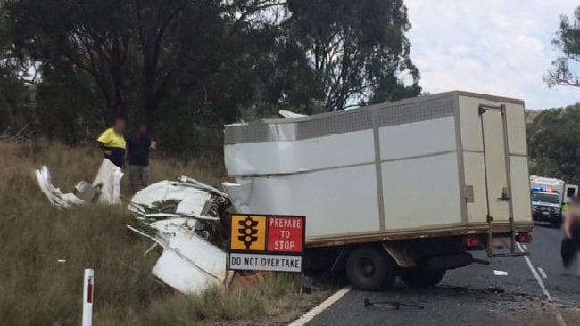
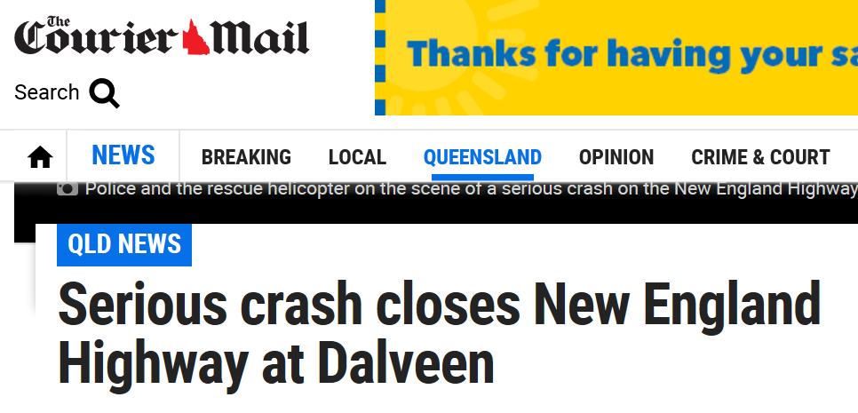
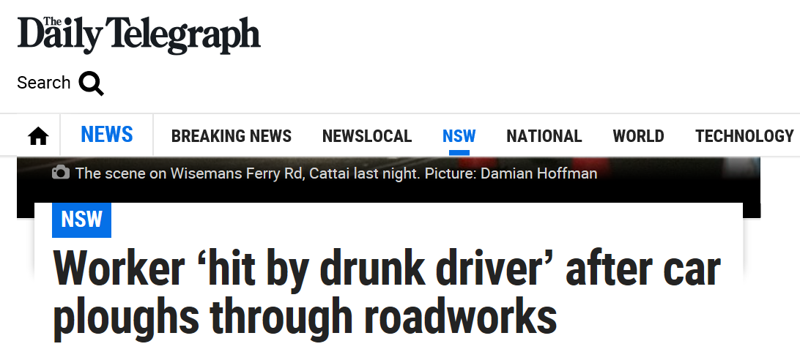
Recent Events in Australia
Notes:
And the outcomes of this risk is evident across Australia with numerous fatalities each year to both workers and road users.

Slide 6
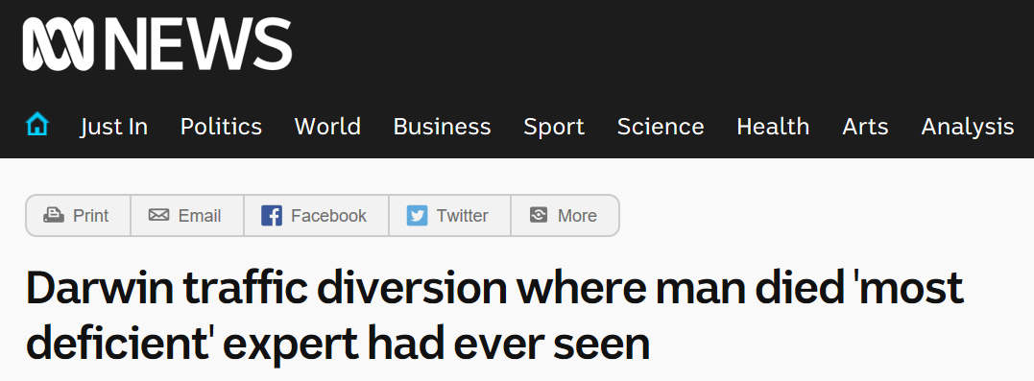
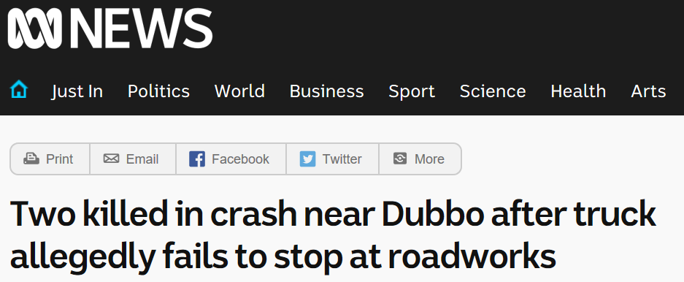
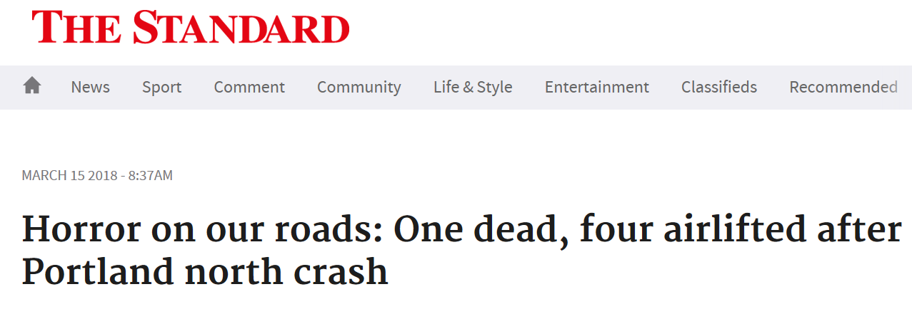
Recent Events in Australia

Slide 7
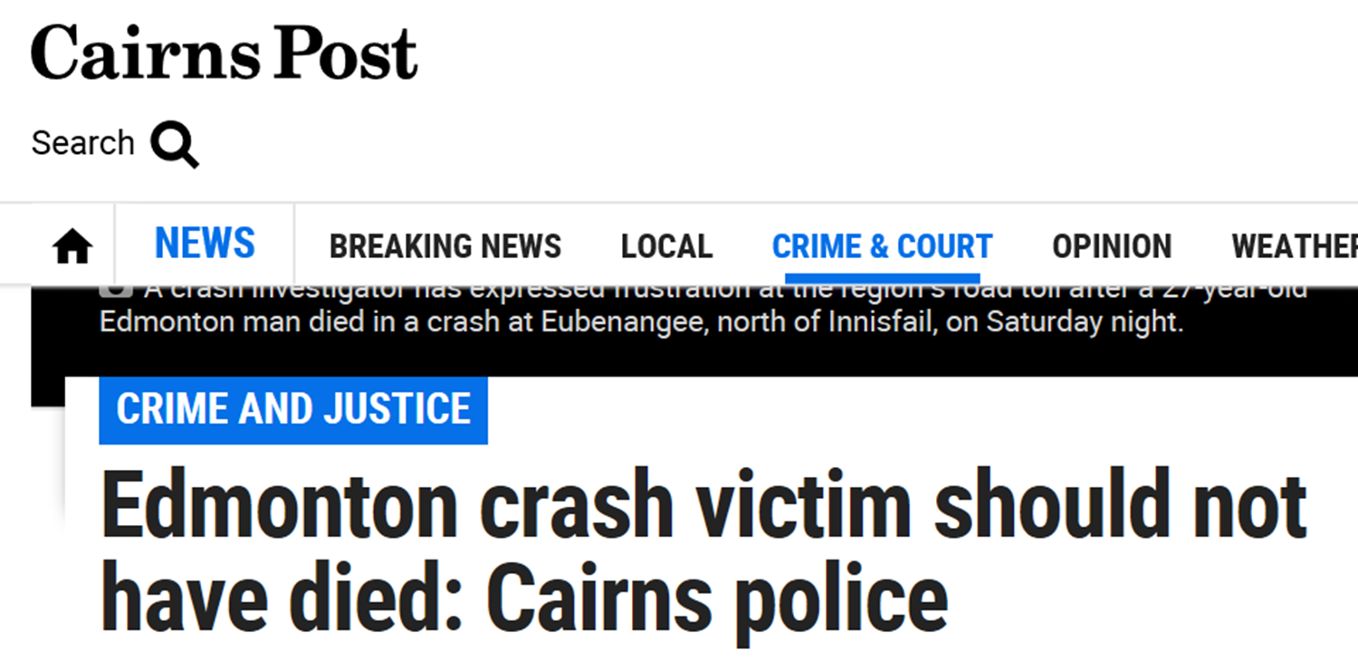
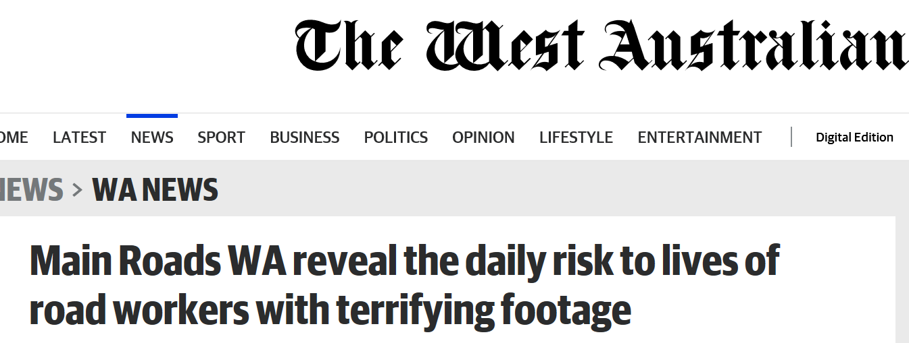
Recent Events in Australia

Slide 8
Personal Risk
Where do traffic management staff stand?
This event was a tragedy
Should he have been there?
Workers walking along the line of cones
Worker standing in lane with back to traffic
Worker reading plans in the middle of the road
How do you ensure that you are safe?
Notes:
Talk to this case
Giving a cup of coffee to the TMA driver. The TMA is there for a reason – to protect workers and is arguably in one of the most hazardous locations on a worksite. Therefore no one should be near it on foot.

Slide 9
Customer Satisfaction
Who are our customers?
Everyone we need to protect
All the workers on the road
All of the traffic management personnel
The road users
Why do we want to keep them satisfied?

Slide 10
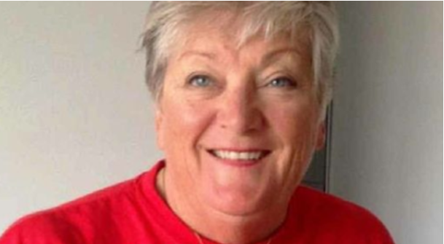
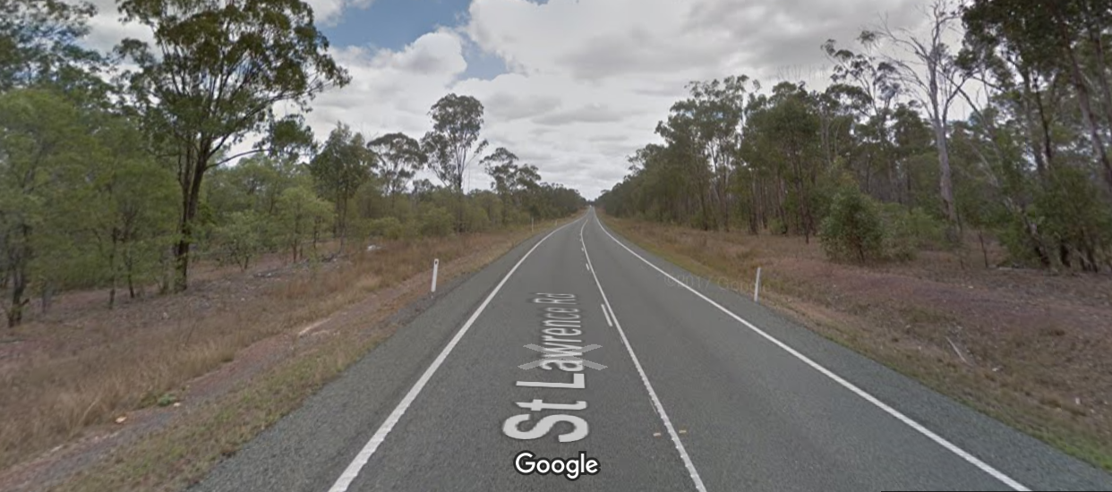
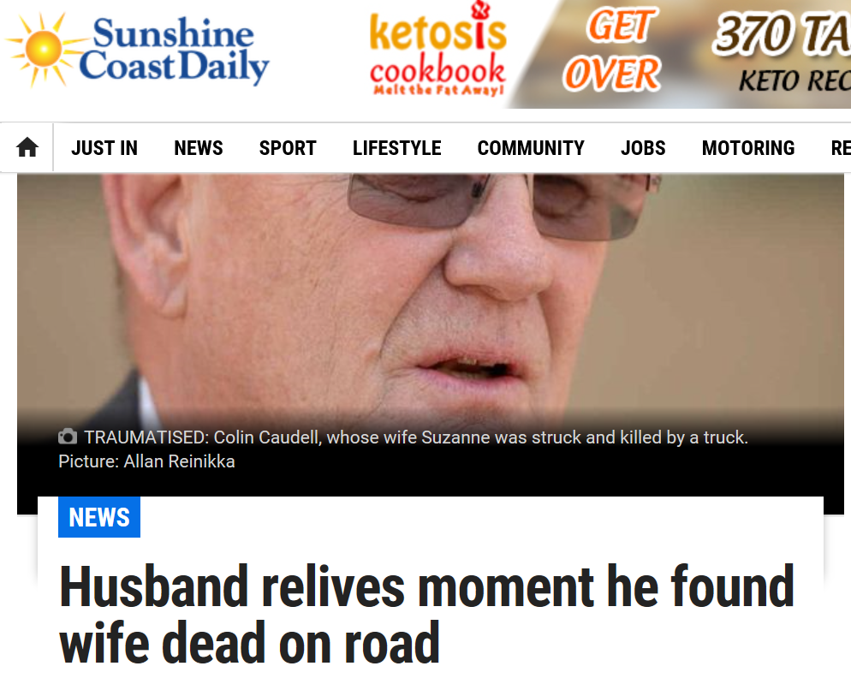
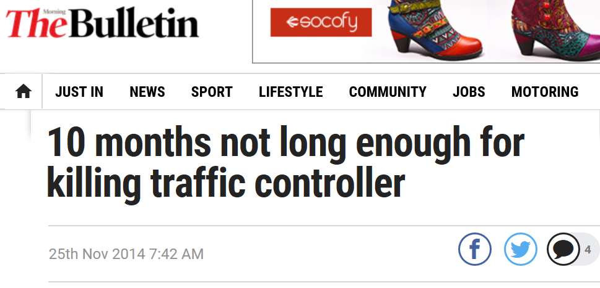
Suzanne Caudell
Notes:
Story of Suzanne Caudell
Suzanne and her husband Colin were on a working holiday, travelling around Australia and spending time as traffic controllers at worksites around the country as they travelled.
On January 16, 2013, Suzanne was killed instantly when she was struck by a B-Double while performing traffic controller duties at a roadworks site. In this tragedy the truck driver avoided a queue of vehicles stopped at her TC station and drove along the shoulder of the road where Suzanne was standing performing her duties.
The tragedy was made worse by the fact that her husband who had just finished relieving Suzanne while she had a break was driving away from her and only 500m from her when the accident happened. He immediately attempted to contact her by radio and drove straight back to find her on the road.
In court – the truck driver was found travelling 46kmh over the reduced 60kmh speed limit when he hit Mrs Caudell. He claimed in court he did not see the reduced speeding signs.
The tragedy for us as an industry was yet to come. In court, the defence argued that part of the reason that he was speeding was that everyone did it at roadworks. The prosecution experts acknowledged that speeding at roadworks sites was indeed an issue and that a large proportion of drivers sped at these sites.
In sentencing, the judge agreed and the driver was convicted in the Rockhampton District Court on October 14 2014 of dangerous operation of a vehicle. This was in place of the higher level offence of dangerous operation of a vehicle causing death.
What did this tell us? That we know we have a speeding problem that we are not doing a lot about. That the police and the courts agree that we know – and that it is a mitigating factor when considering the negligence of drivers. This is a massive failure in our system.

Slide 11
Customer Satisfaction
Road Users
Partially controlled only
Observed to comply – when it makes sense
But when it doesn’t make sense
Reduce compliance
And can become irate
Irate and non-compliant drivers increase our risk
Notes:
Road Users represent a substantial risk
They remain only partially controlled
Observed to comply when the traffic management make sense.
An irate driver is an increased risk
Drivers become irate at perceived continued irrelevance of road works sites
Irrelevance
Sites where the works are only beginning and we reduce speed limits just because occupation of the site has begun. In some states of Australia it is legislated that speeds can be a maximum of 80km/h when works have begun
Why
I have seen examples where the works are well off line and have no impact
I have seen sites where the initial works are to clear the batters and roadside. I would argue it is actually safer for road users than before the contractor turned up. So when the contractor goes home for the night what speed should we use
I have seen examples where the final surface and linemarking has been completed but there is some final landscaping works to complete.

Slide 12
Customer Satisfaction
Optional download of video
W-02a Customer satisfaction
Notes:
So what did we feel about this
This video was just under 2 and a half minutes in length
Although it felt quite agonising
The actual delay costs just 50 seconds.
But imagine coming across this several times on a journey
And then coming to an active site.

Slide 13
Customer Satisfaction
Safety at Your Worksite can depend on the performance of others in the industry
We all need to work together to deliver happy customers
Ask yourself – what speed could we safely operate at
If you are not happy as a customer imagine how others feel
Happier customers are more likely to comply and less likely to speed

Slide 14
Safety at Road Worksites Raising the Bar on Competence
Notes:
Competence is the key.
We need to look like we know what we are doing. Too often stuff is wrong and looks dumb. It may look right for us but we are not the audience. 17 yo to 80 yo

Slide 15
What is Austroads?
The peak organisation of Australasian road transport and traffic agencies.
Austroads members are collectively responsible for the management of over 900,000 kilometres of roads valued at more than $200 billion representing the single largest community asset in Australia and New Zealand.
Roads and Maritime Services New South Wales
Roads Corporation Victoria
Department of Transport and Main Roads Queensland
Main Roads Western Australia
Department of Planning, Transport and Infrastructure South Australia
Department of State Growth Tasmania
Department of Transport Northern Territory
Transport Canberra and City Services Directorate, Australian Capital Territory
Commonwealth Department of Infrastructure and Regional Development
Australian Local Government Association
New Zealand Transport Agency.

Slide 16
Austroads purpose
Improving the safety, productivity and sustainability of Australasian road networks through research and collaboration.
Austroads purpose is to support our member organisations to deliver an improved Australasian road transport network.
One that meets the future needs of the community, industry and economy.
A road network that is safer for all users and provides vital and reliable connections to place and people.
A network that uses resources wisely and is mindful of its impact on the environment.
Notes:
Talk to my role

Slide 17
Safety at Road Worksites – the Project
Austroads Board - Strategically Important Issue
Legislative requirement
Employer in construction, operation maintenance
Provide a safe work environment
Manage risks of working in or near traffic through Australian WHS Act 2011 NZ HSW Act 2015
Risks
Prequalification Scheme - Companies
Austroads and Industry Partners
Austroads and Industry Partners
Registration Scheme - Individuals
Austroads
Accredited Training
Traffic Management workers
Austroads
CoPTTM
Standards Australia
AS1742.3
Contractors
Public
Notes:
Tell the story of the project so far
QLD project
NSW project working near traffic
NZ project on Zero Harm
WA is quite advanced in this area
It is all about communication
1. The risks
Recognition - one of the most dangerous activities for roads agencies,
Obligation - to ensure works are undertaken by experienced competent trained practitioners,
Consideration for everyone.
WHS obligations
So what does the current situation look like
Common issues
Application on the ground does not conform with the standards
Driver compliance with what we want is low
I am sure you can all tell me numerous stories of how dangerous work sites are
Traffic Management is treated as a low cost service provision
You get what you pay for
We cannot accept that the current situation continues
Solutions
We commonly hear that we need to educate drivers - However we have been – and for the past 30 years I have been involved we have been teaching them that we are not to be believed
We commonly hear that we need to enforce our roadwork sites – However we already ask them, and they often refuse because the sites are not enforceable.
We commonly hear that drivers do not obey our signs – however – often it is our own people – WHS supervisor example
We see repeated errors at many sites, some of them serious. In many cases what gets installed looks dumb.
We therefore need to start by improving our own practices. The same themes are repeated across Australia and New Zealand.

Slide 18
Safety at Road Worksites
Project Elements
Module 1 – Code of Practice for Temporary Traffic Management
Module 2 – Nationally Harmonised Training
Module 3 – National Registration Scheme for individuals working in Traffic Management
Module 4 – National Prequalification Scheme for companies operating in Traffic Management
Module 5 – AS1742.3 Update
Module 6 – Engagement Plan
Notes:
Then talk about the model that we have ended up with.
Includes the four main modules and the continued support of the update to AS1742.3.

Slide 19
CoPTTM
Part 1 – Introduction and General
Code of Practice for Temporary Traffic Management
Part 1 - Introduction and General
Part 2
Traffic Management Planning
Planning
1
Part 3
Devices
Part 4
Static Work
Sites
Part 5
Mobile Works
Part 6
Short Term Low Impact Works
Design
Part 7
Guide for Field Staff - Implementation and Supervision
Part 8
Traffic Controller Instructions
Field
Part 9
Processes and Procedures
Part 10
Sample Layouts
Part 11
Supporting Guidance

Slide 20
Nationally Accredited Training
NZ Role | Australian Role | Road Category | Skills Set
 | Road Labourer | 1, 2, & 3 | Road Labourer
 | Traffic Controller | 1 | Traffic Controller
 |  | 2 | Traffic Controller 2
 | Implementer of a TGS ^{(➢)} | 1 | Implementer of a Traffic Guidance Scheme
 |  | 2 | Implementer 1 + Supervisor + technical unit
 |  | 3 | Implementer 1 + Supervisor + specialist motorway training
 | Design & Develop the TMP and TGS ^{(➢)} | 1 | Guidance Plan Developer – 1
 |  | 2 | Guidance Plan Developer – 2
 |  | 3 | Guidance Plan Developer – 2 +specialist motorway training
Traffic Controller
STMS
➢ Implementer and Developer skill set includes a Non-Practitioner qualification
Notes:
Message – need for more logical progression for industry participants
Message – need for skills to be matched to the risk profile of the network
New pathways for practitioners in the industry
Talk about non – practitioner
Biggest challenge in this area is harmonising roles and training across Australia and New Zealand

Slide 21
Registration Database
Register for all individuals in the Industry
All qualifications recognised across Australia and NZ
Records qualifications, ongoing CPD, and competency assessments
Online tool to allow site managers to instantly check qualification status
Records feedback – positive and negative
Non-practitioners – need to submit performance reports of a percentage of their sites to retain their qualification
Poor performers – Conditional qualification or qualifications suspended / cancelled
OUTCOME – industry with better trained individuals and improved safety and performance

Slide 22
Company Prequalification
Register for all Traffic Management Companies in the Industry
All qualifications recognised across Australia and NZ
Records company prequalification details
Records level that the company is prequalified to – company or city qualification
Online tool to allow site managers to instantly check prequalification status
Records feedback – positive and negative
Poor performers – Conditional qualification or qualifications suspended / cancelled
OUTCOME – industry with companies operating at the appropriate levels with improved safety and performance

Slide 23
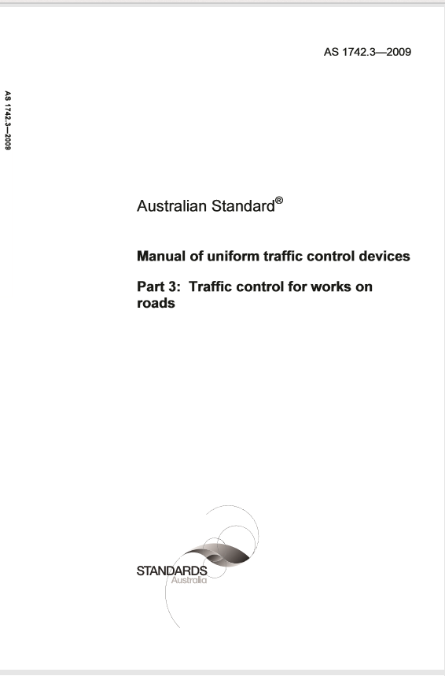
Australian Standard AS1742.3
The historical manual of practice for Australia
Not relevant to NZ
Has been the core for Australian practice for decades.
Provides some good guidance but is significantly less comprehensive than the NZ CoPTTM
Being updated to just provide standards information on each of the traffic control devices
No longer guidance on how to use devices.

Slide 24
Engagement
Agency Based Projects
Queensland - Improving Safety at Roadworks
New South Wales – Working Near Traffic
New Zealand – Zero Harm at Roadworks
Publications
Austroads Newsletters
TMAA Detours Magazine
Presentations
Traffic Management Association of Australia National Conference 2016, 2017, 2018
TMAA State events – WA, VIC, NSW, QLD and SA (forthcoming)
Roads Australia – 2016
Road Marking Industry Association of Australia 2017, 2018 (forthcoming)
Australian Local Government Association - 2017
NZ TTM Conference - 2018

Slide 25
How do you get involved?
Collaborating with industry - we cannot do this without you
Working Group Members
Will be involved in all stages of each part of the project
You can write to us at any time
New practices to be considered
Industry Consultation phase
Formal consultation for every part of the project
Review and comment on the draft documents
Suggested amendments to existing practices
Issues / concerns with existing practice
Fergus Tate (NZTA)
Numerous comments received to date from NZ
NZTA are members
austroads@solutionsintransport.com.au
www.austroads.com.au
Notes:
We don’t have all of the answers
I don’t have all of the answers.
This is not about me telling you how to do your job
This is about me facilitating a process that meets all of our needs.
NZTA has nominated Fergus Tate as representative to sit on working groups?
Input is to be sought by NZTA on
Translation and adoption of NZ practices
Impacts on NZ Practices.
New practices to be considered
Suggested amendments to existing practices
Issues / Concerns with existing practices
Industry consultation to be held for each Guide Part and for training modules – big emphasis here, we are being very consultative going forward, “we cannot do this without you” message

Slide 26
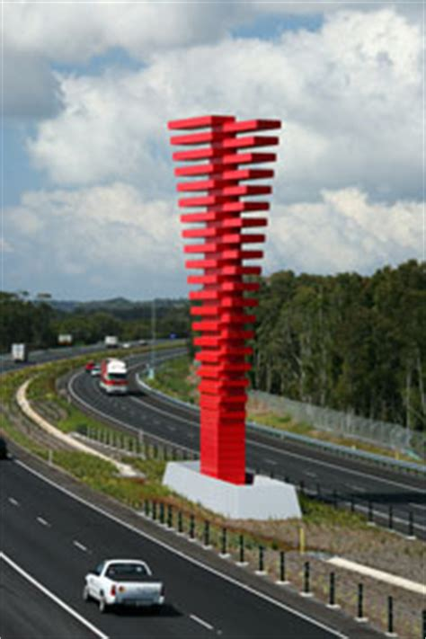
Australia and New Zealand harmonisation
Benefits
Scant senior technical resources in road agencies
Increased opportunities for joint research and improvements
Ability to update Guidance and Training more proactively
Mobile workforce able to serve both countries
Ease of company operations across jurisdictions
Notes:
Talk to Tugun Bypass issue

Slide 27
Take away message
Safety at Your Worksite can be dependant on the performance of others
We need to hold others to account
We need to consider the customer at out sites

Slide 28
Delivering the Take Away Message
Risk
Consider both sides of the risk event
Safe Systems
Consider personal risk appetite
Consider the road user and their satisfaction – a happy customer is a safer customer
Competency - Improved designs from competent trained practitioners, working in accordance with best practice and for companies experienced and competent in undertaking the works.
Harmonisation of our industry strengthens us all and strengthens the thin orange line

Slide 29
Thank You
Dr Dan Sullivan
Founding Director and Project Manager, Safety at Road Worksites Project
+ 61 423 782 189
austroads@solutionsintransport.com.au
PO Box 721, Kenmore, QLD, 4069, Australia

