Slide 1
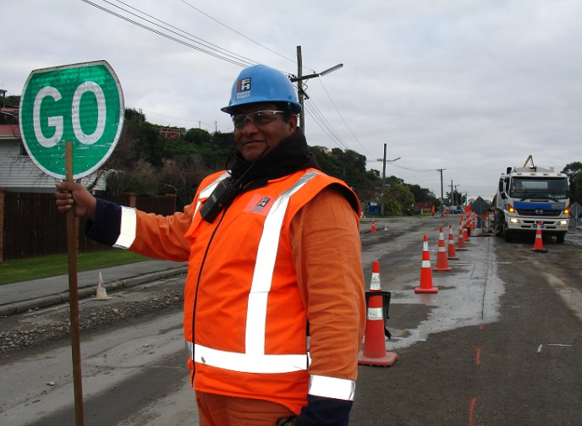
WELCOME
Notes:
Welcome
Sponsors –
Independent Traffic Control (Platinum)
Traffic r us (Gold)
Hurford (Silver)
Presenters – great selection 30+ with motivation and insight from NZ and overseas.
Most importantly our attendees
Well over 200 registrations, beyond our expectation
With busy lives & many training & conference opportunities we appreciate this investment of your time.
So why did I chose this photo – a good stop/go operator can make or break the customer experience. They are the face of TTM. They manage queues, engage with customer and smile and wave (hopefully)

Slide 2
Great Journeys to keep New Zealand Moving
Notes:
Say something about Transformation

Slide 3
Strategic responses
^{One Connected}
^{Transport System}
^{People-centred}
^{Services}
^{Partnerships}
^{for Prosperity}
Transform land transport system performance by integrating digital technology with physical infrastructure to create a safe, connected system that works for everyone
Simplify our customers’ lives and our partners’ work with innovative services and experiences that make it easy for them to do what they need to
Unlock social and economic opportunities for customers, business and communities through targeted partnerships

Slide 4
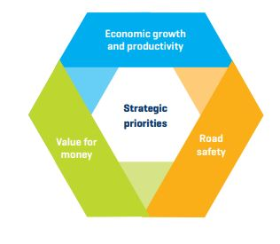
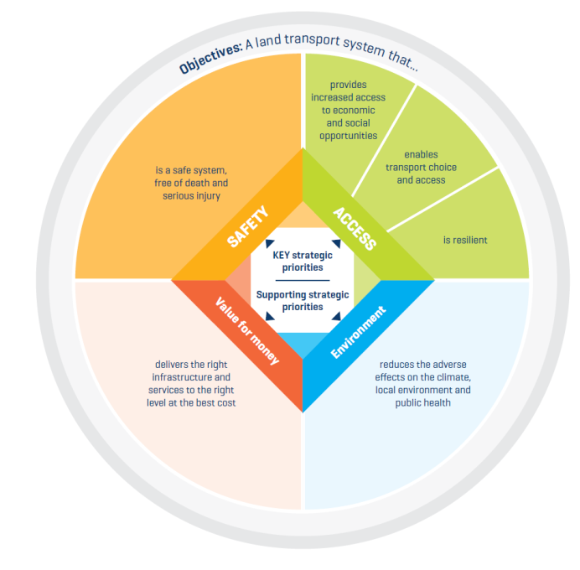
 | 2015 | 2018
Strategic Priorities | Economic growth and Productivity Safety Value for Money | Safety Access Value for money Environment
Themes | Technology One-transport system approach | Modal neutrality Technology Integrated land use and transport

Slide 5
The draft GPS signals key shifts in NLTP investment priorities
a stronger focus on reducing deaths and serious injuries
a new emphasis on transport infrastructure to support liveable cities
a proactive modal shift in urban areas from roads to public transport and active modes, with a particular focus on rapid transit
increased investment in optimising the efficiency of the system across modes, e.g. through integrated urban and transport planning, travel demand management, new technologies
increased regional investment – through local road improvements, safety improvements, inter-regional passenger and freight connections and resilience, including adaptation to climate change
an increased focus on environmental outcomes and greater parity across economic, social and environmental outcomes
Overall increase in transport investment
a reduced emphasis on state highway improvements (from 38% of investment in GPS 2015 to 25% in GPS 2018)

Slide 6
Workers Safety / Competency
Increased Board interest
want to understand the risks and how we are responding
Importance of customer outcomes
Data & intelligence is key
Link innovation and trials to risk reduction
Show return on investment
Move to competency based qualifications
Responding to supplier insight
Providing a better career path

Slide 7
What’s the Agency’s focus
This continues to be a critical risk
Set up collaborative programme with sector
Innovations and trials; validate benefits; implement across NZ
Areas of focus
Speed enforcement
Physical worksite layout and signage
Driver education and information
Design out the risk (process & solutions)

Slide 8
Questions

