Slide 1
Proposed Training and Competency Model

Slide 2
What we will cover
Background to the model
Overview of the model
Impacts on the industry
Notes:
In this session we will:
Click
Provide you with some background information about the Training and Competency model
Click
Explain some of the key parts of the model
Click
And we will finish by reviewing some of the impacts on the industry when the model is implemented

Slide 3
Industry concerns
No career path
Need to change
Lack of experienced staff on-site
Practical experience of trainers
Training considered theoretical
TCs with no practical experience
Notes:
It would be fair to say that the industry had some concerns about the current training model
Click
The industry really wanted a career path for staff. We wanted a way of sitting staff down and working out where they could go within the industry – the current model does not give us that but the new one does
Click
Some of the trainers do a really good job but overall it was felt that most of the trainers lacked practical experience of working in the field
Click
A major concern was the fact that we were getting TC qualified staff onsite who had no experience of working on the roads which is a major risk for the industry
Click
The training was consider theoretical rather than being practical
Click
This all led to a lack of experienced staff onsite

Slide 4
About the project
Coroners Court recommendation
Priority project for CGG
Working party 11 industry representatives
Notes:
Added to those industry concerns…
Click
There was a Coroners Court recommendation that the industry needed competent of our staff
Click
The industry concerns and the Coroners Court recommendation resulted in The CoPTTM Governance Group setting a priority project for the development of a revised Training and Competency model
Click
A working party was formed to develop the revised Training and Competency model. The working party had 11 industry representatives.

Slide 5
Working party members  6 CGG members
Contractors
TTM specialist
James Scully
Angela McNeil
Ray Edwards
Chris Harmer
AMA (Fulton Hogan)
Downer
Higgins
Higgins
Ben Isdale
Peter Graham
Evolution Road
Services
Traffic Management and Control
Consultants
RCAs
George Boyd
GHD 
Tom Kiddle
Simon Harty
Auckland Transport 
CTOC 
Trainers
NZTA
Neil Greaves
NGTC 
Stuart Fraser
NZTA 
Notes:
The working party has representation from across the industry including Contractors, TTM specialists, Consultants, RCAs, Trainers and Stuart representing NZTA
Angela and I represent the Contractors
Included in the working group are 6 members of the CoPTTM Governance Group – these are shown with the orange Asterix
So as you can see this is very much driven by the industry – dealing with our issues

Slide 6
The process
Working party developed Training and Competency model
4 Industry consultation workshops
(Dunedin, Christchurch, Palmerston, Auckland)
339 submissions
Submissions and proposed model online; Documents under discussion
CGG endorsed the model
Awaiting NZTA approval
General consensus – this is the right way to proceed
Notes:
The working party developed the draft model
Click
Then 4 industry consultation workshops were held around the country with some members of the working party attending each workshop
Click
During these workshops we received 339 submissions for changes to the model which have all been actioned. The draft model and the submissions are available on the NZTA website on the CoPTTM page under the heading Documents under discussion
Click
CGG have endorsed the model and it has been submitted to NZTA for final approval
Click
The overall impression from everyone that we speak to is that this is the right way to be heading
So that is the background to the project and I will now hand over to Tony to take us through some of the key parts of the model

Slide 7
Training and Competencies model
Key roles
Learning blocks
Profiles
2.62"
Key roles requiring some form of CoPTTM knowledge
Map showing the CoPTTM learning blocks with preferred order of learning and any pre-requisites
Profile for each learning block covering knowledge to be included in learning and skills to be assessed
Key roles
Learning blocks
Profiles
Notes:
The training and Competencies model consists of 3 separate but interrelated parts:
Key roles – a list of the key roles that require some form of CoPTTM knowledge
Learning blocks - A map showing the CoPTTM learning blocks with preferred order of learning and any pre-requisites
Profiles – a profile has been developed for each learning block identifying knowledge to be covered during the learning and skills to be assessed after the training is completed

Slide 8
Link to NZQA
Knowledge
Roles
Competency
Practical
Use competencies to revise the NZQA unit standards
NZQA
Certificate of Temporary Traffic Management registered on the NZ Qualification framework
Other certificates as required
Notes:
It was decided that the best way to develop the model was to work through the following process:
Identify the key TTM roles requiring CoPTTM competency (of some type)
Identify the elements needed to be competent in the roles (primarily knowledge and practical skills)
This gives us the CoPTTM Competency
Use these competencies to revise the NZQA unit standards.
Then work with NZQA to set up a Certificate of Temporary Traffic Management registered on the Qualification framework

Slide 9
Key roles requiring CoPTTM knowledge
1
8
General Worker
TTM Mentor
2
9
TTM Worker
TTM Verifier
3
10
Inspector
CoPTTM Trainer
4
11
Traffic Controller
CoPTTM Assessor
5
12
STMS (Onsite supervisor)
Auditor
6
13
Manager of activities requiring TTM
TMP Designer
7
Corridor Manager (includes TMC)
14
Approving Engineer
Notes:
Here are the key roles which we identified as needing CoPTTM knowledge
As you can see there are more roles than what is covered in the current CoPTTM training (for example, the TTM Worker is not addressed in the current training packages)

Slide 10
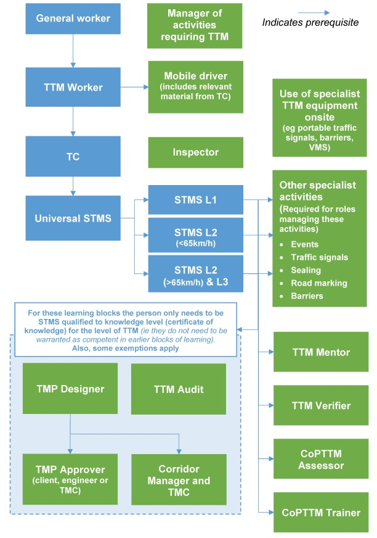
Map of learning blocks
Learning block could be:
Formal training
On-job training
Briefing
Online learning
Combination of any of above options
Link to map of learning blocks
Notes:
Once the key roles requiring CoPTTM training were established, we then identified what learning blocks were required for each role.
As part of this we also looked at what learning blocks were prerequisites to other learning blocks
We were careful not to assume that each learning block would be a workshop. We considered the range of options which include:
Formal training
On-job training
Briefing
Online learning
Combination of any of above options
Click the link to go to Map of learning blocks
Notes of what to cover included under the learning blocks slide

Slide 11
NZTA qualifications
Completion of training
Certificate of knowledge (Non practising - NP)
Assessed as competent
Warrant
(Practising - P)
Notes:
Some points to note about the model
A certificate of achievement is issued after the person successfully completes the training and passes all of the tests
The warrant is issued once the person has been assessed as competent in all of the practical skills associated to the learning block

Slide 12
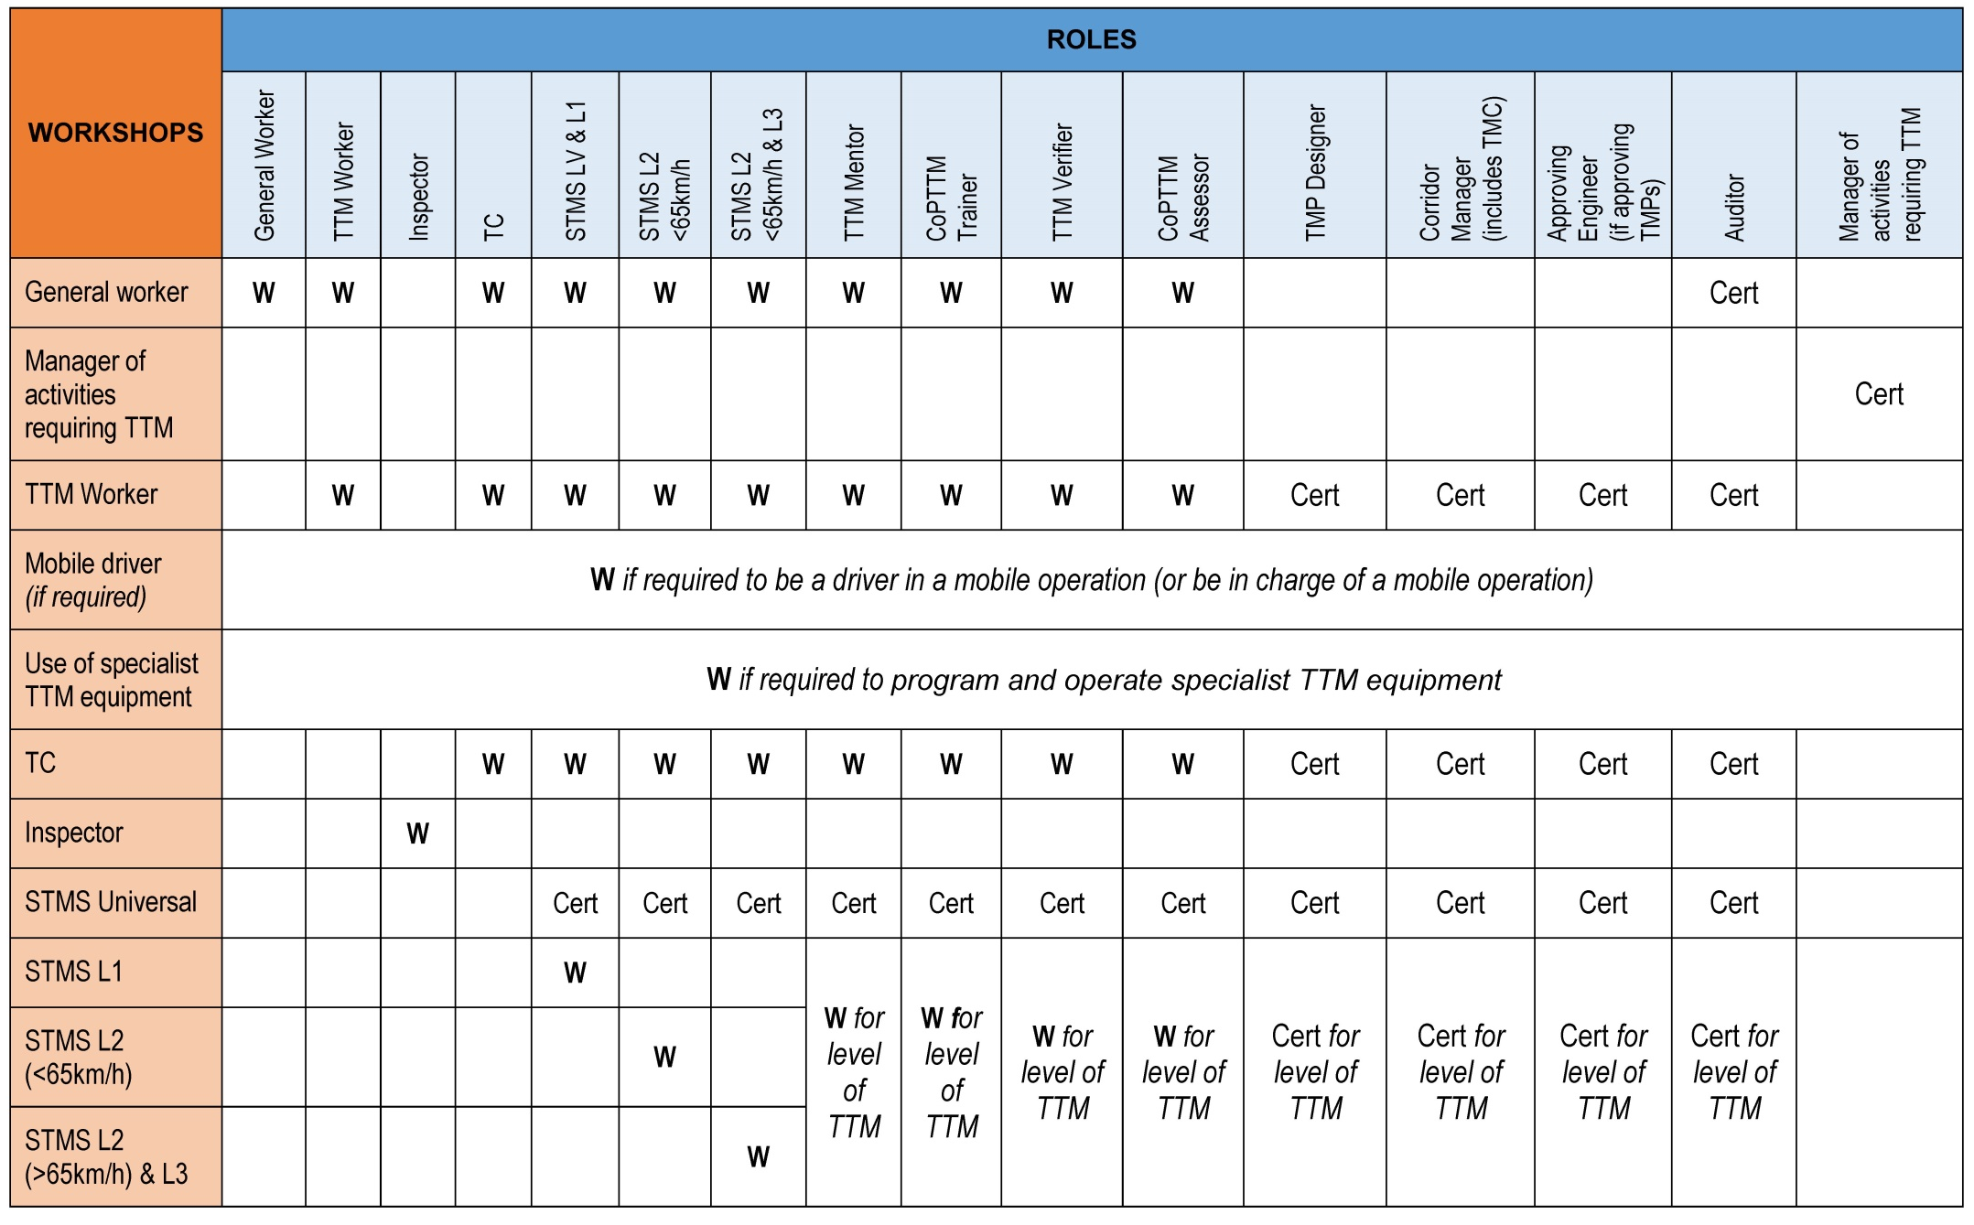
Matrix of Certificate or Warrant 1st page
Notes:
Some roles only require an understanding of the requirements (certificate of achievement) for any prerequisites
Other roles require the person to be have been assessed as competent (warrant) for any prerequisites
The matrix is a quick way to establish what qualifications each role requires

Slide 13
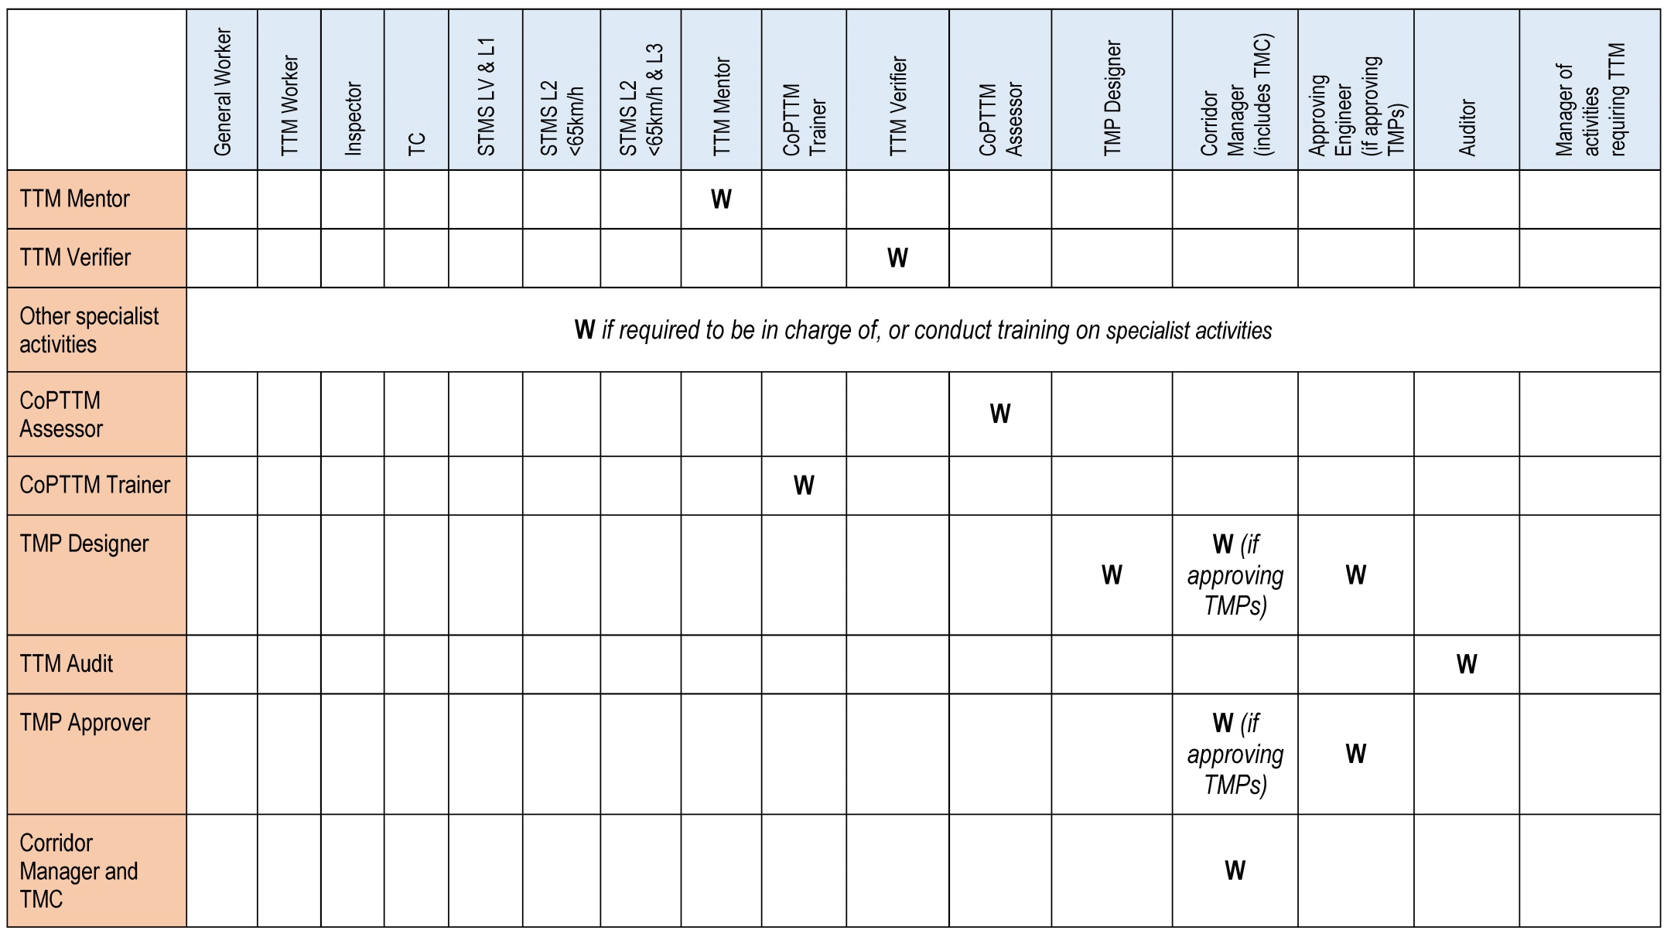
Matrix of Certificate or Warrant 2nd page

Slide 14
Matrix of Certificate or Warrant 1st page
Notes:
For example, the TTM Worker requires warrants (assessed as competent) in the General Worker and TTM Worker learning blocks

Slide 15
Matrix of Certificate or Warrant 1st page
Notes:
The STMS L1 requires warrants in the following learning blocks:
General Worker
TTM Worker
TC
STMS L1
They also need a certificate of achievement for the STMS Universal learning block

Slide 16
Matrix of Certificate or Warrant 1st page
Notes:
The STMS L2 over 65km/h and L3 requires warrants in the following learning blocks:
General Worker
TTM Worker
TC
STMS L2 over 65km/h and L3
They also need a certificate of achievement for the STMS Universal learning block

Slide 17
Matrix of Certificate or Warrant 1st page
Notes:
A TMP Designer developing TMPs on level 1 roads requires a certificate of achievement in the following learning blocks:
TTM Worker
TC
STMS Universal
STMS L1
Click to next slide

Slide 18
Matrix of Certificate or Warrant 2nd page
Notes:
And they will also need a warrant in the TMP Designer learning block

Slide 19
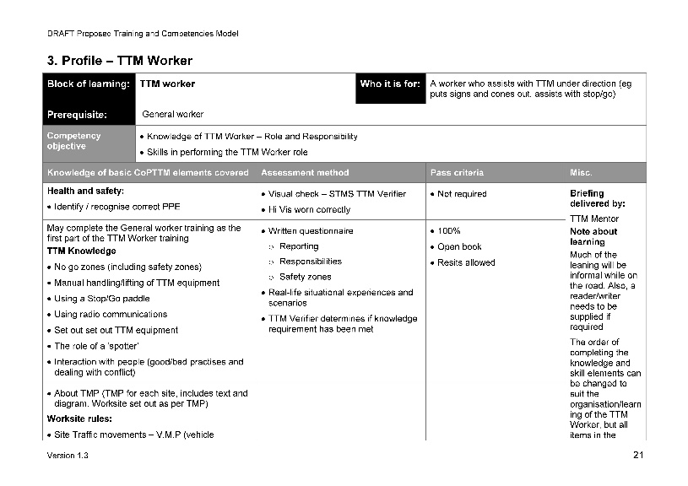
Outlines for each learning block
The detailed learning block outline identifies:
Who is it for?
What’s covered – during formal learning
What’s covered – on the job
Competency to be assessed
Assessment approach
Is a refresher required?
Notes:
Each learning block has a profile which outlines key information about the learning block
Who it is for
What learning blocks are prerequisites
The competency objectives for the learning block (what the person will be able to do at end of training/briefing and assessment)
What’s covered during formal learning
What’s covered on the job
Practical skills to be assessed and the assessment approach
Whether a refresher is required
Approximate learning time (not including time after the training/briefing session to practice skills and complete assessment)

Slide 20
Priority for development
Development of learning and assessment packages will occur over multiple years
NZTA recommends following priority:
TTM Mentor
TTM Verifier
CoPTTM Assessor
CoPTTM Trainer
General Worker
TTM Worker
TC
Universal STMS
STMS L1
STMS L2 under 65km/h
STMS L2 over 65km/h & L3
Priority 1
Notes:
NZTA acknowledges that the development of the material (learning packages and assessments) will need to occur over multiple years.
NZTA recommends that the following priority for development be adopted:
Priority 1
TTM Mentor
TTM Verifier
General Worker
TTM Worker
TC
Universal STMS
STMS L1
STMS L2 under 65km/h
STMS L2 over 65km/h and L3

Slide 21
Priority for development
TMP Designer
Mobile Driver
Inspector
Use of specialist TTM equipment on-site
Other specialist activities
Priority 2
Manager of activities requiring TTM
TTM Audit
TMP Approver
Corridor Manager & TMC
Priority 3
Notes:
Priority 2 will include:
TMP designer
Mobile driver
Inspector
Use of specialist TTM equipment on-site
Other specialist activities
Click
Priority 3 will include:
Manager of activities requiring TTM
TTM Audit
TMP Approver
Corridor Manager & TMC

Slide 22
What will happen to existing warrants?
Trainer processes renewal of warrant once competence assessment completed
6-month phase in period (allows time for training of TTM Verifier)
Existing warrant
Competence assessment
Expiry date
Existing warrant continues to apply until expiry date
Before expiry, candidate completes the competence assessment for current warrant (verified by TTM Verifier/CoPTTM Assessor)
Candidate attends refresher workshop (Trainer processes renewal of warrant once competence assessment completed)
6-month phase in period (allows time for training of TTM Verifier)
Refresher workshop Trainer processes renewal
Notes:
Implementation strategy dealing with current warrants
There was general reluctance to having a recognition of prior experience procedure with candidates able to roll their existing warrant over to the new warrant without there being a check on the person’s practical competence.
The following implementation strategy has been proposed:
Click
The existing warrant continues to apply until the expiry date for that warrant
Click
Before the expiry date the candidate completes the competence assessment(s) for the current warrant with verification from a TTM Verifier/CoPTTM Assessor as required
Click
Candidate attends the refresher workshop for the warrant, but trainer does not process the renewal until all the required competence assessments have been completed
Click
To allow time for this process to be organised and TTM Verifiers to be warranted, it is suggested that an initial period of 6 months, following the implementation of the model, be allowed before the competence assessment requirement kicks in
This means that anyone refreshing their warrant during that 6-month phase in period will not be required to complete the competence assessment for the warrant.
They will however have to do the competence assessment at or before the next renewal of their warrant.

Slide 23
What about warrants for key roles
More discussion required
Consider an acting role during the transition period
Competency verification / proof / training etc being completed within a certain timeframe
Notes:
There needs to be more discussion on how this strategy is to be applied
For some key roles (eg TMC or TMP Approver) it may be necessary to consider an acting role during the transition period
This may mean competency verification / proof / training etc being completed within a certain timeframe.

Slide 24
Comparison of training time old vs new Traffic Controller

Slide 25
Comparison of training time old vs new STMS Level 1

Slide 26
Comparison of training time old vs new STMS Level 2 under 65kmh

Slide 27
Comparison of training time old vs new STMS Level 2 over 65kmh and Level 3

Slide 28
Comparison of training time old vs new TMP Designer Level 1
Notes:
I now want to hand over to Angela who will explain the impacts for the industry when the new model is introduced

Slide 29
Some significant changes
Need to align to a new national system for assessing competence
It will take longer to get staff qualified (competent) in a role
We need to have TTM Mentors and TTM Verifiers (employ or contract)
Notes:
There are some significant impacts for the industry
Click
Many of the companies within the TTM industry already operate a competency assessment for each role. We will now need to align our own systems to a national system
Click
With the introduction of the Training and Competency it is going to take longer to get a person qualified. But that is what the industry has been asking for - competent people on site. We need to put the time into our people to get them competent and that will lead to safer sites and lower risk
Click
We are going to need to TTM Mentors to complete on-job practical training and TTM Verifiers to confirm competence at Level 1. Both of these roles could be either existing employees or someone who is contracted to complete that role.
I can see the larger companies having both roles as employees but I can also see some smaller companies contracting in a TTM verifier to confirm competence of staff.

Slide 30
Companies will need TTM Mentors
They deliver training in the following learning blocks:
General Worker
TTM Worker
Mobile Operation Driver
TTM Mentor
They also provide mentoring on other learning blocks
Notes:
The TTM Mentor will deliver training in the following learning blocks:
General Worker
TTM Worker
Mobile Operation Driver
They also provide mentoring in a range of other learning blocks

Slide 31
Companies will need TTM Verifiers
They determine competence in the following learning blocks:
General Worker
TTM Worker
Mobile Operation Driver
TTM Verifier
They also determine competence in the following level 1 learning blocks:
Traffic Controller (TC)
STMS level LV and level 1
Use of specialist TTM equipment on-site
Other specialist activities
Notes:
The TTM Verifier determines competence in the following learning blocks:
General Worker
TTM Worker
Mobile Operation Driver
They also determine competence in the following level 1 learning blocks:
Traffic Controller (TC)
STMS level LV and level 1
Use of specialist TTM equipment on-site
Other specialist activities

Slide 32
Impacts for CoPTTM level 1 trainers
They deliver training for the following CoPTTM learning blocks:
TC
Universal STMS
STMS level LV and level 1
Manager of activities requiring TTM
CoPTTM L1 Trainer
Will need to hold the same practising warrants as a STMS L1
Will need to hold (or be working towards) New Zealand Certificate in Adult and Tertiary Teaching (previously National Certificate in Adult Education and Training)
Notes:
CoPTTM L1 Trainers will continue to deliver training for the following CoPTTM learning blocks:
TC
Universal STMS
STMS level LV and level 1
They will also be able to work with the managers of activities requiring TTM to help them understand the CoPTTM requirements and establish compliant policy and procedures
A big change for the trainers is that they will now need to hold the same practising warrants as a STMS L1 – which means that we will have practical trainers
But we also want to make sure that they know how to train people so they will also have to hold (or be working towards) New Zealand Certificate in Adult and Tertiary Teaching (previously National Certificate in Adult Education and Training)

Slide 33
Competent staff
Benefits of Training and Competency Model
Lower risk
Confidence of using a national system
Career path
Notes:
So to sum it all up then, whilst there are some implications we need to work through, there are some major benefits in adopting the Training and Competency model
Competent staff - Lower risk
We will have competent staff at worksites which will lower our risks and make sites safer
Confidence of using a national system
Companies will have the comfort of knowing that they are using an industry approved national system
Career path
We will have a career path that staff can work towards

