Slide 1
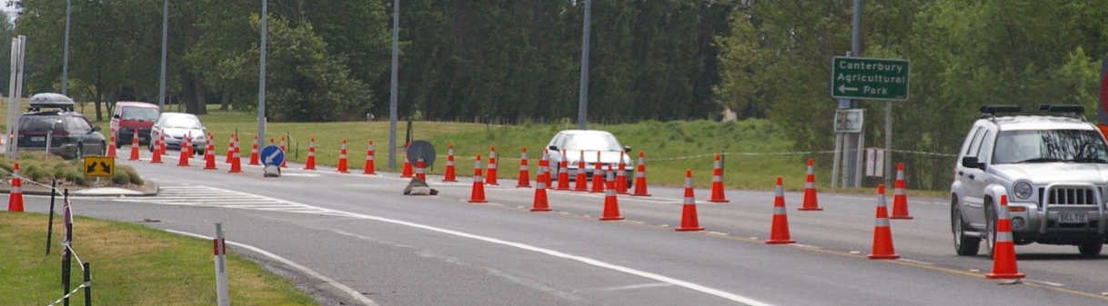
Discussion document
Level 2 low speed (2LS) roads

Slide 2
The issue
Current level 2/3 practice for low speed roads has been questioned
It is clear that level 2 low speed roads do not fit within current practice
For example:
The use of a work vehicle covered by a shadow vehicle and a tail pilot (AWVMS) is clearly more than required and contributes to congestion
Notes:
Observations through ATOC cameras clearly show that often only 1 vehicle is used to set up a site in LS roads

Slide 3
CGG projects
Produce a policy for low speed level 2 roads
  Develop a low speed level 2 layout distance table and guidelines for signs and vehicles. Include sign sizes for level 2 urban roads
Apply the One Network Road Classification (ONRC)

Slide 4
Where are we up to in the process
To date:
  Discussion document produced (AT, ChCh, Trainers, NZTA)
  Consultation with RCAs
To follow:
  Complete consultation with RCAs
  Consultation with wider industry
  NZTA finalise policy
  CGG endorse changes

Slide 5
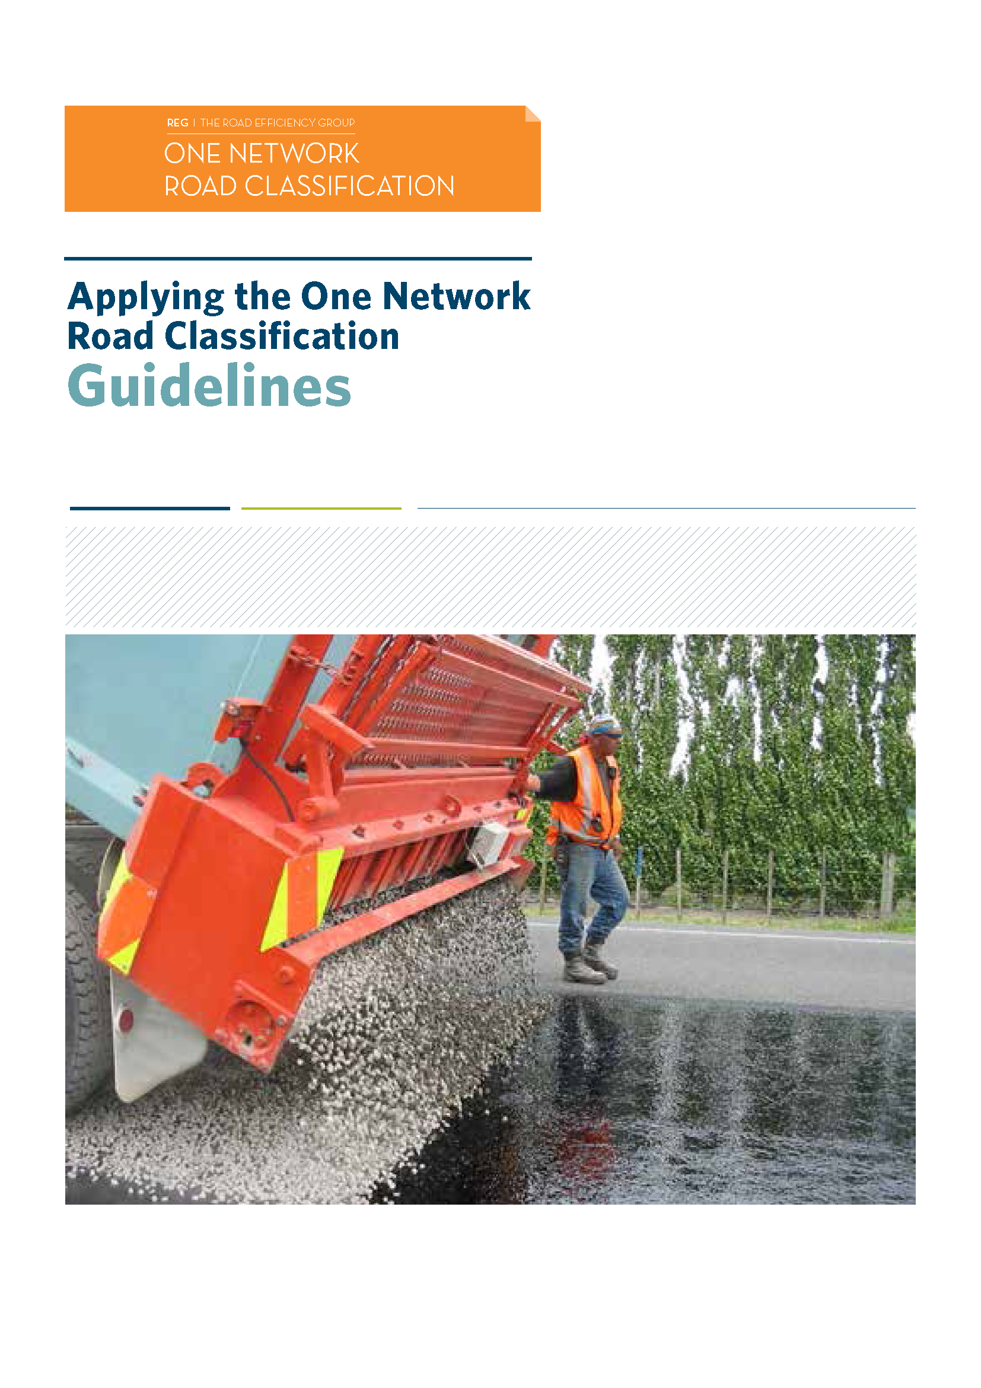
Applying the One Network Road Classification (ONRC)
This document sets out guidelines for applying ONRC to all New Zealand’s public roads
The ONRC has been developed by a joint local government/ transport agency project team as part of the Road Efficiency Group (REG) work programme

Slide 6
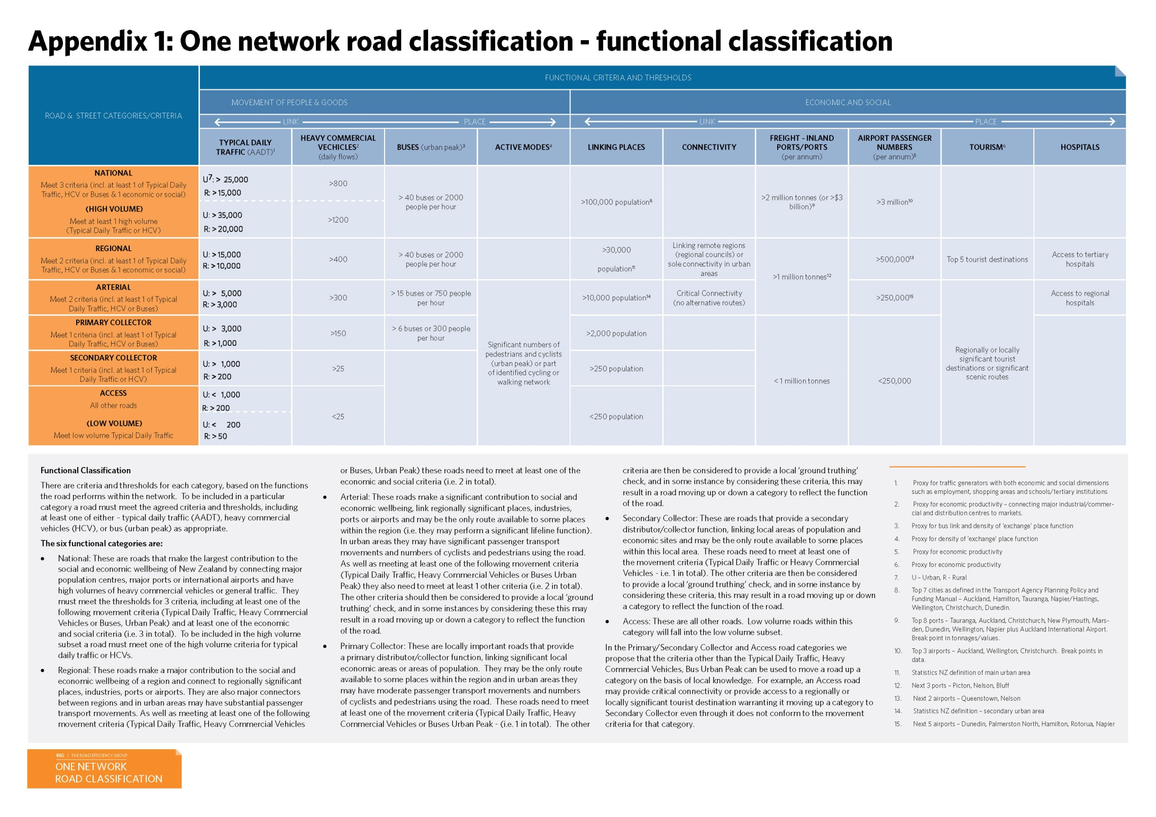

Slide 7


Slide 8
Level of road | AADT | Comments
Level LV / low risk | < 250vpd
Level LV | < 500vpd
Level 1 | <15,000vpd Urban <10,000 Rural
Level 2 low speed (2LS) | >15,000vpd | < 65km/h. May have a central median division with at grade access
Level 2 | >15,000vpd Urban >10,000 Rural | May have a central median division with at grade access
Level 3 | >15,000vpd | Roads with permanent central median division with limited access

Slide 9
Additional notes
  The table is indicative and RCAs may declare a road at another level where they deem it necessary
  The operating speed of some level 2 low speed roads may increase beyond 65km/h during off peak periods such as evenings. The RCA may require full level 2 treatment during those periods
  Congestion is an increasing problem especially for roads on the cusp between level 1 and level 2 usages. RCAs may choose to limit work access to these roads during times of congestion such as peak periods

Slide 10
Proposed relaxations for 2LS roads
Use level 1 layout distances
(but not all of the reductions for road environment constraints)
Dimensions | ≤40km/h | 50km/h | 60km/h
Sign visibility | 40m | 50m | 60m
Warning distance | 40m | 50m | 80m
Sign spacing | 20m | 25m | 40m
Longitudinal safety zone | 10m | 10m | 15m
Lateral | 1m | 1m | 1m
Taper length | 25m* | 30m | 50m
Distance between tapers | 30m | 40m | 50m
Cone spacing in taper | 2.5m | 2.5m | 2.5m
Cone spacing working site | 5m | 5m | 5m

Slide 11





Lane merges
TSLs not required (dependant on needs further through the site)
There must be positive traffic management
(eg cones on the edgeline for 1 sign spacing immediately prior to the taper)
Distance to notification not required on lane drops
One RD6L/R sign to be used in centre of taper
T144 mandatory if TSL is used

Slide 12
Here is an example

Slide 13
Working on shoulder or roadside
Allow the exemption in C8.1.2.2 Shoulder closures on level LV and level 1 roads to be used on 2LS roads including special use lanes
Notes:
Each site would be subject to RCA approval

Slide 14
Size of signs used
Use level 1 signs and stands unless otherwise stipulated by the RCA (eg where there are 3 lanes or more in one direction):
Type of road | Sign requirements
Two-way two-lane roads | Gated signs not required, except for TSLs
Multi-lane roads | Gated signs required
Ensure 10m clear space in front of signs for visibility
RCA to provide guidance on when level 2 signs should be used (eg increased risk, lack of visibility)

Slide 15


Vehicles used to set up, maintain or remove TTM
A shadow vehicle is not required if the work vehicle can pull off the lane outside the edgeline to offload or pick up TTM equipment
Work
vehicle

Slide 16

Vehicles used to set up, maintain or remove TTM
Once the TTM equipment has been offloaded on the side of the road and the advance warning sign has been installed…
…the work vehicle may then act as a shadow vehicle while the taper/delineation is being installed
Shadow
vehicle

Slide 17
Vehicles used to set up, maintain or remove TTM
In situations where the work vehicle cannot pull off the lane…
…a shadow vehicle will also be required
Work
vehicle
Shadow
vehicle

Slide 18
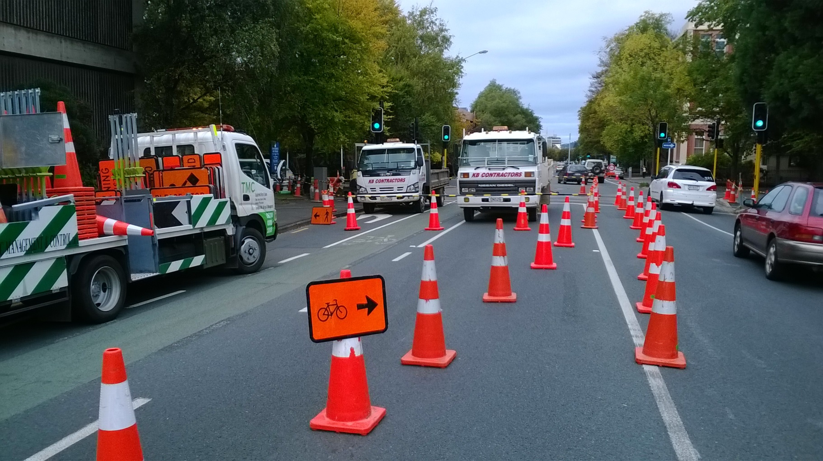
Vehicles used to set up, maintain or remove TTM
Once the work vehicle is covered by a static closure the shadow vehicle is no longer required
TMA is not required on the work or shadow vehicles

Slide 19
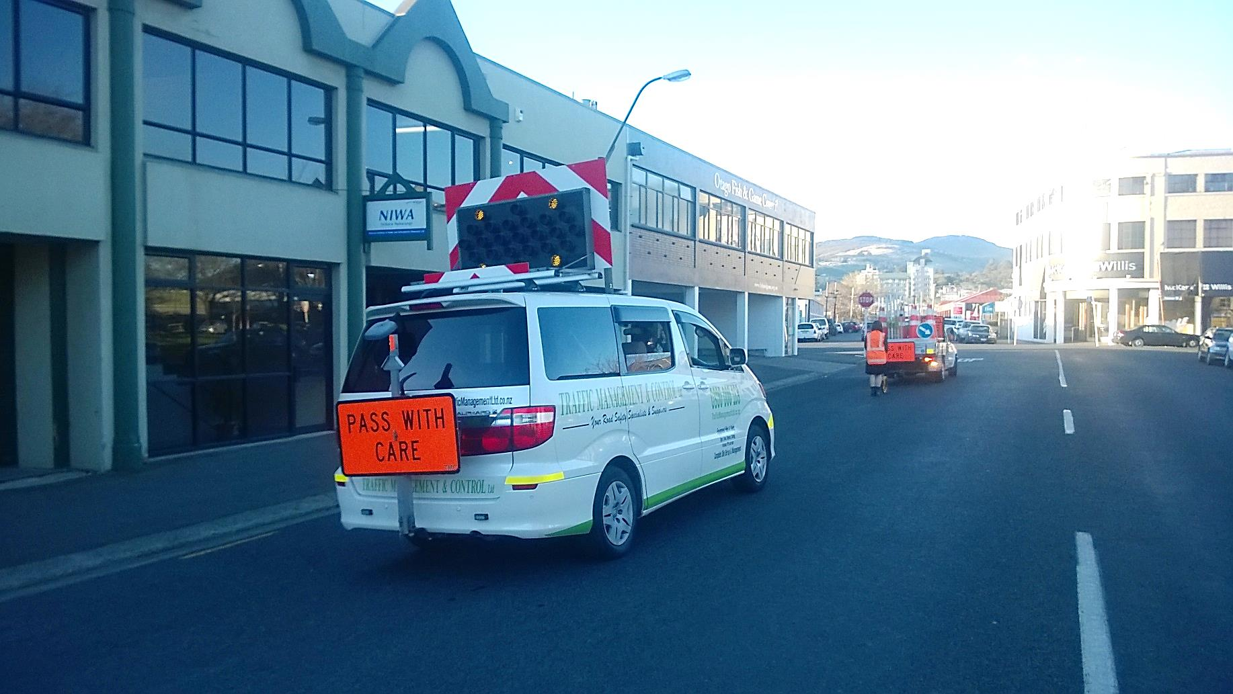
Vehicles used to set up, maintain or remove TTM
Workers can work on the non-traffic side or at least 10m in front of a vehicle but no further than 30m ahead of the vehicle (risk is increased where no work vehicle is in front of the worker)
Workers must not access the rear of the work vehicle unless there is a shadow vehicle protecting them

Slide 20
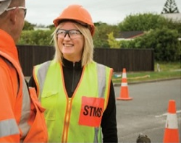
Level of qualification required to take charge of 2LS worksites
The qualified person on site must be L2/3 STMS
An alternative up for discussion could be a level 1 STMS who has been assessed as competent to install worksites on 2LS roads

Slide 21
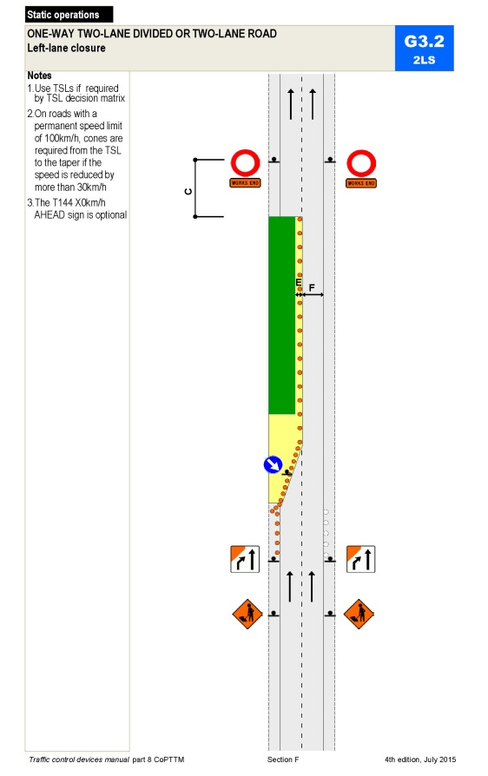
Use of 2LS TMDs included in CoPTTM
  2LS TMDs will be included in CoPTTM
  May be used in TMPs
  (eg GTMPs)

Slide 22
Reminder about the process
To date:
  Discussion document produced (AT, ChCh, Trainers, NZTA)
  Consultation with RCAs
To follow:
  Complete consultation with RCAs
  Consultation with wider industry
  NZTA finalise policy
  CGG endorse changes

Slide 23

Questions and discussion

