Slide 1
Christchurch Initiatives for Cyclist Management Through Worksites

Slide 2
Background
Christchurch was and is still facing an intensive rebuild programme with activities requiring a large amount of road space to undertake works and a scope far greater than any programme seen in NZ before.
Continuous high impact and high intensity worksite deployments in multiple locations for extended lengths of time.
Damaged carriageways decreasing available space to accommodate rerouting or redirecting different transport modes including cyclist and pedestrians
Increased number of complaints from different modes regarding levels of service
Promotion of smarter travel choices by multiple agencies including continued promotion self powered modes

Slide 3
Best Practice for Cyclist Booklet
CoPTTM Requirements
CTOC Requirements
Signage Location
Priority of methodology choice
Flow Diagram to aid decision making
Example Setups
Developed in collaboration with SCIRT
SPOKES consulted and provided feedback
Solutions fit within Aust roads criteria

Slide 4
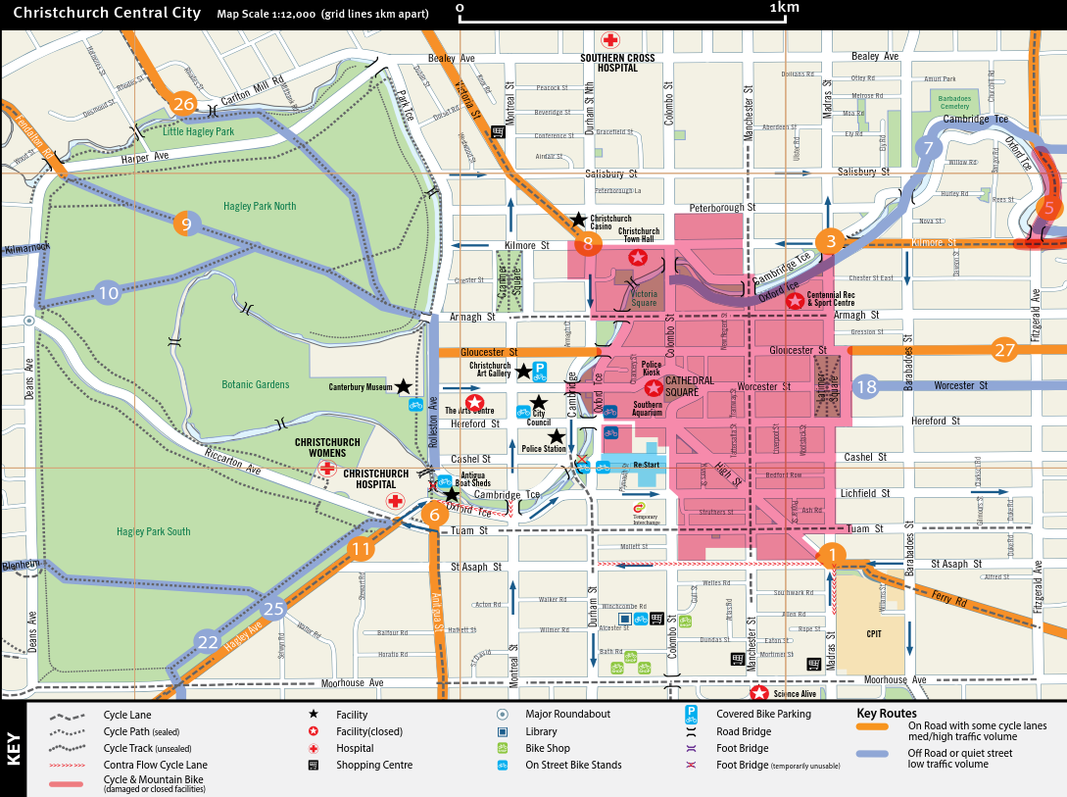
CTOC Requirements
1.5m Cycle lane
Increased measures around:
Schools / Tertiary Education Facilities
Routes with high cyclist volumes
Designated cycle routes
Links to Cycle route maps

Slide 5
Special Signage
EXTREME CARE CYCLIST MERGING
NARROW LANES
ALL TRAFFIC MERGE
EXTREME CARE CYCLIST MERGING

Slide 6
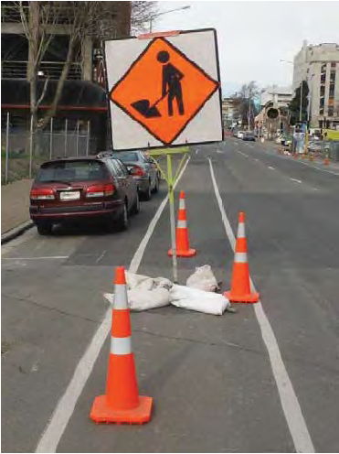
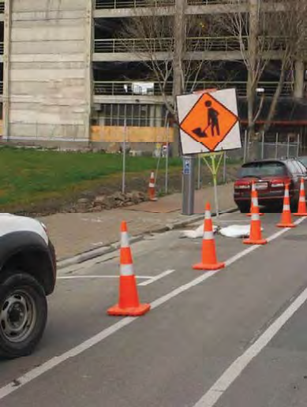
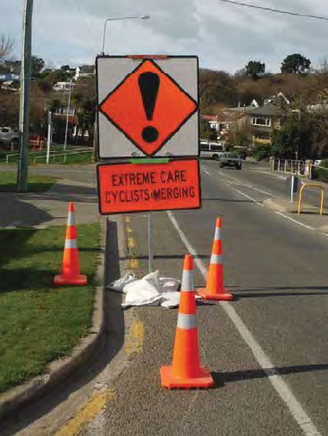
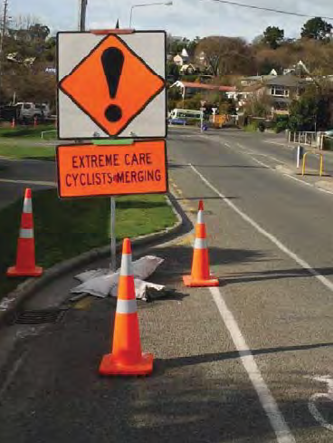
Sign Location Guidance
Undesirable Location
Vs
Desirable Location

Slide 7
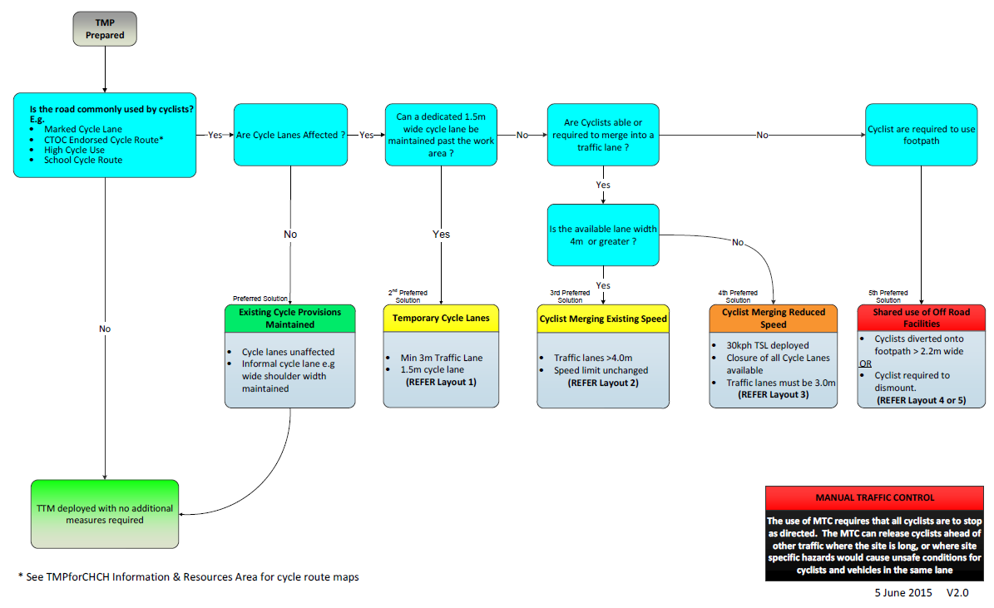
Flow Diagram to aid decision making

Slide 8
Example Diagrams
Dedicated Cycle Lane provided through site

Slide 9
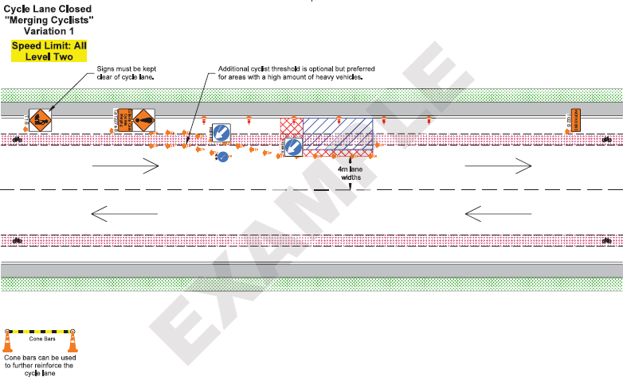
Example Diagrams
4m lane width available to allow cyclist and vehicle to pass and signage to warn Cyclist and Motorists of merging requirement

Slide 10
Example Diagrams
m
m
3m lane width to allow cyclist to “Take the Lane” Speed reduction & signage to warn Cyclist and Motorists of merging requirement

Slide 11
What the Statistics say
Number of crashes involving cyclists in Christchurch City by severity
Crash_period | Fatal | Serious | Minor | Non-injury | Total
Sept 2008- August 2009 | 1 | 33 | 100 | 32 | 166
Sept 2009- August 2010 | 2 | 35 | 94 | 26 | 157
Sept 2010- August 2011 | 1 | 34 | 100 | 20 | 155
Sept 2011- August 2012 | 1 | 43 | 100 | 19 | 163
Sept 2012- August 2013 | 3 | 31 | 107 | 23 | 164
5 year total till August 2013 | 8 | 176 | 501 | 120 | 805
Sept 2013- August 2014 | 1 | 45 | 83 | 16 | 145
Sept 2014- 16 June 2015 | 1 | 18 | 63 | 16 | 98
Total post August 2013 | 2 | 63 | 146 | 32 | 243
Number of crashes involving cyclists in Christchurch City by severity where crash factor was related to road works
Crash_period | Fatal | Serious | Minor | Non-injury | Total
Sept 2008- August 2009 | 0 | 0 | 0 | 0 | 0
Sept 2009- August 2010 | 0 | 0 | 0 | 0 | 0
Sept 2010- August 2011 | 0 | 0 | 0 | 0 | 0
Sept 2011- August 2012 | 0 | 0 | 0 | 0 | 0
Sept 2012- August 2013 | 0 | 1 | 1 | 0 | 2
Total till August 2013 | 0 | 1 | 1 | 0 | 2
Sept 2013- August 2014 | 0 | 1 | 3 | 0 | 4
Sept 2014- 16 June 2015 | 0 | 0 | 1 | 0 | 1
Total post August 2013 | 0 | 1 | 4 | 0 | 5
CAS data is inconclusive as at this stage we have not had a statistically significant enough period to evaluate changes since introduced
Trends in Customer dissatisfaction has significantly decreased
Customers complaints now received if Cyclist best practise measures have not been deployed.

Slide 12
What the Statistics say

Slide 13
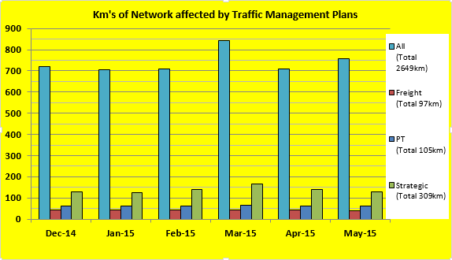
What the Statistics say

Slide 14
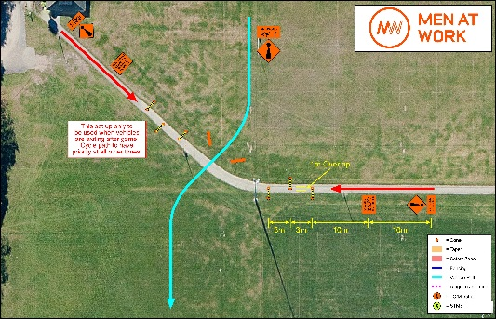
Where to from here?
All green space environments where normal operating condition is varied to be managed as if it were an on road facility
On road concepts transferred to green space and major event management where vehicles and self powered modes are required to interact
CWC 2015 Hagley Park Prioritising modal flow rates to adjust during major events and consider permanent use vs temporary use

Slide 15
Acknowledgements
Luke
Murphy
Dean
Hurford
Logan Dawson
Analytical Services Team

Slide 16
Questions?

