Slide 1
Raising the Bar
Ivan Aplin
Representing the minor Sports!

Slide 2
Background
Cycling New Zealand
President – 3 years up to May 2015
Commissaire
Practicing STMS Involved only in Approx. 40 events pa.
Trainer up to recently only specialised in Events.

Slide 5
To raise the bar you must understand and acknowledge events require different TTM in some cases

Slide 6
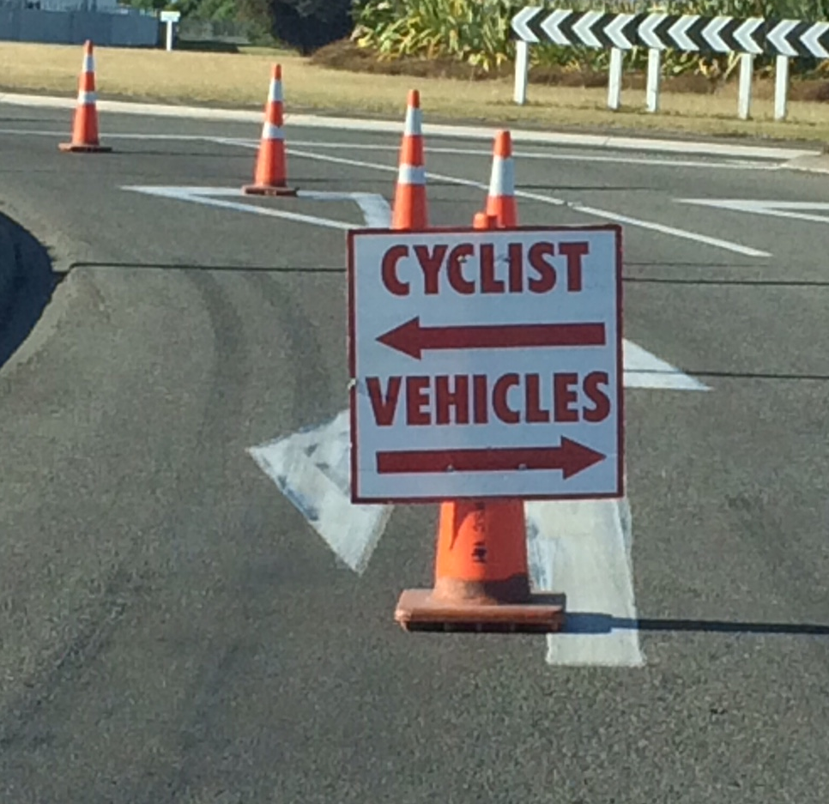
Event Sites are not Work Sites

Slide 7
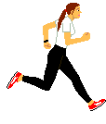
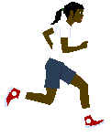
TTM is different for Running, Triathlon and Cycling Events
Notes:
When setting out the worksite vehicles must have flashing beacons on (hazard lights do not count)
Work out where your signs are going (start with the working space required and work out from there)
Place the advance warning sign
Place the next sign if required
Drop your cones off
Place the next sign if required
Place the end of works sign
Go down the road, turn around
Place the advance warning sign
Place the next sign if required
Place the next sign if required
Place the end of works sign
Go down the road, turn around
Under the protection of a vehicle setup your taper
If it is a short site set out the cones down the side of the worksite as well
If longer worksite drive off. The cones along the side of the worksite can be set out safely as the taper has moved the traffic past the worksite
Tapers and delineation devices must only be placed once all signs have been installed
Once the site is setup immediately complete a drive through, checking that the site works as required
Once you have checked the site it can be occupied with workers and equipment

Slide 8
Fun Events need different considerations

Slide 9
As do the number of participants

Slide 10
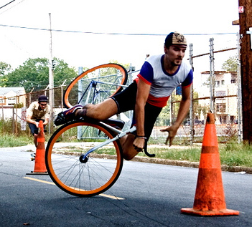
Cones are a Hazard for cyclists

Slide 11
Events such as concerts/markets need other different consideration

Slide 12
Such as Increased traffic & Parking

Slide 13
With declining Police support – we need to review options for rolling road blocks
Can we get some sort of permitting system for STMS?

Slide 14
Main issues experienced by our clubs
The cost of TTM Equipment & Training
Volunteers’ time
Vehicles used to set up
Consistency across RCA
Decrease in Club Membership/racing
Increase in “underground cycling groups” who fall outside Cycling New Zealand and there rules

Slide 15
Other Issues
Resource consent required
Sending in On Site forms for events only
Touring groups
If No Pilot and Tail vehicles - falls out side CoPTTM (road rules apply!)
Add in Pilot and Tail need a TTM Plan
Greater clarity around Mobile Operations for Cycle races

Slide 16
A.4 Levels of Road
A.4b Levels of Events
Level 1 (Up to 10,000vpd)
Roads
Low Volume (Up to 500vpd)
Low volume/low risk (Less than 250vpd)
Level 1 (Big Events)
Low Volume (Small)
Events
Low volume/low risk (Small/Low Risk)

Slide 17
Examples
Rural School – Motocross LV Roads. Advance warning signs only.
Urban High School - Annual run around the block – mainly foot paths but one leg on the road. All 50 staff on the course! STMS must be on site.
Hockey event. Advance warning only. Required to do 2 hourly inspections

Slide 18
Gating Speed Signs
Why do Events have to? - when others do not!
3 very recent examples
Urban Road- over 3850 vpd and not gated!
Rural Rd with Est 3,000 vpd and not gated!
1.4km Rd over 10,000 vpd not gated nor repeaters!

Slide 19
We need to
Start adding to section I.3 (Reversed for events) of the CoPTTM.
Create some forum discussions on events.
Improve knowledge/sharing best practices of events TTM.
Relook at training material.
Briefings Include as part of TMP?
RCA
CoPTTM
Sports

Slide 20
Questions/Discussion?

Slide 21
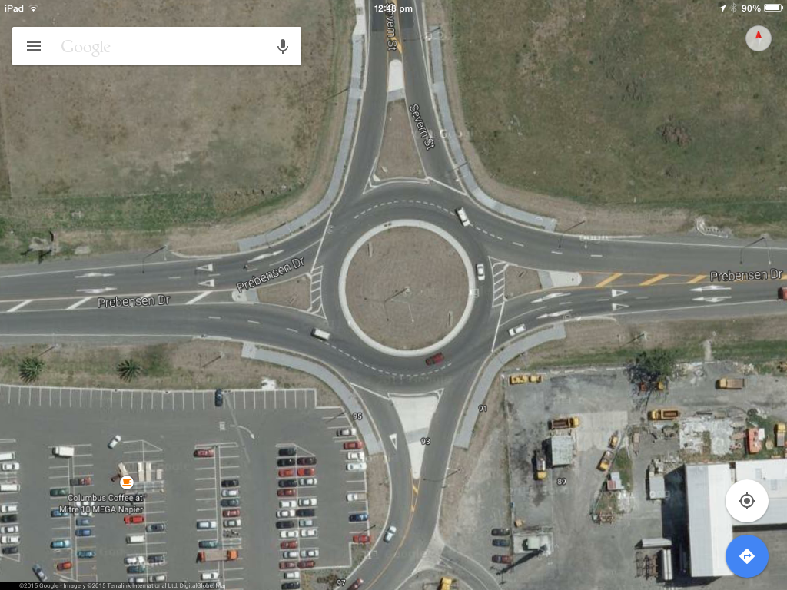
Exercise

Slide 22
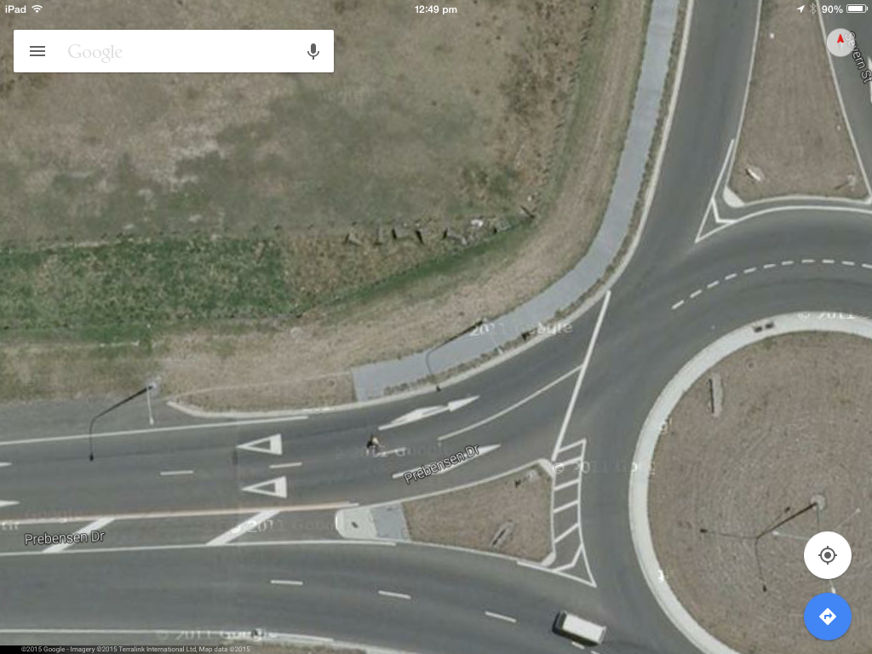
Single land Road
70 km therefore lanes Width 3.25m
Busy Rd
Min Width 5.5m max width 6.0m
At Intersection Lane 1 - 4.4m
Lane 2 - 4.6m
At Crossing Lane 1 - 4.4m
Lane 2 - 4.5m
4.4m
Centre Line 38m long

Slide 23
Option 1
Create lane for Cyclist

Slide 24
Option 2
Create lane for Cyclist and Lane shift

Slide 25
Option 3
Lane closed sign added

Slide 26
Option 4
Lane Narrows

Slide 27
Option 5
Take out whole lane

Slide 28
Who suggest what
Option 1 - Just create lane
Option 2 - Create lane and move 1 lane over
Option 3 - Lane closure
Option 4 - Road Narrows
Option 5 - close whole lane
Option 6 – Don’t let the event go ahead full stop. Bored don’t care.

