Slide 1
Site Condition Reviews
A relook at how to consistently assess a temporary traffic management site

Slide 2
TTM Site Condition Reviews (SCR)
Background
  Issues
  Needs
Development Process
Site Condition Review
  Changes to SCR form
  Clarifications
  Guidelines
Results

Slide 3
TTM SCR Review Background
Lack of consistency
  17+ Auditors, 5 TTM Advisors, Engineers, Contractors
  Inconsistent evaluation
  Inconsistent messages to STMS’ / TTM Industry
  Uncertain expectations
Feedback that some reviews impractical and pedantic
Disconnect between statistics (review results) and empirical knowledge
Three components to systems: effective Standards, Training & Monitoring / Feedback

Slide 4
TTM Site Condition Reviews
Basic needs
Full Audit elements aligned to what is really important
Everything must be recorded
Everybody needs guidance
Guidelines provide specific details of how to measure each element of the SCR
Each site is assessed based on the approved TMP
If TMP is not available, does not exist or is not applicable, site will be reviewed based on CoPTTM

Slide 5
Development of the new SCR
Workshops sought feedback for contents / changes to current Full Audit SCR Form (Contractors and Trainers)
Follow up workshops were held with representatives from:
  Industry representatives from ATMA
  Industry trainers
  Auckland Transport
Each element was discussed in detail to agree minimum standards required

Slide 6
Development of the new SCR
Development of (idiot proof) spreadsheet
Development of database (to support)
Usage and continual improvement over the last 6 months
  New guidelines being disseminated within AT and Contractors, etc
  workshops
  joint reviews

Slide 7
TTM Full SCR Relook
Full form only
Reorganisation of the form
Some items removed
Some items added
Clarifications and shuffles
Notes:
One tool for reviews
Simple / Clean
Electronic version with formatting in the background.
Even each individual component has a dropdown with some guidance / consistency in evaluating the item.

Slide 8
Removed
Condition marginal
Signs
Delineation
Excavation not protected
Notes:
Some of Lower Risk Items Removed
Create some much need real estate
Work Space Hazard Management issues
I.e.. Excavation not protected.

Slide 9
Re-allocated
Sign Position
Spacing
Wrong side
Speed limit not correctly aligned
Lateral location wrong
Non Compliant support
Sign too low
Not Visible
Not upright
Faulty TSL
Notes:
RE-ALLOCATED
Green Box - All about sign position
Purple Box - Support for the sign / message
Blue Box – Visibility
Yellow Box - Moved into other checks, TSL inappropriate

Slide 10
Re-allocated
Delineation
Missing
Tapers too short
Spacing between multiple tapers
Signs omitted
Arrowboard
Missing
Message
Site Induction
Notes:
Green Box - One item to cover potentially multiple failures, was insufficient
Yellow Box - Delineation along lanes. Is really what it is. Further clarification coming.
Blue Box - Signs missing on a mobile, thus scored under missing signs
Purple Box - Multiple similar areas amalgamated
Pink Box - Site induction not scored , recorded only

Slide 11

Notes:
Easy Comparison
Colour coded between original review form and the AT new
Same information
More space to note site observations
Areas for improvement
Critical issues to attend to
Positive attributes
- Focus on the issues not the score
Added information like the:
TTM Company
Main Contractor
Principal
- Greater reporting
STMS receives SCR however not necessarily responsible, looked at afterwards and in more depth
* Systematic or root cause analysis

Slide 12
Notes:
Green Box – The New Areas
Blue Box - Amended areas
Green Circle - Categorized, refer to Missing Signs A1 or missing MTC E2

Slide 13
SCR Guidelines
Training package (we’ll snapshot a few parts of this – all are available on your tables and electronically on request)
https://www.dropbox.com/sh/m22m68oqxcc6gcn/AACDvsARgM4zM8pSp1nwa7pja?dl=0
Notes:
We have created a guideline and training package to assist reviewers today
On your table to share
Also electronically as per the DropBox link noted on the screen and on the Cover page of the material
Now… Lets just explore a just few areas in greater detail

Slide 14
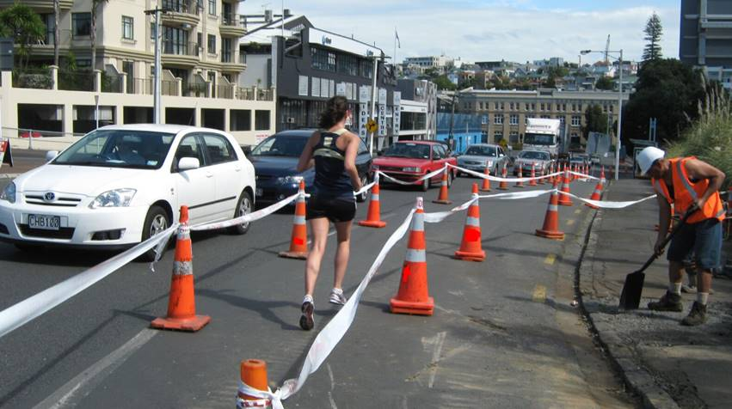
Pedestrians / Cyclists – C1
Inadequate provision for pedestrians
Footpath obstructed by activity and neither temporary path nor direction to alternative pedestrian facilities provided.
Features (recorded individually) include footpath width, ramps, gradient, visibility, location, any obstructions from exiting environment (low hanging tree branches, street furniture blocking path etc., and use of Footpath Controllers when not used where required.
Surface of footpath to be recorded under E6 and signs and delineation for pedestrian management covered under the other relevant sections.
Measure | Weighting
Feature | 10
Notes:
This is purely around the features involved in Pedestrian Management that are not included elsewhere
Delineation / Safety fences
Signage
Surface condition ….. Are all excluded
What is included:
Considerations for ramps, width and clear space required for the Ped corridor.

Slide 15
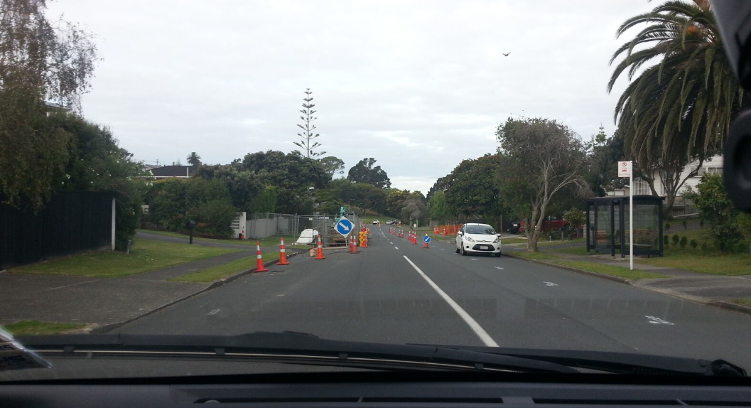
Delineation Devices – D1
Missing or ineffective taper
(including chicane)
Where leading taper delineation is missing which is required for traffic to shift from normal alignment.
Note: Short tapers, where required due to road environment, should be included in TMP with appropriate EED and mitigation
Measure | Weighting
Leading taper | 26
Notes:
Just note the information on the slide
But, you will see greater weight on the scoring due to greater risk with a leading taper vs trailing

Slide 16
TTM Full SCR: [D] Delineation
Along Lanes
Trailing Tapers
Leading Tapers
Notes:
Beautiful slide
What we have done here is separated out all of the individual components of delineation
RED Leading Tapers
Green Tailing Tapers
Black Delineation sections scored per section and/or per 100m

Slide 17
Miscellaneous – E1
Working in live lanes
People or plant/equipment associated with the activity are in the live lane outside the established working space.
If personnel cross the road without any equipment this is not classified as working in live lane but if carrying or moving equipment/materials from one side of the carriageway to the other then this is classified as working as their full focus is not on task of crossing road.
Consider proximity to pedestrian crossing if available but not used or if under stop/go operation where could change to stop/stop for all traffic approaches.
Traffic must not be expected to slow down or move to avoid the individual or plant.
Measure | Weighting
Individual | 20
Notes:
Working in the live lane
Major risk area
Improvements as of late
Still an area of continual concern
Most important aspect:
Traffic must not be expected to slow down or move to avoid the individual or plant.

Slide 18
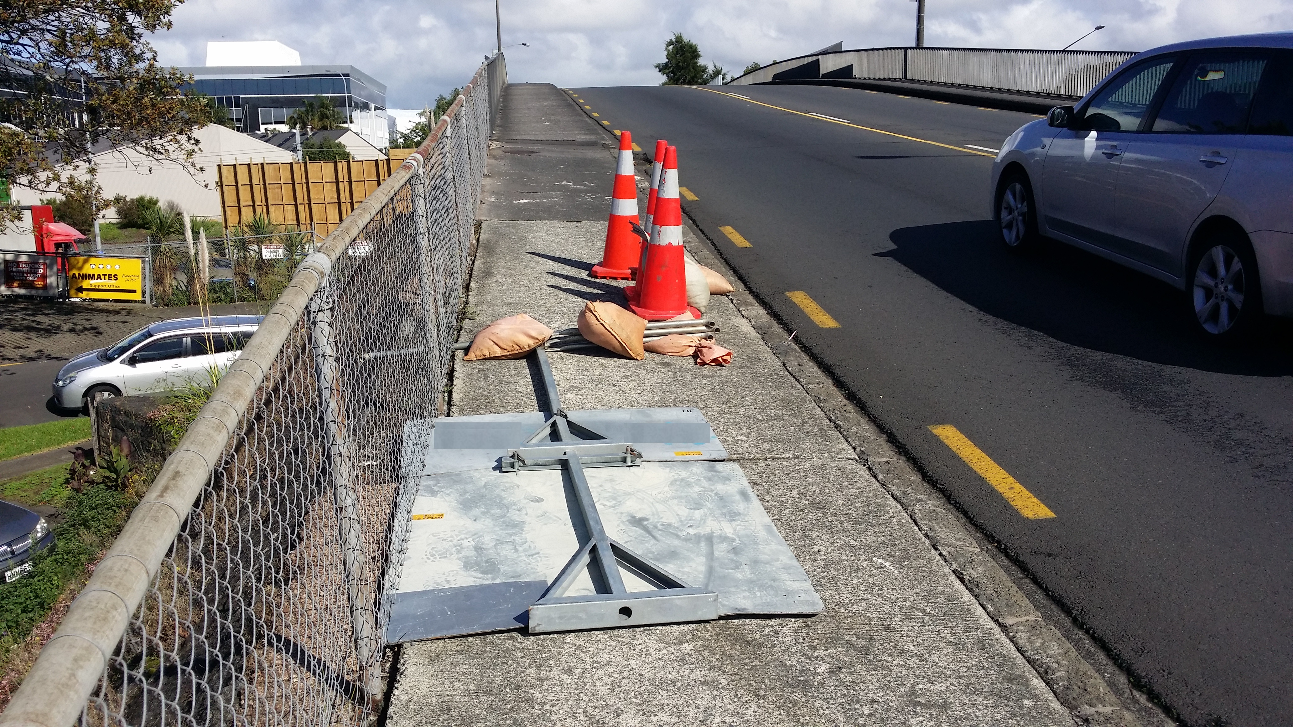
Miscellaneous – E8
Unsafe redundant TTM
TTM equipment non-compliantly stored on site when not required for active closure.
Equipment may be stored in a manner that does not pose a hazard to the road user for no more than 48 hours. Hierarchy: back berm first, front berm if under 65km/h permanent speed limit and there is kerb and channel. Footpath must not be affected.
Also includes when TTM equipment is stored in front berm, frame and base left upright with sign on ground, frame and base left upright with signs turned to have back panel facing traffic or sign turned 90° to traffic flow.
Notes:
Storage of Redundant Gear
Source of continual and serious concerns / complaints
Numerous reported injuries some serious due to or contributed by Unsafe TTM Storage of Redundant gear
Cries wolf Road User
Increased risk of thief
- It needs to be stored safety for a short period or removed
- It’s a hazard that needs to be treated appropriately

Slide 19
Miscellaneous – E8 (Cont)
Unsafe redundant TTM
Includes signs in cycle lanes or footpaths, cones stacked to side not required for unattended, TTM equipment left in manner which causes hazard to road user (for example not delineating equipment).
Signs not to be stored in footpaths regardless of width available. Storage only permitted in suburban or commercial areas but not around shopping areas
To be recorded for each sign that is unsafe redundant and once for every 10 delineation devices.
Measure | Weighting
Equipment | 5
Notes:
Cont.
Sensibility and fairness, not each device is scored on its own.
- I.e.. Sign and base and stand plus a couple of cones ballasts .. One package .. 35 pts ?
- Allows for the grouping the issue(s) with some guidance.
Seems to be gaining ground and showing some real dividends up in Auckland.

Slide 20
TTM Full SCR Review: G Other Checks
Notes:
G1. Self explanatory Suitably qualified person on site
G2. Same Approvals and Matrix
G3. Included unacceptable road uses congestion / queues
* Can also include Vehicular conflict / observed Risk
G4 . Onsite records
Opportunity to review the site on a regular basis
Scored if there is a serious disconnect between the site condition and the records ( 10 min ago site check all sweet – serious issue Side road missing MTC operation in its entirety)
G5 to G8. Is the TMP approved
Sighted
Applicable
And installed as per the approval
Helps to identify the root cause deficiency or alternatively, that all the planets are nicely aligned and things are as they said.. truly sweet.

Slide 21
TTM Full SCR Review: Final Result
Notes:
Again, focus on the issues and the critical areas for improvement or the remedy required .. rather than the score

Slide 22
Final Result
As per CoPTTM (Unchanged):
High Standard
Acceptable
Needs Improvement
New / Changed:
Unacceptable (Default): same as current “Dangerous
  Other Checks vs Total Tally
Dangerous:
  Stop Work Order
Notes:
Scores over 50 default to unacceptable and sites where there are actual serious safety issues, ( not death by a thousand paper cuts), are transferred into the Dangerous category.
After a sensibility check which is embedded in the electronic SCR to Dangerous
Dangerous sites are issued Stop Works Order without delay
* As why would you want sites to continue to operate a site in a dangerous manner

Slide 23
The Spreadsheet
Notes:
Load Spread sheet
Demonstrate

Slide 24
Key Points & Actions to be taken
Key Points
Reviewer notes areas identified in the review including both good aspects and areas for improvement.
Actions
Reviewer notes actions to improve the condition / operation of the site.
Where site is identified as unacceptable, actions must include areas to be addressed prior to activities re-commencing.
Corrections should be communicated, understood, accepted and recorded.
Notes:
Main points here:
- Consistent message which is well communicated / hopefully agreed upon actions for timely remedy
- All about education and driving the necessary improvements
Making the SCR assist / empower the STMS
- Or better yet, that the site fantastic and the STMS should get a well deserved pat on the back

Slide 25
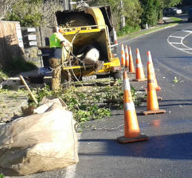
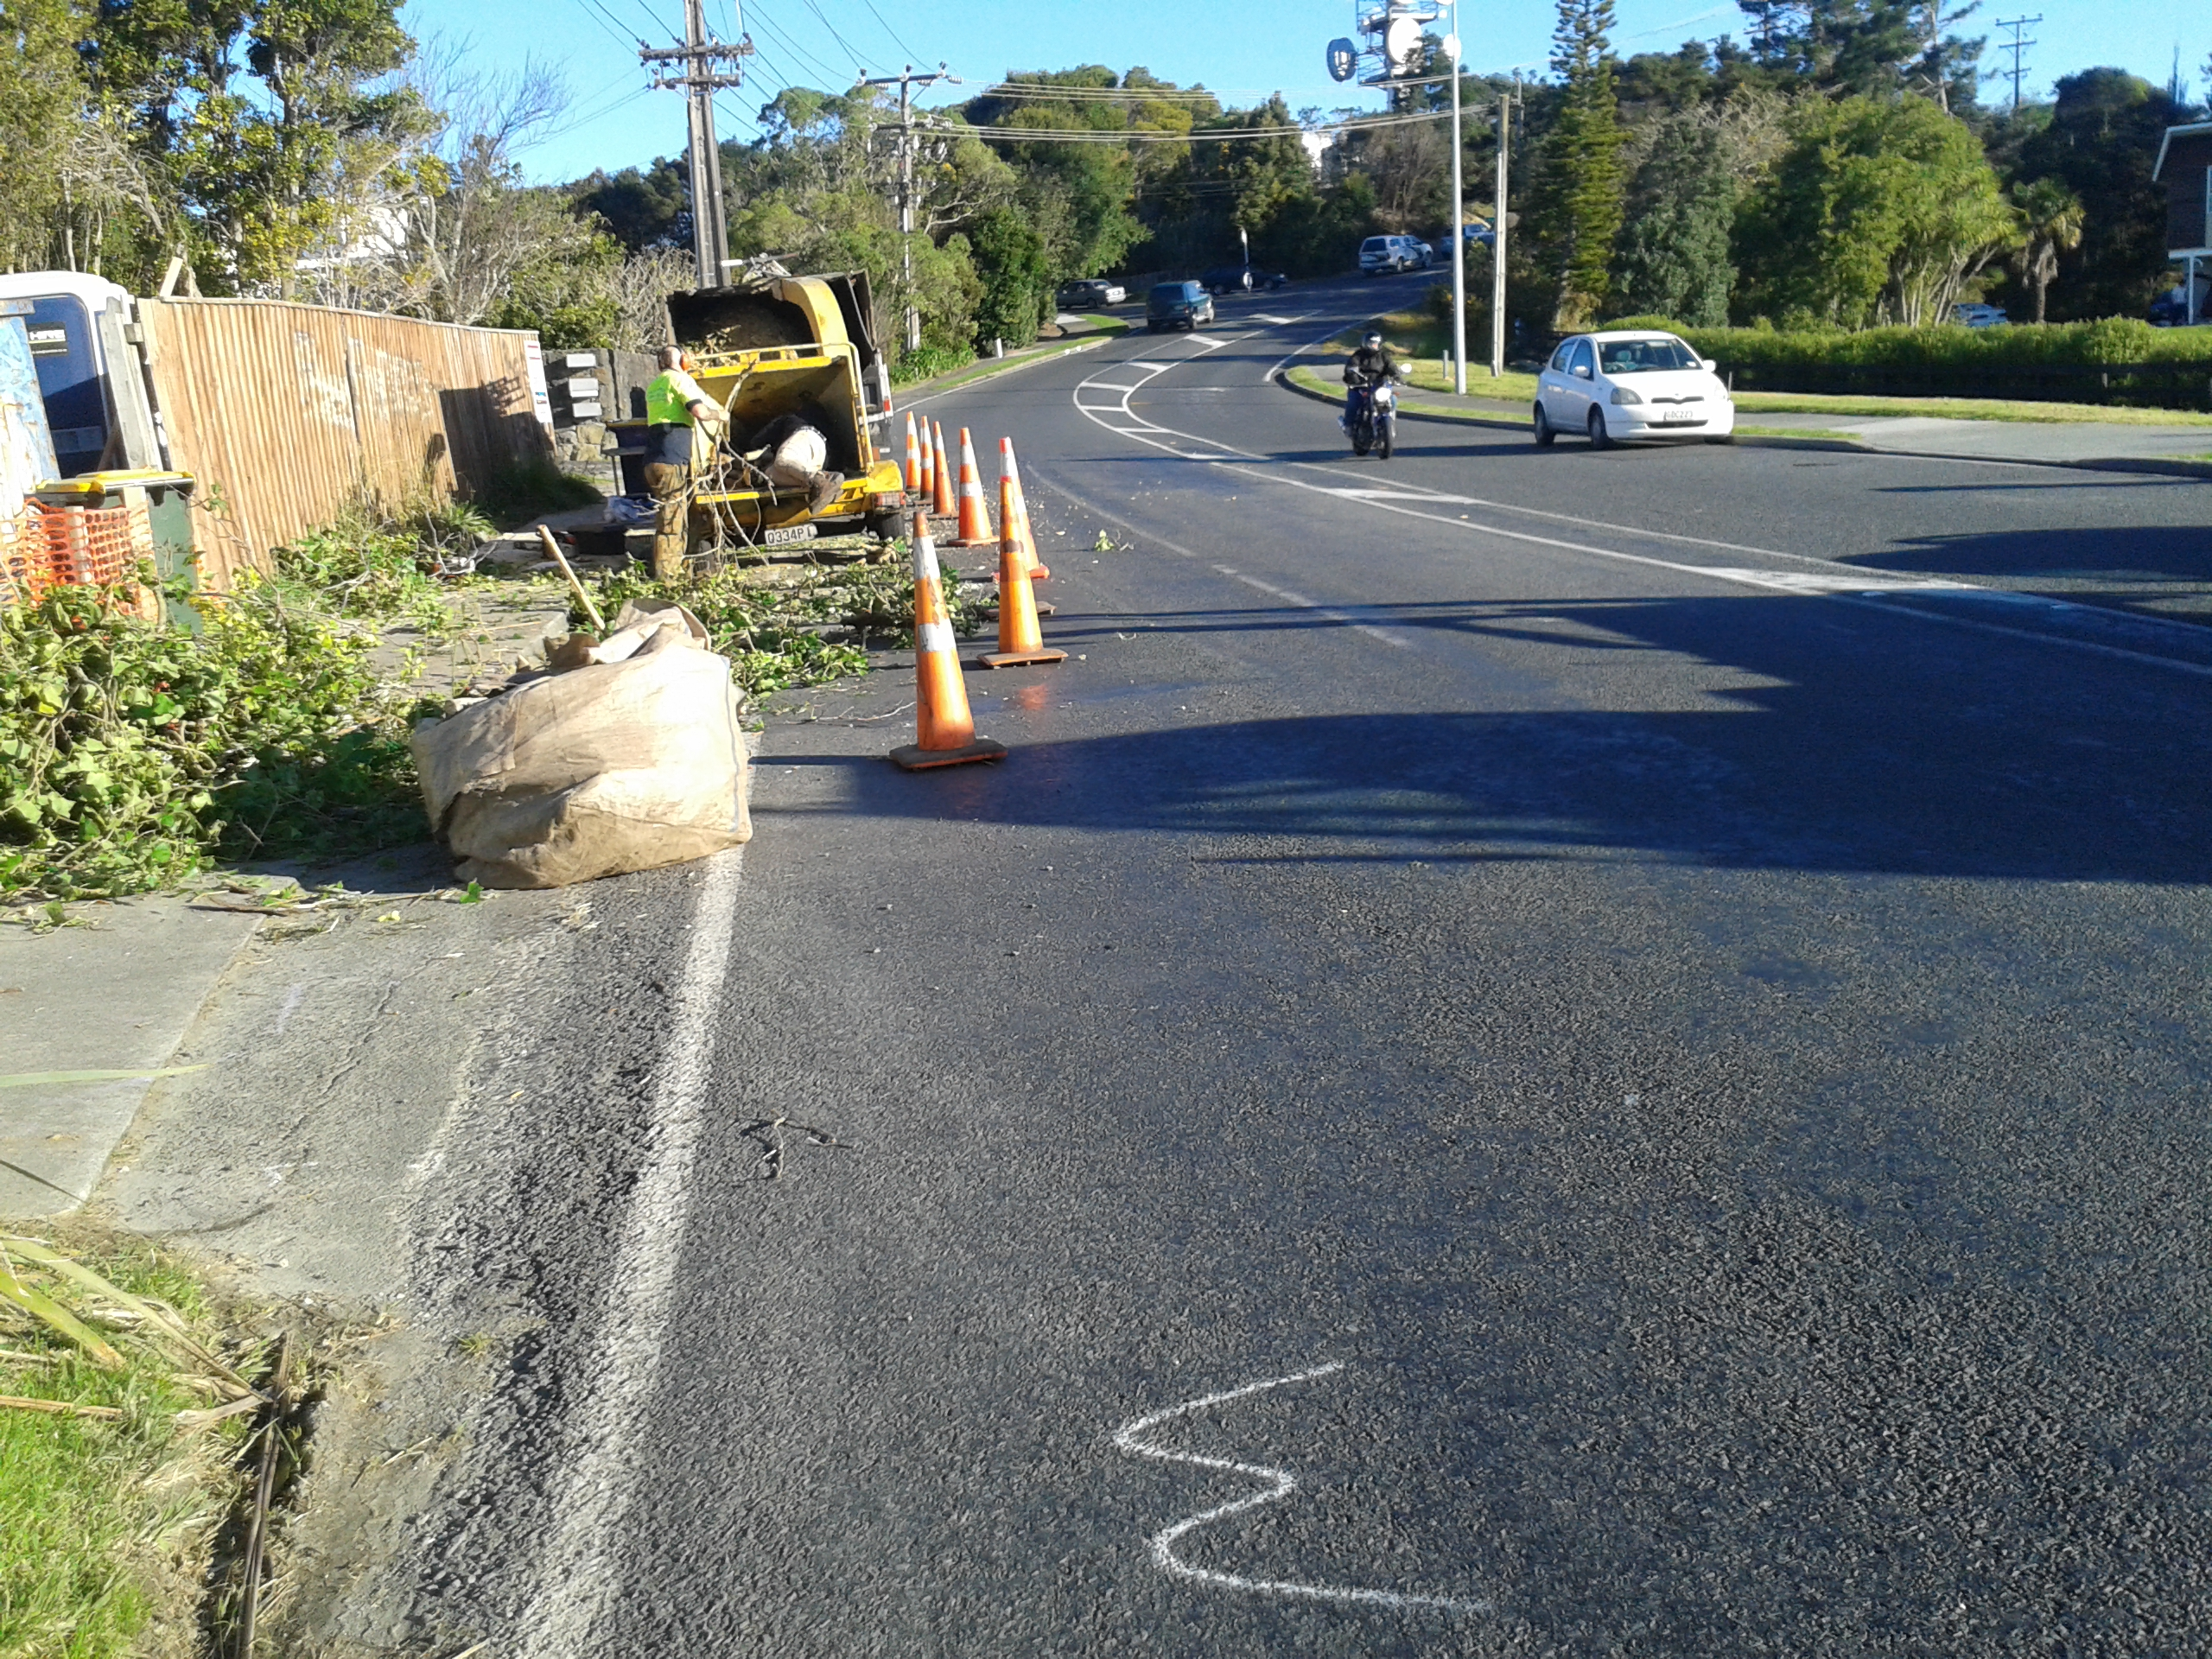
Questions?

Slide 26
Group Exercise
In groups (by table):
Review video of site and supporting photos
Record areas identified individually
Discuss as a group
Agree final SCR amongst group
Overall discussion of findings

