Slide 1
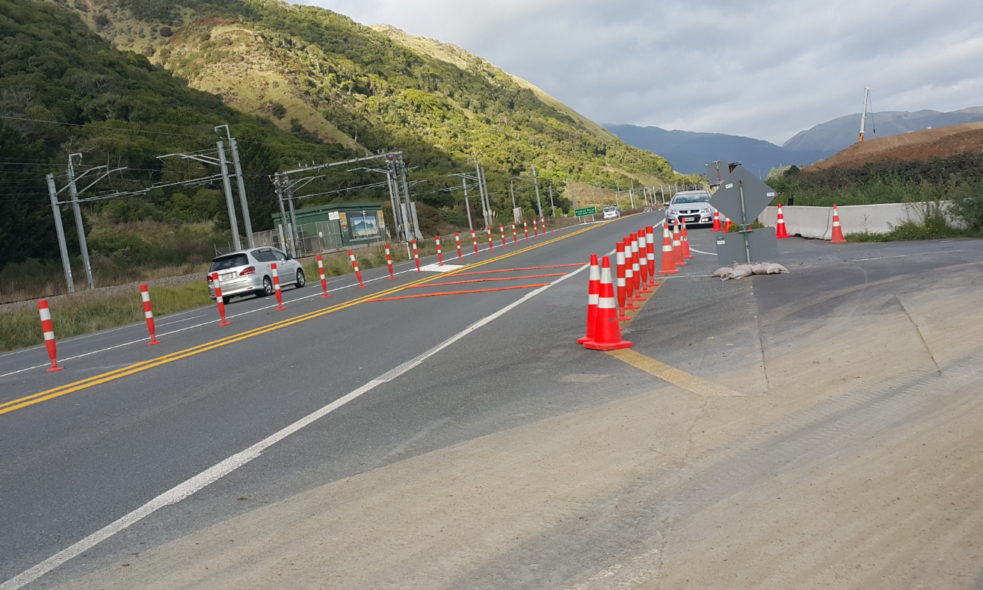
To identify the effectiveness of rumble strips at road works sites
Anandita Pujara
Intermediate Engineer

Slide 2
Purpose
This research paper investigates the impact of the rumble strips on drivers’ speed through road works.
Notes:
It is a supplier led study. The two different types of rumble strips have been imported for testing. This paper investigates the impacts of those rumble strips on drivers’ speed through road works sites and the most effective spacing of the rumble strips.

Slide 3
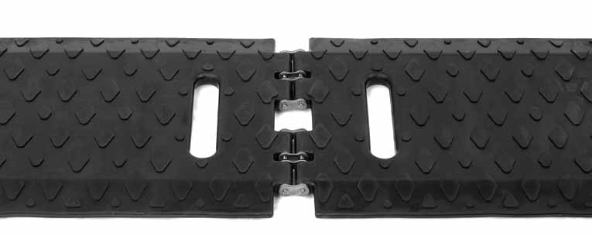
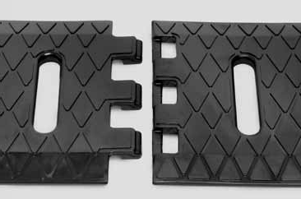
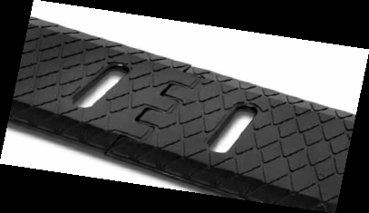
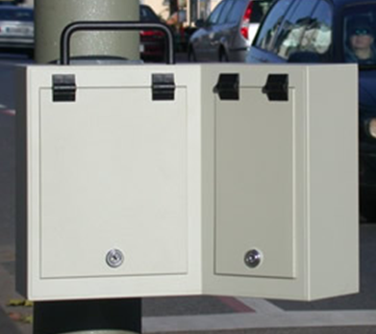
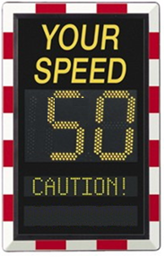
Equipment used
Type 1: RoadQuake 2F Hinged
Type 2: RoadQuake2
A radar unit
SAW sign
Notes:
The first type of rumble strip was a one-piece folding design and the other type had 3 sections that make 1 rumble strip when assembled, to traverse an entire lane. They both are 13” wide and ¾” thick. Type 1 weighs 110 lbs and type 2 weighs 105lbs.
The rumble strips were laid across a traffic lane, perpendicular to the direction of travel. This alerts motorist about the road-works environment by creating a noise when rumble strip is traversed by a vehicle.
A radar unit was used to collect the speed data and a SAW sign was also used compare the effectiveness of rumble strips.
Type 1: is a one-piece folding design, weight 110lbs, at 13” wide and ¾” thick
Type 2: 3 sections make 1 rumble strips, measures 45”long x 13” wide x ¾” thick, weight only 35 lbs, total weight 105lbs

Slide 4
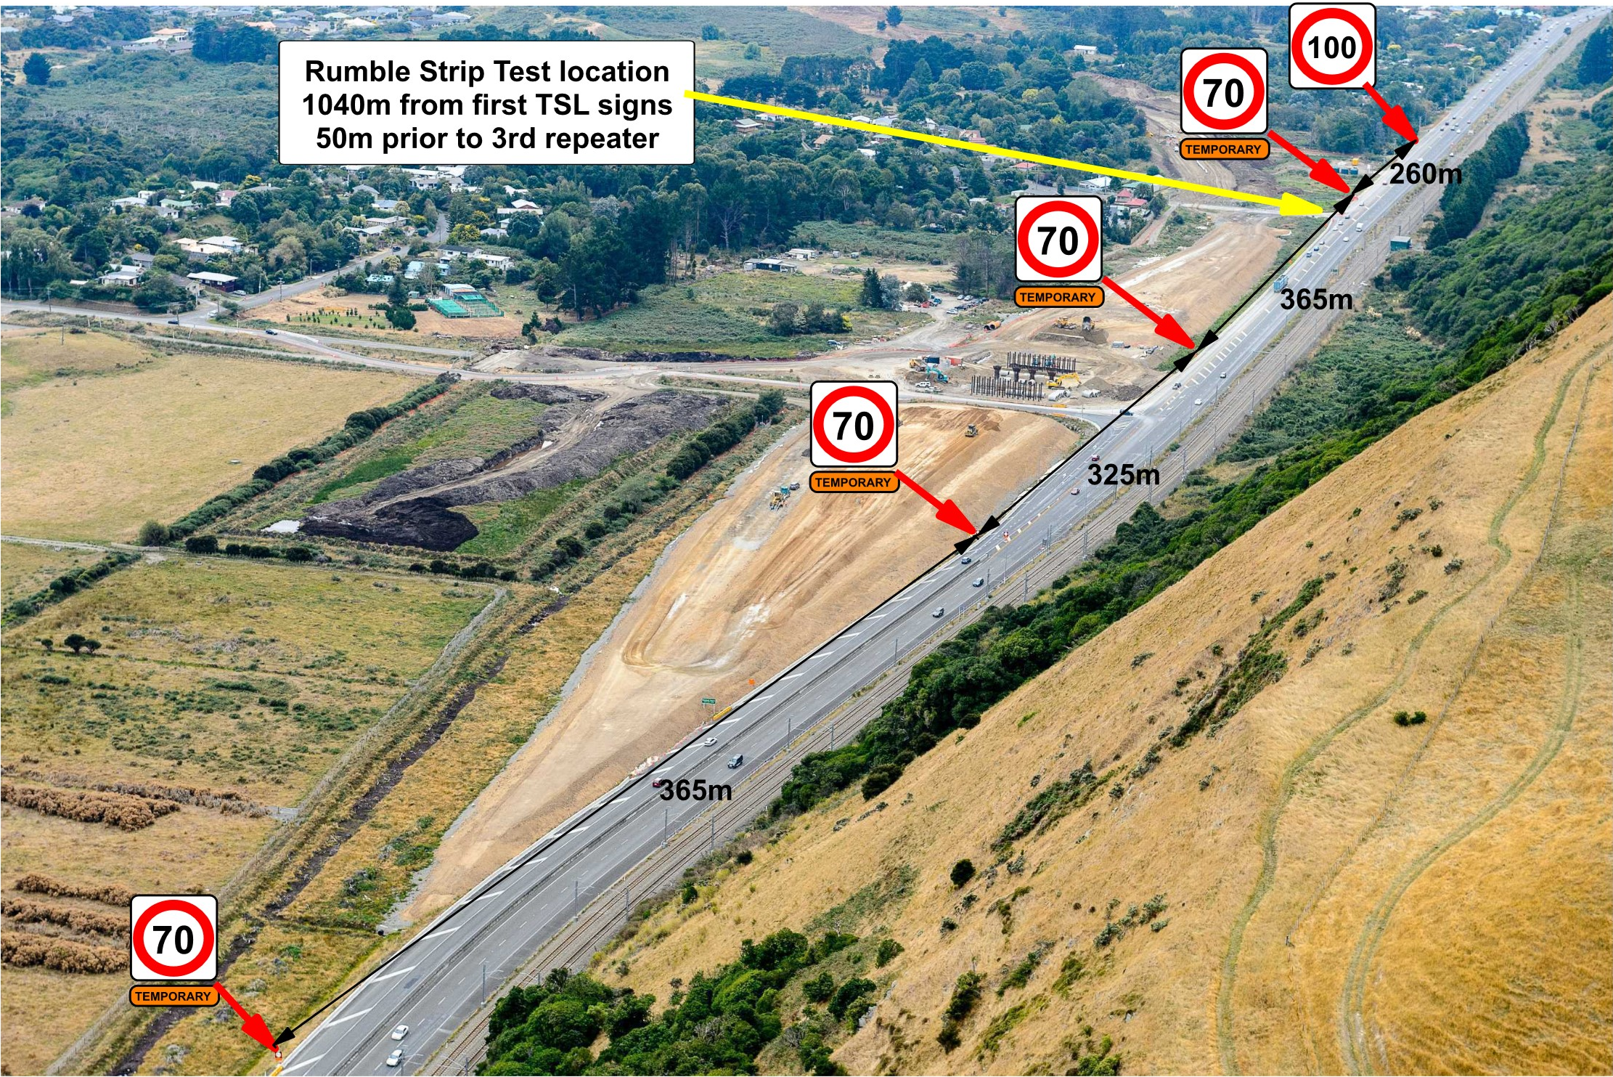
Location
Notes:
The worksite selected was at the MacKays to Peka Peka Expressway construction project, north of Wellington. The location was on SH1. This site has a temporary speed limit of 70km/h dropping from 100km/h, which well suited with the trial requirement, as one of the features of these types of rumble strips are that it can be used at sites with speed limits of 75mph or less. The yellow arrow shows the test location.

Slide 5
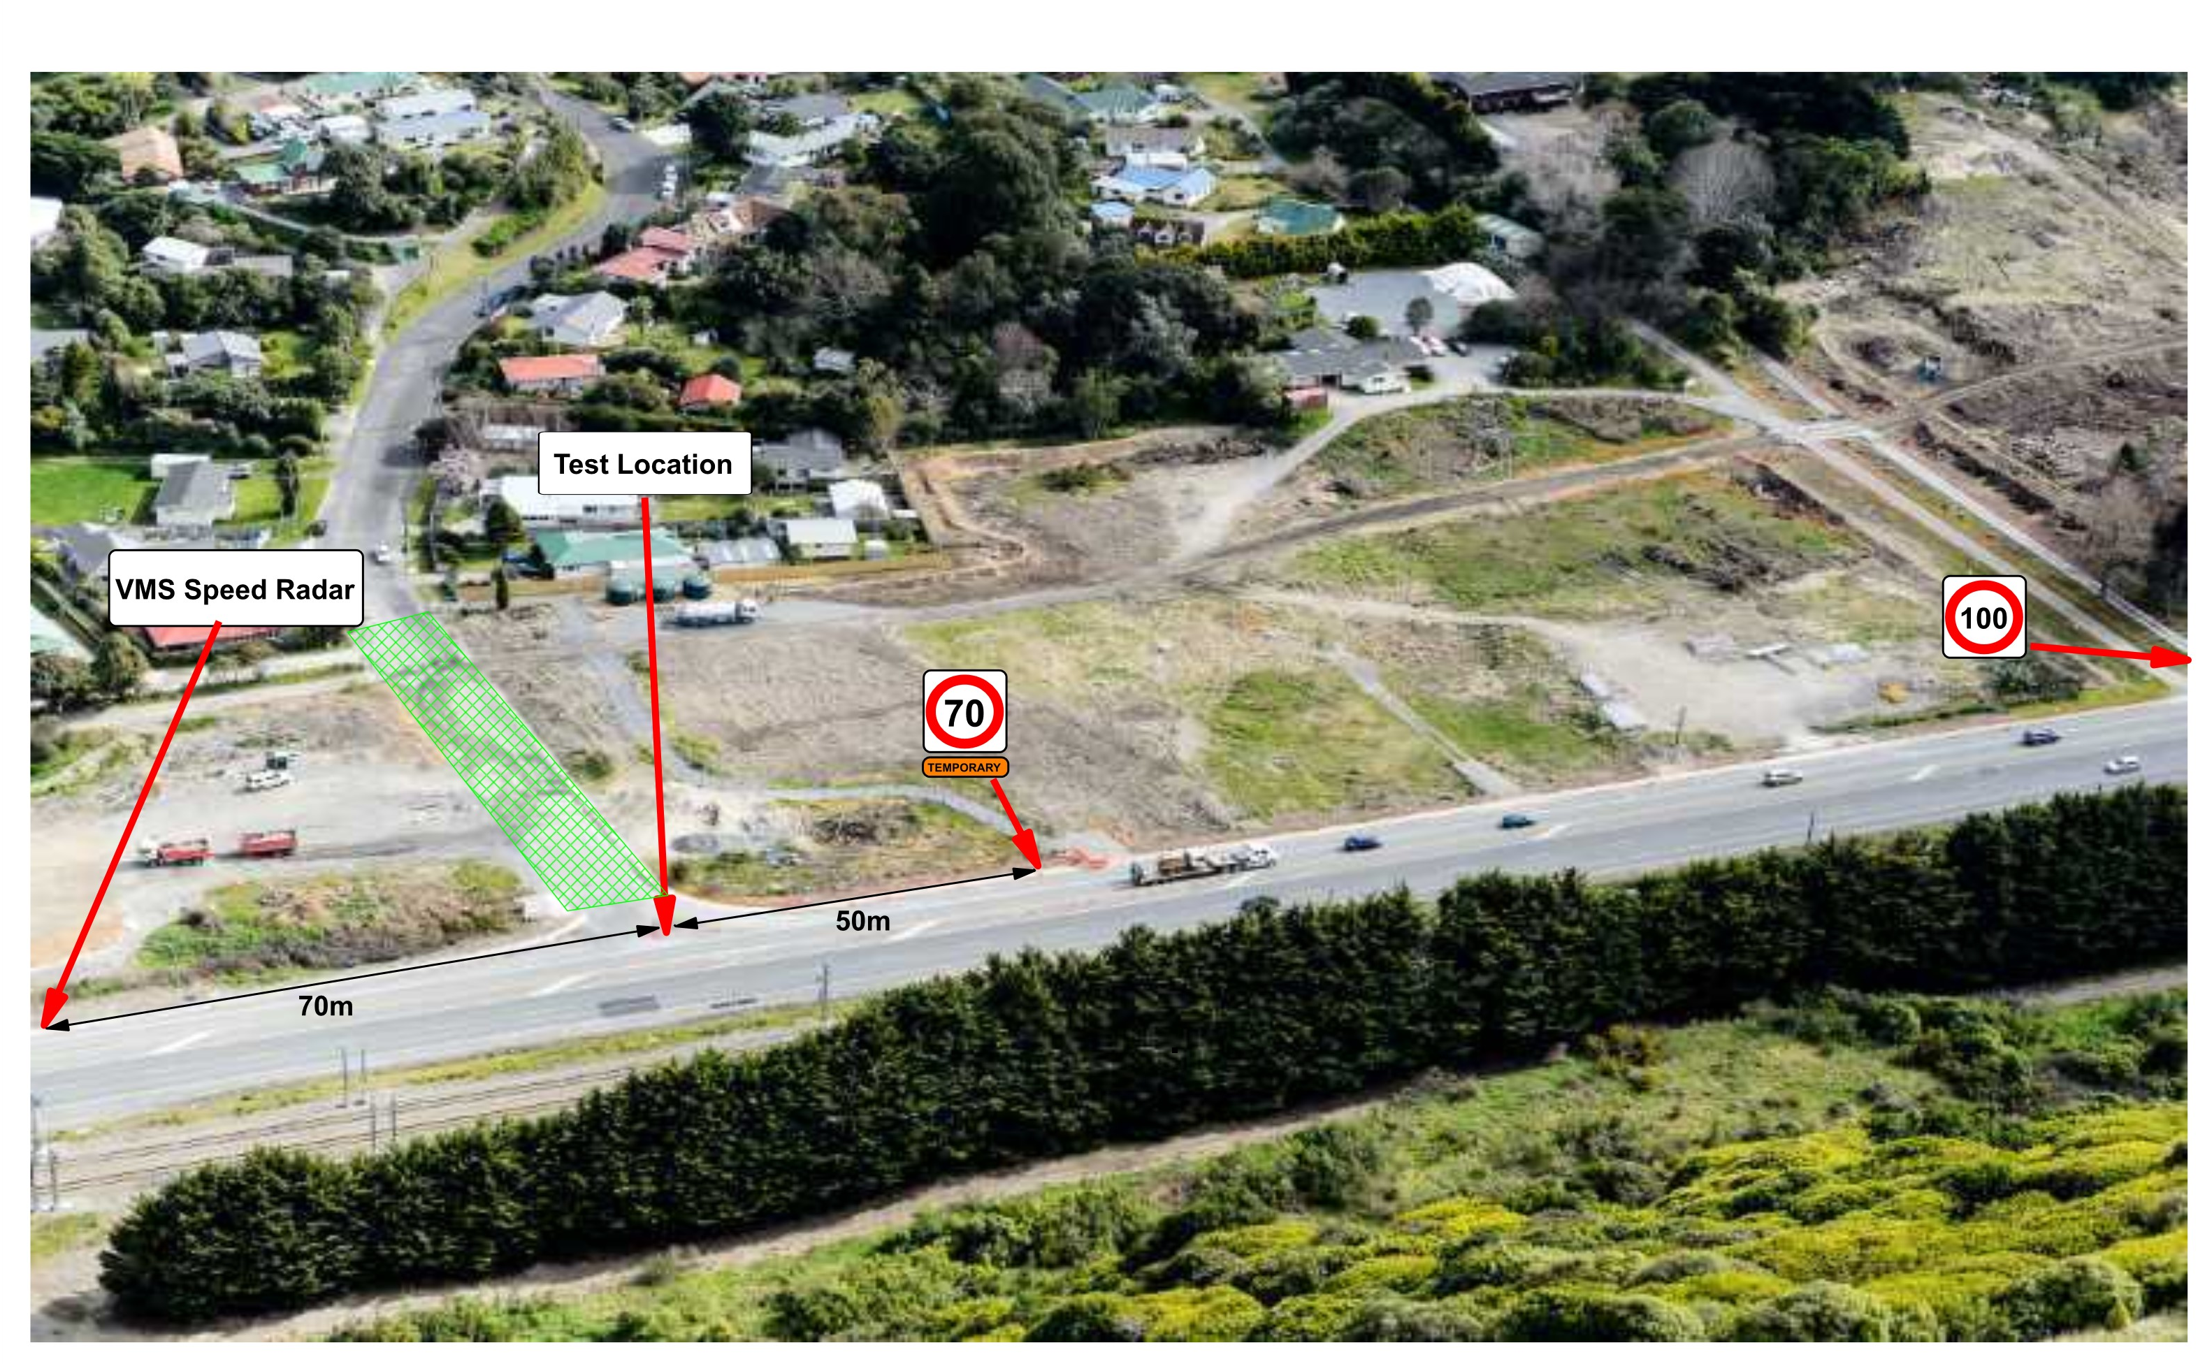
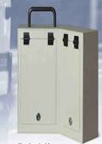
Test Location
Radar
Notes:
This is a closer view of the test location. Work site was a single lane. The radar was installed 25 metres south of TSL sign and rumble strips were laid 50 metres south of TSL sign. We also conducted an additional test of SAW sign, which was placed 70m south of the test location. The weather on all 4 days was sunny.

Slide 6
Day 1 - Methodology
Point 1 – Day 1
Work Area
Notes:
The study mainly consists of 3 days to assess the compliance by drivers to the temporary speed limit before and after the installation of the rumble strips at road works site. We also carried the study for an additional day by placing a SAW sign to identify the impact of it on drivers’ speed and how it compares with the rumble strips results.
On day 1, a radar unit was installed at site to study drivers’ speed through road works.

Slide 7
Day 2 - Methodology
Speed Activated Warning Sign
Point 2
Point 1
Point 1
Work Area
Notes:
As I mentioned in my previous slide about the additional day, this was the additional day, when we installed a SAW sign to identify the impact of SAW sign on this particular worksite.

Slide 8
Day 3 - Methodology
Rumble Strip Type 1
Spacing
3 metres 10:00am to 12:00pm
5 metres 12:00pm to 2:00pm
Point 1
Work Area
Notes:
On day 3, we laid type 1 rumble strips. For first two hours, the array was placed at 3 metres spacing from leading edge to leading edge and at 5 metres spacing for the next 2 hours. It took less than 5 minutes to lay the strips. First two arrays were type 1 and the last array was type 2 in this case.

Slide 9
Day 4 - Methodology
Rumble Strips Type 2
Spacing
3 metres 10:00am to 12:00pm
5 metres 12:00pm to 2:00pm
Point 1
Work Area
Notes:
Next day, we carried the same test by placing type 2 arrays at the first two points and last array was type 1.

Slide 10
Analysis Methods
Analysis Method 1: Speed
Before and after results for Type 1
Before and after results for Type 2
Before and after results for SAW sign
Analysis Method 2: Spacing
Review of the most effective spacing of the rumble strips
Compares Type 1 and Type 2 speed data
Notes:
To identify the effectiveness, I compared the before and after speed data for Type 1, Type 2 and SAW sign.
In addition to that, the movement of rumble strips were also reviewed and effective spacing was identified by comparing the speed behaviour and overall movement of the arrays.

Slide 11
Results Type 1
 | Before | After
Average | 74.1 | 69.8
Speeding % | 71.3% | 52.7%
26% of the speeding drivers slowed
down to keep within the TSL
Number of vehicles
Speed
Notes:
The Graph shows the effectiveness of rumble strips in improving compliance. The x axis is the speed and y axis shows the number of vehicles. The graph shows that the number of speeding vehicles has dropped after the installation of rumble strips. The 26% of the speeding drivers slows down to keep within the speed limit. The ones who were not within the speed limit have also dropped their speed compared to day 1. The average speed has also dropped from 74 to 70. It has increased the alertness.

Slide 12
Results Type 2
 | Before | After
Average | 74.1 | 69.9
Speeding % | 71.3% | 52.2%
27% of the speeding drivers slowed
down to keep within the TSL
Number of vehicles
Speed
Notes:
This graph shows the results of Type II rumble strips, which is similar to Type 1 results. 27% of the speeding drivers slowed down to keep within the speed limit and average speed has dropped to 70 from 74km/h. This indicates that we received consistent response from motorist on both days, when the rumble strips were installed on site.

Slide 13
Result – Speed Activated Warning Sign
 | Before | After
Average | 74.1 | 58.4
Speeding % | 71.3% | 2.5%
Number of vehicles
96% of the speeding drivers slowed
down to keep within the TSL
Speed
Notes:
This graph shows the results of drivers speed behaviour before and after the installation of a Speed Activated Warning sign. It indicates that 96% of the speeding drivers slowed down to keep within the TSL. Another reason for speed compliance is because the difference in the strength of different types of equipment. This constantly tells drivers to slow down if they are speeding, which shows drivers complied what they were advised to do, whereas in rumble strips case, it focuses on making drivers more alert of the road works environment and drivers have showed this in their behaviour by slowing down from their usual speed.

Slide 14
Analysis Methods
Analysis Method 2: Spacing
Review of the most effective spacing of the rumble strips
Notes:
Study also focused on reviewing the most effective spacing of the rumble strips. We reviewed 3 and 5 metres spacing.

Slide 15
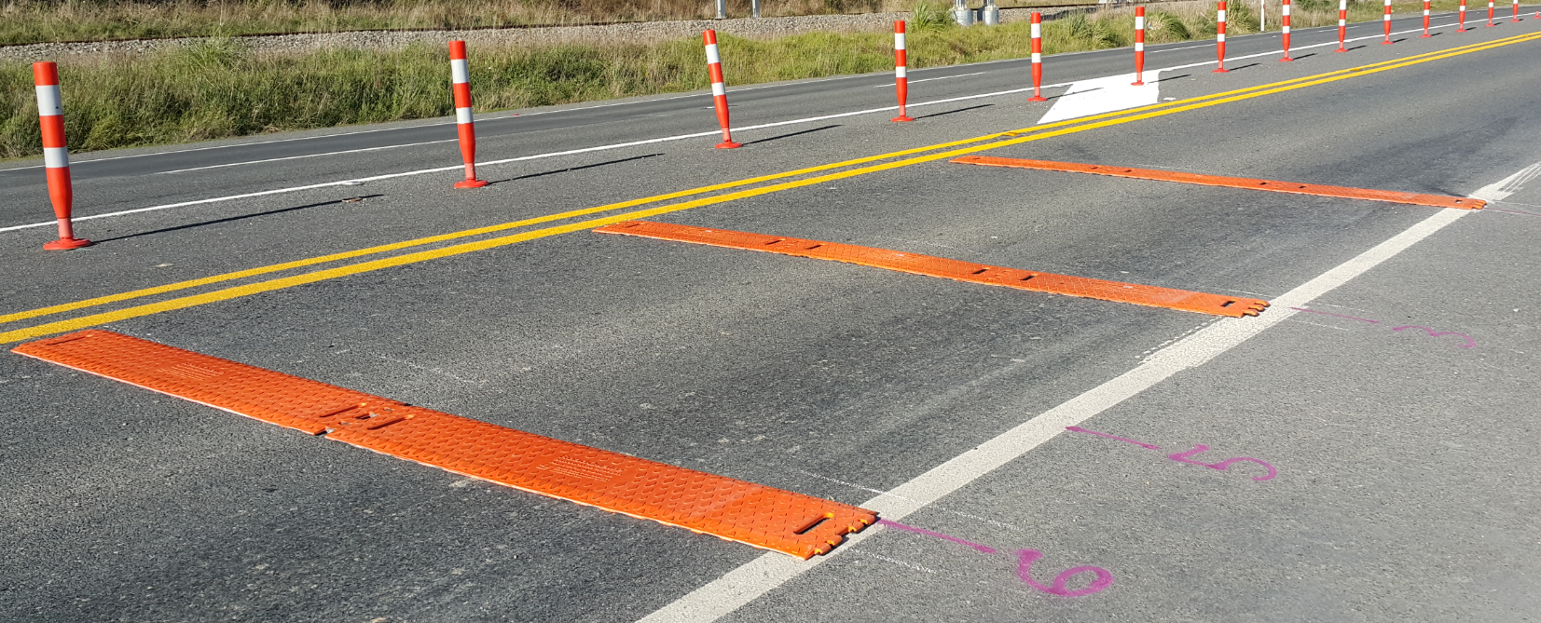
Results Review of rumble strips spacing
Movement over time – Type II 3 metres
Before
After
Notes:
This shows the photos taken before and after the trial.

Slide 16
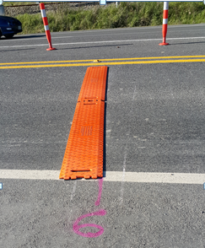
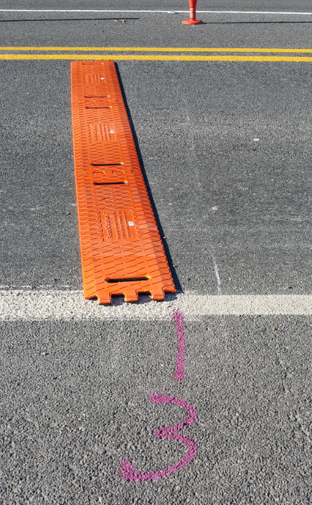
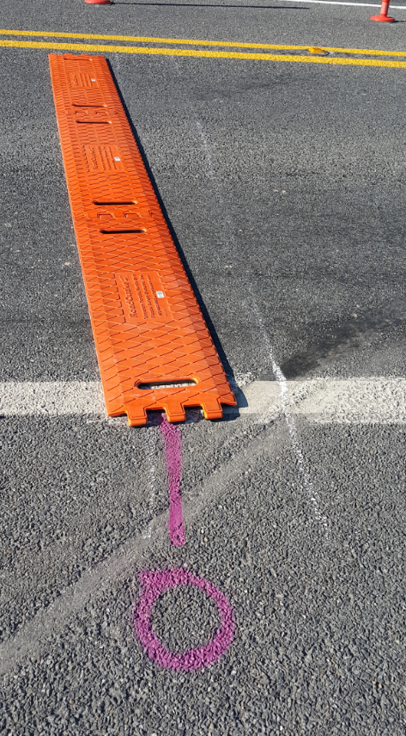
Type II – 3 metres spacing
Notes:
This shows the side movements of type II arrays at 3 metres spacing. The white line is the reference point of where it was laid first.

Slide 17
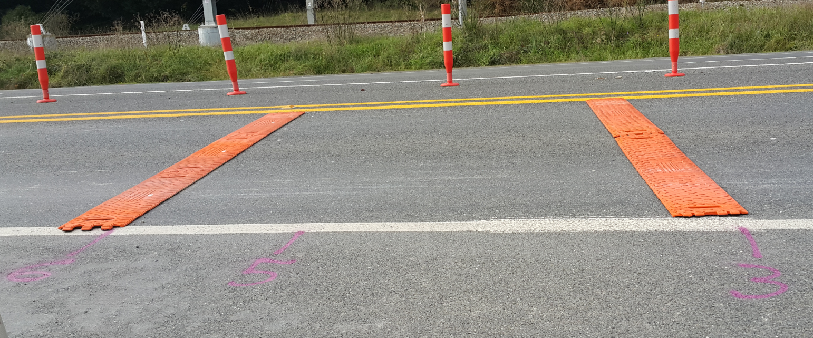
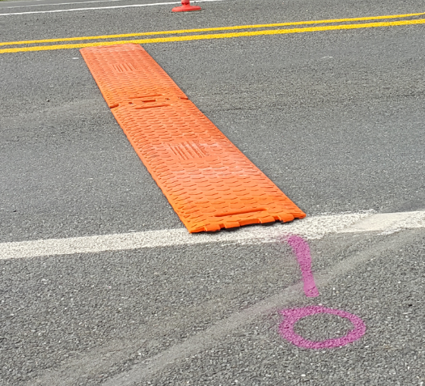
Type I – 3 metres spacing
Notes:
This shows Type 1 rumble strips movements, which is similar to type II side movements over time.

Slide 18
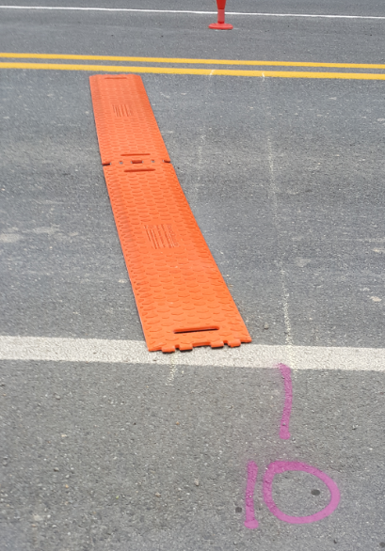
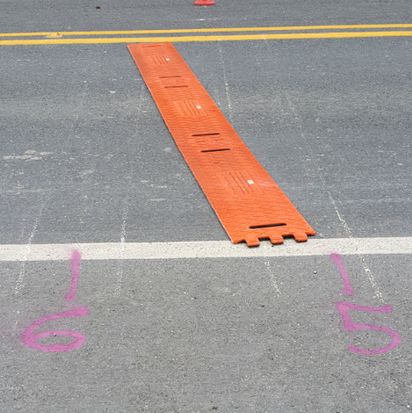
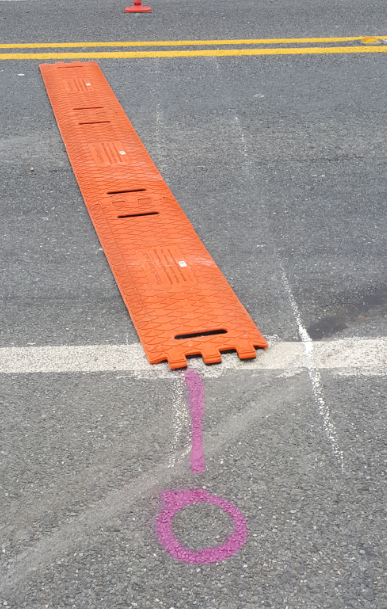
Type II – 5 metres spacing
Notes:
This slide shows the side movements of Type II rumble strips when there were laid at 5 metres spacing. From the photos we can notice that the arrays have move further away from the reference point than the arrays that were placed at 3 metres spacing.

Slide 19
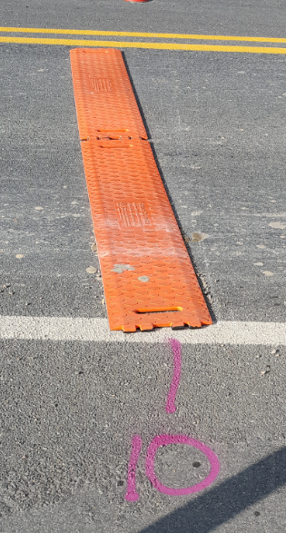
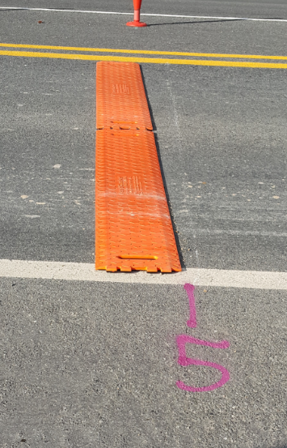
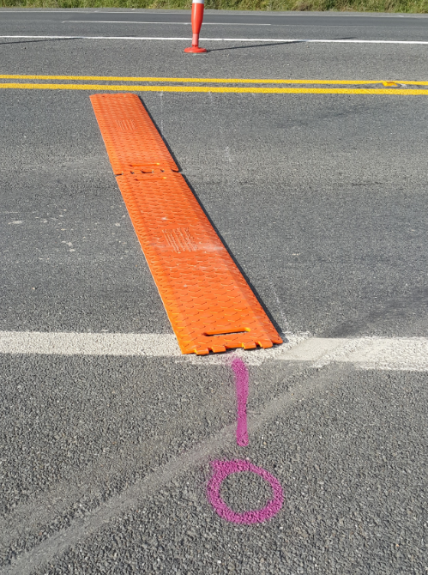
Type I – 5 metres spacing
Notes:
Similar movement can be observed for Type 1, however, Type 2 at 5 metres spacing (that we saw in previous slide) has moved more from its position than the rumble strips we can see in this slide.

Slide 20
Results Review of rumble strips spacing
On reducing speed
 | Type 1 | Type 2
3 metres | 52% | 56%
5 metres | 54% | 48%
Notes:
In terms of speed : Type 1 at 3 metres spacing is more effective and when using type 2 then 5 metre spacing is more effective
If we combine the results of speed measurement and movement, than Type 1 at 3 metres spacing appear to be the most effective.

Slide 21
Results - Type of vehicles
% speeding | Before | After
Type 1 | 69% | 52%
Type 2 | 69% | 50%
Type I: 25% and Type II: 28%
of the speeding drivers slowed
down to keep within the TSL
Number of vehicles
Speed
Notes:
I have got 3 more slides to show the effectiveness of rumble strips on different types of vehicles. This slide shows the result on vehicle type ‘car’. For type 1, 25% and for type 2, 28% of the speeding drivers slowed down to keep within the TSL. We can also see that both the strips had similar effect and even though the other vehicles have not slowed down to 70, they have slowed down from their usual speed.

Slide 22
Results - Type of vehicles
% speeding | Before | After
Type 1 | 73% | 53%
Type 2 | 73% | 53%
27% of the speeding drivers slowed
down to keep within the TSL for both types
Number of vehicles
Speed
Notes:
For medium vehicles, 27% of the speeding drivers slowed down to keep within the speed limit for both types.

Slide 23
Results - Type of vehicles
% speeding | Before | After
Type 1 | 84% | 59%
Type 2 | 84% | 55%
Type I: 30% and Type II: 35%
of the speeding drivers slowed
down to keep within the TSL
Number of vehicles
Speed
Notes:
For Heavy vehicles, Type 1 had improved 30% of the drivers’ speed compliance and 35% when Type 2 was used.
450 vehicles per hour and 14% of heavy vehicles, approximately 12000 vehicles each direction and 24000 vehicles both direction per day

Slide 24
Conclusions
The use of rumble strips will increase alertness at roadworks
It improved compliance to temporary speed limit
Type I and Type II rumble strips provided similar effect in improving compliance to TSL
3 metre spacing resulted in less movement compared to 5 metre spacing
In terms of speed compliance & side movement, Type I at 3 metres spacing was most effective than other combinations.
It was more effective in reducing speed of heavy vehicles
Quick and easy installation
Notes:
The result shows that use of rumble strips will increase motorist alertness at roadworks
It improved compliance to temporary speed limit
Type I and Type II rumble strips provided similar effect in improving compliance to TSL
In terms of speed compliance & side movement, Type I at 3 metres spacing was most effective than other combinations.
It was more effective in reducing speed of heavy vehicles
3 metre spacing resulted in less movement compared to 5 metre spacing
In addition, we also identified that the proportions of drivers exceeding the Temporary Speed Limit (TSL) were significantly reduced when Speed Activated warning Sign was in operation.
It can be installed in minutes, which saves time to hold the traffic during installation and causes less disruption to traffic and if it can be checked every few hours to ensure it stays at its place then the rumble strips can be a useful way of increasing alertness of motorist and improving safety at our road works site.

Slide 25
Questions
Thank you for listening

