Slide 1
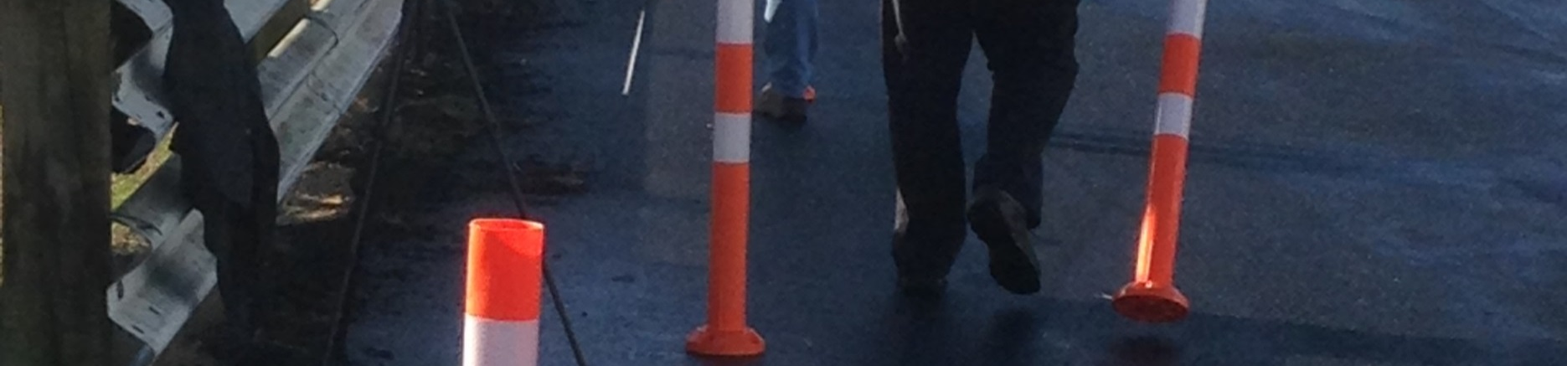
A STANDARD FOR TUBULAR DELINEATORS
Notes:
Have on screen when trainees arrive

Slide 2



































Tubular Delineators
Raising the bar
Notes:
Our theme for this conference is Raising the bar
Click
And we are confident that this conference will inspire people in a similar manner as the last conference
Click

Slide 3
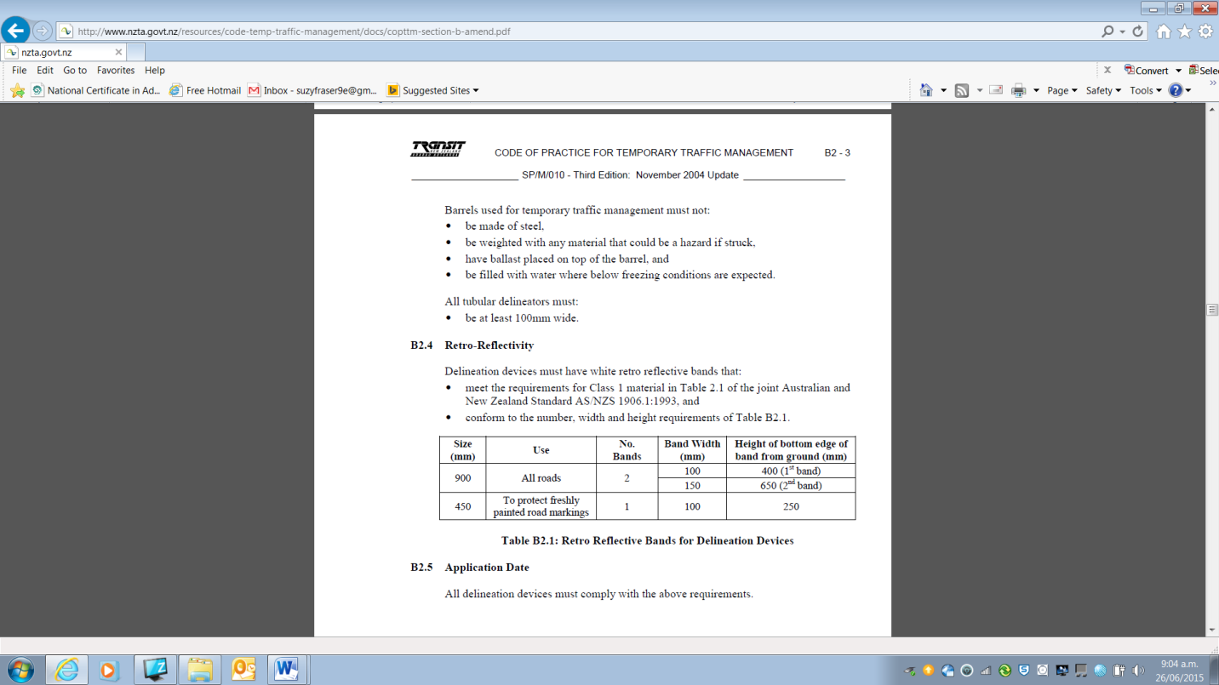
TCD Rule
There has been no standard for tubular delineators in the TCD Rule
CoPTTM (3rd Edition) adopted the British Standard from Part 8 of Traffic Control – 100mm diameter

Slide 4
What was happening
  Contractors seeking to cut their costs were importing tubular delineators (TD) as narrow as 65mm, with various colour combinations
  It seemed that some of the narrower TDs were working, however, it was noted that in bad light conditions the non fluorescent ones and very thin ones were regularly knocked over

Slide 5
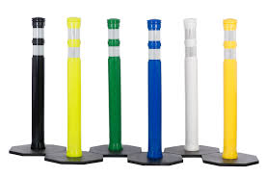
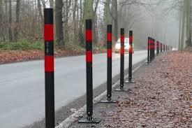
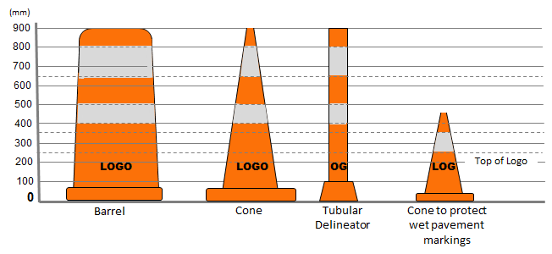
Unofficial tubular delineators
Official delineators

Slide 6

NZTA decided to run a trial to compare 75mm Tubular Delineators (TDs) with standard cones

Slide 7
Trial Standards
We chose to set up a 100m taper with delineators at 5m spacings as this is the largest gap in the taper
We chose to photograph from distances of 50m and 25m
Our camera was set at 1.07m which is the current AASHTO driver eye height

Slide 8

Cars on the lane
Replicated 3 positions of cars on the lane:
1
1m left of centreline

Slide 9
Cars on the lane
Replicated 3 positions of cars on the lane:
1
1m left of centreline
2
On the centreline

Slide 10
Cars on the lane
Replicated 3 positions of cars on the lane:
1
1m left of centreline
2
On the centreline
3
1m from edgeline of the right lane
(for multiple lane roads)

Slide 11
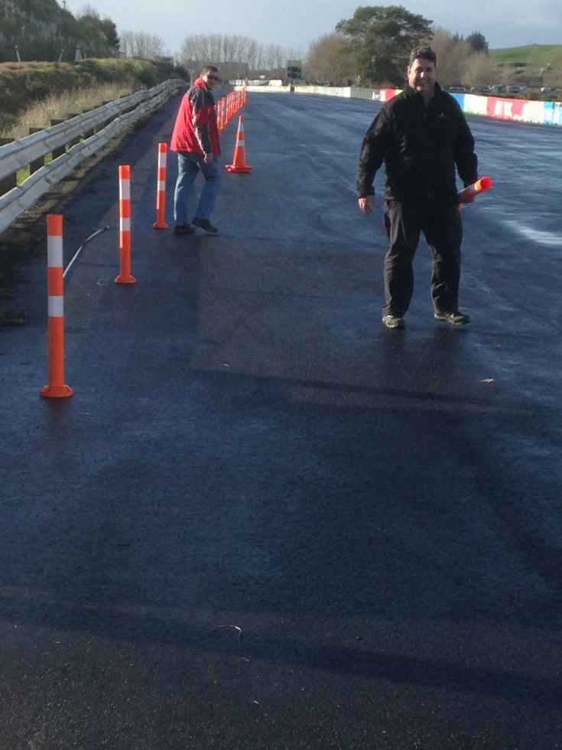
Set up of the trial site
Thanks to my helpers Julian Chisnall and
Alan Gardiner

Slide 12
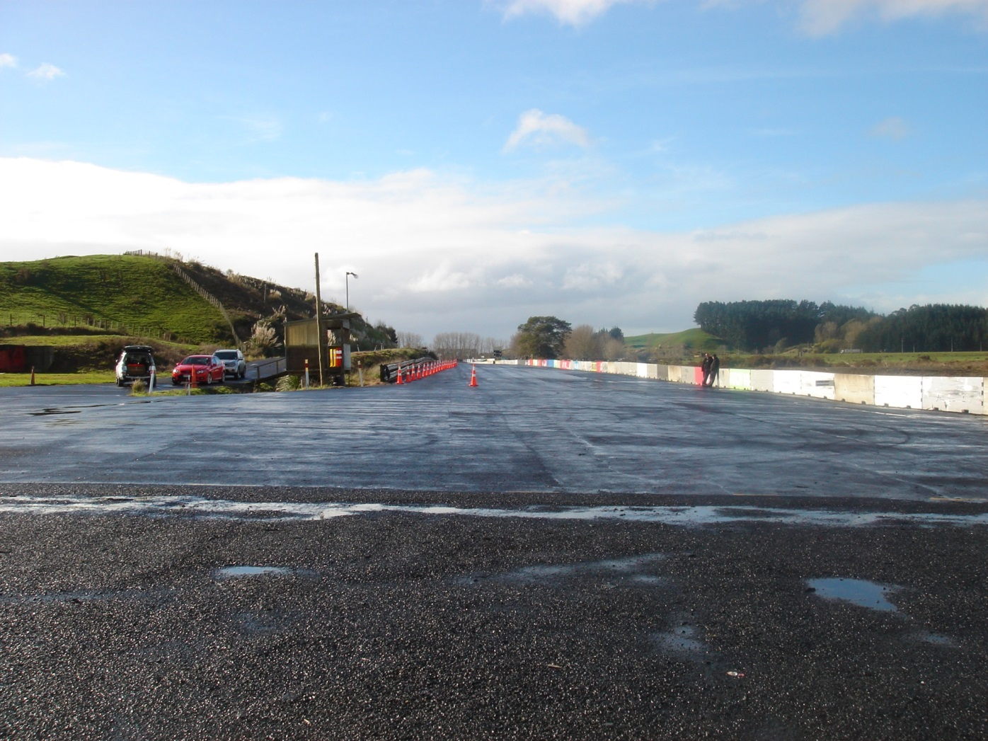
Cones at 50m

Slide 13
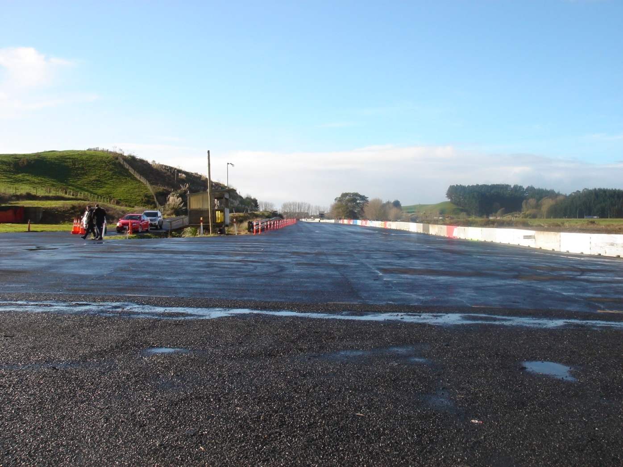
TDs at 50m

Slide 14
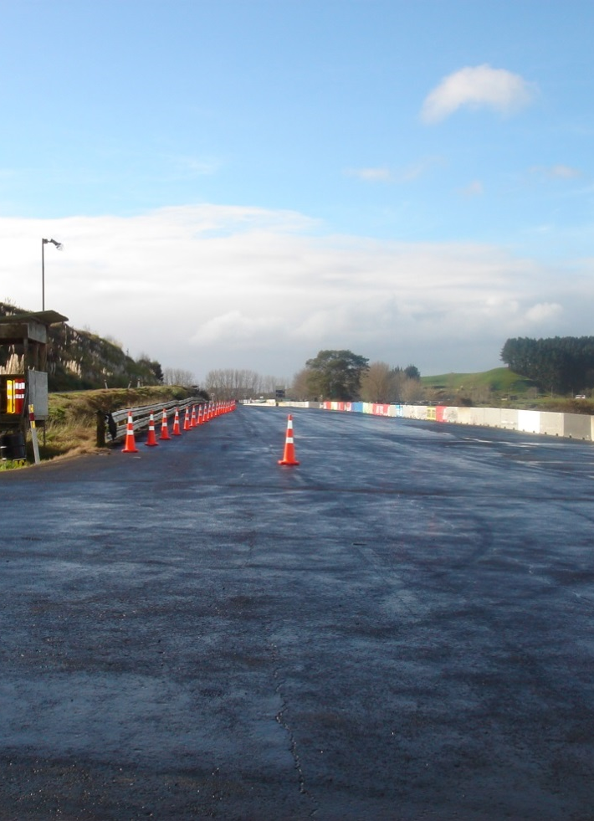
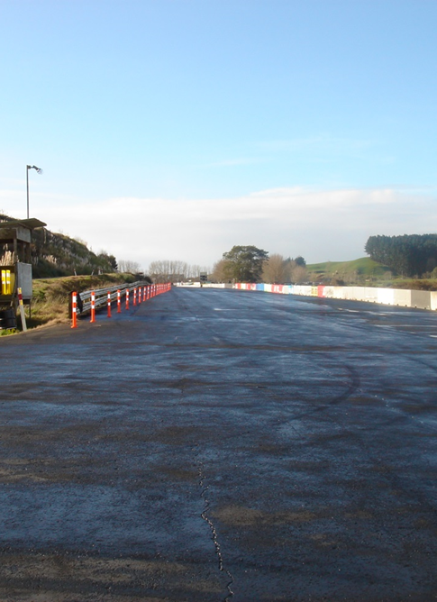
Comparison at 50m
Cones
TDs

Slide 15
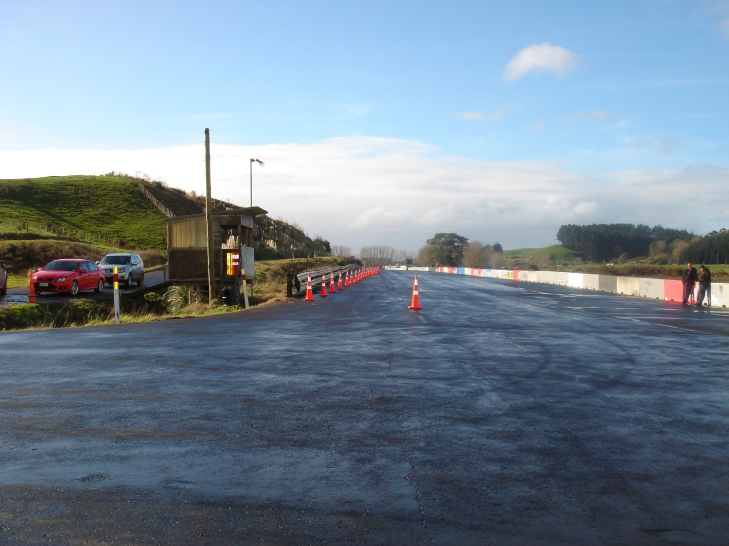
Cones at 25m

Slide 16
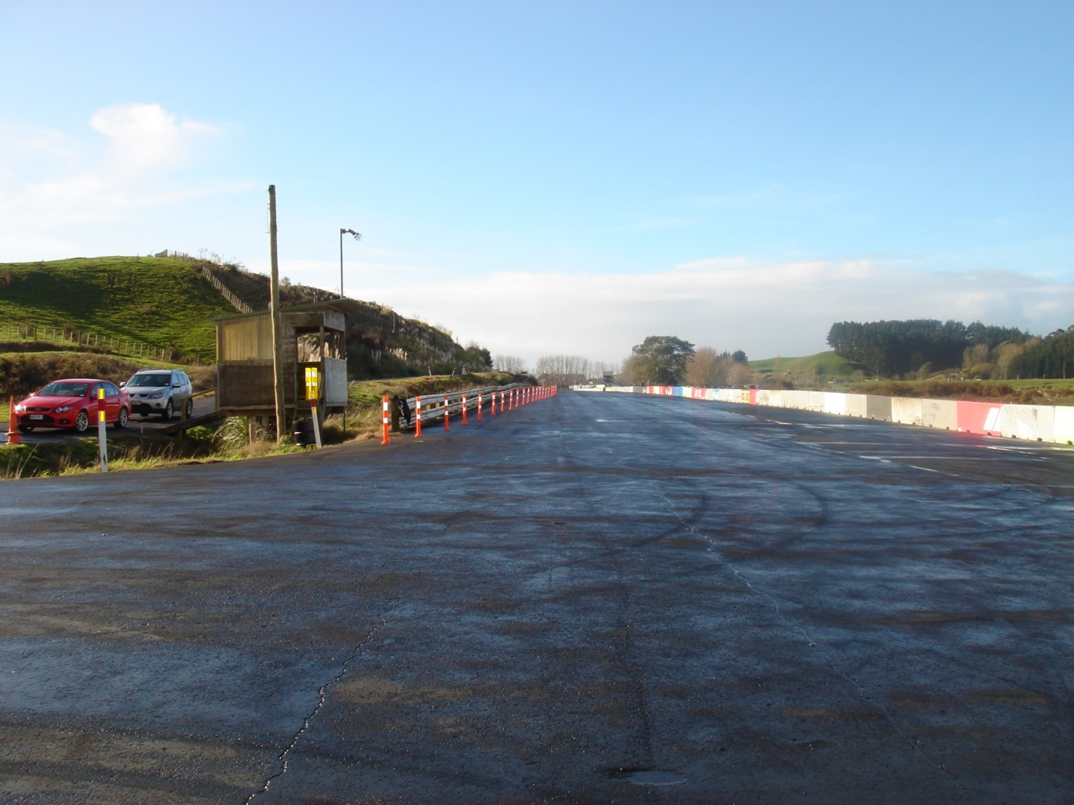
TDs at 25m

Slide 17
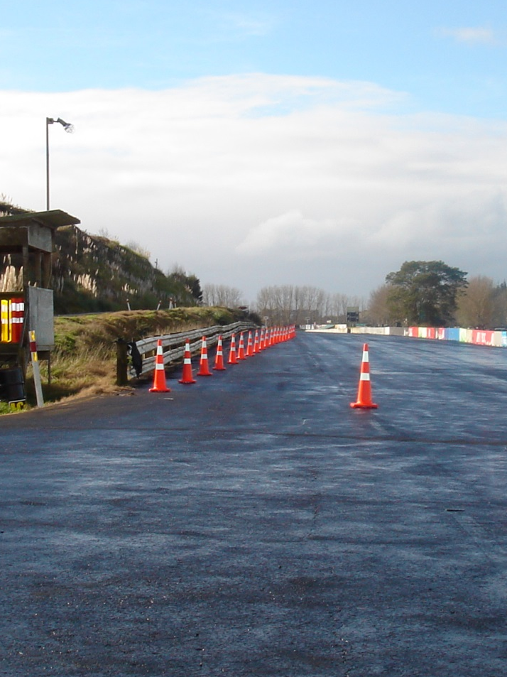

Comparison at 25m
Cones
TDs

Slide 18

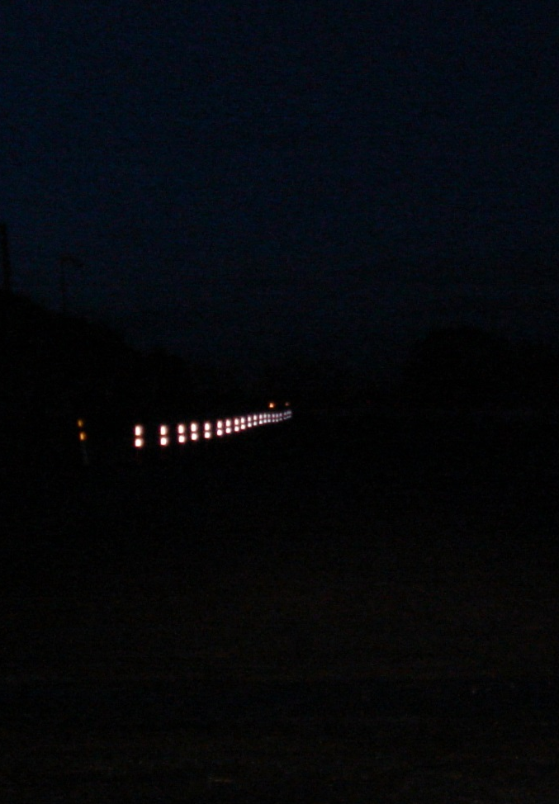
Comparison at 50m
Cones
TDs

Slide 19


Comparison at 25m
Cones
TDs

Slide 20
Conclusions
  Daytime fluorescence – Cone slightly better
  Nigh time retro-reflectivity – TD slightly better
  Hence we have written the new specifications allowing a minimum of 75mm

Slide 21
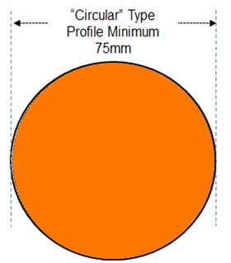
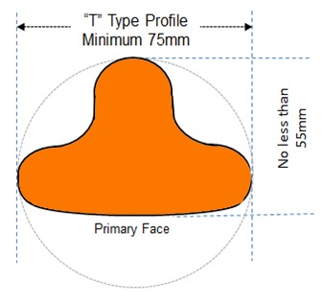
Outcome - Revised specification in CoPTTM

