Slide 1
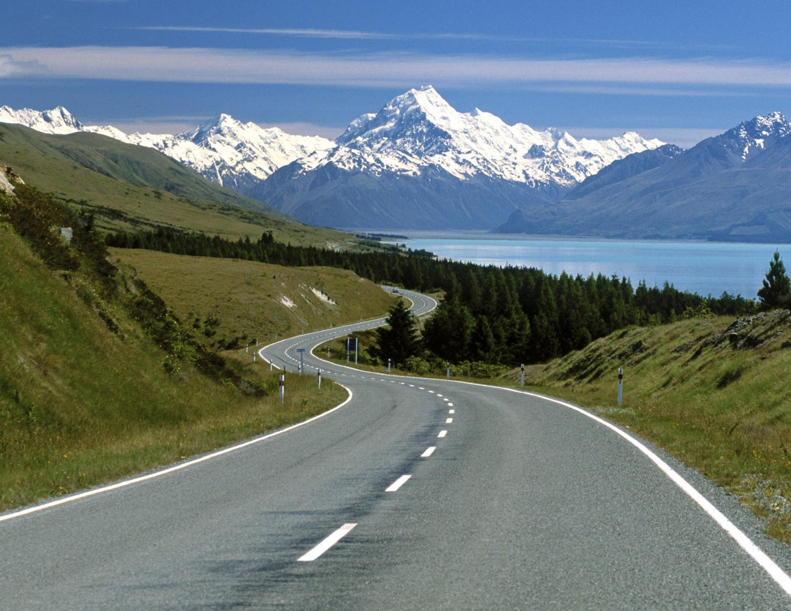
Understanding Road Users
Samuel G. Charlton
Traffic & Road Safety Research Group Waikato University

Slide 2
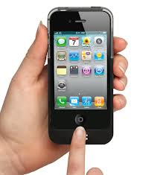
Applied Cognitive Psychology
Mātai hinengaro whaipainga me te roro tāiao
Human Factors
Ergonomics
Engineering Psychology
Applying what we know about people, how they think and behave, their characteristics, requirements and and designing tools, procedures, and systems to fit them
Human-centered design
Hard technology the user has to fit the tool
Soft technology designing the tool to fit the user

Slide 3
Human-centered design is at the heart of the Safe System philosophy
1
2
People make mistakes
People are vulnerable
3
4
We need to share responsibility
We need to strengthen all parts of the system

Slide 4
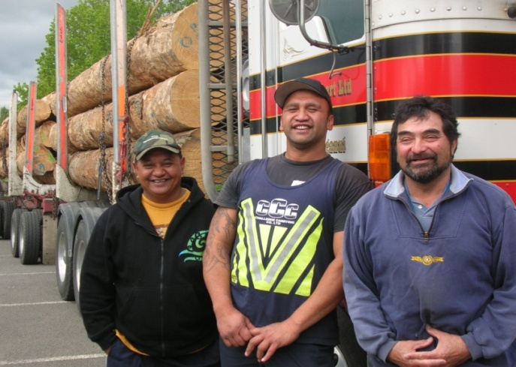
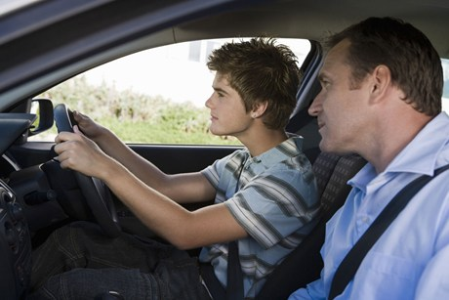
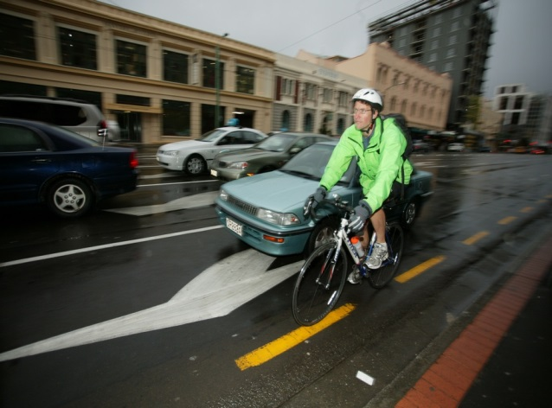
Human factors – people first
Old Approach | Safe System approach
Tell people to ‘get with the system’ | Design systems around people
Blame road users when things go wrong | Understand people and the tasks they do
Address the immediate issues only | Consider all factors that lead to crashes

Slide 5
Why study driver behaviour?
Road transport should be as easy and safe to use as a consumer product
Significant public health issue
1.3 million people killed on the roads each year worldwide forecast to rise to 1.9 million people by 2020 World-wide 3,400 people die on the road every day Number one cause of death for young people 50 million people injured, many remaining disabled for life
A common skill we acquire as young adults
A very good applied area for studying cognition
human performance, attention & decision making

Slide 6
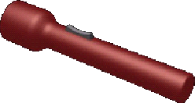
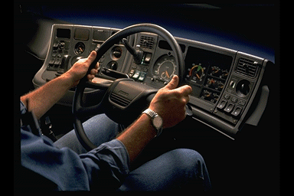
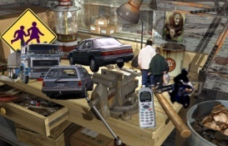
Driving as a skill
Perceptions
Environment
The Perception-Decision-Action (PDA) Cycle
Modifies
Samples
Knowledge
Skills
Decisions
Actions
10,000 PDA cycles per hour on a straight road
Directs
Highly practised tasks become automatic
Individual thoughts and actions repeated together often enough become combined into a single unit
an open-loop (ballistic) program or script

Slide 7
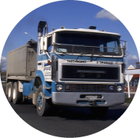
1) Perception stage – Effective field of vision
The driver’s eye cannot take in the whole roadway with acuity Foveal vision is 2° - 4°
Drivers use rapid fixations to take in the scene
100 – 300 msec for lane position
2 sec for estimating speed and distance or reading road signs
50 km/h = 14m per sec 100 km/h = 28m per sec
Horizontal field of vision = 150° at 50 km/h Horizontal field of vision = 50° at 100 km/h Effective field of vision becomes narrower and deeper

Slide 8
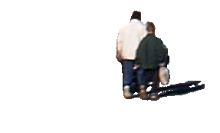
1) Perception stage -- channelised attention

Slide 9
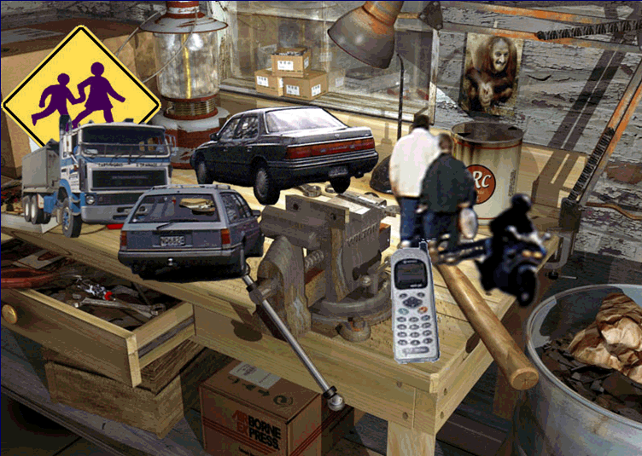
2) Decision stage – comprehending & planning
We use working memory to identify situations, make conscious decisions, apply rules, solve problems, etc.
Working memory is limited in capacity and conscious thought takes time
Notes:
compressed

Slide 10
3) Action stage
The effect of reduced field of vision & time compression in decision making: We steer where we look (DWA)

Slide 11
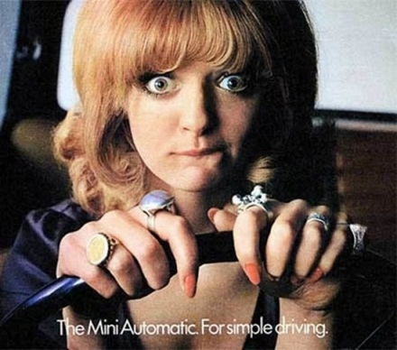
Looked-but-failed-to-see crashes
(SMIDSY)
collisions in which a driver fails to detect another road user or object despite looking at it
Third most frequently occurring driver error
(Brown, 2005; Treat, 1980; White & Caird, 2010)
Looked-but-failed-to-see crashes
appear to predominate on familiar roads
(Brown, 2002; Hills, 1980; Kousanaï, Boloix, van Elslande, & Bastien, 2008; Rumar, 1990; Treat, 1980; White & Caird, 2010)
Why do looked-but-failed-to-see crashes occur?
Most drivers are driving without awareness, most of the time
Highly practised tasks become automatic

Slide 12
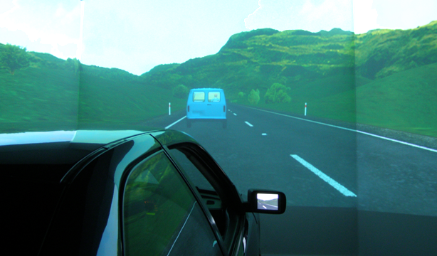
Driving Without Awareness
29 participants drove a simulated road twice a week for approx 12 weeks
13 males, 16 females
Mean age = 30.17 years (ranged 17 to 49 years)
All participants developed stereotyped driving patterns Speed and lane position became less responsive
Participants noticed fewer and fewer things in their environment
(Charlton & Starkey, 2011, 2012, 2013)

Slide 13
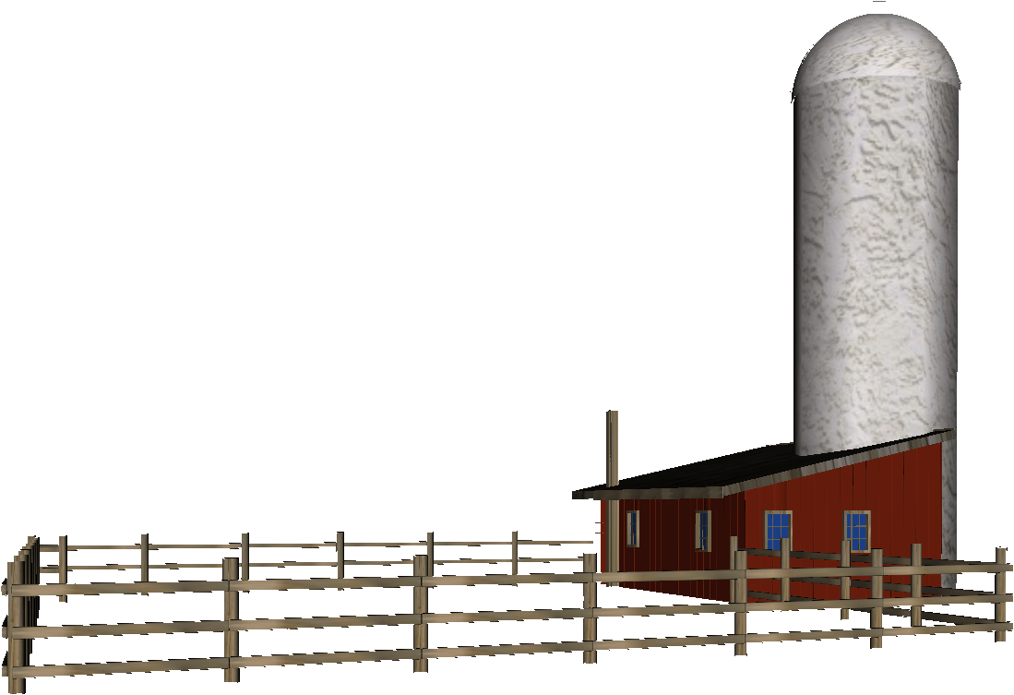
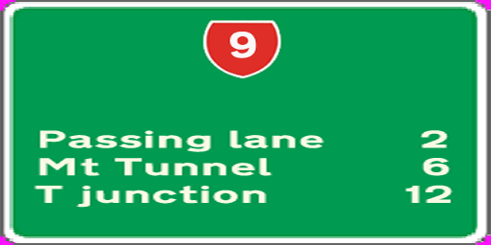
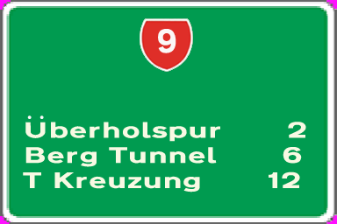
Driving Without Awareness
Participants developed stereotyped driving patterns
Participants noticed fewer and fewer things in their environment
Change detection sessions: changes to or removal of road markings, road signs, buildings, etc
Participants did not detect removal of prominent buildings or changes from English to German wording

Slide 14
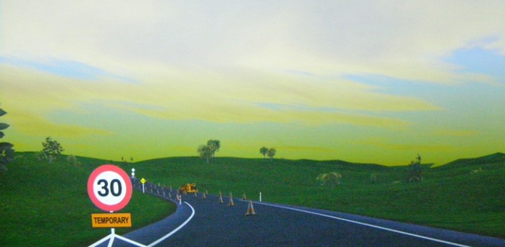
Road works trials
First time through the road works
Drivers reduced their speeds well before entering the site
Second and subsequent times
Drivers noticed the sites earlier and earlier but slowed down less and less

Slide 15
Two modes of driving
Supervisory level
explicit attention
10%
learning to drive, navigating in an unfamiliar area, overtaking, controlling a skid on ice
Procedural level
automatic procedures
speed maintenance, lane position, following distances, brake reactions, changing lanes, eye scanning, checking mirrors, negotiating a familiar intersection, school zones,
approaching and driving through curves, entering traffic
90%

Slide 16
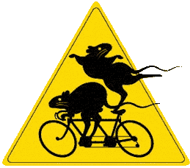
Driving without awareness (DWA)
Charlton & Starkey’s Tandem Model an “operating process” and “monitoring process” working in tandem
Operating process: conscious, intentional decision making, uses deliberate search of environment, requires effort and can be undermined by distractions
Monitoring process: an unconscious error monitoring system, requires little cognitive effort, continuously active, rapid error detection, sufficient to maintain many aspects of driving (esp. on familiar roads)
Proceduralisation (automaticity) represents a broadening and refinement of the templates (schemata) used by the monitoring process
Much of our driving behaviour is governed implicitly esp. lane keeping & speed maintenance

Slide 17
Driving without awareness (DWA)
We steer where we look
Monitoring process: relies on the presence of familiar cues When potential failure stimulus is detected, the object receives additional activation until the operating process returns conscious attention to task
#1 change detected by drivers – removal of centrelines #2 – removal of edgelines

Slide 18
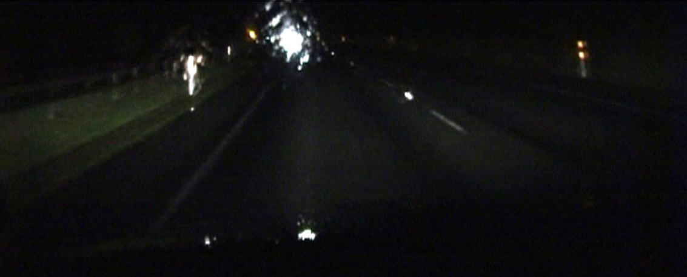
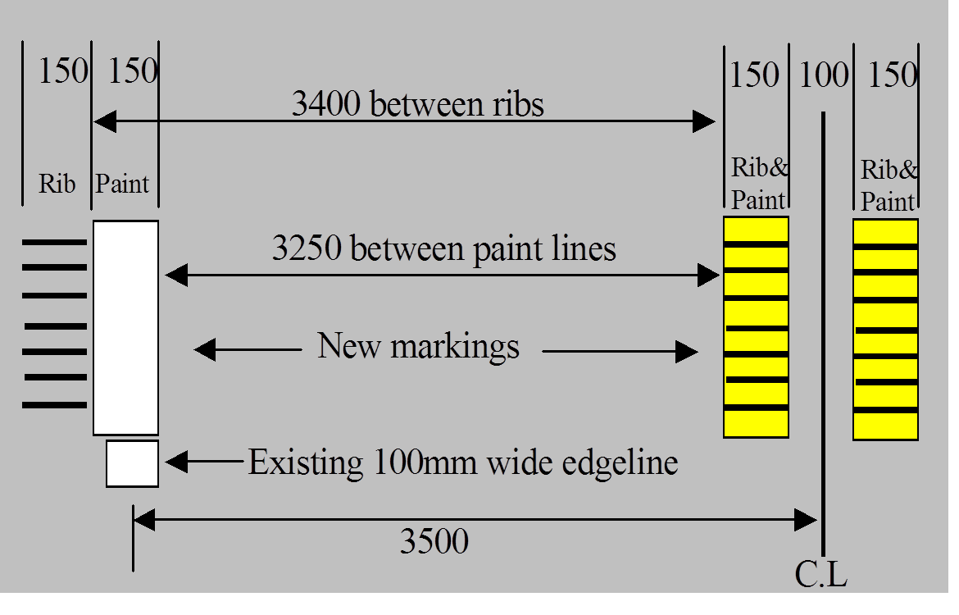
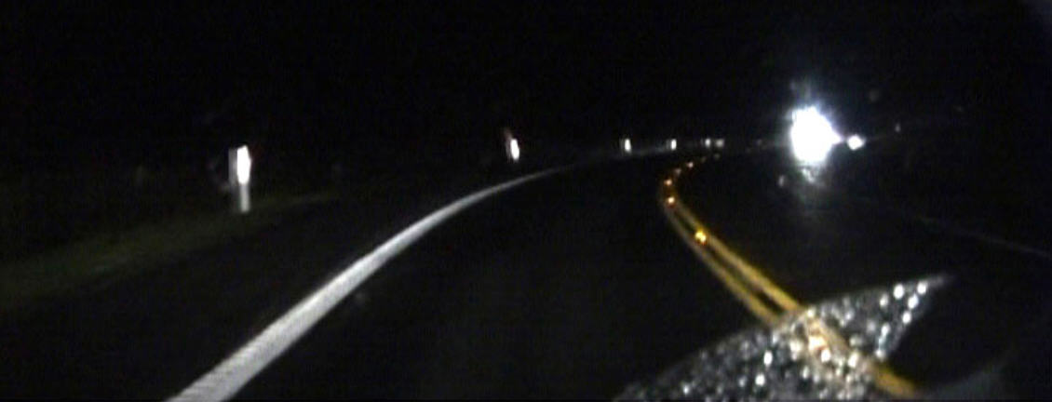
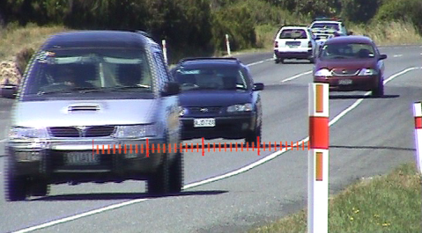
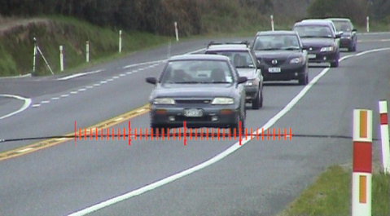
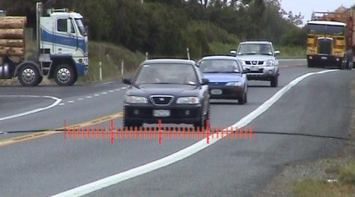
Rural delineation treatments
South Waikato & Taupo Target 2010 Project
SH1 Before
SH1 After
Pre treatment
Phase 1
Phase 2
Significant safety gain with no increase in speed

Slide 19
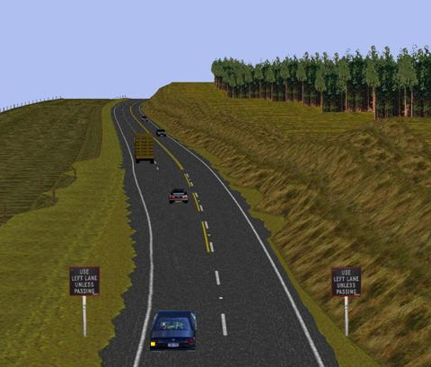
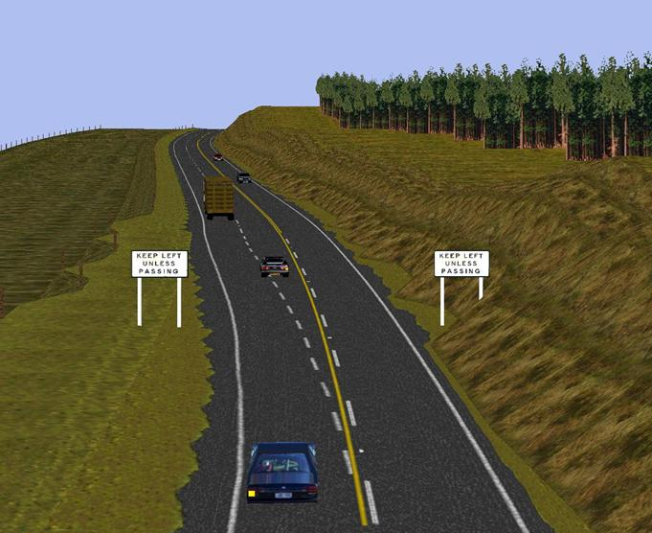
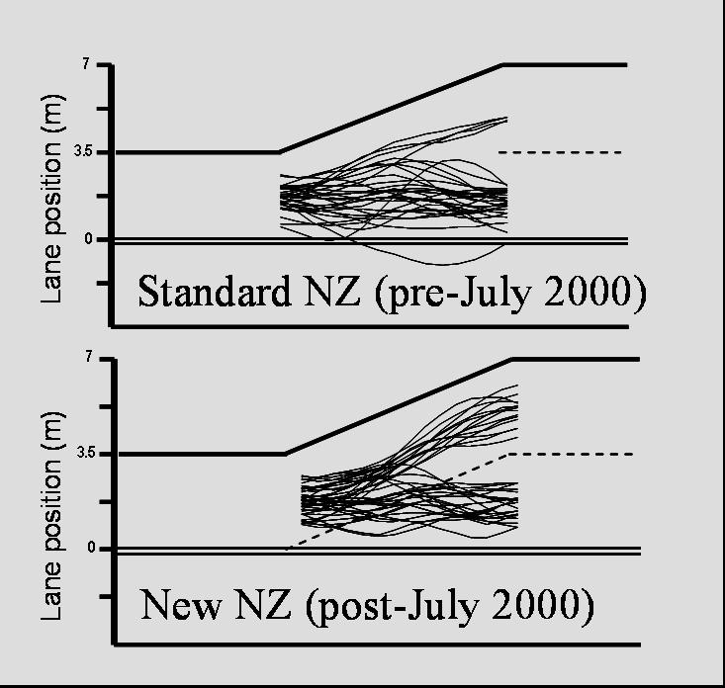
Lane Delineation Treatments
Addition of continuity lines resulted in more drivers keeping left
Drivers didn’t notice the changes
(Charlton et al 2001 ; Charlton 2007)

Slide 20
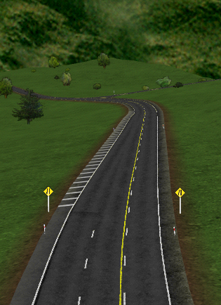
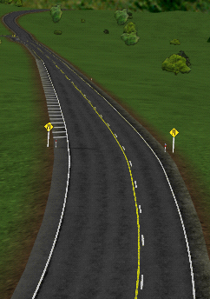
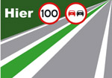
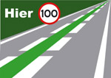
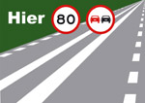
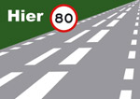
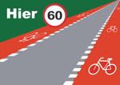
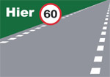
The effect of removing lane delineation: One of the most effective merge treatments for overtaking lanes
(Drivers hated it: increased perceived risk)
We could make better use of road markings
Continuous side line: max 100 kph.
Continuous middle line: no overtaking
Green line in middle: absolutely 100 kph
overtaking allowed
Dashed side line: max 80 kph.
Continuous middle line: no overtaking
Dashed side line only: max 60 kph.
Bicycles only in red lane
Bicycles on road

Slide 21
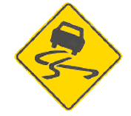
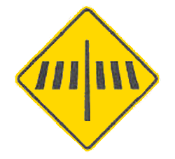
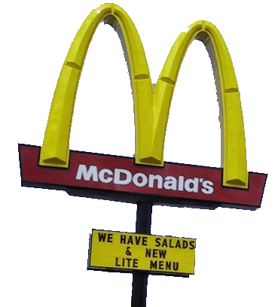
Most common way of communicating information to drivers is via road signs
Drivers may notice as few as 1 in 10 road signs and have very poor memory for road signs they’ve just passed (6% recall - 9% recognition)
Assessment of Hazard Warning Signs
(Charlton, 2006)
12.90%
25.81%
38.46%
19.35%
41.94%
What cues do drivers use?

Slide 22
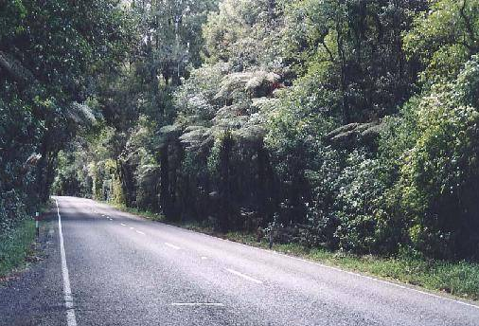
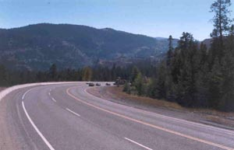
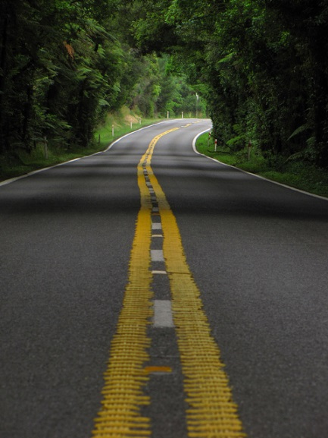
The look and feel of a road determines how it is used
Fitzgerald Glade SH5
Much of our driving behaviour is governed implicitly esp. lane keeping & speed maintenance

Slide 23
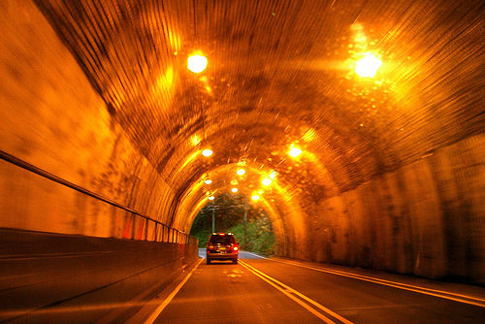
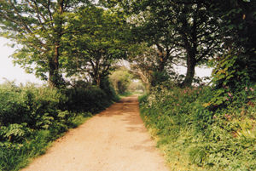
Optic flow drivers use edge rate in the visual environment to judge their speed (preconsciously)
increasing the visual edge rate increases drivers’ sense of speed

Slide 24
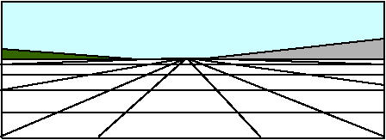
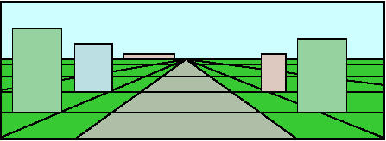
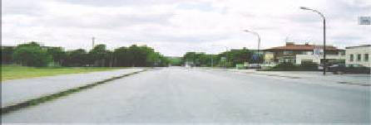
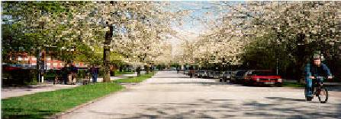
We can use psychological principles to affect the “look & feel” of a road
Choosing road widths, delineation, and road furniture designed to afford a desired speed and lane position
Affordances: perceptual properties that function as “built-in” instructions, processed without awareness

Slide 25
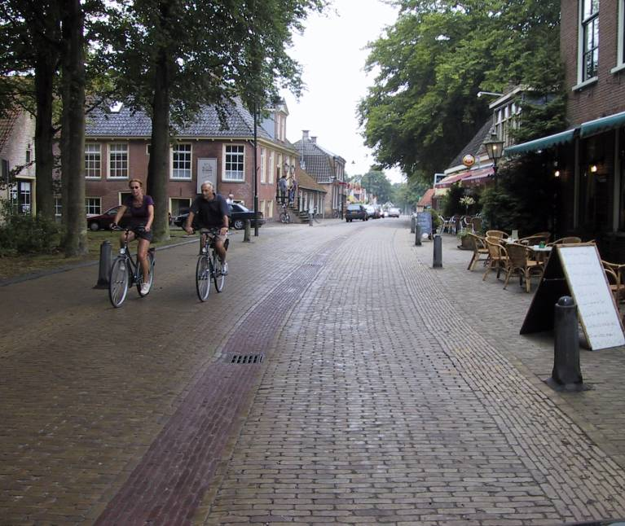
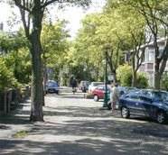
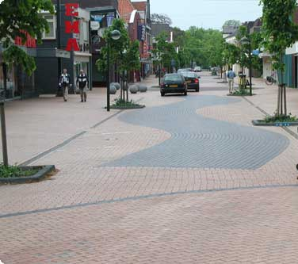
Sustainable Safety – The Netherlands
Differentiating the road hierarchy
Access roads
Distributor roads
Through roads

Slide 26
Currently, we don’t do a very good job at telling drivers what kind of road they are using
These NZ roads look very similar
but they all have different speed limits
100
80
70
60
50

Slide 27
These three NZ roads all have the same speed limit, 100 km/h
Self-Explaining Roads for Sustainable Safety Programme (Liveable Streets)
Funded by Foundation for Research Science & Technology
Using psychological principles to affect the “look & feel” of a road

Slide 28
Step 1: Select trial area
Control Area
Glen Innes / Pt England
Treatment Area
Need to monitor two areas to quantify the effectiveness of the SER designs

Slide 29
Self-Explaining Roads for Sustainable Safety Programme (Liveable Streets)
SER requires a clear hierarchy of roads
Pt England Rd Collector road 5,000-7,000 vpd
Anderson Ave Local road 377 vpd
(high intersection crash rate)
Existing streetscapes didn’t provide enough information about the road hierarchy or appropriate use of the streets

Slide 30
Steps 4-5: Analyse existing road features & develop SER design template
What is good about these streets? Which ones are working?
Develop a template around those features that visually reinforce the appropriate speeds
Make each level in the hierarchy Visually Distinct and promote the correct uses at each level

Slide 31
Participatory design for self-explaining roads

Slide 32
Participatory design for self-explaining roads

Slide 33
Development of an SER design template
for Glen Innes / Pt England
Local roads
Collector roads

Slide 34
Steps 6-9: Implementation planning, community input & design reviews

Slide 35
Implementation
Cost could not exceed amount already budgeted for “minor safety improvements”

Slide 36
Before
Local roads
Collector roads

Slide 37
After
Local roads
Collector roads

Slide 38
Pre-treatment speeds
50
Local road
45
Collector road
40
35
30
Percent of vehicles
25
20
15
10
5
0
0
10
20
30
40
50
60
70
80
90
100
Speed (km/h)

Slide 39
Post-treatment speeds
50
Local road
45
Collector road
40
35
30
Percent of vehicles
25
20
15
10
5
0
0
10
20
30
40
50
60
70
80
90
100
Speed (km/h)
Different speed profiles for different road categories

Slide 40
Results
A decrease in local road speeds Significant homogeneity of speeds
30% reduction in crashes
86% reduction in crash costs
Health benefits 3x the road safety benefits
No speed signs
No enforcement
Self-Explaining Roads
Charlton et al (2010) Using endemic road features to create self-explaining roads and reduce vehicle speeds. Accident Analysis and Prevention
Safer Journeys 2010
The government will work to improve our roads so that each type of road will eventually have a recognisable and distinctive set of self-explaining features such as signage, lane width, road markings and speed limits. This work will ensure roads are predictable … should encourage people to travel at speeds that best fit the design and function of the road.

Slide 41
Is driving with a 0.05 BAC any safer than driving at 0.08?
Drunker Than You Think: Delayed Performance Impairment From Moderate Amounts Of Alcohol
2 research questions:
1. Evaluate the biphasic effects of .05 and .08 alcohol levels on psychomotor, cognitive, and driving performance
2. Identify the relationship between drivers’ self-perception of intoxication and the actual level of performance impairment produced

Slide 42
Biphasic effects
Acute tolerance (Mellanby Effect) lower impairment on the descending limb of the intoxication curve as compared to the same BAC on the ascending limb
Acute protracted error greater impairment on the descending limb of the intoxication curve as compared to the same BAC on the ascending limb
acute tolerance
acute protracted error
BAC
BAC
Impairment
Impairment
ascending limb
descending limb
ascending limb
descending limb

Slide 43
Method
61 participants 33 males 28 females average age of 31.11 years (SD = 8.34)
Randomly assigned to 3 alcohol dose groups: placebo, medium (.05), or high (.08)
30% vodka, 70% orange juice divided equally across three drinks
Two drinks given after baseline testing, 5 minutes to consume each drink
Third drink given 35 mins later unless BAC within .01 of target
5 Test blocks (approx 3.5 hrs)
Each test block triggered by elapsed time

Slide 44
Performance Measures
CogState test battery
Timed Chase Test
Groton Maze Learning Task (GMLT)
Card identification Task (RT)
GMLT Recall Task
Driver Attention Inhibition & Reaction (DAIR) test
Speed, lane position, hazard reactions
Walk & turn test NZ Police Compulsory Impairment Test
Self-ratings of intoxication & willingness to drive

Slide 45
Results
Participants were unable to judge how much alcohol they had consumed
.08 BAC participants’ estimates not significantly different than .05 participants (about ½ as much as they actually consumed)

Slide 46
Results
3 measures showed acute tolerance
Subjective intoxication
Willingness to drive
GMLT recall errors
6 measures showed acute protracted error
Chase task speed
GMLT errors
Centre line crossings
Chase task errors
Sec over 100 km/h
Sec over the centre line
6 measures showed symmetric dose-dependent effects (no difference between ascending and descending limbs)

Slide 47
Symmetric dose-dependent effects
More alcohol = more impairment
No difference due to time
Sec over the edge line
False alarm responses
Significant BAC effects
F(2,45) = 5.332, p = .008, η_{p}² = .192
F(2,45) = 4.168, p = .022, η_{p}² = .156

Slide 48
Acute Tolerance Effects
Impairment decreases faster than BAC (you feel less drunk than you are)
Subjective intoxication rating
Willingness to drive rating
*
*
Significant BAC & phase effects
* Pairwise comparisons p < .05

Slide 49
Acute Protracted Error
Impairment increases with time (even though BAC hasn’t changed)
Sec over 100 km/h
Chase task errors
*
*
*
Significant BAC, phase, & interaction effects
* Pairwise comparisons p < .05

Slide 50
Are these effects found in “normal” drinking?
Usually people consume alcohol in groups,
with smaller drinks over longer periods of time
Would acute tolerance and acute protracted error still be evident if participants were intoxicated for longer periods?
Study 2 -- Research goals
1. Assess the effect of other drinkers’ presence (expectancy effects)
2. Determine whether Acute Tolerance and Acute Protracted Error occur with longer peak alcohol plateau (habituation effects)

Slide 51
Method
44 participants 21 males 23 females average age of 32.84 years (SD = 8.49)
Three alcohol dose groups: placebo, medium (.05), or high (.08)
Tested in groups of three (random selection)
Alcohol administered ad libitum until desired BAC levels obtained, maintained at peak for 1 hour
5 Test blocks
Block 1 baseline
Block 2 ascending limb (.03 or .05)
BAC
Block 3 peak 1 (.05 or .08)
Block 4 peak 2 (.05 or .08)
Block 5 descending limb (.03 or .05)
1
2
3
4
5

Slide 52
Measures
CogState test battery
Driver Attention Inhibition & Reaction (DAIR) test
Self-ratings of intoxication & willingness to drive

Slide 53
Subjective intoxication
Placebos reported being as intoxicated as the Med and High alcohol groups

Slide 54
Subjective intoxication
Compared 20 Solo Placebos from previous study to the 3 social drinking groups in the current study
Solo Placebo significantly lower than Placebo & .08 groups (p < .028)
No acute tolerance effect

Slide 55
Drink estimation
Participants were unable to judge how much alcohol they had consumed
Solo Placebo significantly lower than all other groups (p < .036)

Slide 56
Cognitive & driving performance
4 measures showed symmetric alcohol effects (no difference between ascending and descending limbs)
Centre line crossings
SDLP
Sec over the centre line
GMLT recall errors
4 measures showed acute protracted error
Chase task errors
Maximum speed
Sec over 100 km/h
GMLT rule break errors
0 measures showed acute tolerance

Slide 57
Symmetric Alcohol Effects
More alcohol = more impairment (note impairment displayed by Social Placebos)
No difference due to time
Significant BAC effects
Centre line crossings
Sec over the centre line

Slide 58
Acute Protracted Error
Impairment increases with time (even though BAC hasn’t changed)
Sec over 100 km/h
Maximum speed
*
*

Slide 59
Conclusions
1. Participants were unable to judge how much alcohol they had consumed or their level of intoxication (expectancy effects)
2. Alcohol dose effects and acute protracted error were found even with lengthy BAC plateau and moderate amounts of alcohol (no habituation effects)
3. Acute tolerance of intoxication judgements were not found with longer social drinking
Starkey & Charlton (2014) The effects of moderate alcohol concentrations on driving and cognitive performance during ascending and descending BACs. Human Psychopharmacology: Clinical and Experimental.
Charlton & Starkey (2015) Driving while drinking: Performance impairments resulting from social drinking. Accident Analysis & Prevention.

Slide 60
Is talking on a cellphone while driving any riskier than conversing with a passenger?
Driving while conversing: Cellphones that distract and passengers who react
Compared 4 groups of drivers
No conversation (control)
Drivers conversing with a passenger
Drivers conversing on a hands-free cellphone
Drivers conversing with a remote passenger

Slide 61
Participants drove a simulated 25 km road containing 5 hazards & an overtaking lane
Hazard 1 - Busy intersection
Hazard 2 - Parked car entering traffic
Hazard 3 - One-lane bridge
Overtaking lane
Hazard 4 - Road works
Hazard 5 - Land slip

Slide 62
Controls and drivers talking to a passenger slowed down as they approached a hazard, braked earlier and further away from hazards
Drivers talking on cellphones had significantly more crashes
Conversation complexity: cellphone conversors made longer (and more difficult) utterances
Conversation suppression: when the passenger saw an approaching hazard, they stopped talking
SA enhancement: passengers discussed the road & often alerted the driver to hazards

Slide 64
Conclusions
Talking on a cellphone while driving is different than conversing with a passenger
Talking on a hands-free cellphone while driving is just as dangerous as talking on a handheld phone
Charlton (2009) Driving while conversing: Cell phones that distract and passengers who react. Accident Analysis and Prevention.
Wilson, Thomson, Starkey, & Charlton, (2013). Persisting mobile phone use while driving and possible solutions for New Zealand. The New Zealand Medical Journal.

Slide 65
Its always tempting to concentrate on “High Risk” drivers
Option 1: Raise the driving age
In NZ, 15-19 yr old drivers are 7% of the driving population, but are involved in 14% of fatal crashes (10% male, 4% female)
Option 2: Lower the driving age
In NZ, older drivers are over-represented in their rates of intersection crashes and fatigue-related crashes

Slide 66
Concentrate on “High Risk” drivers
Option 3: Get tough on recidivist drunk drivers
16% of drivers treated at Midland Region Trauma Service
are over the legal BAC limit
Option 4: Get tough on drunk walkers
56% of pedestrians treated at Midland Region Trauma Service
are over the legal BAC limit

Slide 67
Concentrate on “High Risk” drivers
Option 5: Don’t allow driving in Northland & Waikato
Northland: 3.6% of the population but 6.8% of the social cost of crashes
Waikato: 9.4% of the population but 15.4% of the social cost of crashes.

Slide 68
Concentrate on “High Risk” drivers
Option 6: Don’t allow women from Whangarei to drive
The highest rates collision across the two islands come from Whangarei women, who reported an incidence of at-fault collisions of 2.5 times the national average
Kirsty Nelson
first woman ever to win the Hella International Rally

Slide 69
We like to blame other drivers for the road toll

Slide 70
We like to blame other drivers for the road toll
Have you ever noticed that anybody driving slower than you is an idiot, and anyone going faster than you is a maniac?
George Carlin 1984

Slide 71
We like to blame other drivers for the road toll

Slide 72
It’s not the other drivers *it is us*

Slide 73
Use research to inform policy & practice
A Safe System approach
Providing roads that are self-explaining & self-enforcing
Providing vehicle safety equipment & decision support information
Roads (Task factors)
Vehicles (Machine factors)
Drivers (Human factors)
Providing training & education for an engaged and safety-conscious road user population
Traffic & Road Safety Research Group Waikato University

