Slide 1













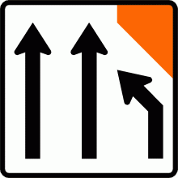

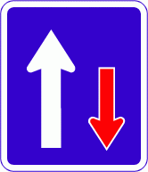



















Raising the bar
CoPTTM Training
Notes:
Our theme for this conference is Raising the bar
Click
And we are confident that this conference will inspire people in a similar manner as the last conference
Click

Slide 2
Priority project
CGG Priority project:
Moderation of trainers
Raising the bar with trainers
Raising the bar with training

Slide 3

Raising the bar with trainers
Centres of excellence (COE)
A group of trainers working collaboratively within a region to lift the quality of CoPTTM training
  Meet 2 to 3 times a year
  Currently piloting in Wgtn
  Full roll-out later this year
  Trainers are really interested

Slide 4
Raising the bar with trainers
Centres of excellence (COE)
  Buddy systems
  Visiting other trainers
Provide opportunities for trainers to improve delivery
  Mentoring
  Discussing options for delivery
  Establishing RCA local requirements
  Moderation
  Proposing changes to training material to NZTA

Slide 5
Raising the bar with trainers
Moderation / Audit
Moderation
  Trainer requests a member of the COE to complete moderation of their training
Audit
NZTA have serious concerns about the training being delivered. They commission a senior trainer to complete an audit

Slide 6
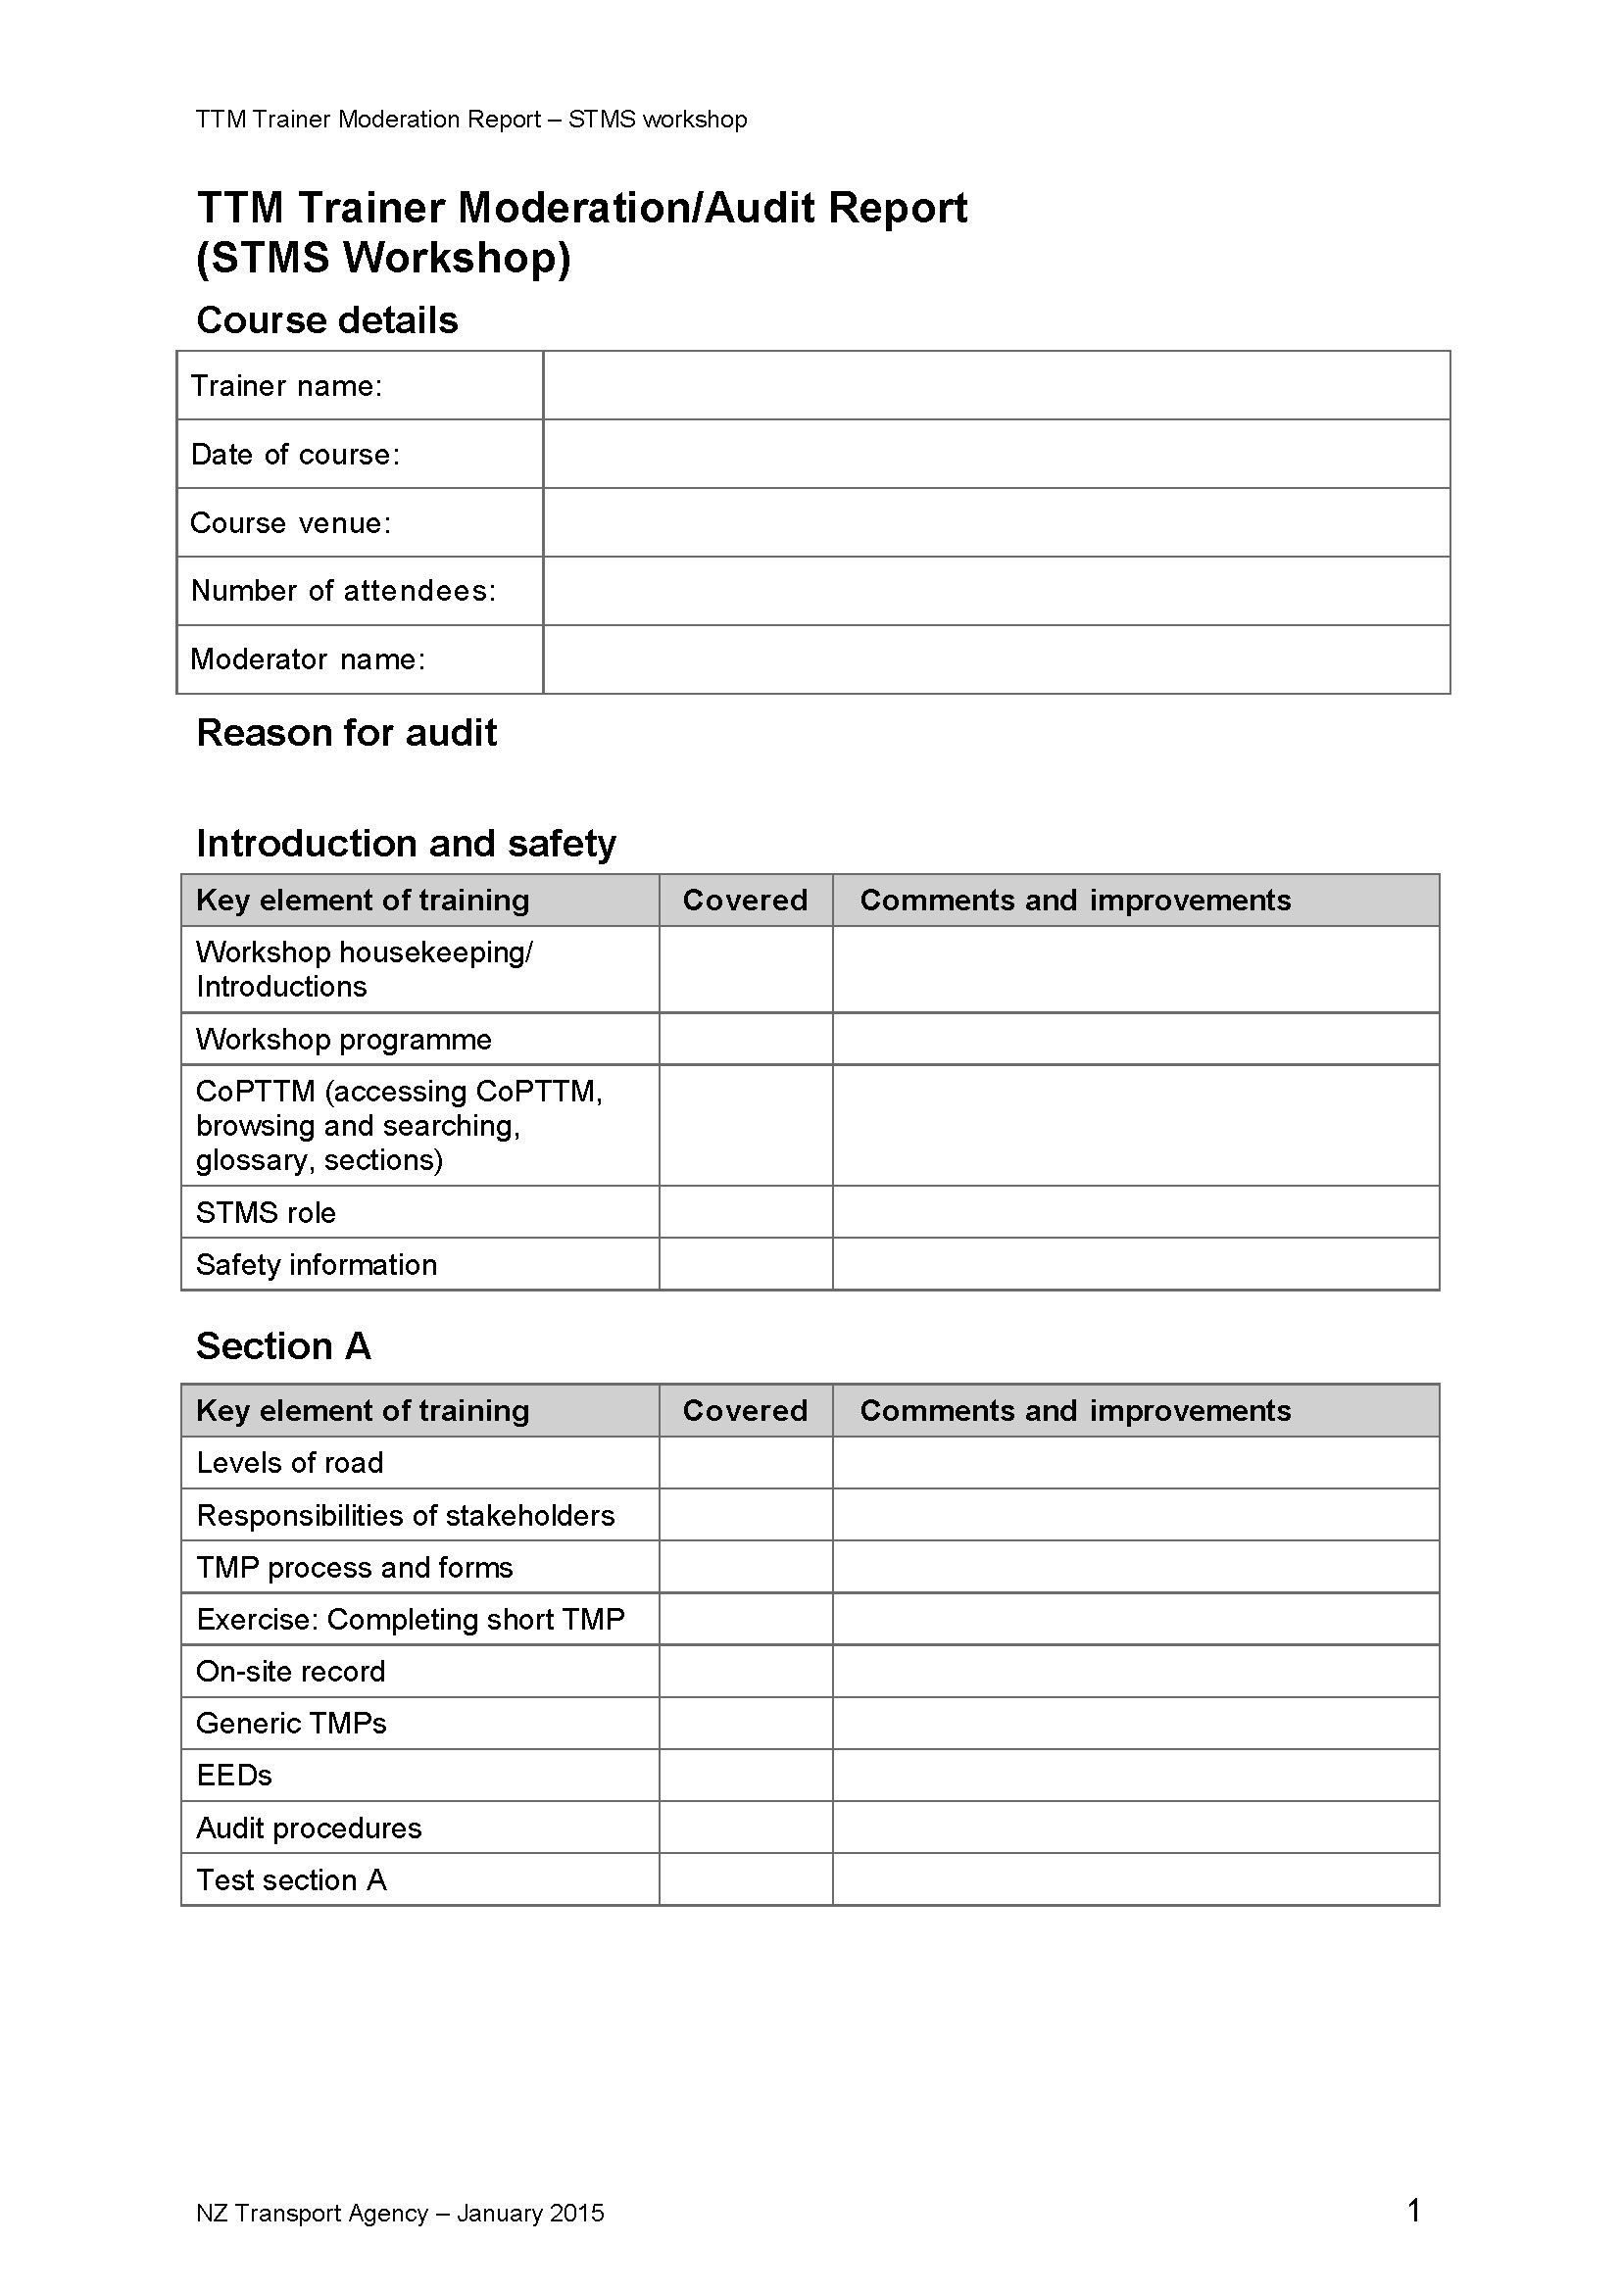
Raising the bar with trainers
Moderation / Audit
  Report is like a warrant of fitness check for the trainer
  Same form used for both moderation and audit:
  Moderation report goes to the trainer for action
  Audit report goes to NZTA for action

Slide 7
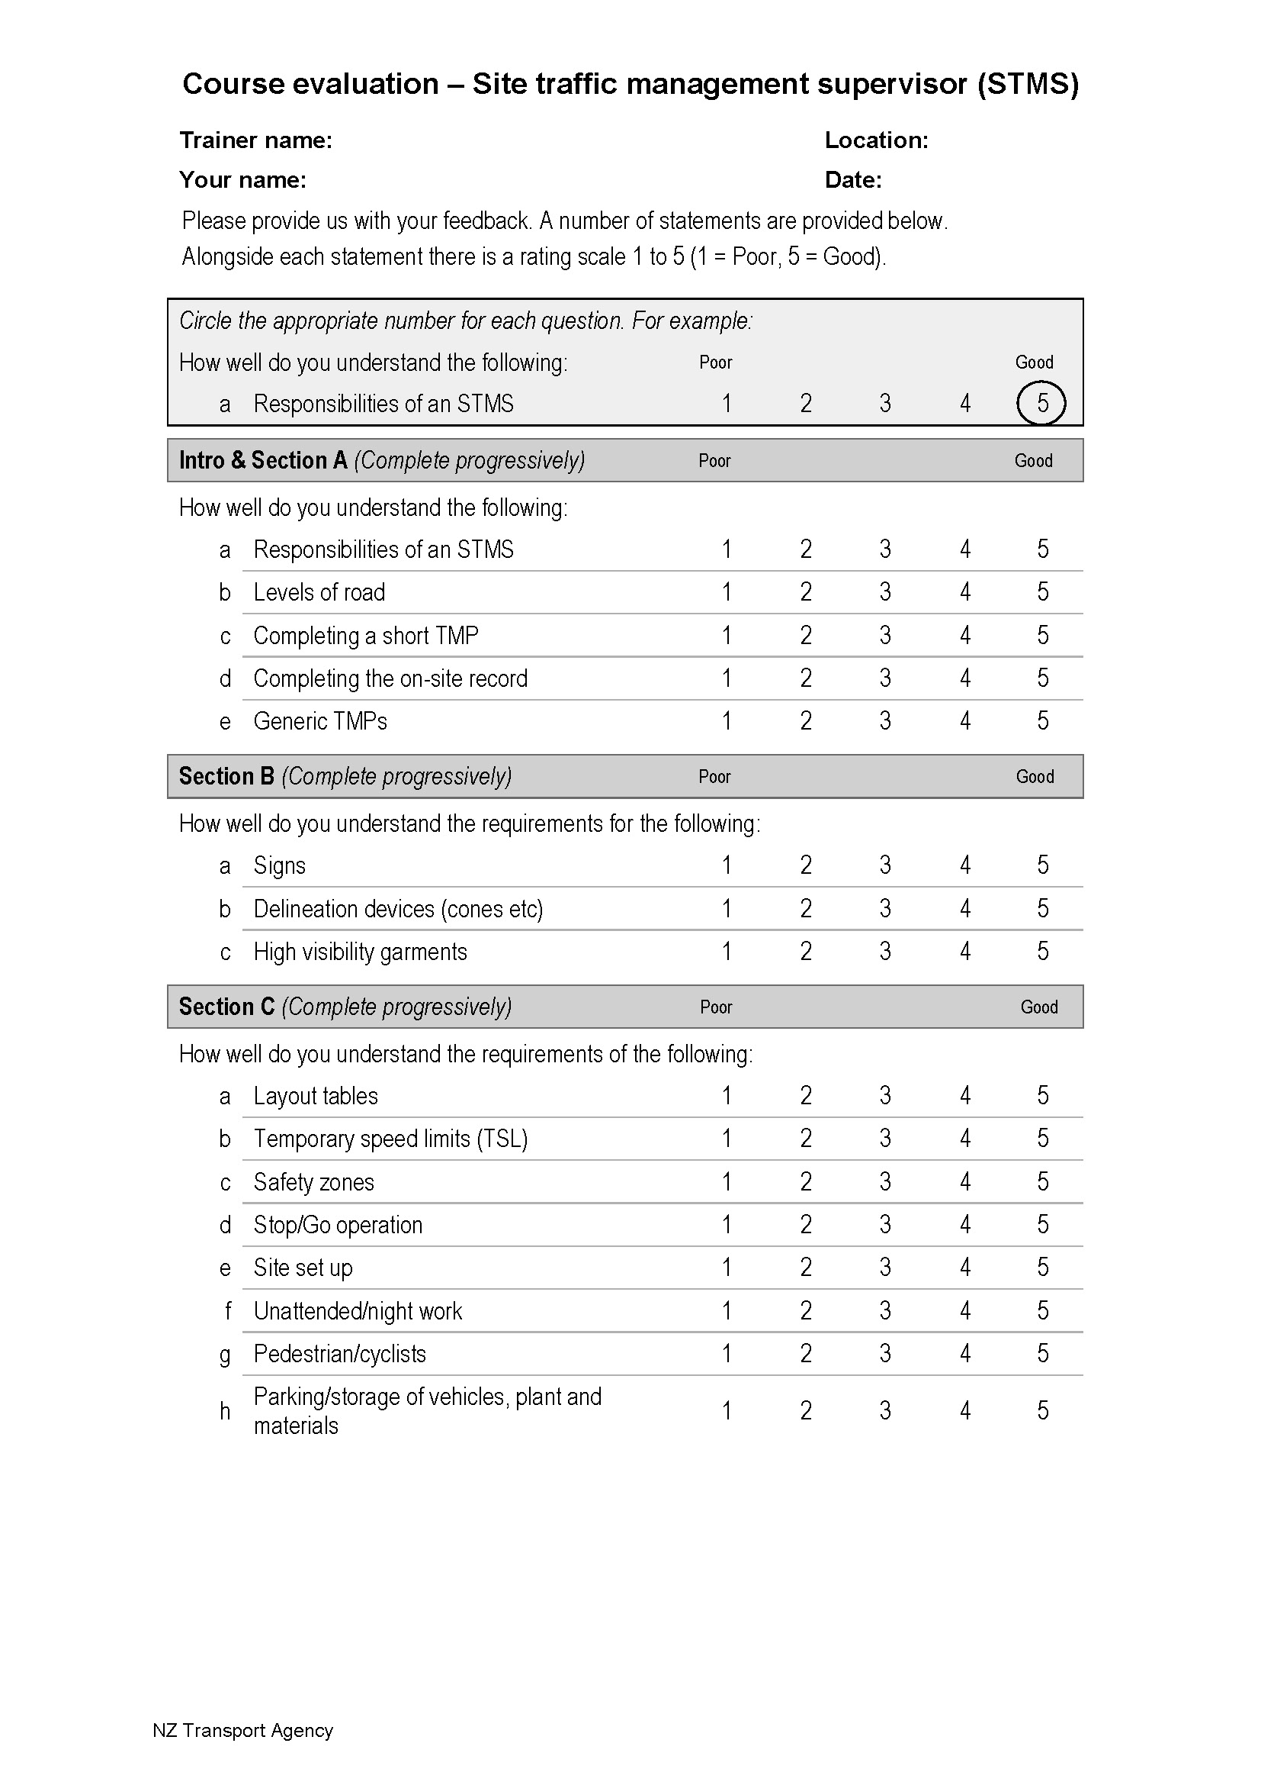
Raising the bar with trainers
Course evaluations
  Introduced as part of the COE
  Gives trainer feedback on how the learning is progressing
  Highlights areas where trainer may need to adapt their delivery to improve learning

Slide 8


Raising the bar with trainers
Course evaluations
  After courses are completed, NZTA will randomly select which courses trainers are to submit evaluations for

Slide 9
Priority project
CGG Priority project:
Moderation of trainers
Raising the bar with trainers
Raising the bar with training

Slide 10



Raising the bar with training
  Whangarei
New courses
Auckland
  TMC workshops
    2 days
    Consistent approach across RCAs
    Hamilton
  Napier
  Advanced planning workshop
    Pilot in Hamilton - August 2015
    Dunedin

Slide 11
Raising the bar with training
Trainer refreshers
  Now 2 days (was 1 day)
  Allows time for discussion on delivery
  Practice presentations with feedback
  Different tests for trainers
  Pass mark of 80% required

Slide 12
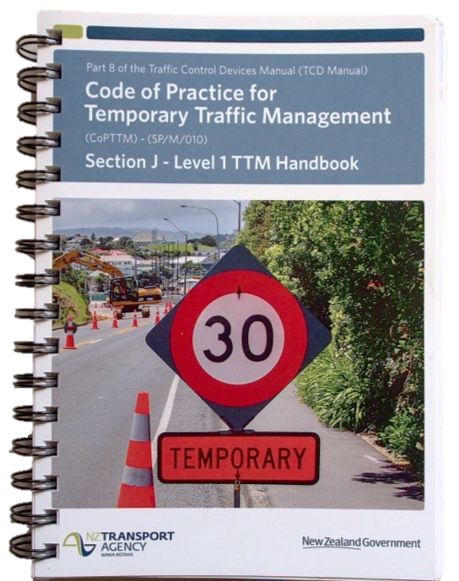
Raising the bar with training
New requirements for CoPTTM training
  Must use the NZTA course presentations
  Smaller group size (eg 15 preferred, max 18) - improves learning
  TC workshop
    May use the level 1 TTM handbook
    Refer to CoPTTM periodically during the training

Slide 13
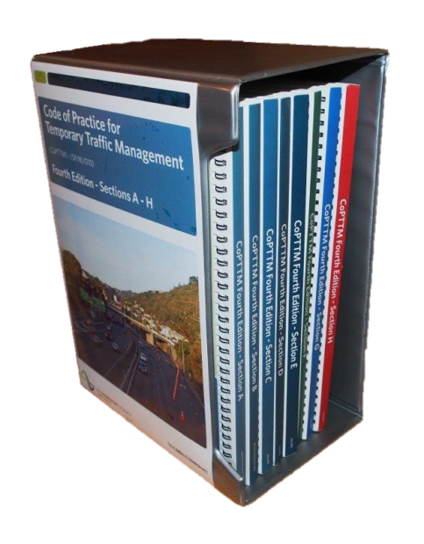
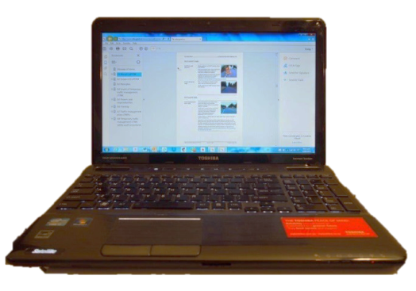
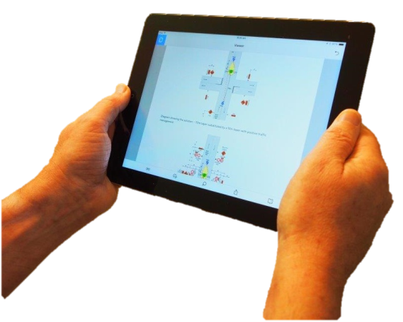
Raising the bar with training
New requirements for CoPTTM training
  All other workshops participants use CoPTTM throughout the training (either print or electronic versions)

Slide 14
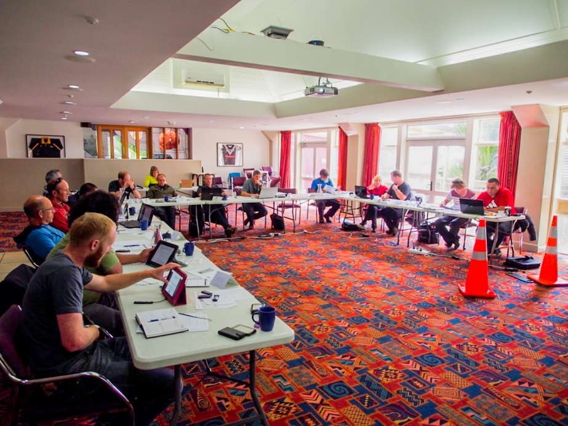
A typical training room
Everyone has CoPTTM
Most have laptops or tablets

Slide 15
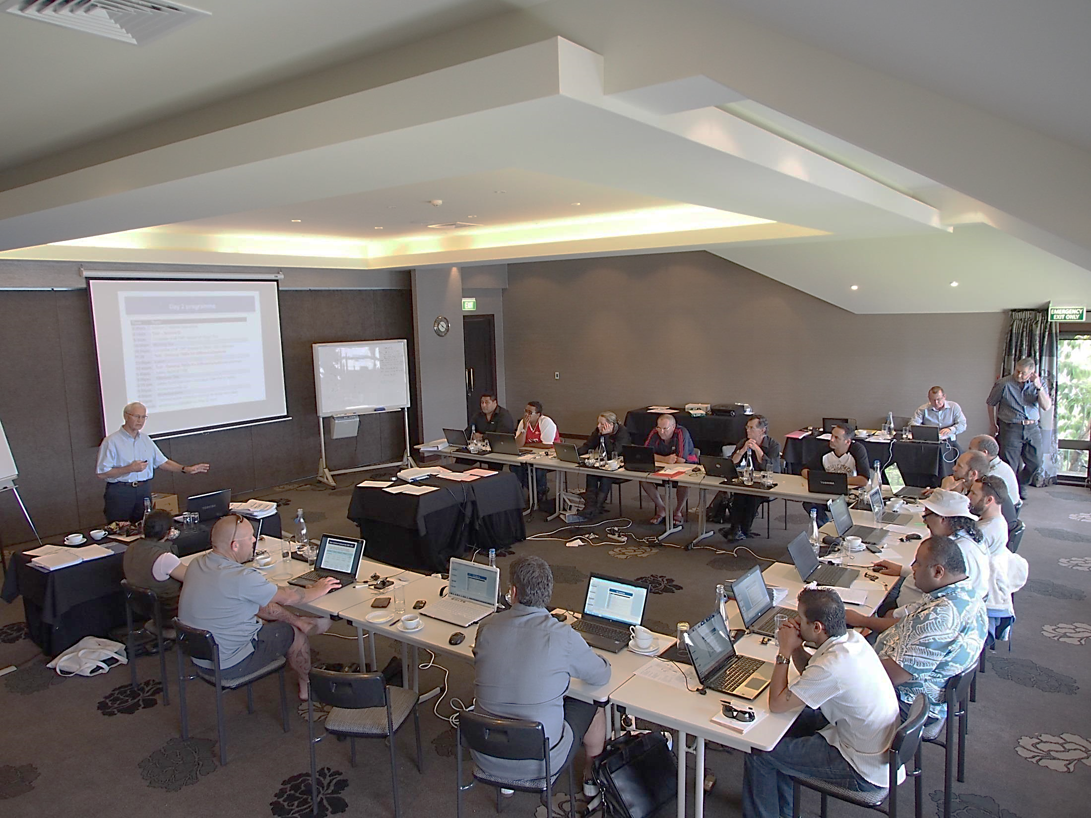
A Train the Trainer workshop
Everyone has CoPTTM
Everyone has a laptop

Slide 16
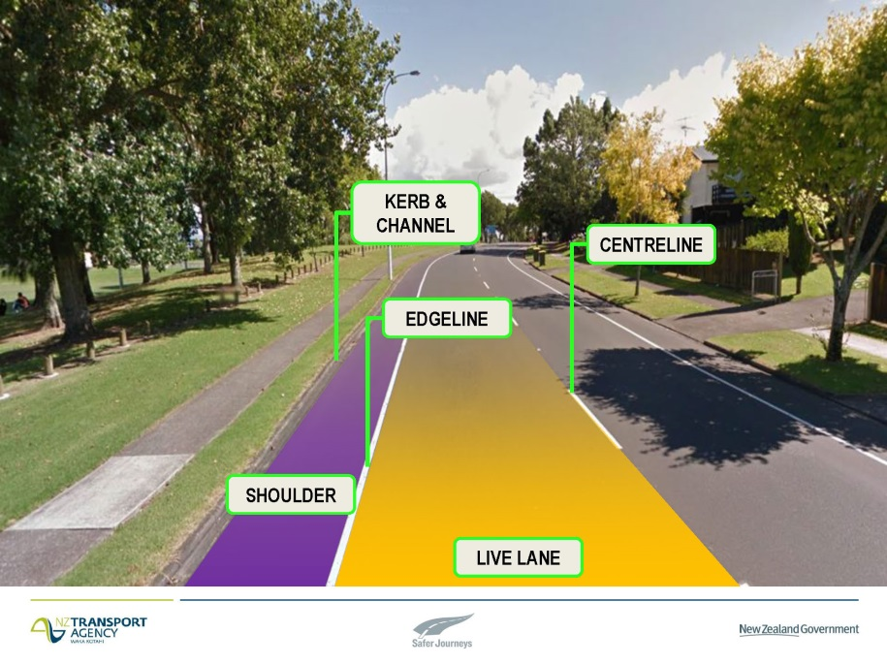
Raising the bar with training
Redesigned training packs
  A number of trainers have made their packs available for NZTA to use
  Trainers have proposed changes
  Increased visuals
  Clearer explanations
  Here are some examples

Slide 17
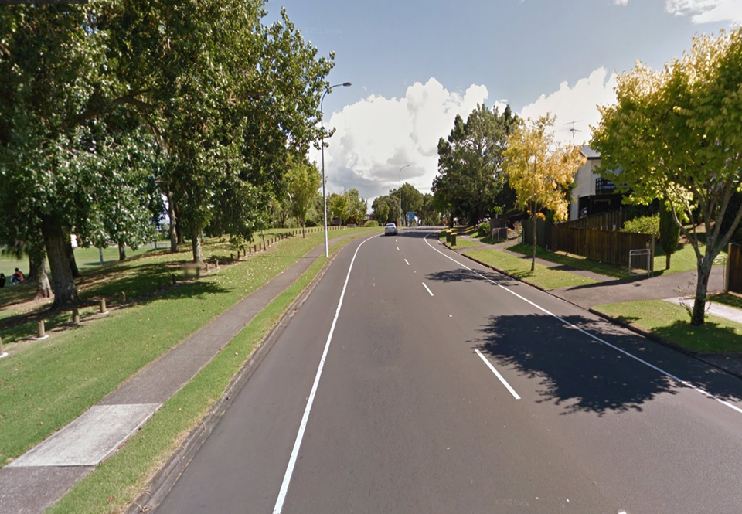
KERB & CHANNEL
CENTRELINE
EDGELINE
SHOULDER
LIVE LANE
Notes:
To assist your trainees with understanding the terminology we use

Slide 18
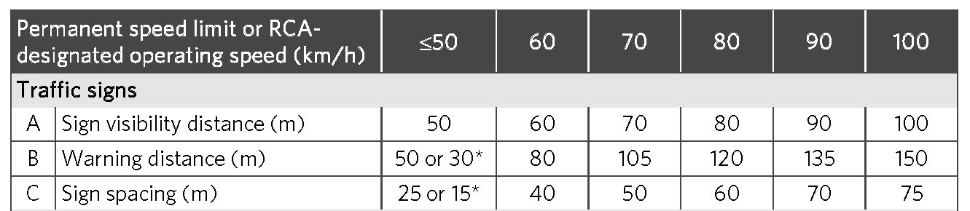

Sign Spacing
Sign Spacing
Sign Spacing
Notes:
When there are 3 signs in advance of the taper there will be 3 sign spacings
Click
Click
Click
Don’t forget the asterix
Click
This is a multi-lane road so…
click

Slide 19
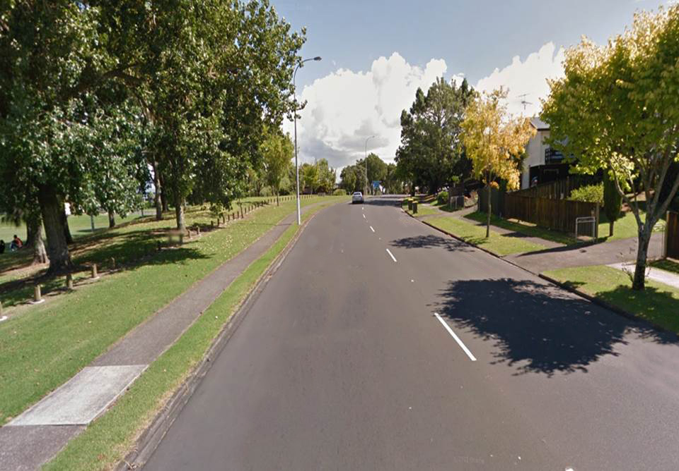




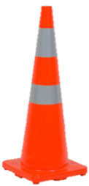
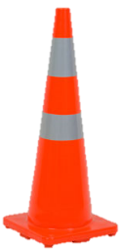
3.0m
Notes:
Here is an example:
On a road with a permanent speed of 70km/h and a TSL of 50km/h,…
Click
…we may reduce the lane width to 3m at 50km/h

Slide 20
2.75m
Notes:
If the TSL was 30km/h we would squeeze the speed out of motorists by reducing the lane width to 2.75m

Slide 21
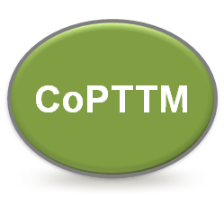
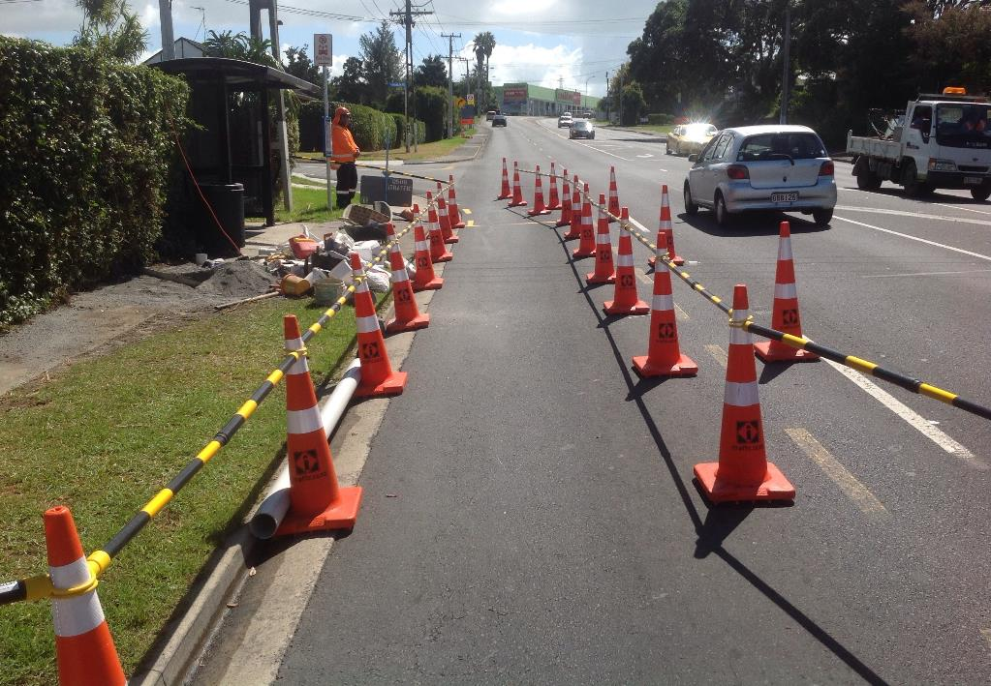
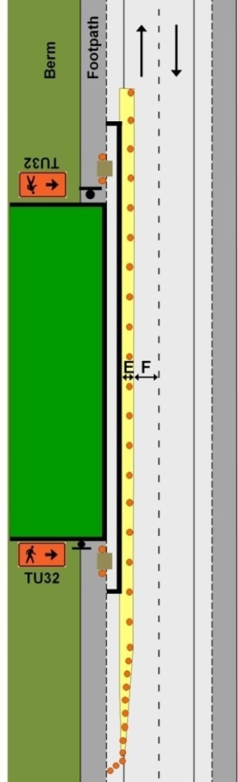
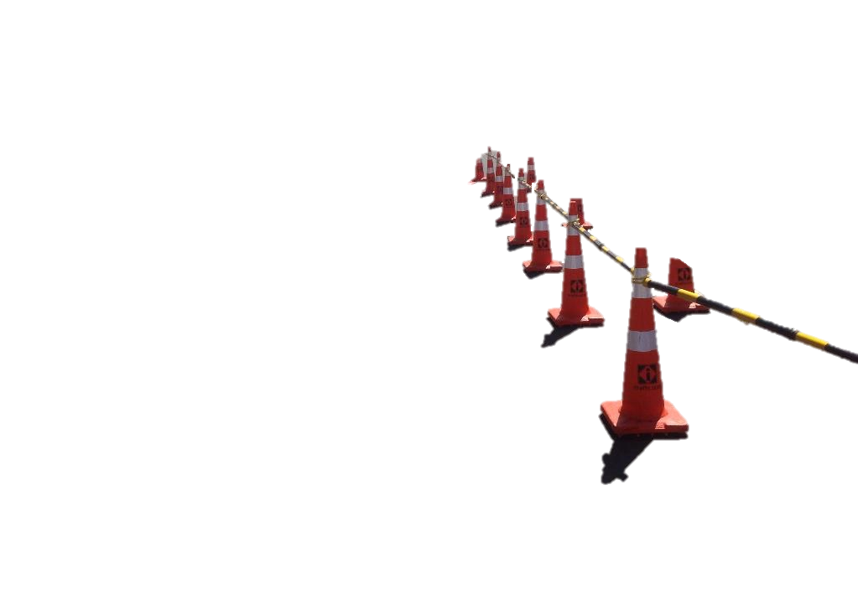
Into the carriageway (either parking lane, shoulder or traffic lane)
3
TMD F2.3
Can use cone bars at attended sites – must use safety fences or barriers for unattended sites
Provide safety zones
Use kerb ramps (or driveways)
Must have pedestrian signs
Notes:
Note for trainer:
Also explain that TMD must be used in conjunction with appropriate TTM in for any carried out on the shoulder or in the live lane

Slide 22
CoPTTM Training
Raising the bar

