Slide 1
TTM Conference 2015
Raising the bar
Notes:
Opening slide on display at start of session
Click

Slide 2
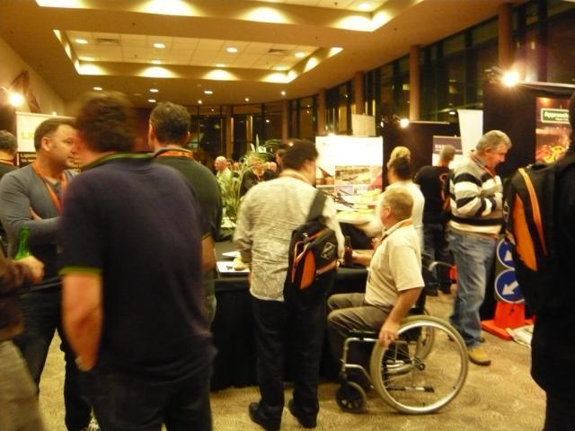
Welcome to the conference
Theme for 2013
Challenge the way we do TTM
Notes:
It is my pleasure to welcome you to the 2nd TTM conference
Our 1st one held in 2013 was a resounding success and inspired a lot of people and their organisations to challenge the way we do TTM
Click

Slide 3
Our theme for this conference
Raising the bar
Notes:
Our theme for this conference is Raising the bar
Click
And we are confident that this conference will inspire people in a similar manner as the last conference
Click

Slide 4
Why raise the bar?
Our aim is to try and do better
This includes improving TTM:
Methods
Equipment
Knowledge
Notes:
So why have we picked Raising the bar as our theme
Well our aim is to try and do better in everything that we do
Click
This includes improving our temporary traffic management Knowledge
Click
Improving the equipment we use
Click
And improving the way we do things (our methods)
Click

Slide 5
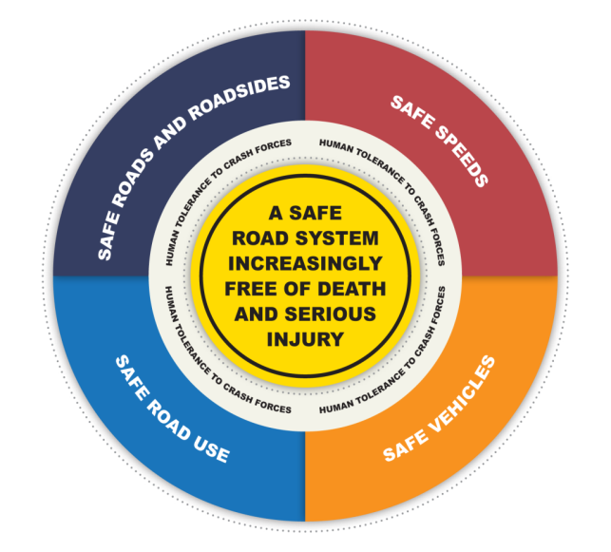
How we are ‘Raising the bar’
The safe system
Notes:
During the conference you will hear speakers talking about going for zero fatalities and the adoption of a safe system for this purpose
For some of you the safe system may not have much meaning.
By the end of this conference I am hopeful that you will have learnt about the 4 pillars of a safe system and where we sit in that system
Click

Slide 6
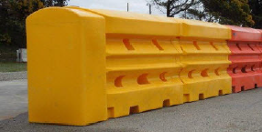
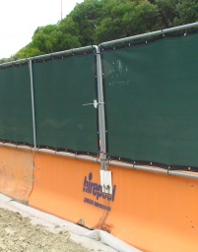
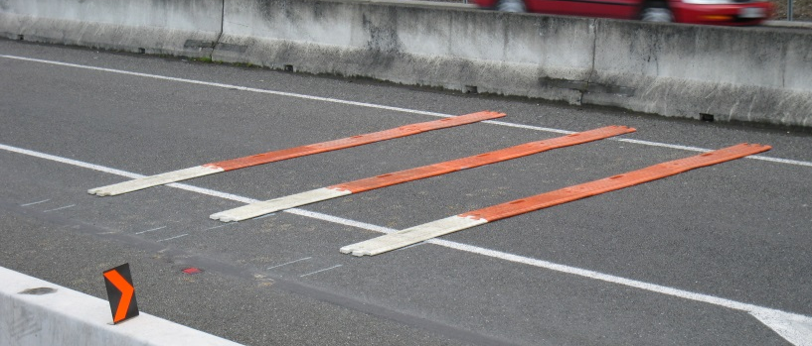
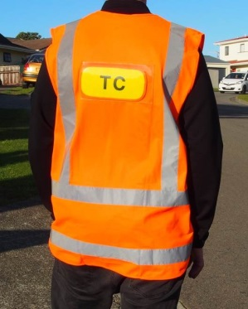
New traffic control devices
Barriers & visibility screens
Tubular delineators
Rumble strips
TC vest
Notes:
You will also learn about a number of new traffic control devices which in their own way will go towards raising the bar
Click

Slide 7
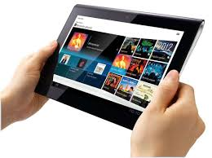
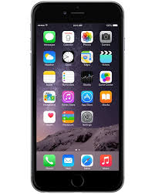
Revised systems
Audit
Onsite records
Notes:
And you will hear about revised systems that take advantage of the opportunities that increased technology offers our industry
Click

Slide 8
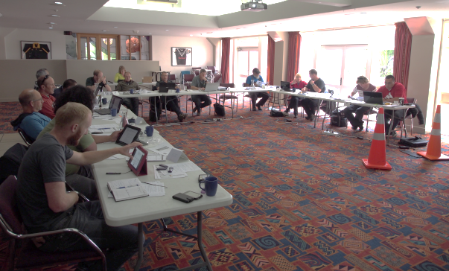
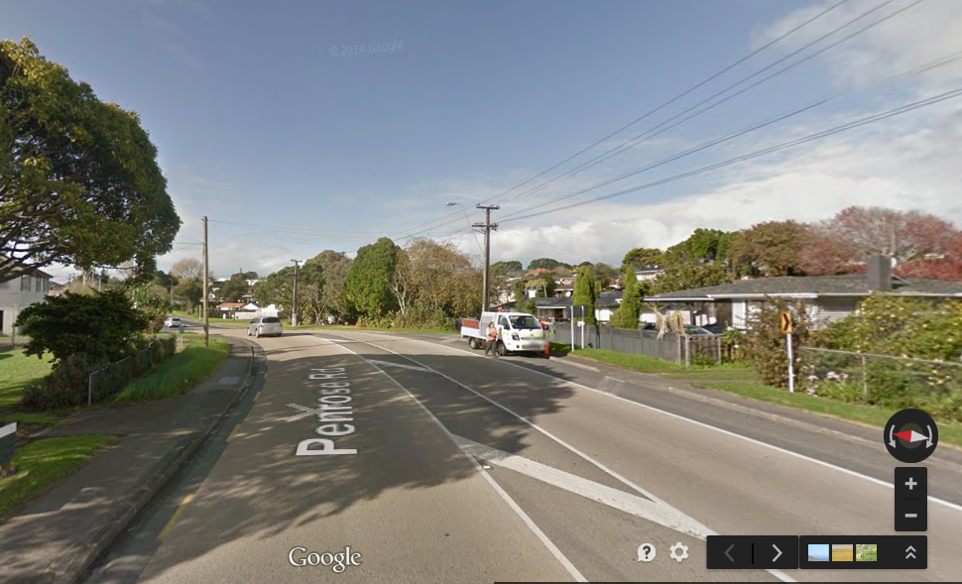
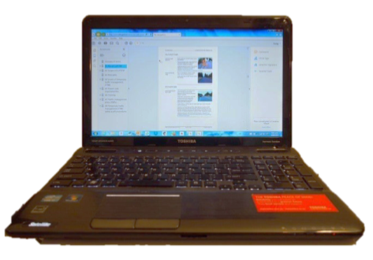
New approaches
Training
Level 2 low speed
Online learning
Notes:
And you will also hear about new approaches we are taking in CoPTTM training, level 2 low speed roads and online learning
Click

Slide 9
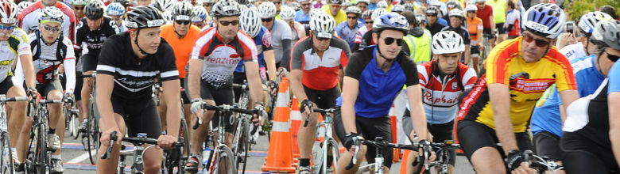
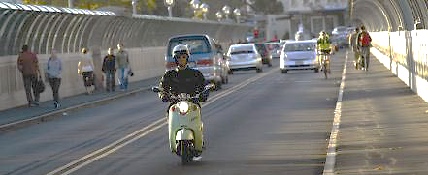
Getting better at what we do
Events
Journey managers
Notes:
Our speakers will also challenge us to get better at what we do with events and with managing journeys for the road user
Click

Slide 10
Networking
Notes:
As well as all of that this conference will provide a wonderful opportunity for you to network with like minded people and discuss how you can go about…
Click

Slide 11
TTM Conference 2015
Raising the bar
Notes:
Raise the bar in everything you do
Click

Slide 12
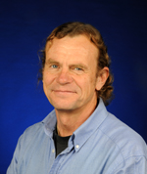
Understanding road users
A better understanding of driver behaviour
Dr Samuel Charlton
Notes:
It promises to be a very interesting and enlightening conference so lets get underway
Our first speaker will be talking about the human dimension of our road users
I am sure that you will come away with a better understanding of driver behaviour
It is my pleasure to introduce Dr Samuel Charlton
He is an Associate Professor and is Head of the School of Psychology at the University of Waikato in New Zealand.
A member of the Traffic and Road Safety Research Group (TARS) for the past 20 years, his work has examined a range of road transport issues such as driver attentiveness and fatigue, drivers’ perceptions of risk, acute protracted error effects associated with alcohol, the effect of cell phones on driver performance, the conspicuity and comprehension of hazard warning signs, and the design of self-explaining roads.
Samuel is also interested in driving as a skilled behaviour, and how it can inform theory development in attention, decision-making, and automaticity of performance.
Here is Dr Samuel Charlton

