Slide 1




Monetised benefits and costs manual
Introductory workshop 2023
Coco Zhan
Bryce Hartell
Rafael Furtado
Wentao Yang
Ian Melsom

Slide 2
Learning outcome
By the end of this workshop you should understand how the Monetised benefits and costs manual (MBCM) contributes to investment decision making.
This introductory workshop is intended for those who are new to:
The Monetised benefits and costs manual
The NZ Transport Agency Waka Kotahi
Transport
Economic assessment

Slide 3
Karakia
E ngā hau e whā, e ngā mata-ā-waka, e ngā waewae tapu,
tēnā koutou.
Nau mai, haire mai,
e koa ana te ngākau kua tae mai
koutou ki te whakanui i te Kaupapa o te rā.
Nō reira, e aku rangatira,
tēnā koutou, tēnā koutou, tēnā koutou katoa.
To the four winds, the many canoes, the first-timers, I acknowledge you.
Welcome, welcome
I am joyful that you have arrived to support today’s occasion.
On that note, my esteemed colleagues,
I greet you, I greet you, I greet you all.

Slide 4

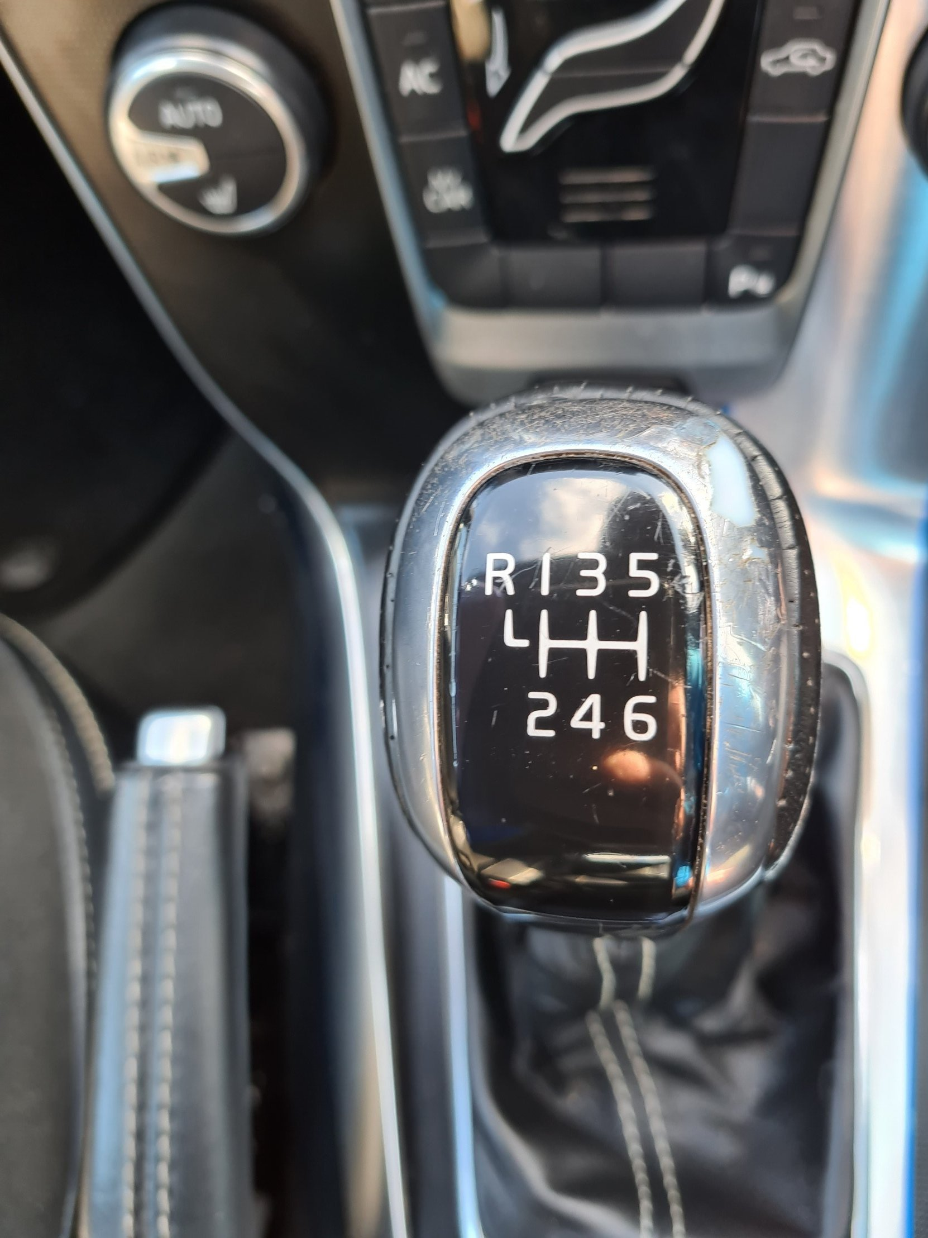
Transport economics
A transport analogy
Monetised benefits and costs manual Transport economics

Slide 5
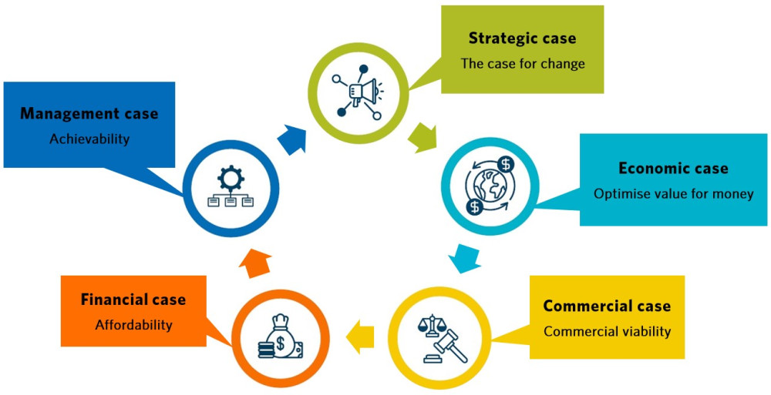
Transport economic assessment
Introduction
Business case:
  Strategic case
  Economic case
  Commercial case
  Financial case
  Management case

Slide 6
Transport economic assessment
Economic case
Used to assess the value for money of various investment options.
Methods can include:
  Multi-criteria analysis
  Cost-effectiveness analysis
  Cost-benefit analysis

Slide 7
Transport economic assessment
Thought experiment
Which of these potential investments is the “best”?
Option A
Pros | Cons
Prevents 3 deaths | One-off $10m from Govt
Prevents 200 serious injuries | All new cars become $500 more expensive
Option B
Pros | Cons
Decreases carbon emissions by 10Mt per year | $2m from Govt every year for 10 years
Reduces premature death from harmful emissions by 5% | Increases every commuter’s travel time by 5 minutes per day
Option C
Pros | Cons
Saves every commuter 10 minutes per day | Increases carbon emissions by 5Mt per year
Reduces vulnerability to natural disasters | $1m from Govt every year for 15 years

Slide 8
Transport economic assessment
Cost-benefit analysis (CBA)
Strengths:
  Quantifies all benefits & costs into a common unit of comparison ($)
  Produces simple easy-to-understand results
  Good for assessing value for money
Weaknesses:
  Some benefits and/or costs are difficult to estimate and/or monetise
  Poor at assessing equity
  Can be hard to understand (a so-called “black box”)
  Rubbish in = Rubbish out

Slide 9
Transport economic assessment
“Typical” CBA process
Identify the expected benefits and costs of each option
Model the counterfactual
Estimate the benefits and costs of each option
Monetise the estimated benefits and costs
Discount the benefits and costs
Perform sensitivity analysis
Analyse the results

Slide 10
Transport economic assessment
CBA process explained pt 1
Identifying expected benefits and costs
  Think of all possible societal benefits and costs (excluding “transfers”)
Modelling the counterfactual (AKA status quo, do nothing, etc)
  Project the current situation forward (based on trends or expectations)
Estimating the benefits and costs
  Use assumptions to model the options and compare these to the counterfactual.

Slide 11
Transport economic assessment
CBA process explained pt 2
Monetise the estimated benefits and costs
  Convert the estimated benefits and costs into monetary values
Discount the benefits and costs
  Reduce the value of future benefits and costs to recognise time preference
Perform sensitivity analysis
  Assess how “sensitive” the estimated benefits and costs are to changes in assumptions

Slide 12
Transport economic assessment
CBA process explained pt 3
Analyse the results
  Net present value (NPV)
    Total discounted benefits – Total discounted costs
    Measures the overall benefit to society
  Benefit-cost ratio (BCR)
      Total discounted benefits ÷ Total discounted costs
      Measures efficiency (or “value for money”)

Slide 13
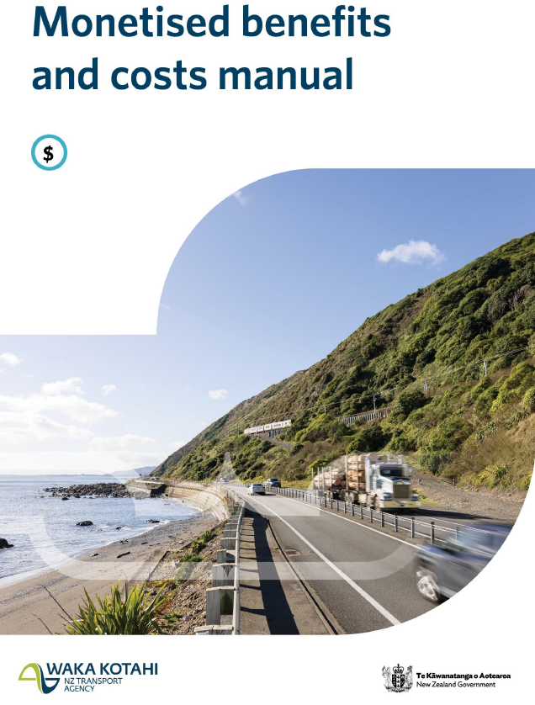
Monetised benefits and costs manual (MBCM)
Purpose of the manual
Monetised benefits and costs manual (MBCM)
  Guidance to assess monetised benefits and costs of proposed
  investments in land transport
  Robust approach to enable consistency, transparency and comparability
  between activities
  In line with international best practice
Updated regularly and available online
(formerly known as the Project Evaluation Manual/Economic Evaluation Manual)

Slide 14
Monetised benefits and costs manual (MBCM)
Structure of the Manual
Basic concepts
Demand estimation and mode share
Monetised benefits including parameter values
Evaluation procedures
Benefit Cost Ratios
Sensitivity tests and risk analysis

Slide 15
Monetised benefits and costs manual (MBCM)
Basic concepts
Period of analysis – 40-year standard over which benefits and costs accrue and are discounted to time zero
  In certain situations, shorter analysis periods can be justified, or up to a maximum of 60 years
  For example, short-lived IT projects, or larger multi-generational rail projects
Benefits ÷ Costs = Ratio
Net Present Value
First Year Rate of Return
Break-even point

Slide 16
Monetised benefits and costs manual (MBCM)
Counterfactual
Do Nothing
Do Minimum - to keep a facility or service functioning or maintained to provide a minimum level of service ​
Used as a baseline against which to compare the options
Scenario
$100 was invested in a fund last year and you get $106, did the fund manager do a good job managing your money?​
Option​ | Gross return | Performance against the Do Minimum | Analysis
Do Nothing (cheque account) | $0 | $-3 | Not successful
Do Min – bank deposit 3% | $103 | $0 | -
Investment A 6% | $106 | +$3​ | Successful
Investment B 2% | $102 | -$1 | Not successful

Slide 17


Monetised benefits and costs manual (MBCM)
Demand estimation
Transport models forecast demand and changes from an activity
  Simpler models (spreadsheets)
  Complex, across multiple modes, and incorporating land use
Factors that influence demand:
  Travel time
  Fares or tolling
  Comfort of facilities or the mode
Behavioural parameter values from research
Demand is used to calculate the benefits from use of the transport system
Option
Do min
 | 2023 | 2033 | 2043

Slide 18
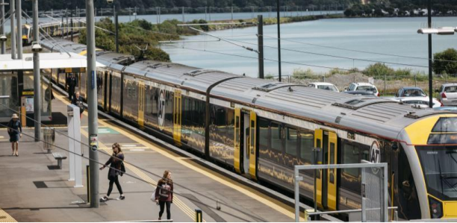

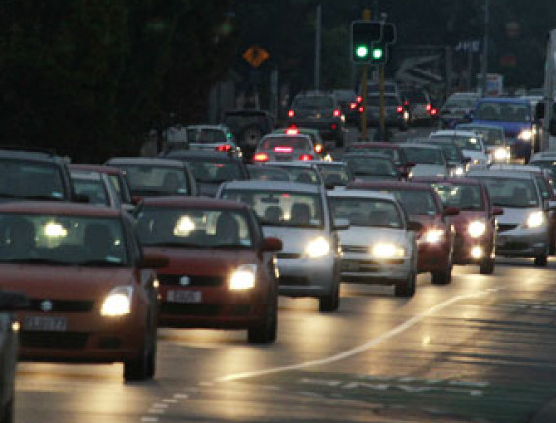
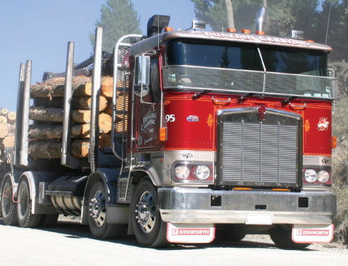

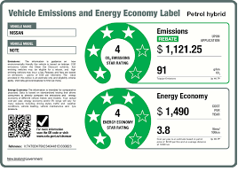

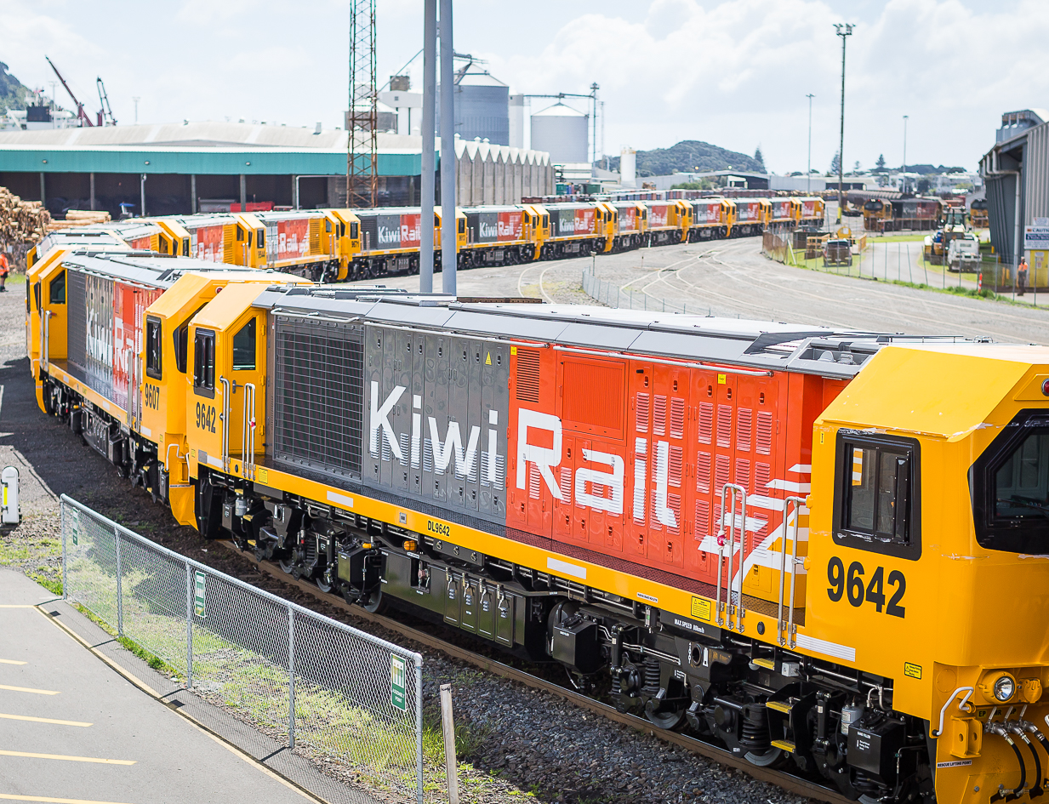
Monetised benefits and costs manual (MBCM)
Evaluation procedures
All modes and facilities and outcomes
Full procedures
Simplified Procedures

Slide 19
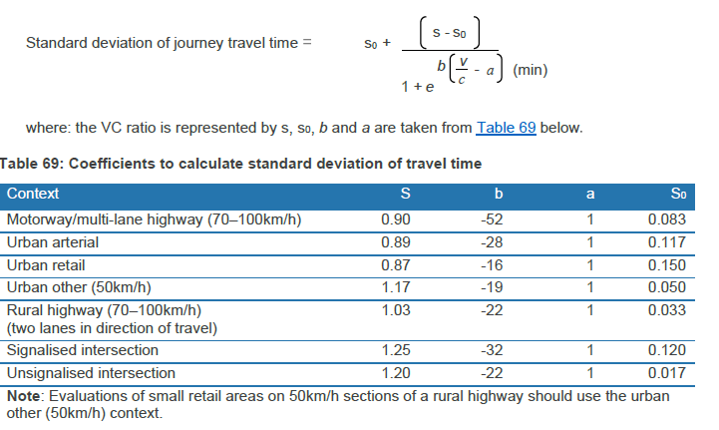
Monetised benefits and costs manual (MBCM)
Full procedures (higher cost, risk and complex activities)
  Walking and cycling
  Roading activities
  Public transport services
  Travel demand management
  Education, promotion and marketing
  Freight activities
  Private sector financing and road tolling

Slide 20
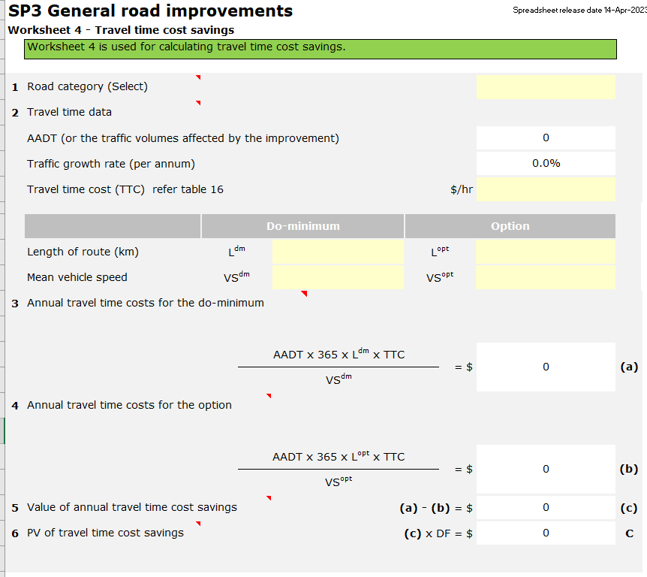
Monetised benefits and costs manual (MBCM)
Simplified Procedures (<$15m Whole of Life Cost, Lower Risk and Complexity)
  Road renewals
  Structural bridge renewals
  General road improvements
  Seal extensions
  Isolated intersection improvements
  Freight transport services
  New public transport services
  Existing public transport services
  Walking and cycling facilities
  Travel behaviour change
  Road safety promotion
  HPMV route improvements

Slide 21
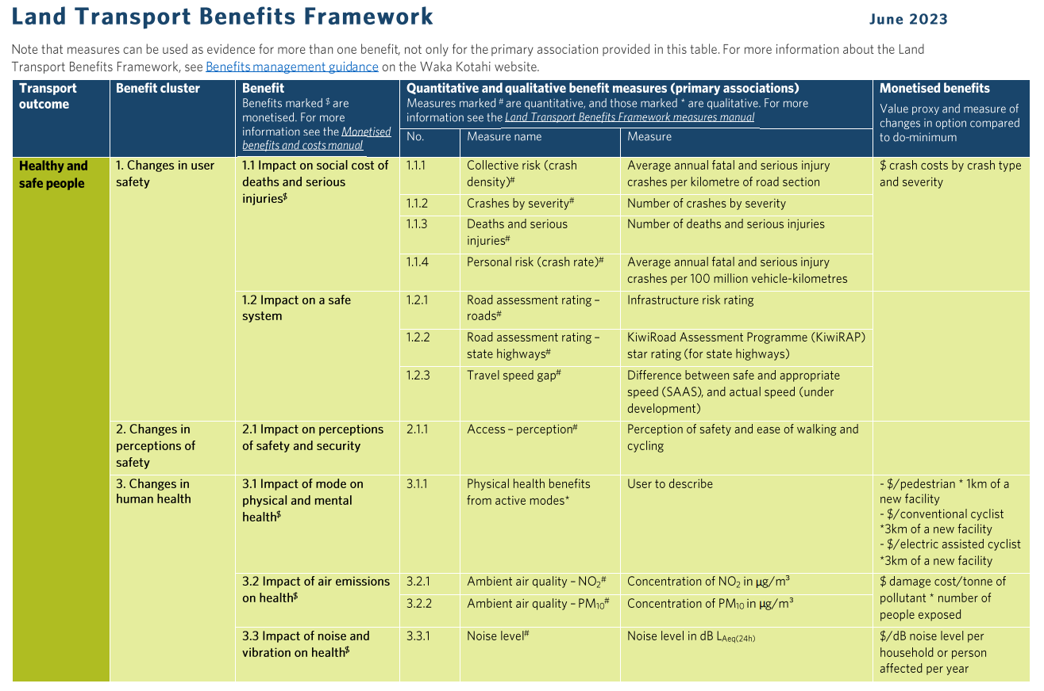
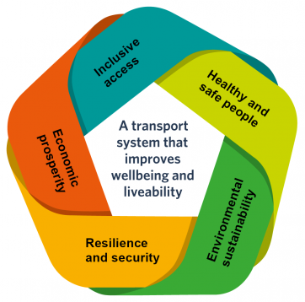
Monetised benefits and costs manual (MBCM)
Monetised benefits - examples

Slide 22
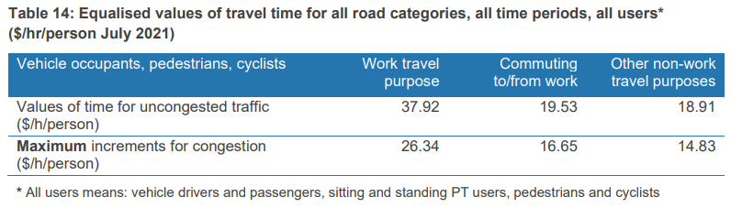
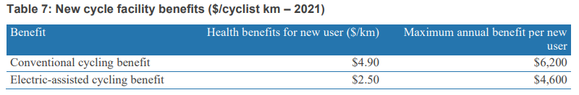
Monetised benefits and costs manual (MBCM)
Assigned values or parameter values - examples
Fatal | Serious injury | Minor injury
$12.5 million | $660,100 | $68,000

Slide 23
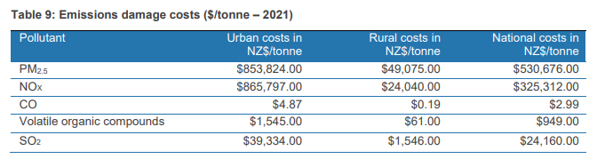
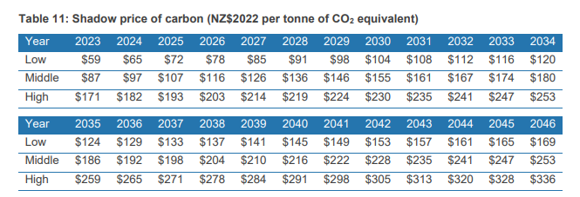
Monetised benefits and costs manual (MBCM)
Assigned values or parameter values

Slide 24
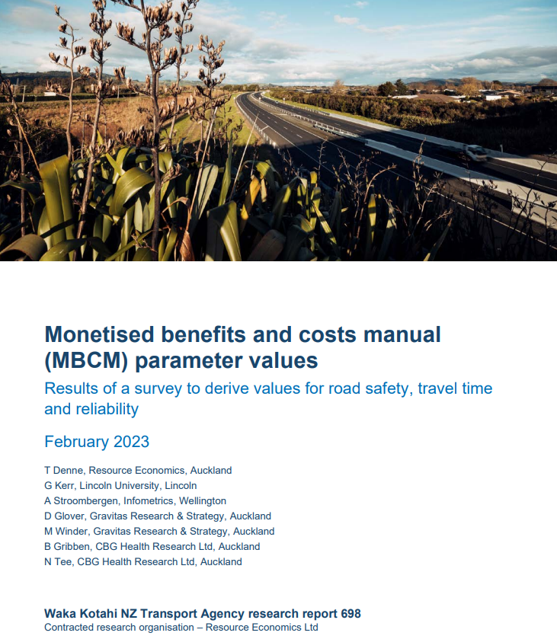
Monetised benefits and costs manual (MBCM)
Assigned values or parameter values
Choice experiment research & pilot study tests
VoSL
The Treasury CBAx guidance
Health and air pollution in New Zealand
(HAPINZ 3.0)

Slide 25

Monetised benefits and costs manual (MBCM)
Wider Economic Benefits
Productivity/agglomeration
Employment impacts
Imperfect competition
Regional economic development

Slide 26
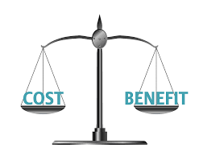

Monetised benefits and costs manual (MBCM)
BCR
National BCR_{N}
Government BCR_{G}
Incremental BCR

Slide 27
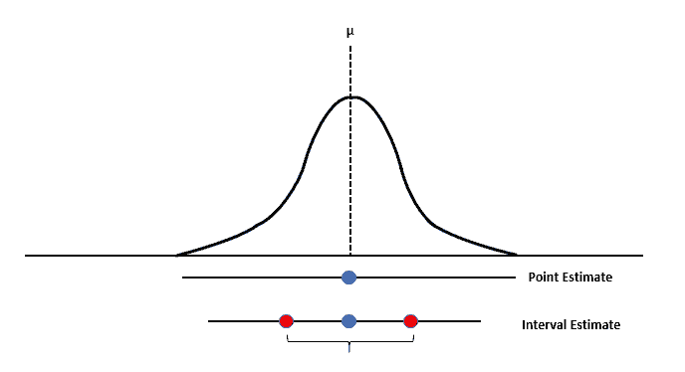
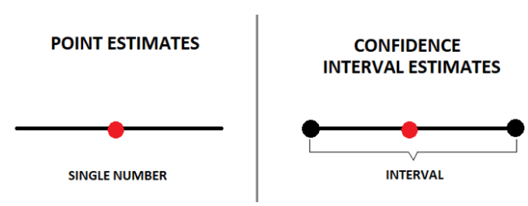
Monetised benefits and costs manual (MBCM)
Sensitivity testing
Discount rate
Demand estimation
Benefit assumptions
Cost assumptions

Slide 28
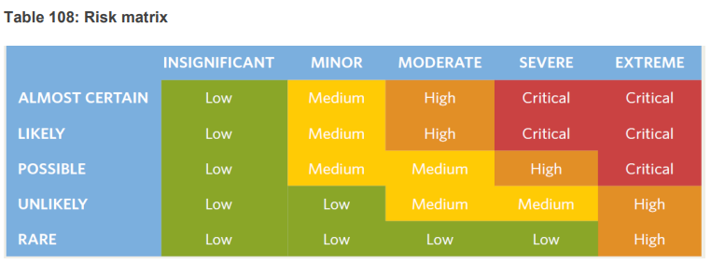
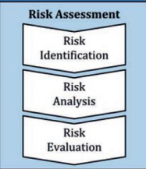
Monetised benefits and costs manual (MBCM)
Risk analysis
Consequence
Likelihood

Slide 29
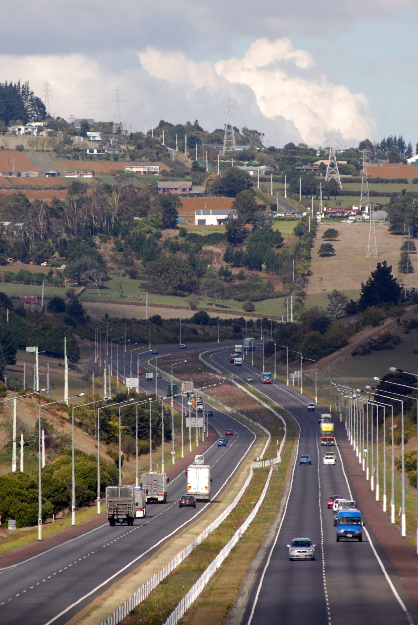
Who is responsible for the MBCM?
Owner = Kevin Wright (Senior Manager Investment Assurance)
Responsibility = Ian Melsom (Lead Advisor)
Working group = Bryce Hartell, Wentao Yang, Rafael Furtado, Jeremy Robertson, Coco Zhan, Martin Ai, and Sandy Fong
Registered users of MBCM = approx. 500
Updates usually provided annually

Slide 30
What is the MBCM used for?
Initial stages to calculate rough order BCRs for option consideration
BCRs refined as new information becomes available
BCRs finalised during preparation of detailed economic case
Incremental analysis used for selection of (economic) preferred option
BCRs and other economic information used for preparation of RLTPs
BCRs and other economic information used for prioritisation of activities for inclusion in NLTP

Slide 31
Monetised benefits and costs manual
Useful tools and references
Land Transport Benefits Framework Measures Manual
Cost estimation manual (SM014)
Transport Model Develoment Guidelines (TMDG)
Crash Estimation Compendium
Vehicle Emissions Prediction Model (VEPM)
The Treasury's Guide to social cost benefit analysis
ISO 31000 Risk management

Slide 32
Monetised benefits and costs manual (MBCM)
Questions and answers
?

Slide 33
Thank you
For further questions, or if you wish to be added to our mailing list (for future updates to the Monetised benefits and costs manual and/or future training sessions) please email: MBCM@nzta.govt.nz

