Slide 1
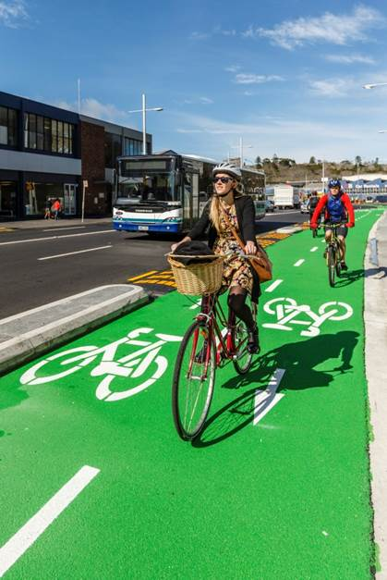
Riding with a tail wind
Dunedin One Way Pair Separated Cycle Lanes
2 February 2016
Dougal List
National Cycling Manager
NZ Transport Agency

Slide 2
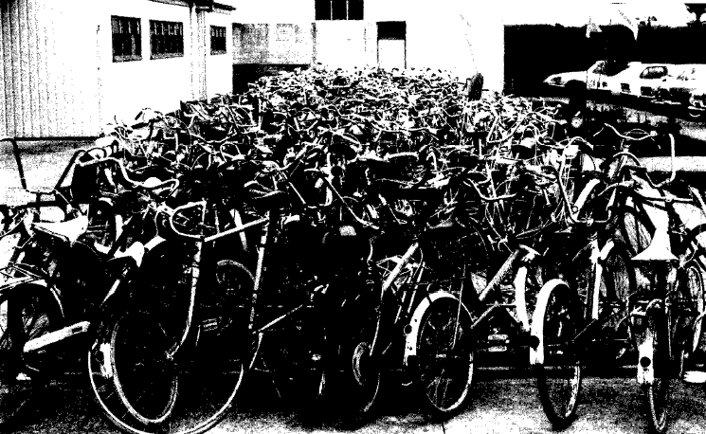
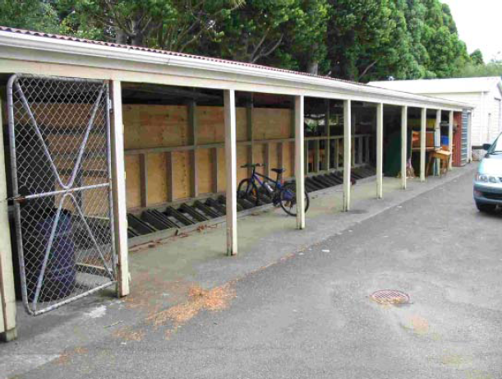
Notes:
Not all positive, starting from low base
NZ has a similar history of everyday cycling. 8000 cyclists a day riding down Colombo St in Chch in the 1960s. Cycle drought. Post 1990.

Slide 3
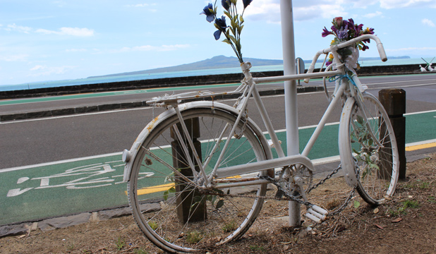
Notes:
Jane Farrelly – Auckland. Nov 2010 – 5 deaths in 5 days, 5 years ago. Coroners inquest over 2 years looking at causes for all the deaths.
Created a platform for change

Slide 4
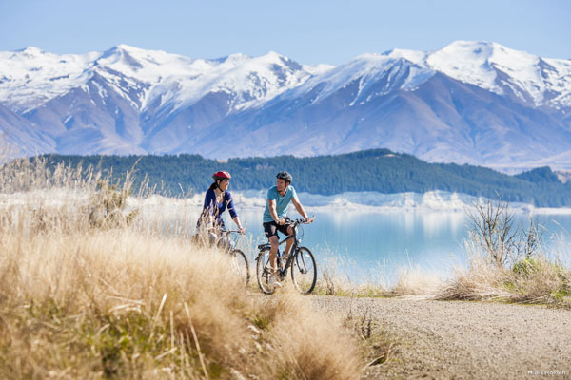
Notes:
2009 – turning point for cycling in NZ. Huge good news story for the Government – more praise than any other investment. The people who were riding in the 1960s were riding again.
Created platform for demand

Slide 5
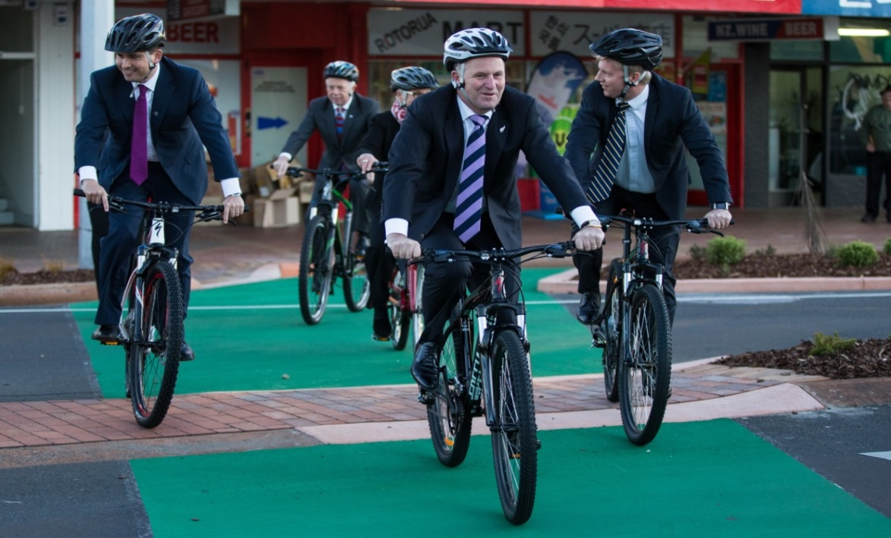
Riding with a tail wind
Customer demand for cycling – transport, choice, recreation
Cycling Safety Panel report
Strong interest from all major councils
Strong political support
= Customer demand and a national platform for change
Notes:
Note John Key
Don’t need to change the photo so often like Australia
NZCT and increased interest in cycling, third most popular recreational activity

Slide 6
Notes:
Cycle trails had popularised cycling again – good for attracting votes!

Slide 7
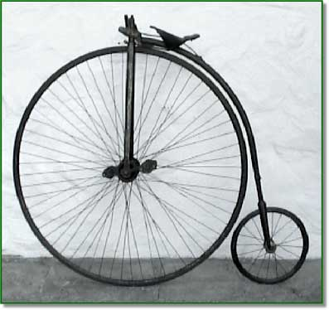
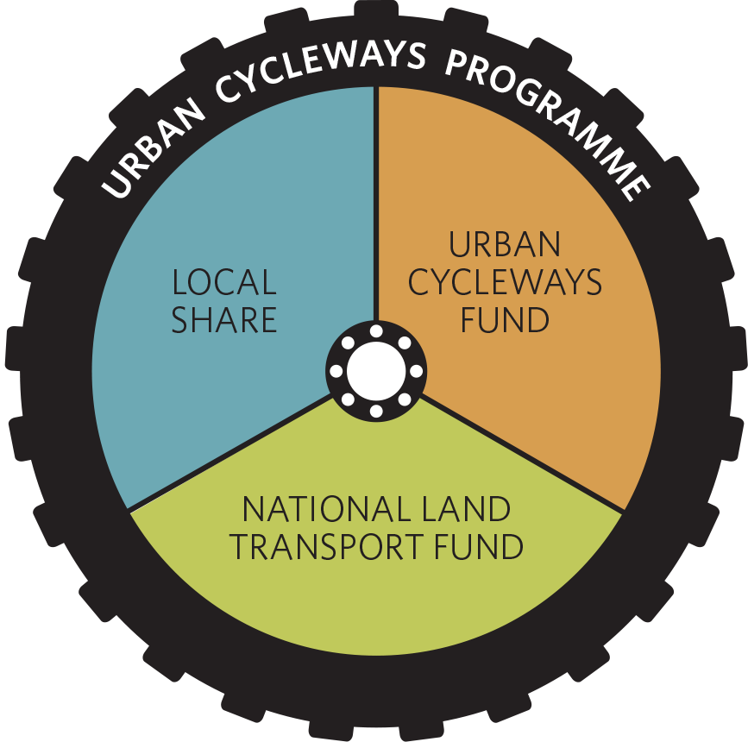
2015-2018
c. $350m
2012-2015
$80m

Slide 8
Mandate
Cycling is a Government priority
NZ Transport Agency priority for 2015-19
Working together to make urban cycling a safer and more attractive transport choice
Goal: 10 million more trips by 2019
Notes:
This is what my boss looks like

Slide 9
Things are not the same:
Focus is on more people to cycle more often – not just existing riders
Innovation and new ideas – don’t having 100 years of cycleway experience
In some cases means providing infrastructure that may look a bit different to what people have seen in the past
Delivery critical

Slide 10
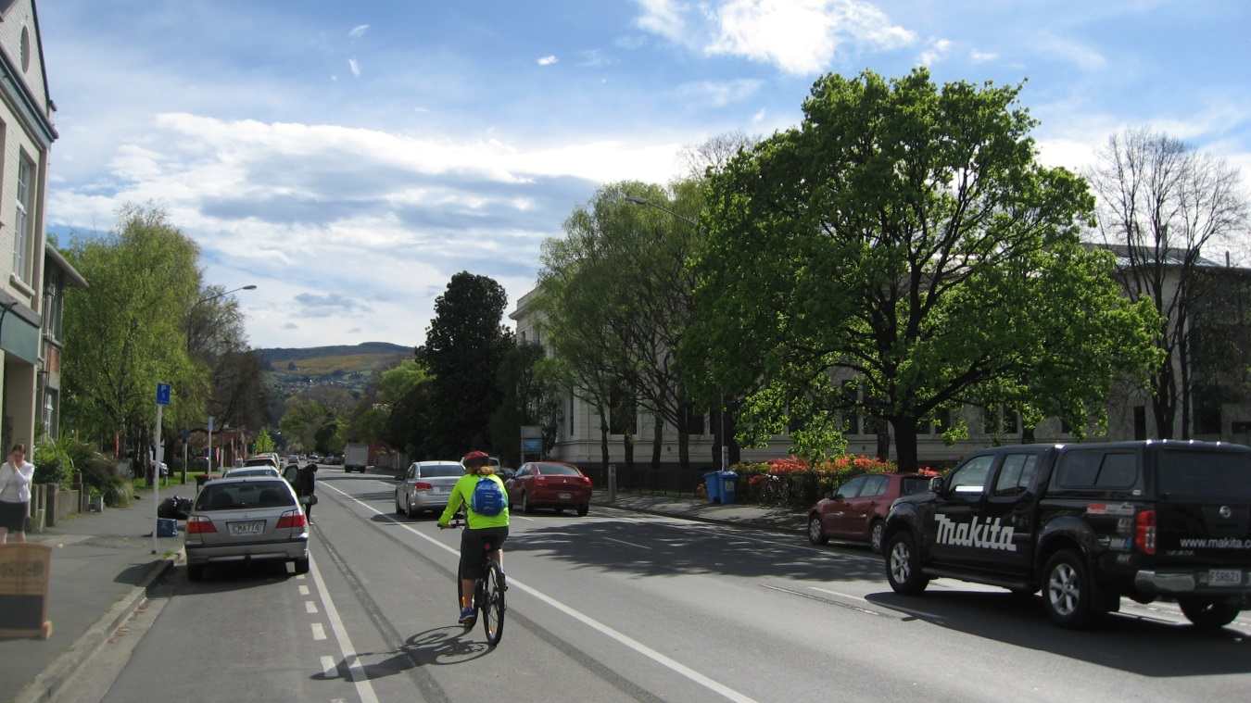
Summing it up - Why cycling
Increasing everyday, active transport choice, safety and accessibility
Demand is high and growing
Thriving towns and cities provide quality of life options
NZ can be a world-class place to explore by bike
The time is now!

Slide 11
One Way Pair: independent review
Independent team f experts
Walk, drove and rode the route
Need: Demonstrated need for improvement to address safety and provide right LoS, and meet customer demand
Route: best option for north / south connections + connects to existing cycle routes
Design for customer: Safe and attractive for cycling – existing and future users; appropriate level of service for cycling for all
Other users: Provides for high demand parking needs; integral of with highway traffic use; complementary to pedestrian use

Slide 12
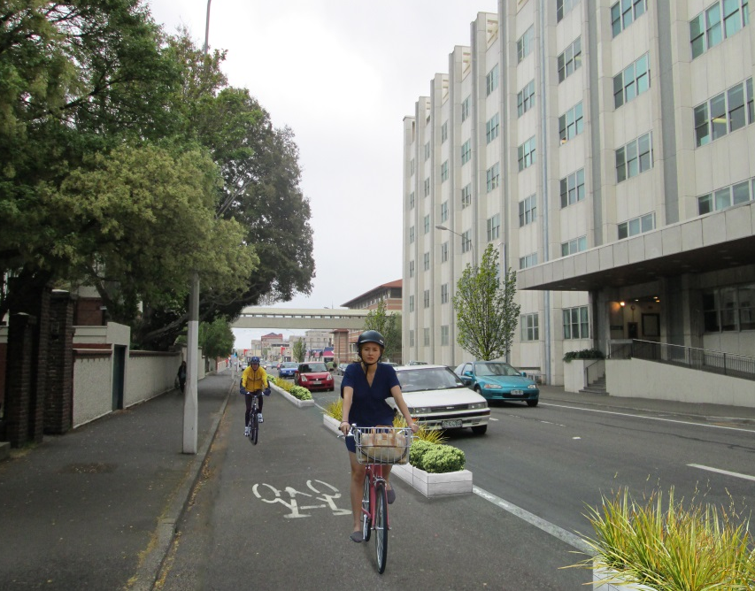
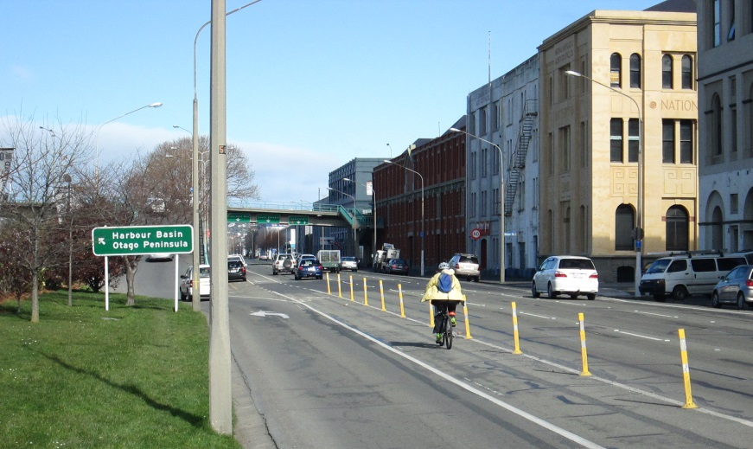
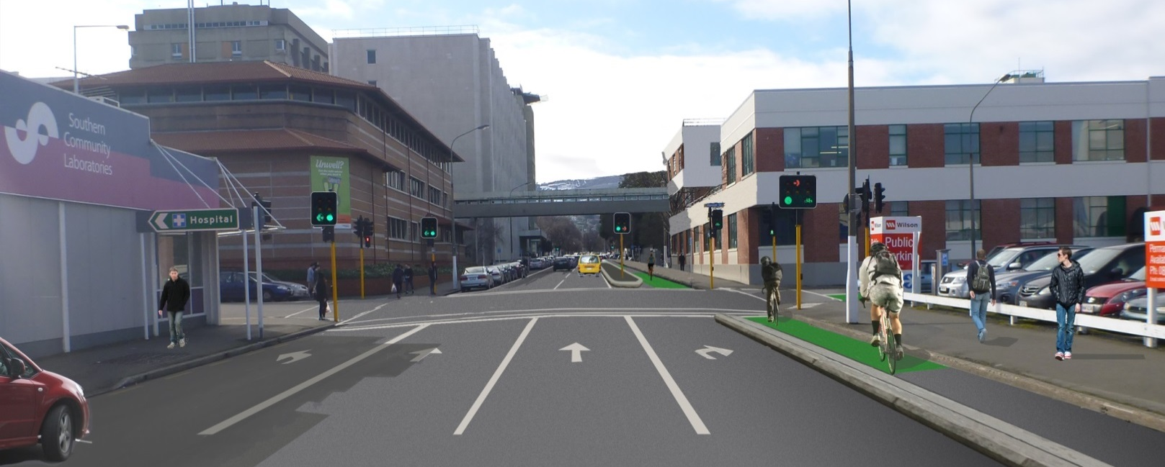

Slide 13
The ride ahead – we are on a journey
Will not be a quick ride around the block!
But we plan to have fun on the way.

